Slide 1
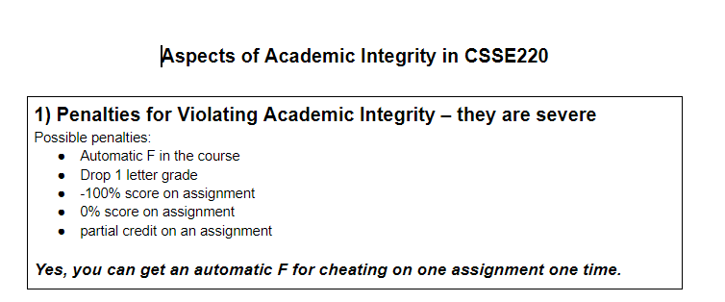
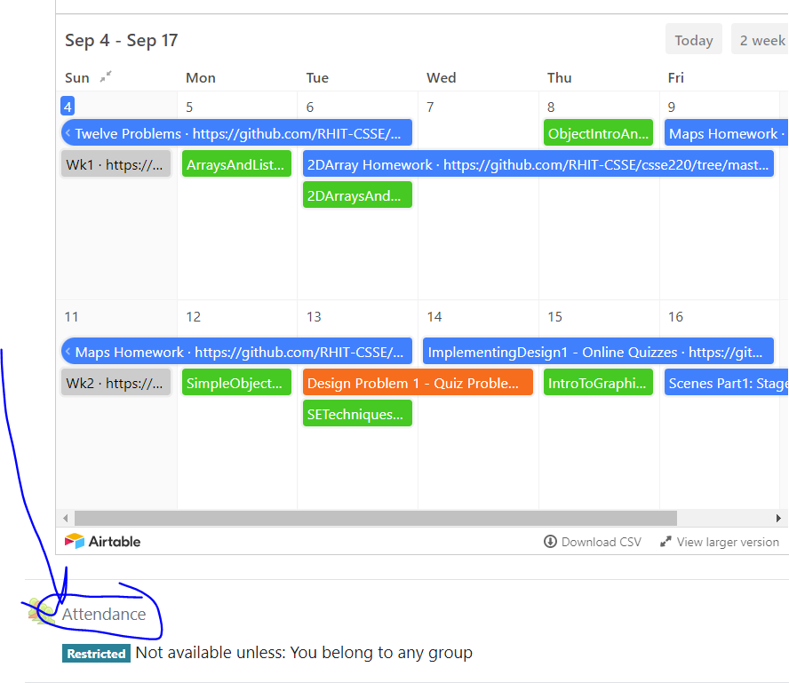
CSSE 220
Today’s Attendance password
__________
Grab a handout on the back table!
2D Arrays
The git projects for today are:
PracticeUsingObjectsAndAPIs
PracticeSolutionUsingObjectsAndAPIs
The Quiz for today is
UsingObjectsAndAPIsQuiz
Notes:
JAY: Introduce SECOND row today (Identity Pie)

Slide 2
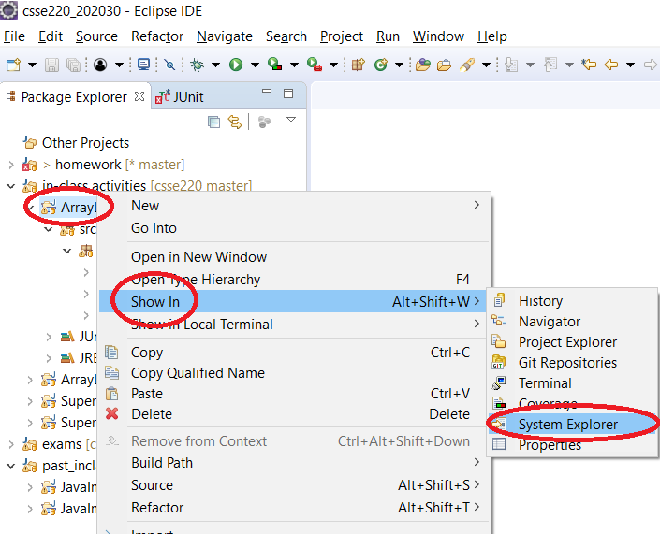
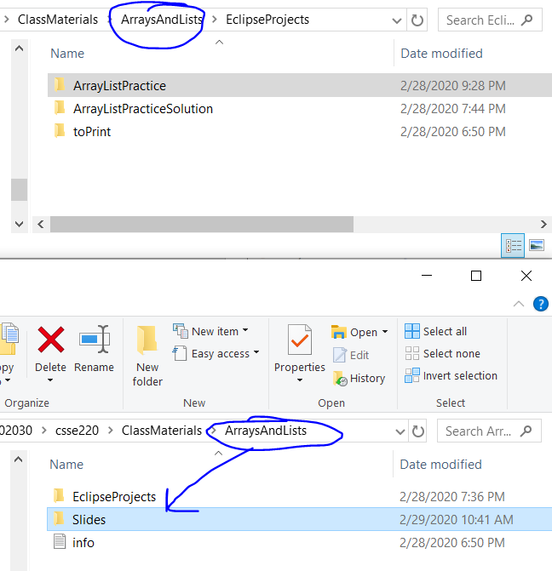
How to access slides (locally)

Slide 3
Today’s Agenda
Help: Piazza, TA Help Hours, Panopto Videos
Quizzes
Academic Integrity
Review:
Coding Gotchas
Enhanced for loops
2D Arrays
Maps
Notes:
Most time will be spent on the last two items

Slide 4
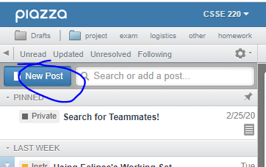
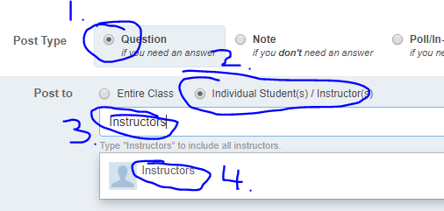
Questions: Post to Piazza
PLEASE Post All Questions to Piazza
If asking a question about an individual assignment (i.e. Homework) and you must share code (Homework) to ask your question:
Email instructors ONLY (see below)
Otherwise: please post questions and look to help provide hints to other students
Collaborative (i.e., in-class activities) or if you don’t have to post code to ask the question
Notes:
Emphasize to the students that if they feel overwhelmed they are not alone!
Remind them to ask questions and that as a class we can go slower if we need to.
As a rule: students really struggle with the enhanced for loop, if there are no questions, people may be scared to ask.
Other topics student are likely to be confused at this point:
different between primitives and classes/objects
the idea that memory stores information somewhere and it effectively is an address (null) for objects
public vs. private: could create a little demo class (Person) to show getter and setters with private/public variables (name)
Person p1 = new Person(“Jason”); p1.name p1.getName()

Slide 5
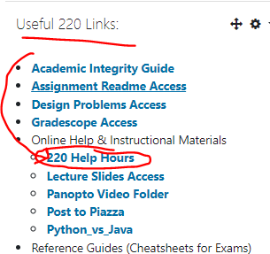
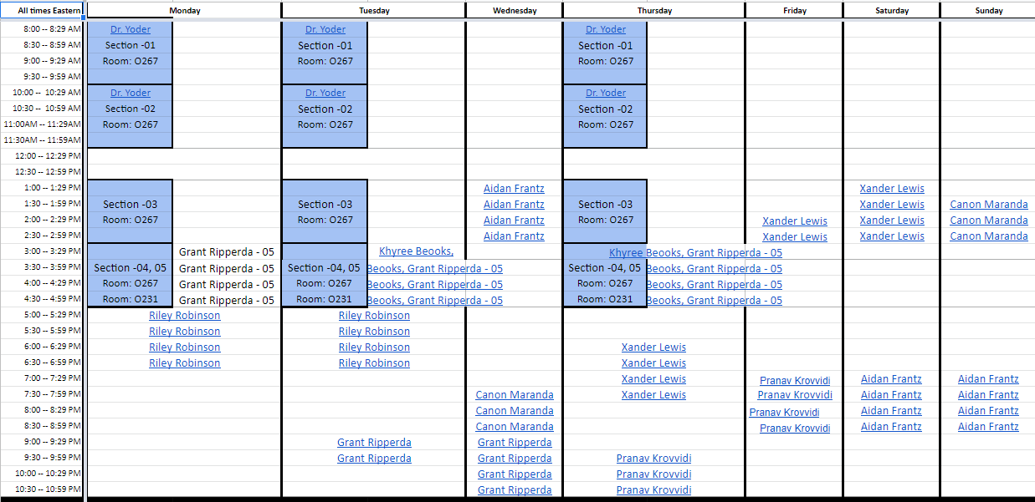


TA Help Hours
Linked from Moodle
Click on links in sheet
Opens MS Team Channel
Send message, then video call/screen share w/ TA
Notes:
Emphasize to the students that if they feel overwhelmed they are not alone!
Remind them to ask questions and that as a class we can go slower if we need to.
As a rule: students really struggle with the enhanced for loop, if there are no questions, people may be scared to ask.
Other topics student are likely to be confused at this point:
different between primitives and classes/objects
the idea that memory stores information somewhere and it effectively is an address (null) for objects
public vs. private: could create a little demo class (Person) to show getter and setters with private/public variables (name)
Person p1 = new Person(“Jason”); p1.name p1.getName()

Slide 6
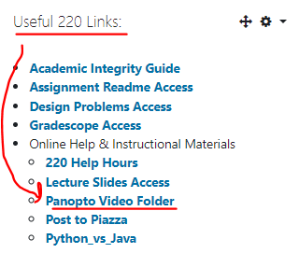
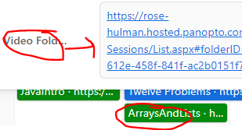
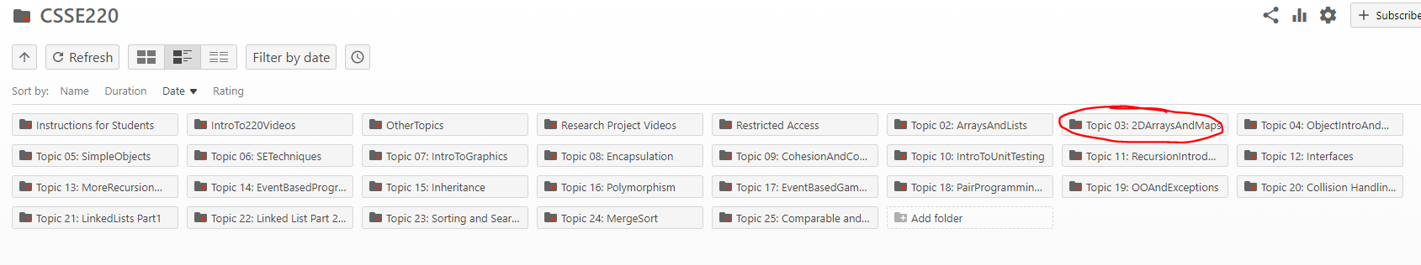
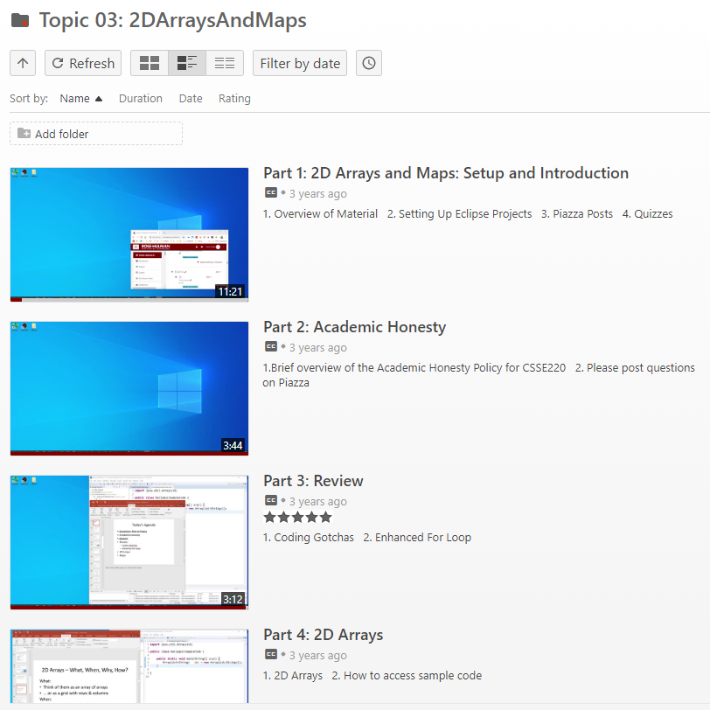
Panopto Videos
Videos cover the content, sometimes slightly different, but always an options for extra review and practice

Slide 7
Quizzes
There will be an online quiz associated with almost every lecture
Available on Moodle
Each week's quizzes due date are the Sunday of beginning of the following week at 23:55
You can post questions relating to quizzes on Piazza, even sharing your code

Slide 8
Academic Integrity in CSSE
Please do not collaborate on homework assignments beyond what is allowed
What is definitely not OK:
Looking at someone else’s solution, “just for a reference” as you write your own code
Pair programming on an individual assignment
Sitting next to someone as you both work on the assignment, working through any problems you have as a group
Notes:
When individual assignment, pair programming is not allowed!

Slide 9
How much help is too much help?
“So you loop across the array elements, getting each element and seeing if it’s in the hashtable. If it is, you get the value and increment it…”
Borderline but OK
“So you write a for loop, 0 to array length - 1. Your key variable is gonna be array[i]. You check if hashMap.get(key) is null, if not, you get the value with get, then hashMap.put(key, oldValue + 1)…”
Giving away the
answer. Cheating.
Notes:
More vague than top OK
Less vague than bottom, NOT OK!

Slide 10
Penalties – they are severe
Automatic F in the course
Drop 1 letter grade
-100% score on assignment
Yes, you can get an automatic F for cheating on one assignment one time.
You should always credit anyone you get help from on an assignment. If you do, it lets us assign one of the weaker penalties.
Notes:
Exam, just immediately F
Worse than a 0% actually negative 100%
1 or 2 lines from stackoverflow is ok, but not 8-10
Its ok to ask for help when you have one small thing.
Unlimited help with Eclipse Git tools etc

Slide 11
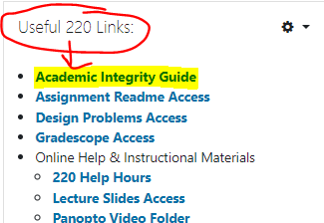
Today’s Handout
Is available digitally if you ever lose it

Slide 12
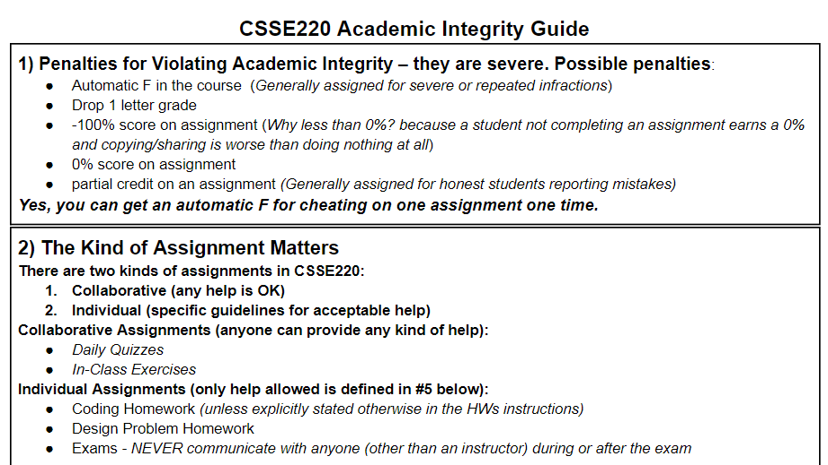

Slide 13
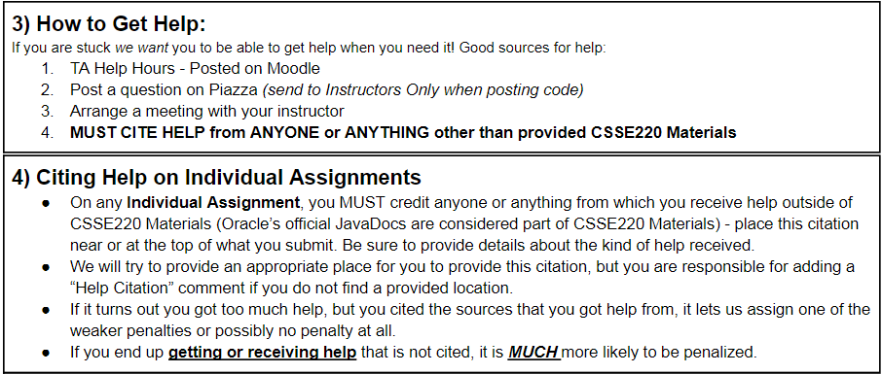

Slide 14
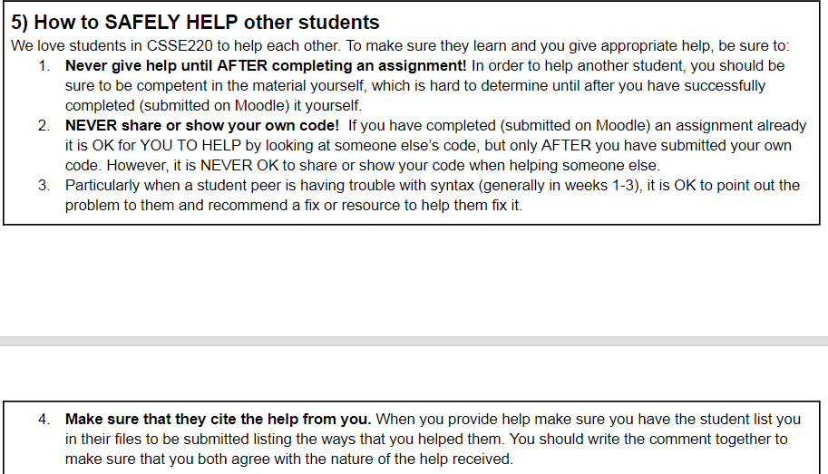

Slide 15
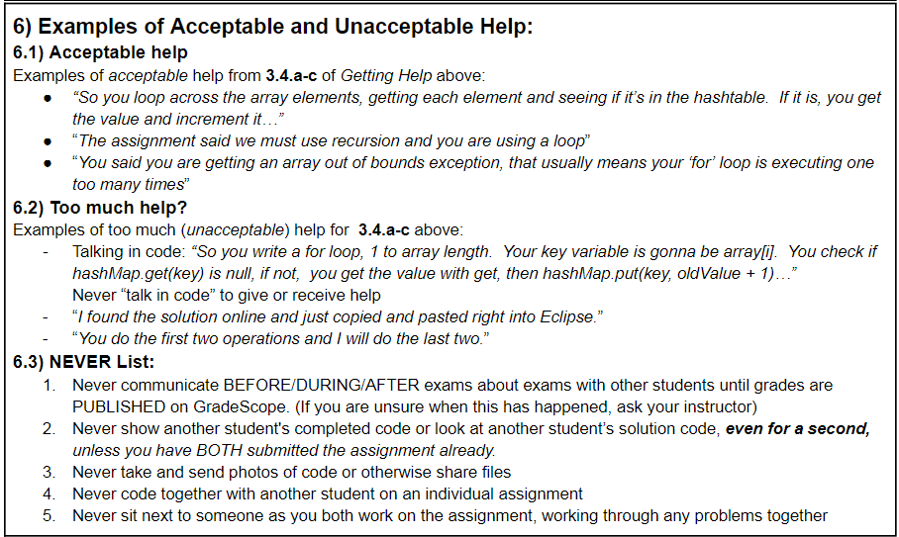

Slide 16
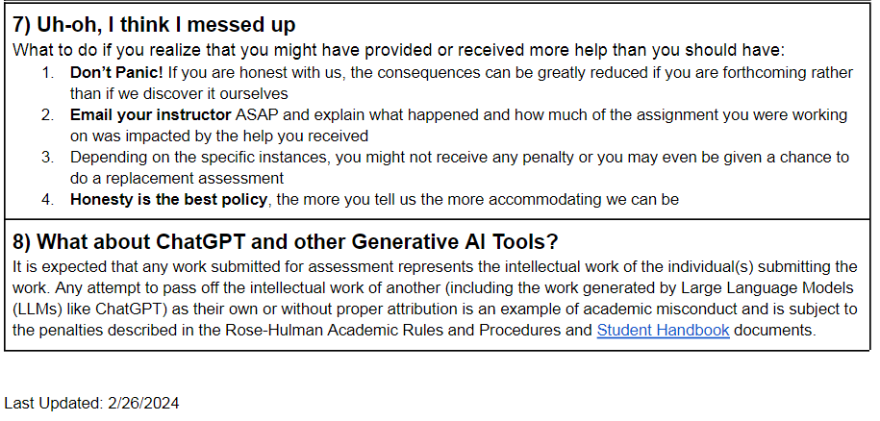
Ask me a question about a “gray area” right now!

Slide 17
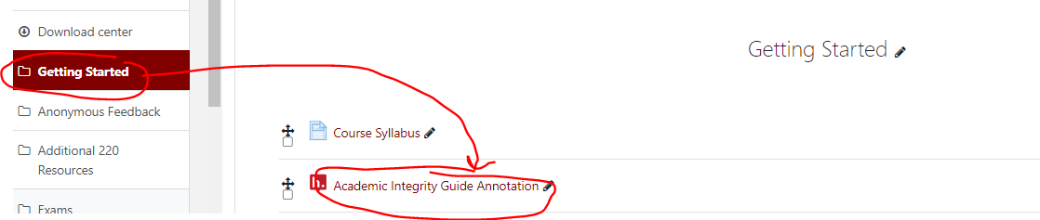
Academic Integrity Annotation
Before next class make at least one annotation on the Academic Integrity Guidelines

Slide 18
Questions from Today
Collaborative Exercises
Practice2DArraysAndMaps
2DArraysAndMapsQuiz
Post ANY questions to Piazza even including code since this is purely collaborative exercise and the solution code is available to you
Please help! Post answers to questions posted by other students. Helping other students can earn you Incentive points (see syllabus) or a future TA job ☺

Slide 19
HWMaps
Can collaborate with a partner on exactly 1 of the operations
Consider draw a few map diagrams for test data for getNumberOfCoursesToTake
Each list the other’s name in Help Citation at top of file
Both responsible for submitting own code
Right Now: Take out a sheet of paper now and tear off a small piece.
Put your name on it
Put the name of 1 or more people you would LIKE to work with
You can say you don’t know anyone, but would like to work with someone
You can say you want to work alone
Put the name of anyone you would prefer NOT to work with
Hand this to our TA and they will make pairs for you to use
Notes:
TAs can handle this with a form or something else if they prefer

Slide 20
Today’s Agenda
Help: Piazza, TA Help Hours, Panopto Videos
Quizzes
Academic Integrity
Review:
Coding Gotchas
Enhanced for loops
2D Arrays
Maps
Notes:
Most time will be spent on the last two items

Slide 21
Coding Gotchas – the size of things
int[] numbers = { 2, 4, 8, 16};
int numbersCount = numbers.length;
// Java array uses 'length'
ArrayList<String> words = new ArrayList<String>();
words.add("Hello!");
int wordsCount = words.size();
// ArrayList uses 'size()'
String word = "Hello";
int characterCount = word.length();
// String uses length()

Slide 22
Enhanced For Loops
Convenient Syntax
for iterating through collections
More readable
Less Typing
Less Error Prone
Works for Arrays, ArrayList, Map (later)
Similar to Python:
for num in nums:

Slide 23
Enhanced For Loop and Arrays
Old school double[] scores = … double sum = 0.0; for (int i = 0; i < scores.length; i++) { sum += scores[i]; } // end for
New, whiz-bang, enhanced for loop double[] scores = … double sum = 0.0; for (double score : scores) { sum += score; } // end for
No index variable (easy, but limited in 2 respects)
Gives a name (score here) to each element
Say “in”
Notes:
Call-outs animated
Like python’s “for num in nums:”
Convenient when we just need to iterate over the objects.
The two limitations:
We CAN’T USE the indices.
We CAN’T MODIFY the element and stick it back in the array. CONCURRENT MODIFICATION EXCEPTION!

Slide 24
Enhanced For and ArrayList’s
ArrayList<State> states = new … int total = 0; for (State oneState : states) {
total += oneState.getElectoralVotes();
} // end for
State is a user defined class
getElectoralVotes() is a method in State which returns an int

