Slide 1
CSSE 220
Design Principle #3
Encapsulation

Slide 2
Major Goals of ALL Program Design
Suppose someone has written a program that works and it has no bugs, but it is poorly designed.
  What does that mean?
  Why do we care?
There are two major goals:
Easy to understand
Easy to modify
Q1
Notes:
Animation for the two major goals

Slide 3
CSSE220 Design Principles
Make sure your design allows proper functionality
  Must be able to store required information (one/many to one/many relationships)
  Must be able to access the required information to accomplish tasks
  Data should not be duplicated (id/identifiers are OK!)
Structure design around the data to be stored
  Nouns should become classes
  Classes should have intelligent behaviors (methods) that may operate on their data
Functionality should be distributed efficiently
  No class/part should get too large
  Each class should have a single responsibility it accomplishes
Minimize dependencies between objects when it does not disrupt usability or extendibility
  Tell don't ask
  Don't have message chains
Don't duplicate code
  Similar "chunks" of code should be unified into functions
  Classes with similar features should be given common interfaces
  Classes with similar internals should be simplified using inheritance
  Avoid all type-predicated code by using inheritance

Slide 4
E.g., What if there were no String class?
Instead, what if we just passed around arrays of characters - char[]
And every String function that exists now, would instead be a function that operated on arrays of characters
E.g.,
char[] stringSubstring(char[] input, int start, int end)
Would things be any different? Discuss this with the person next to you.
Notes:
Hopefully they will come up with at least two ideas:
Makes it less convenient to know what functions exist
Stuck implementing strings as character arrays

Slide 5
Concatenate… compare
String stringName1 = "ian";
String stringName2 = "ludden";
String stringConcat = stringName1.concat( stringName2 );
System.out.println( stringConcat );
----------------------------------------------------------
char[] charName1 = {'i','a','n'};
char[] charName2 = {'l','u','d','d','e','n'};
char[] charConcat =
new char[charName1.length + charName2.length];
for (int i = 0; i < charName1.length; i++) {
charConcat[i] = charName1[i];
}
for (int i = 0; i < charName2.length; i++) {
charConcat[charName1.length + i] = charName2[i];
}
System.out.println( Arrays.toString(charConcat) );
Notes:
Which is easier to use?
Which is easier to understand?
Clearly classes make sense

Slide 6
Class sizes
Why not put all the Math utilities in the String class?
Math Java docs
String Java docs
  We could just get anything we need done with Strings and Math with one library instead of two!
Q2
Notes:
Makes it harder to know what is meant when you have a function say “add” or length
Means you are loading more things than you might actually need
Try to keep conceptual separation!

Slide 7
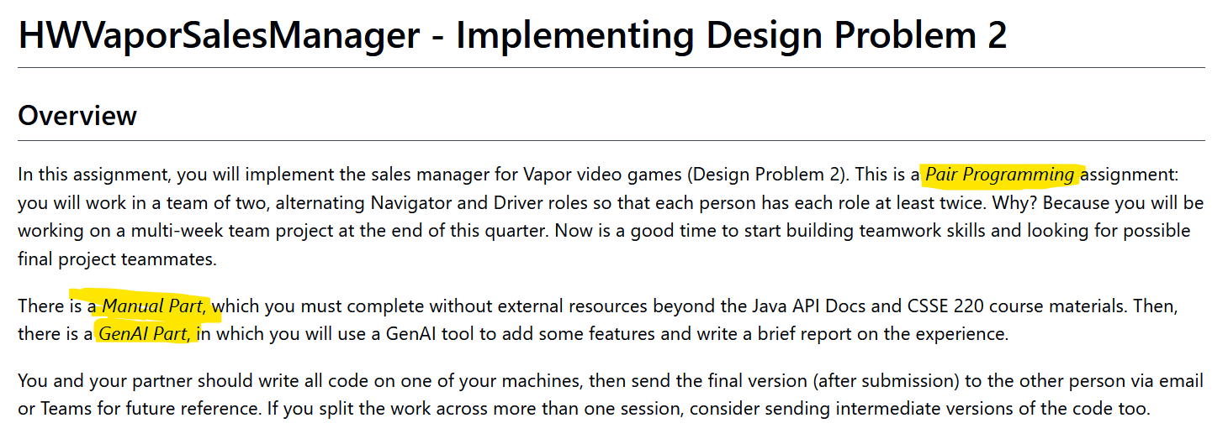
HWVaporSalesManager
Paired assignment, one submission per team
First part: pair programming, no genAI tools
Second part: working together to use genAI tool and reflect on experience
Complete partner preferences form
in Moodle by noon tomorrow
Notes:
TAs can handle this with a form or something else if they prefer

