Slide 1
CSSE 220
Merge Sort
Notes:
No quiz today.
Bring printouts from the MergeSortSimpleSolution.

Slide 2
Merge Sort
Basic recursive idea:
  Base case:
  If list is length 0 or 1, then it’s already sorted
  Otherwise:
    There are >= 2 items
    Divide collection into two halves
    Recursively sort the two halves
    Merge the sorted halves back together into one
Notes:
Don’t burn too much time on it. They understand recursion…
Demo with cards or big letters
[I reviewed selection and insertion sort stressing the differences before going over merge sort. That helps emphasize the differences.]

Slide 3
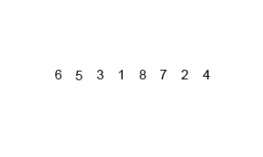
Merge Sort
If list is length 0 or 1,
then it’s already sorted
Otherwise:
  Divide collection into two halves
  Recursively sort the two halves
  Merge the sorted halves back together into one

Slide 4
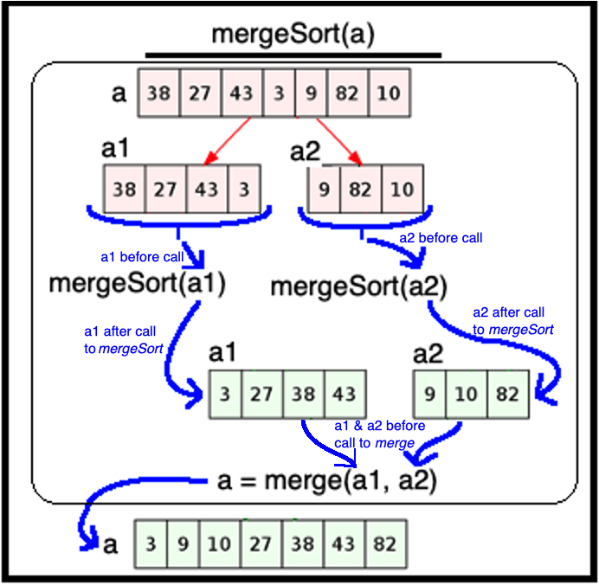
Merge Sort
“you gotta believe” trust the abstraction
If list is length 0 or 1,
then it’s already sorted – i.e., at base case
Otherwise:
  Divide list into two halves
  Recursively sort the two halves
  Merge the sorted halves back together
/**
* ensures a’s values are reordered
* so that they are in sorted order
* @param a
* <br>decreasing: |a|
*/
void mergeSort (ArrayList<Integer> a) {
  if (a.size() > 1) {
  ArrayList<Integer> a1, a2;
  split(a, a1, a2);
  mergeSort(a1);
  mergeSort(a2);
  merge(a, a1 a2);
  } // end if
  } // mergeSort
Notes:
This slide:
Does not unravel the recursion
It shows how we trust that mergeSort works
In other words, we use mergeSort’s ensures clause to reason about the value of mergeSort’s parameter (the array) after the call w/o thinking about how mergeSort did the work

Slide 5
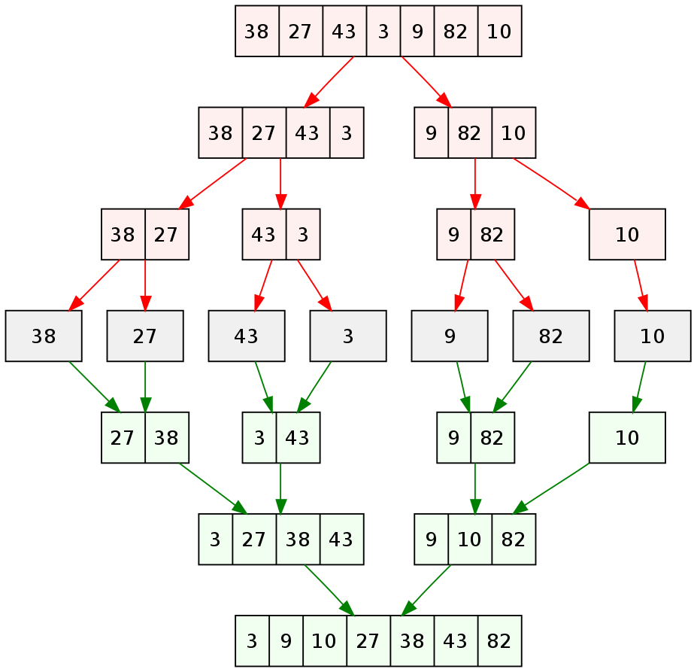
Merge Sort unraveling the recursion
If list is length 0 or 1,
then it’s already sorted
Otherwise:
  Divide list into two halves
  Recursively sort the two halves
  Merge the sorted halves back together
Red: Dividing ->
7 sorted collections ->
Green: Merging ->
Notes:
This slide:
Unravels the recursion for an input array of size 7
Here we are breaking the abstraction provided by procedural abstraction by showing how it does it, instead of sticking to the what it does

Slide 6
Analyzing
Merge Sort
If list is length 0 or 1,
then it’s already sorted
Otherwise:
  Divide list into two halves
  Recursively sort the two halves
  Merge the sorted halves back together
Merge n items
n items merged
Merge n/2 items
Merge n/2 items
n items merged
Merge n/4
items
Merge n/4
items
Merge n/4
items
Merge n/4
items
n items merged
etc
etc
n items merged
Merge 2 items
Merge 2 items
Merge 2 items
Merge 2 items
etc
Notes:
Just summarize it here. Don’t dawdle; this will make more sense when they implement it.
Leading Questions:
What is the run-time for merging N items? O(N)
What is the run-time for merging N/2 items? O(N)
What is the run-time for merging N/2 items TWO times? O(N)
Each row takes O(N)
How many rows? (divides in half each time) O( log(N) )
Have students implement mergesort.StringMergeSort. Walk around the room and help students as needed. Have your TAs do the same. Keep students engaged.

Slide 7
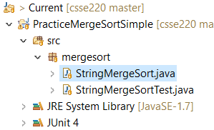
Work on StringMergeSort
Simpler with a String
Same general algorithm applies
Harder (more room for errors) if you track positions in array

