Slide 1
CSSE 220
Collision Handling without instanceof
Checkout PracticeSolutionMultipleDispatchAdvanced project from repo

Slide 2
The problem
Monsters can collide with rocks.
Rocks can crush monsters.
Players can collide with monsters.
Players can be crushed by rocks.
Players can take powerups.
So many collisions! How do we handle them all?

Slide 3
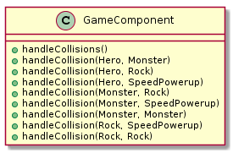
What not to do
Why is this design bad?

Slide 4
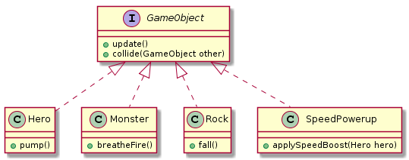
Slightly better?
But tempts you to use instanceof…
Notes:
http://www.plantuml.com/plantuml/uml/PP1D2i8m44RtEKMMAK9FuAAuK3UYw0ccoHIhQMV83oBgtPqMmK2tx-LB7cbYWf3ou5K_9WmTMDGx6F3Otj2cbrfbTf3GL6fboVlUeVbhJUcAeL8VfQo76FKU0yc6yy2cm0SQermkfWq8ijds0Si3Px9tiHruN-8B8xeJFJ1a5WtC_Zcp3L5CPdfDIm3Dao9h_QxhkKKlw2zbAQQ41Im3L8EZau_w0W00

Slide 5
A bad Player.collide(GameObject o1)
// player has landed on o1
if(o1 instanceof SpeedPowerUp) {
// code to increase speed
}
if(o1 instanceof LifePowerUp) {
// code to increase life
}
Notes:
This is bad because
All the code is in one place
This code knows extremely specific details of other classes, in particular their exact type and what shoud be done in that case

Slide 6
Same Bad Idea
//player has landed on o1
if(o1.type().equals(“SpeedPowerUp”)) {
//code to increase speed
}
if(o1.type().equals(“LifePowerUp”)) {
//code to increase life
}
Notes:
Convince yourself that you did not change anything by adding a type method.
Yet, students do this all the time.

Slide 7
instanceof - in general
instanceof is like static. It is dead to you.
Instead: add new interface methods.
Recall this is called polymorphism.

Slide 8
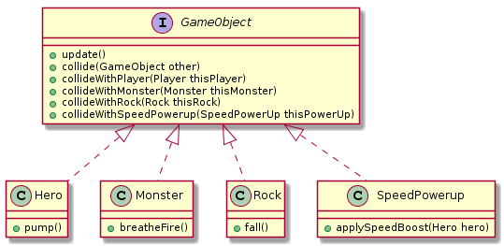
Polymorphic Solution
Notes:
http://www.plantuml.com/plantuml/uml/PL71Zi8W4Btp5Hmn9dx17fezg1Upnit6yqZ7b5tQ8J2DCQl_Bj2QqlJ2FDvxvCqCLM3mtBTMc8xHNq6Zt46BNvTVrFmlrhshWL6jn5gJjQP6DScIk44_IMV3pT727RqQYkJ6X07ENGVgGenJOys-4S-D9z9_AXtPai1S_tQ8zP5kw7kdfikF6w87l19F8RI54EGUFSMfNDywLT1ZTbGk7Y5EjJKUIqDAZkeLh2tfCZxAu9ozP-wJAB1AQJAkYFAJOd4VZyqczo8Nx7ib2o6ri23B1aI5NHs_yWK0

Slide 9
Polymorphic Solution
o1.collideWithPlayer(player);
// in SpeedPowerUpClass
void collideWithPlayer(Player p) {
// code to increase speed
}

Slide 10
What made this work
We knew one of the objects was the Player.
In general:
Objects know their own type.
They also know the other object’s interface.
o1.collideWithPlayer(player);
// in SpeedPowerUpClass
void collideWithPlayer(Player p) {
// code to increase speed
}

Slide 11
Multiple Dispatch
Objects make collide_____() calls on each other
until one decides to handle the collision.
public class SpeedPowerUp extends GameObject {
public void collide(GameObject other) {
other.collideWithSpeedPowerUp(this);
}
public void collideWithPlayer(Player thisPlayer) {
//do specific action to player
thisPlayer.speedUp();
}
…
}
The other object decides for itself how to respond.
The Player called speedPowerUp.collideWithPlayer(thisPlayer)
MultipleDispatchAdvancedSolution in repo
Also, DoubleDispatch & DoubleDispatchSolution
Notes:
Let’s say we’re in the PowerUp class, and GameObject is of type Player.
This will call the collideWithPowerUp method on the Player class.
The Player can decide whether to respond to collideWithPowerUp class, or ask it back to handle the collision by calling collideWithPlayer.

Slide 12
Team Project
Work time
Be sure everyone is getting a chance to drive.

