Slide 1
Debugging
Debugger & JUnit Tests

Slide 2

How to identify a problem in your code?
When you run your code, and you do not pass all the tests...
What can you do?
Try re-running the exact same code
  Do miracles happen for you? (...It’s OK we have all done it...)
Try changing code randomly and see if it helps?
  (do you like the Infinite monkey theorem? ->)
Try to think through through the code and see what goes wrong?
  This is HARD! But tracing out on paper can be very helpful!
There are better, more powerful and much FASTER approaches
Notes:
What ideas do you have? Type them into the chat!

Slide 3
How to identify a problem in your code?
Better, more powerful and much FASTER approaches
Read the error messages when there are test cases
  Examples of errors? How do we see them?
Examine the test cases that fail
  What is the INPUT? What SHOULD the output be?
“When in doubt, print it out!”
  System.out.println("myVar: " + myVar );
  Arrays.toString( arr)
  Classes? -> obj.toString()
For the love of Java... Use the Debugger!
  no code modification/commenting required!

Slide 4
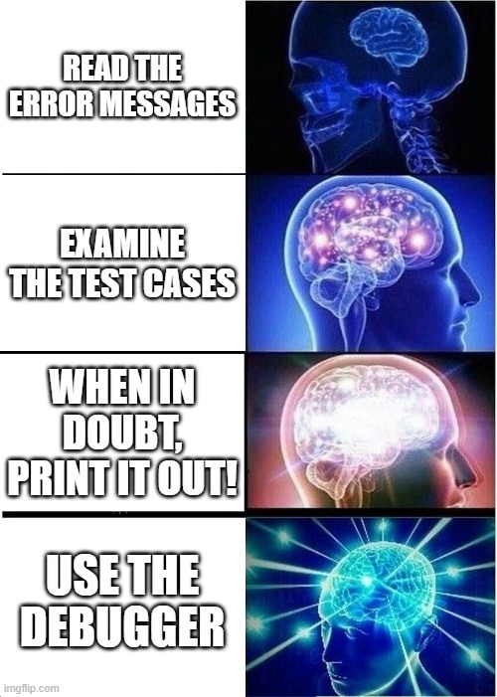
How to identify a problem in your code?

Slide 5
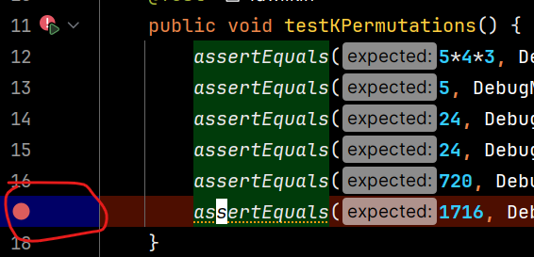
Setting Breakpoint
Set a breakpoint on the line where a test case fails!
Then you can pause the execution of the program and WATCH what goes wrong.

Slide 6
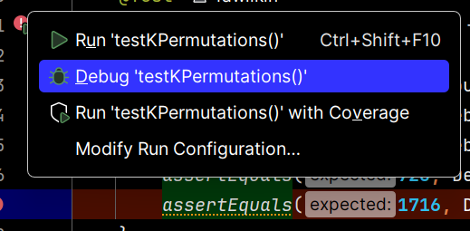
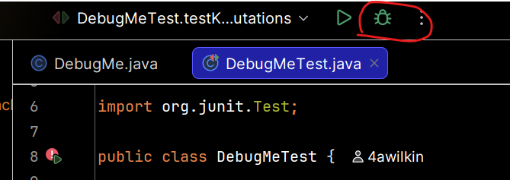
Running in Debug Mode
Click “play” button for individual method, but select “Debug”
Alternatively, click “Debug” button at top

Slide 7
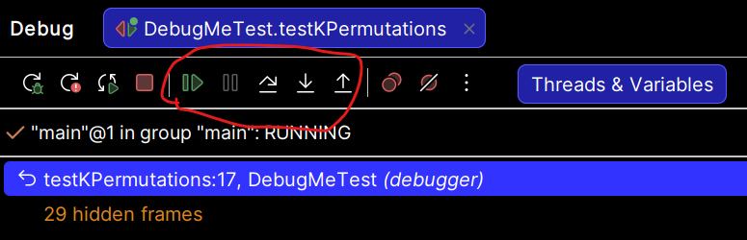
Debugging—Demo
Debugging Java programs in IntelliJ:
  Set a breakpoint where you want to start
  Launch using the bug icon
  Single stepping: step over and step into
  Inspecting variables
Notes:
[Demonstrate the techniques in Eclipse by solving a problem or two from DebugMeTest together, give them time to answer the quiz question, then have them complete DebugMeTest.]
[You can also point them to WhackABug to get more practice when running a Java Application instead of JUnit)]
DebugMeTest make sure to demo:
uppercaseIfExclaimation which ends up showing the gotcha “string are immutable” in two slides

Slide 8
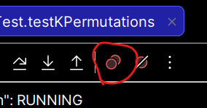
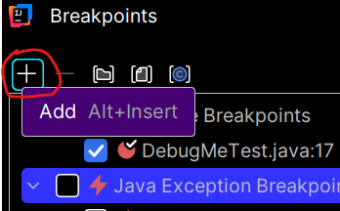
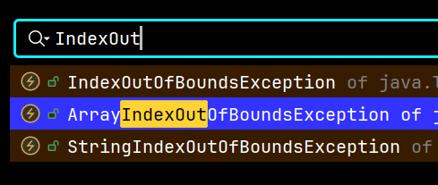
Exception Breakpoint
View Breakpoints…
Add -> Java Exception
Breakpoints
Find the exception
type you want
(start typing to filter)
Notes:
Very useful when an exception is happening but you don’t know where or why
Only spend time on this if you want to show the DebugMeTest examples, in particular the final test which you can use to demonstrate this approach.

Slide 9
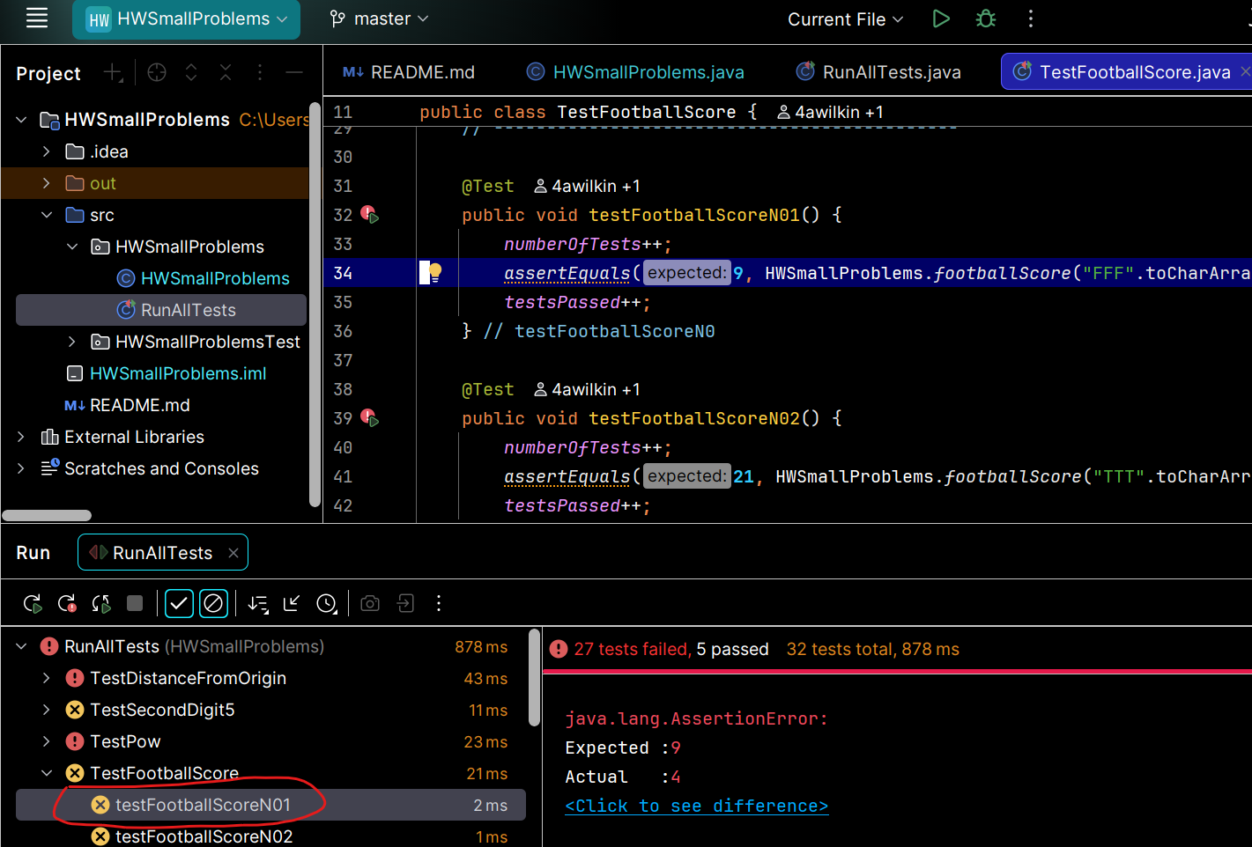
Interpreting a JUnit Test Failure
3. See the assert that failed (and surrounding code),
then set a breakpoint and start debugging!
2. See expected vs. actual (if not booleans)
1. Double-click failing test

Slide 10
Important gotcha: Strings in java are immutable
No method on the string class will modify the content of a String variable
All methods instead return a reference to a new String object
String newSentence = sentence.toUpperCase();
Declare a new String variable
Have new variable catch the returned String
Notes:
uppercaseIfExclaimation ends up showing this

Slide 11
Debugging Practice!
Use the debugger to fix isArrayDoubled
If you have time, also kPermutations
You can also practice catching an Exception
Notes:
isArrayDoubled is a good example where the .equals comparison
fails because it is not implemented properly in the default .equals method.
Without using the debugger, it could be pretty hard to track down the
specific problem that is occurring.

Slide 12
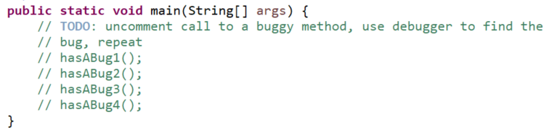
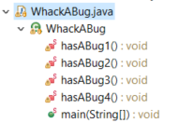
More Debugging Practice!
Can be called on a main method as well!
Use this for extra practice
Set breakpoint on main
method calls ( hasABug1() ) and then step into methods to see what goes wrong!

Slide 13
Optional Opportunities
At the discretion of the professor
There may be incentive points offered
As suggested on the following slides

Slide 14
Incentive Points Opportunity #1
Complete these practice debugging problems
Write a summary of how you caught each bug
  Be sure to list:
    What line did you “catch” unexpected behavior?
    What was unexpected about the behavior?
    What did you determine from this?
Write a summary of what you learned
Email it to me and complete the incentive form on Moodle

Slide 15
Incentive Points Opportunity #2
When you have some spare time, as our in-class TA to “quiz you” on the use of the debugger
You will have 5-10 minutes to resolve a bug introduced
This is worth a small number of incentive points (+2), but more importantly will make sure you understand how to use the debugger

