Slide 1
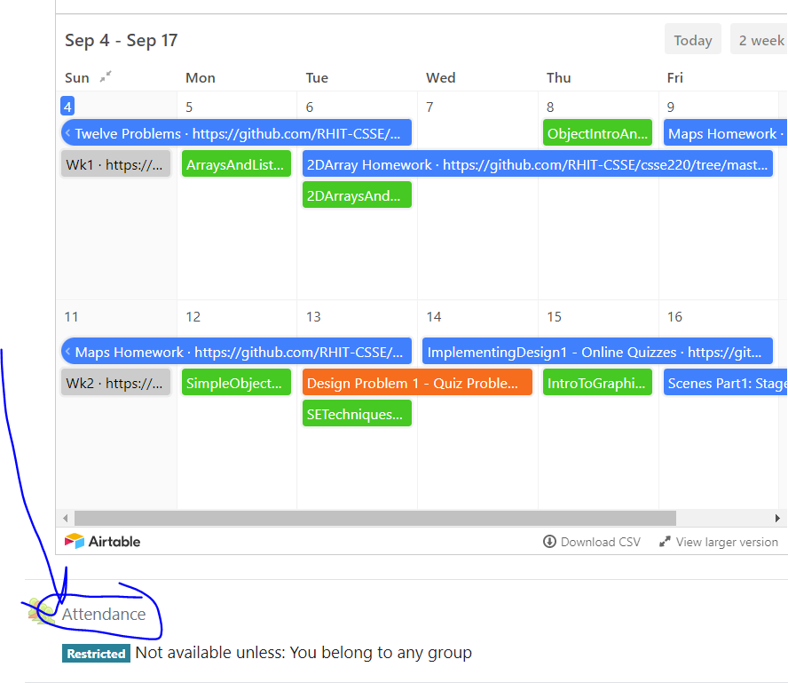
Miscellaneous – Documenting Code
Today’s Attendance password
__________
The git projects for today are:
PracticeObjectIntroAndMisc
PracticeObjectIntroAndMiscSolution
The Quiz for today is
ObjectIntroAndMiscQuiz
Notes:
JAY: Introduce THIRD row today (Identity Pie)

Slide 2
Functions
Give functions descriptive names
Don't allow functions to grow too long
10 to 15 lines max is a nice goal
Rather than commenting an unclear function, modify the code so it is clear
Make a function clear by having it "do one thing, and one thing well"

Slide 3
Naming in Java
Having good names for functions and variables is one of the best things you can do to make your program understandable
The conventions:
variableNamesLikeThis
methodNamesLikeThis(…)
ClassNamesLikeThis
You should follow the conventions!

Slide 4
Javadoc comments
/**
* Has a static method for computing n!
* (n factorial) and a main method that
* computes n! for n up to Factorial.MAX.
*
* @author Mike Hewner & Delvin Defoe
*/
public class Factorial {
/**
* Biggest factorial to compute.
*/
public static final int MAX = 17;
/**
* Computes n! for the given n.
*
* @param n
* @return n! for the given n.
*/
public static int factorial (int n) {
...
}
...
}
Java provides Javadoc comments (they begin with /**) for both:
Internal documentation for when someone reads the code itself
External documentation for when someone re-uses the code

Slide 5
Writing Javadocs
Written in special comments: /** … */
Can come before:
Class declarations
Field declarations
Constructor declarations
Method declarations
Eclipse is your friend!
It will generate Javadoc comments automatically
It will notice when you start typing a Javadoc comment

Slide 6
In all your code:
See: https://github.com/RHIT-CSSE/csse220/blob/master/Docs/grading_guide.md
Write appropriate comments:
Javadocs ( /** .... */ )
Primarily for classes, define the purpose at the top of the file
In-line comments: ( //add comments like this )
Explanations of anything else that is not obvious in any spot.
Give self-documenting variable and method names:
Use name completion in Eclipse, Ctrl-Space, to keep typing cost low and readability high
Use Ctrl-Shift-F in Eclipse to format your code.
Q1

Slide 7
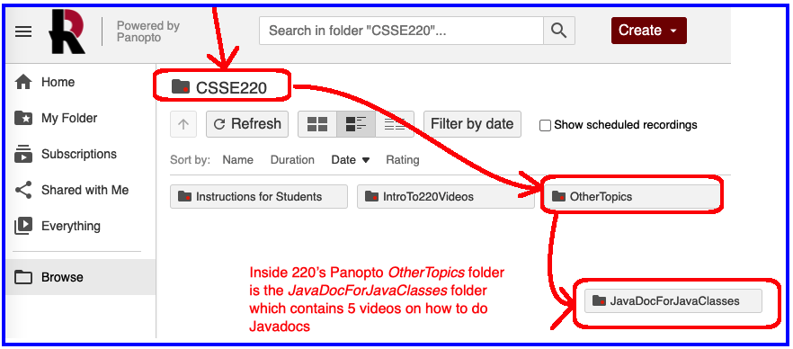
Follow Javadoc Instructions in Videos:
Panopto video folder

