Slide 1
CSSE 220
Presentation Details

Slide 2
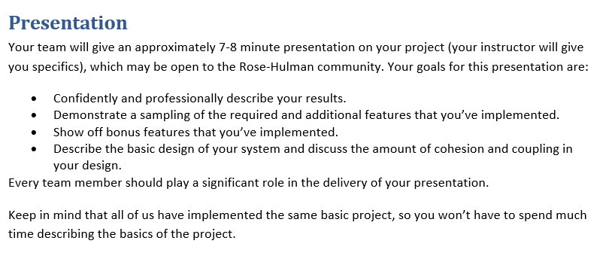
From the project specification document (ArcadeGame.docx)
Recommended:
Script your live demo and follow the script during presentation
Or, prerecord you live demo and insert recording into slides
Notes:
Dress 1 step up form your normal dress level

Slide 3
Your Presentations - Specifics
7 minutes long (Rehearse! Aim to be within 30 seconds +/- )
~3 min. Showing off your extra features
Preferably record a video!
Live demo is “Acceptable” (but beware Murphy’s law!)
~2 min. Explaining your overall design (major classes, NOT all)
“Coupling/Cohesion” or other “Good/Bad” aspects of design
Discuss OODP explicitly in your presentation
OK to say your design is BAD and what you would do differently
~2 min. Design decision, feature implementation, or tricky bug
Be explicit in stating your “Special Item” (decision/feature/bug)
Be careful about code examples (good – but in moderation)
Be sure to include prepared slides usually including diagrams
Be sure to EXPLAIN the item, not just mention it!
Notes:
3

Slide 4
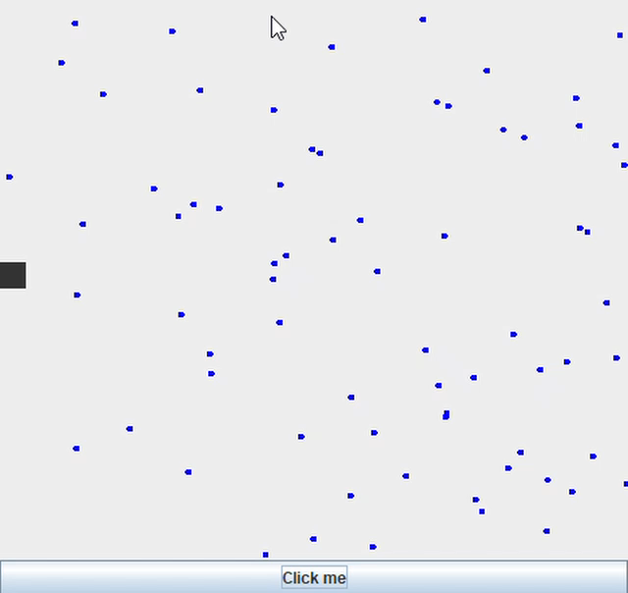
How to Make Screen Recordings
Link: record your screen on Windows 10 using Game Bar (Windows Key + g)
https://www.businessinsider.com/how-to-record-screen-on-windows-10

Slide 5
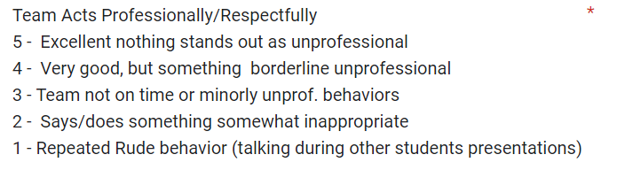
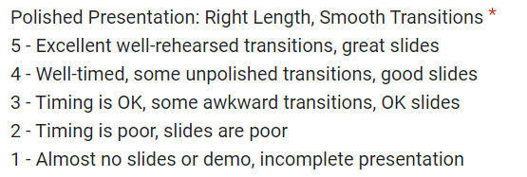
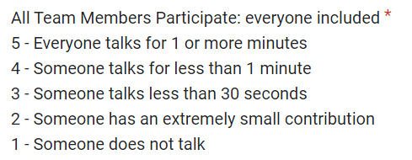
Rubric for Scoring Presentations

Slide 6
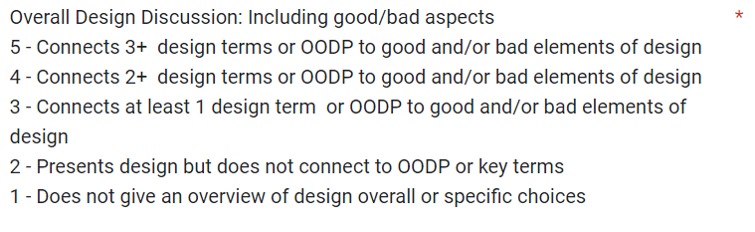
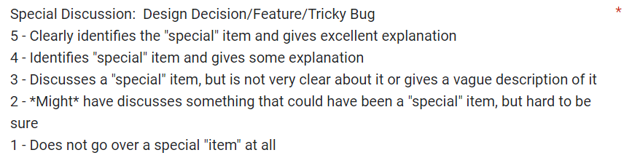
Rubric for Scoring Presentations

Slide 7



Student Voted Awards!
+5 Incentive Points Each!

