Slide 1
CSSE 220
Merge Sort
The git projects for today are:
PracticeMergeSortSimple
PracticeMergeSortSimpleSolution
Notes:
No quiz today.
Bring printouts from the MergeSortSimpleSolution.

Slide 2
Today’s Plan
Review Sorts (Insertion, Selection)
Big-oh practice
Merge sort
Presentation Guidelines
(1 week from today!)

Slide 3
Merge Sort
Basic recursive idea:
If list is length 0 or 1, then it’s already sorted
Otherwise:
Divide list into two halves
Recursively sort the two halves
Merge the sorted halves back together
Notes:
Don’t burn too much time on it. They understand recursion…
Demo with cards or big letters
[I reviewed selection and insertion sort stressing the differences before going over merge sort. That helps emphasize the differences.]

Slide 4
Merge Sort
If list is length 0 or 1, then it’s already sorted
Otherwise:
Divide list into two halves
Recursively sort the two halves
Merge the sorted halves back together

Slide 5
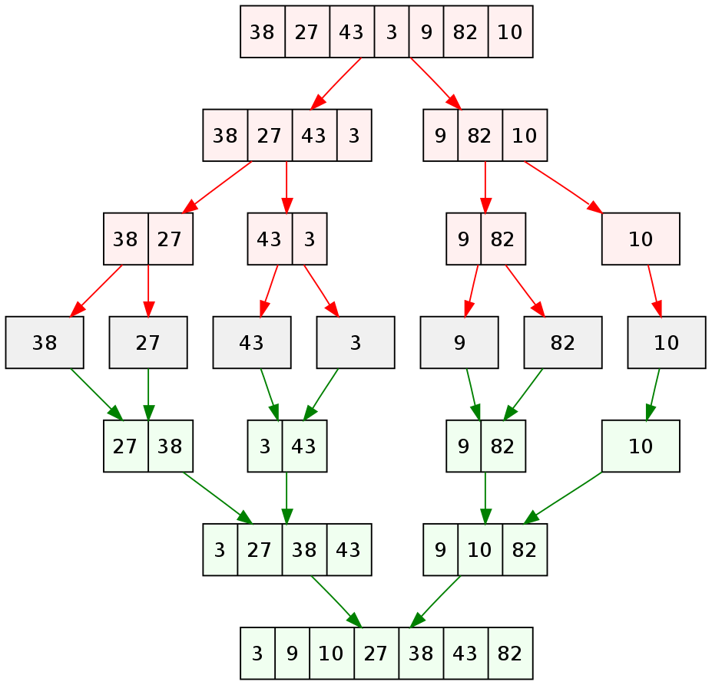
Merge Sort
If list is length 0 or 1, then it’s already sorted
Otherwise:
Divide list into two halves
Recursively sort the two halves
Merge the sorted halves back together
Red: Dividing ->
7 sorted lists ->
Green: Merging ->

Slide 6
Analyzing Merge Sort
If list is length 0 or 1, then it’s already sorted
Otherwise:
Divide list into two halves
Recursively sort the two halves
Merge the sorted halves back together
Merge n items
n items merged
Merge n/2 items
Merge n/2 items
n items merged
Merge n/4 items
Merge n/4 items
Merge n/4 items
Merge n/4 items
n items merged
etc
etc
n items merged
Merge 2 items
Merge 2 items
Merge 2 items
Merge 2 items
etc
Notes:
Just summarize it here. Don’t dawdle; this will make more sense when they implement it.
Leading Questions:
What is the run-time for merging N items? O(N)
What is the run-time for merging N/2 items? O(N)
What is the run-time for merging N/2 items TWO times? O(N)
Each row takes O(N)
How many rows? (divides in half each time) O( log(N) )
Have students implement mergesort.StringMergeSort. Walk around the room and help students as needed. Have your TAs do the same. Keep students engaged.

Slide 7
Work on MergeSortSimple
Simpler with a String
Same general algorithm applies
Harder (more room for errors) if you track positions in array

Slide 8
Video: Final Project Presentations
~7 minutes long
~3 min. Showing off your extra features
(Preferably record a video! (live demo “Acceptable”) )
~2 min. Explaining your overall design (major classes, NOT all)
“Coupling/Cohesion” or other “Good/Bad” aspects of design
~2 min. Design decision, feature implementation, or tricky bug
Be careful about code examples (good – but in moderation)
Should include prepared slides usually including diagrams
Notes:
8

Slide 9
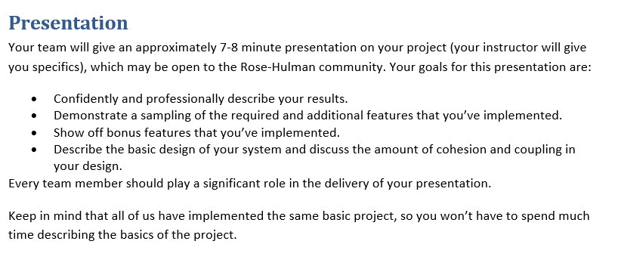
From the project specification document (ArcadeGame.docx)
Notes:
Dress 1 step up form your normal dress level

Slide 10
Next Week: Your Presentations
7 minutes long (Rehearse! Aim to be within 30 seconds +/- )
~3 min. Showing off your extra features
(Preferably record a video! (live demo “Acceptable”) )
~2 min. Explaining your overall design (major classes, NOT all)
“Coupling/Cohesion” or other “Good/Bad” aspects of design
~2 min. Design decision, feature implementation, or tricky bug
Be careful about code examples (good – but in moderation)
Should include prepared slides usually including diagrams
Notes:
10

Slide 11
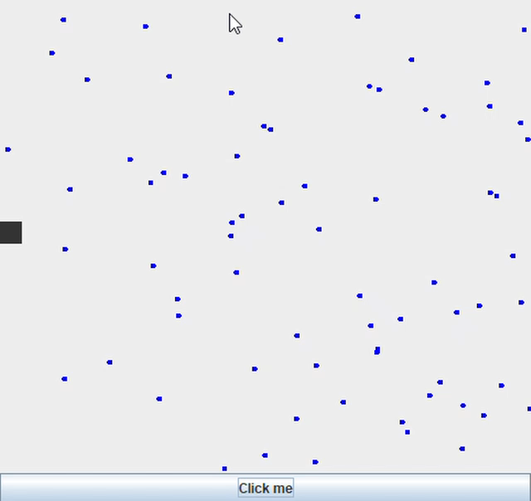
How to record your screen on Windows 10 using Game Bar (Windows Key + g)
https://www.businessinsider.com/how-to-record-screen-on-windows-10

Slide 12
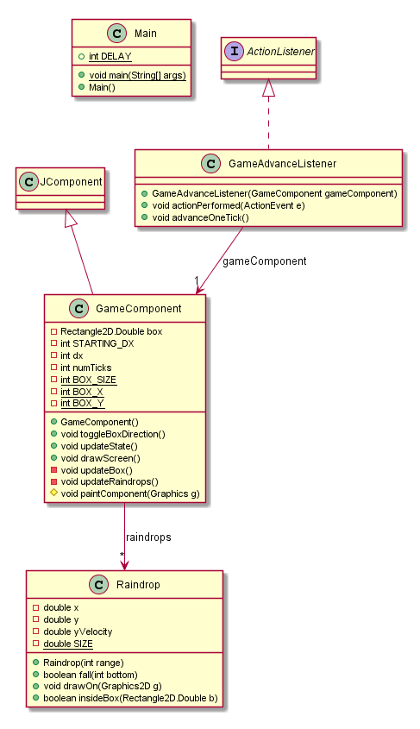
First “RainDrop” sim:
Coupling - ?
Cohesion – ?

Slide 13
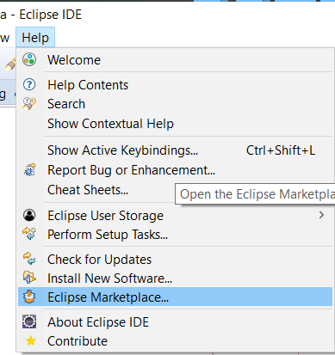
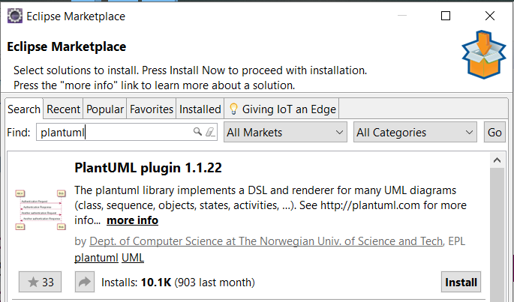
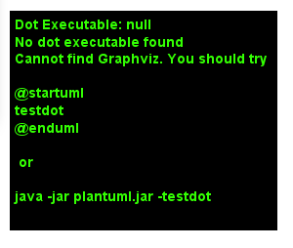
PlantUML Eclipse Plugin
https://plantuml.com/eclipse
https://graphviz.gitlab.io/download/
Windows Stable Installed (msi)
Install Graphviz

Slide 14
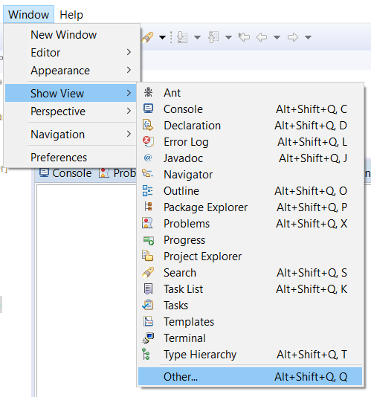
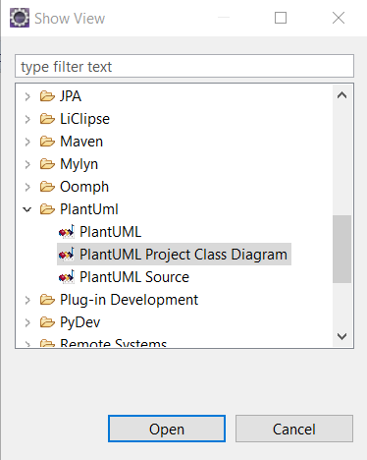

Slide 15
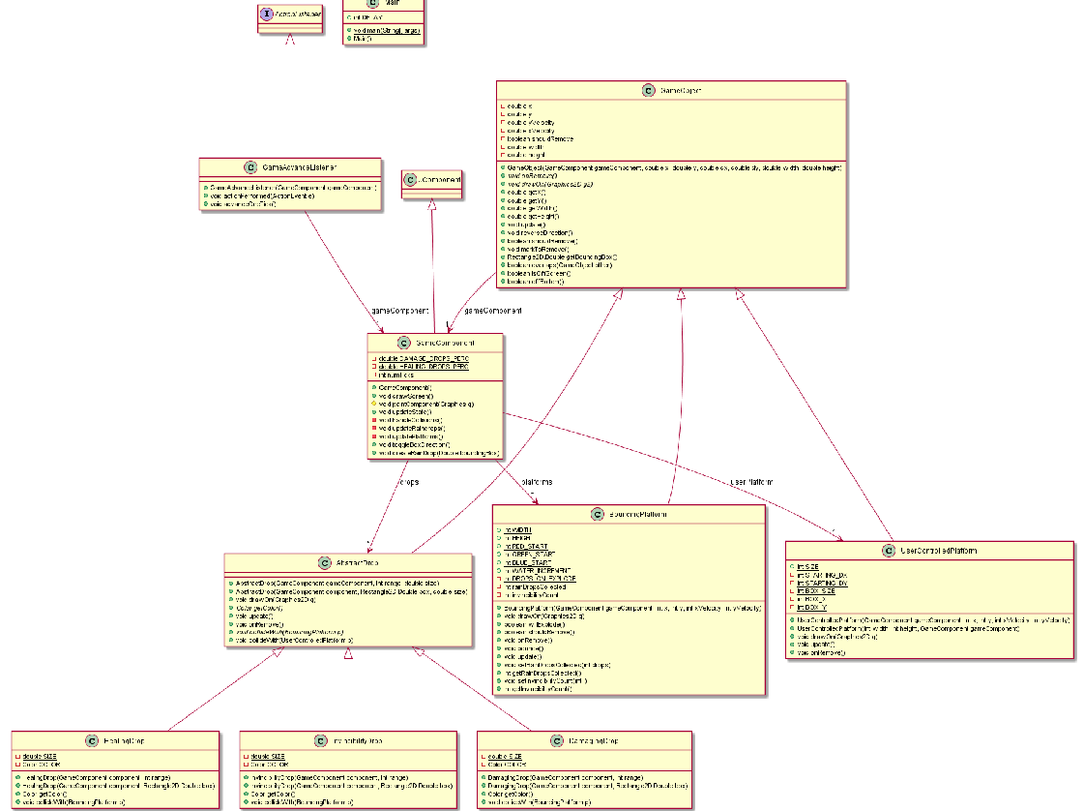
Information
Overload!

Slide 16
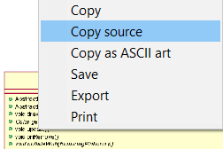
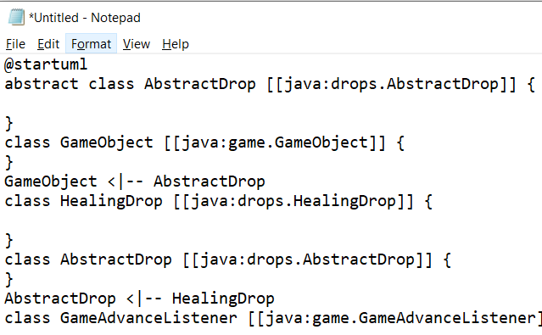
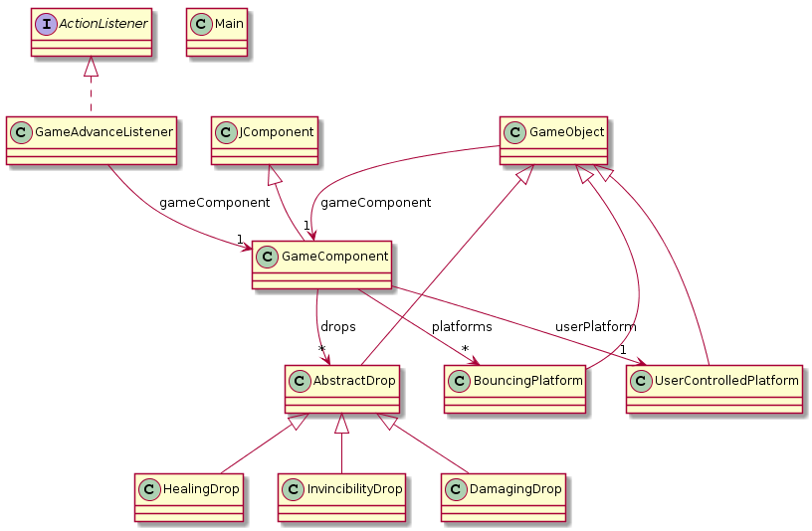
<- Copy UML source and
then remove extra ->

Slide 17
Final Project Advice:
Pull, Edit, Pull, Commit + Push
Only Commit working code
Each Commit: smallest testable chunk
No Major revisions after M3
Debugging Problem?
Is the code running where you think it is?
Are the values what you think they are?
public static final int LOG_LEVEL=0;
…
if (LOG_LEVEL > 0) System.out.println();
The debugger is your friend!

Slide 18
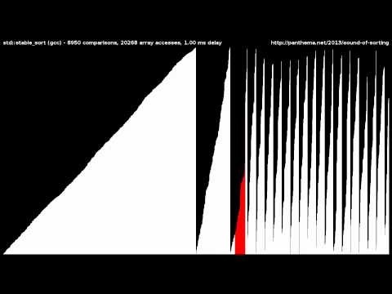
Sounds of Sorting
https://www.youtube.com/watch?v=kPRA0W1kECg

Slide 19
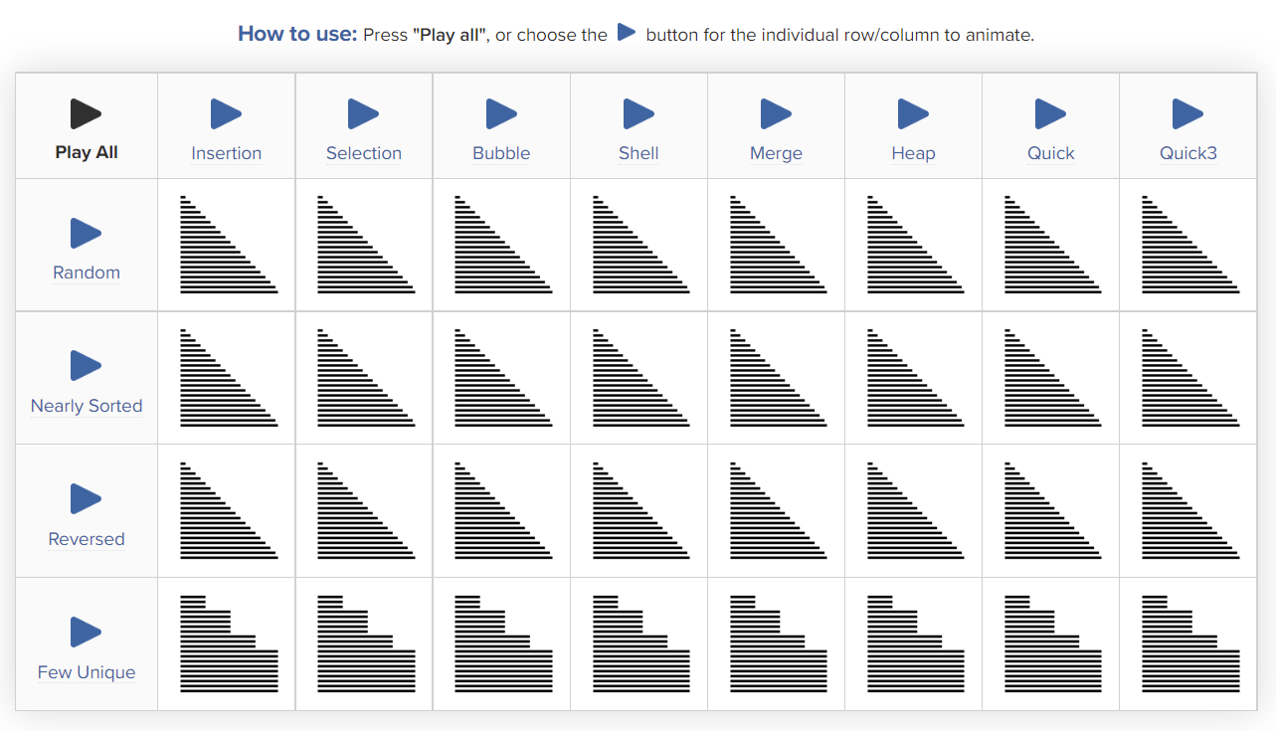
https://www.toptal.com/developers/sorting-algorithms
Can allow you to “race” various searching algorithms with different starting conditions

