Slide 1
CSSE 220
Eclipse PlantUML Plugin
Notes:
No quiz today.
Bring printouts from the MergeSortSimpleSolution.

Slide 2
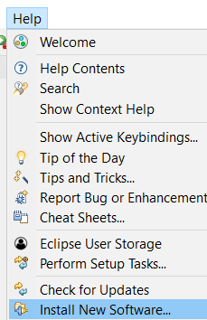
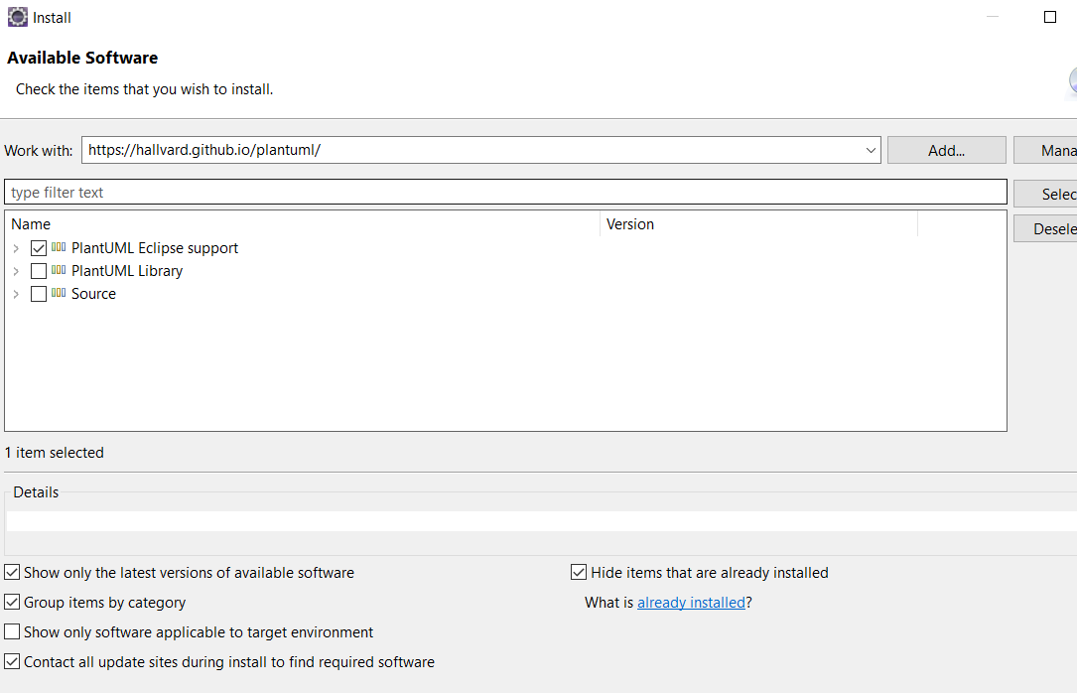

https://hallvard.github.io/plantuml/

Slide 3
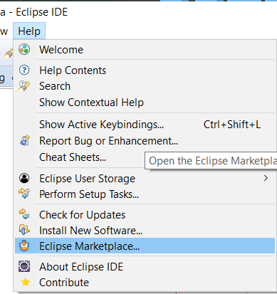
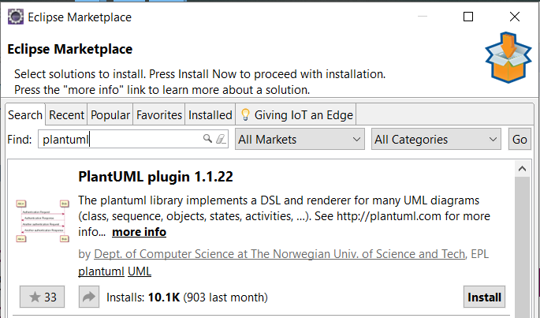


PlantUML Eclipse Plugin
https://plantuml.com/eclipse

Slide 4
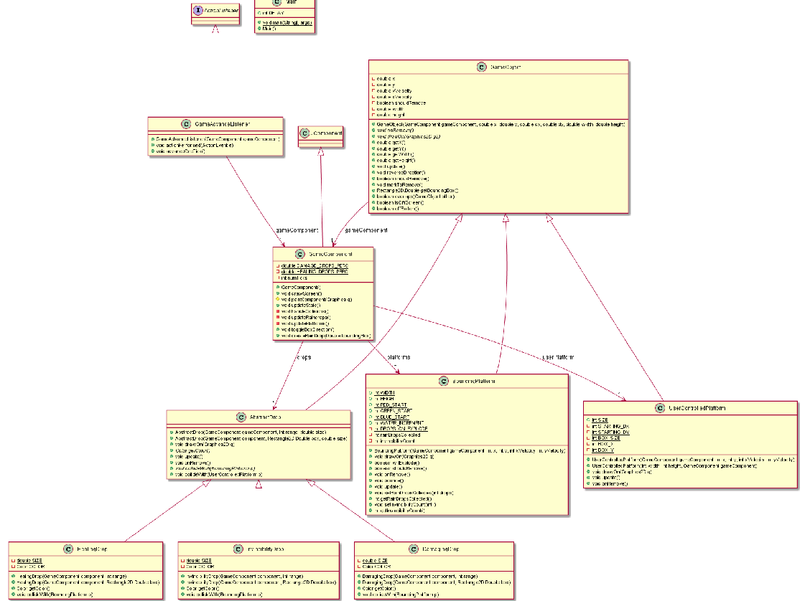
Information
Overload!

Slide 5
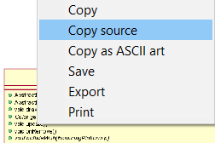
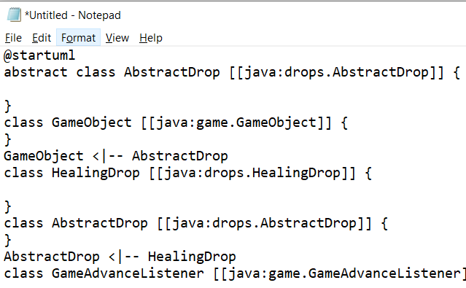
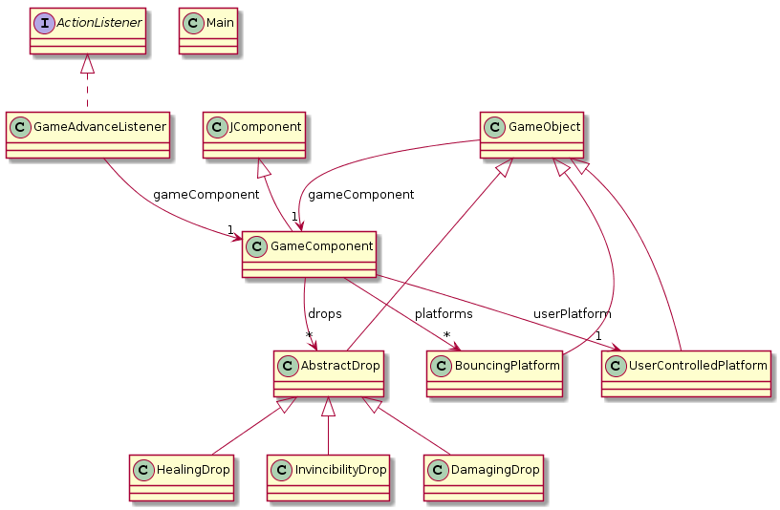
<- Copy UML source and
then remove extra ->

Slide 6
