Slide 1
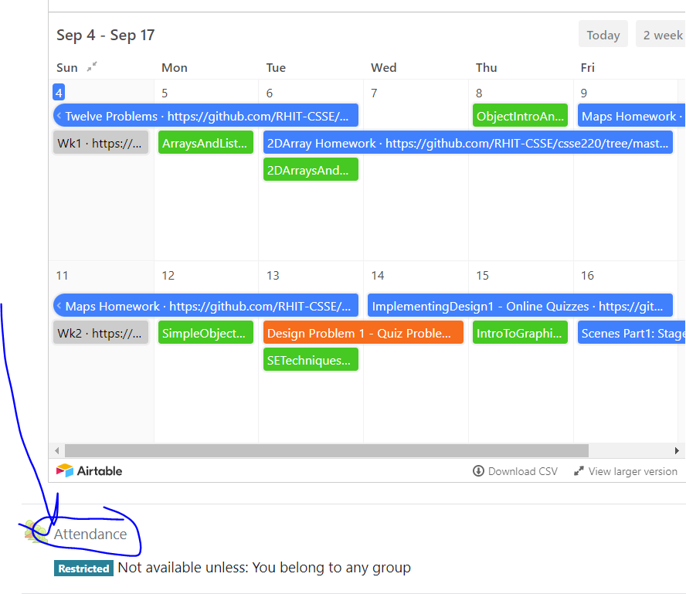
CSSE 220
Today’s Attendance password
___________
Inheritance
The git projects for today are:
PracticeInheritance
PracticeInheritanceSolution
The Quiz for today is:
InheritanceQuiz
Notes:
Bring hard copy of CheckingAccount, ChessPiece, King, Queen, etc.
Aim to finish CheckingAccount exam before the start of the second hour

Slide 2

Inheritance
Sometimes a new class is a special case of the concept represented by another already existing class
New class can “inherit” from an existing class, and new class can be changed to add new/different functional specific to the new class
The new class inherits from the existing one:
all methods
all instance fields
Q1

Slide 3
Examples
class SavingsAccount extends BankAccount
SavingsAccount adds interest earning, keeps other traits
class Employee extends Person
Employee adds pay information and methods, keeps other traits
class Manager extends Employee
Manager adds information about employees managed, changes the pay mechanism, keeps other traits
Notes:
- animated bullets

Slide 4
Notation and Terminology
class SavingsAccount extends BankAccount { // fields // methods }
Say “SavingsAccount is a BankAccount”
Superclass: BankAccount
Subclass: SavingsAccount
Notes:
Draw a Venn diagram here showing the set of all SavingsAccounts is a subset of the set of all BankAccounts. Subclass is like subset.
(Also inheritance flows down, so subclasses are below superclasses.)

Slide 5
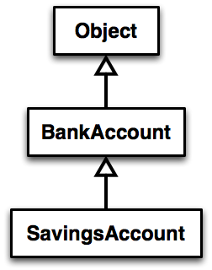
Inheritance in UML
Class Object is the “superest” class in Java
Solid line shows inheritance
Still means “is a”
Q2
Notes:
[Show code example here, just looking at code for BankAccount and SavingsAccount (not writing it live)]

Slide 6
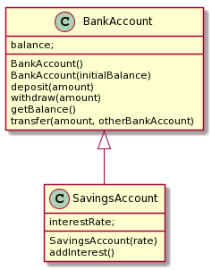
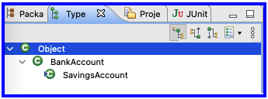
Look at Code
BankAccount (Superclass) Superclass
SavingsAccount (Subclass)
Plantuml source
SavingsAccount -up-|> BankAccount
Notes:
Add a main method:
public static void main(String[] args) {
SavingsAccount sa = new SavingsAccount(5);
sa.deposit(100);
System.out.println(sa.getBalance() );
sa.addInterest();
System.out.println(sa.getBalance() );
}
Ask students, “How does sa know its starting balance?”

Slide 7
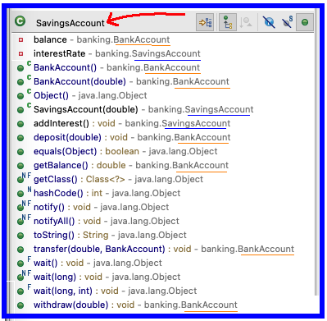
Views in Eclipse
Notes:
Add a main method:
public static void main(String[] args) {
SavingsAccount sa = new SavingsAccount(5);
sa.deposit(100);
System.out.println(sa.getBalance() );
sa.addInterest();
System.out.println(sa.getBalance() );
}
Ask students, “How does sa know its starting balance?”

Slide 8
Interfaces vs. Inheritance
class ClickHandler implements MouseListener
ClickHandler promises to implement all the methods of MouseListener
class CheckingAccount extends BankAccount
CheckingAccount inherits (or overrides) all the methods of BankAccount
For client code reuse
i.e., what it does reuse
For implementation code reuse
i.e., how it does it code reuse
Notes:
We will implement CheckingAccount in a little while.

Slide 9
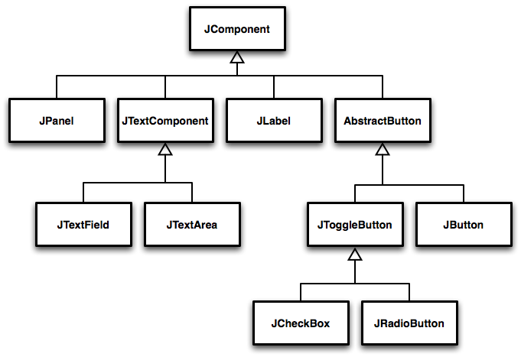
Inheritance Run Amok?
Notes:
Advanced code sometimes has deep inheritance hierarchies
Trace through a few paths asking students what might be inherited and what might be added at each level (See Figure 1 - 3, pages 422 - 3)
Every JComponent has a width and a height, so the JComponent class has a getWidth() and a getHeight() method.
Every JButton can have text or an icon on it, so the AbstractButton class has a setText() and a setIcon() method.

Slide 10
With Methods, Subclasses can:
Inherit methods unchanged
Override methods
Declare a new method with same signature to use instead of superclass method
i.e., change how it works
Add entirely new methods not in superclass
i.e., add new what it does & how it does it
Q3

Slide 11
w.r.t Fields, Subclasses:
ALWAYS inherit all fields unchanged
But cannot access superclass private fields
Can access directly fields at access levels:
public
protected
package
The subclass can add entirely new fields not in superclass
DANGER! Don’t use the same field name as a superclass field!
Q4
Notes:
Start to implement CheckingAccount, just create class, but do not add methods yet.
Draw UML diagram with details (See Figure on page 443) on board first [keep this, you’ll need it later]
Use no-arg constructor initially. We’ll add the argument later.

Slide 12
How Subclass calls Superclass Methods
Calling a superclass method from the subclass:
super.methodName(args);
Calling superclass constructor:
super(args);
Must appear as the first line of the subclass constructor
Q5
Notes:
Discuss super method calls.
Add CheckingAccount(double) constructor

Slide 13
Let’s Code CheckingAccount
A special type of BankAccount
Has 3 free transactions each month Transactions that are counted:
Withdraw
Deposit
Every additional transaction (beyond) costs $1.50
4 cost $1.50
5 cost $3.00
At end of each month fees are deducted (all together)
Transaction count is reset at this time
Add new public method to CheckingAccount called deductFees()
Notes:
Override:
deposit( amount )
withdraw( amount )
deductFees()

Slide 14
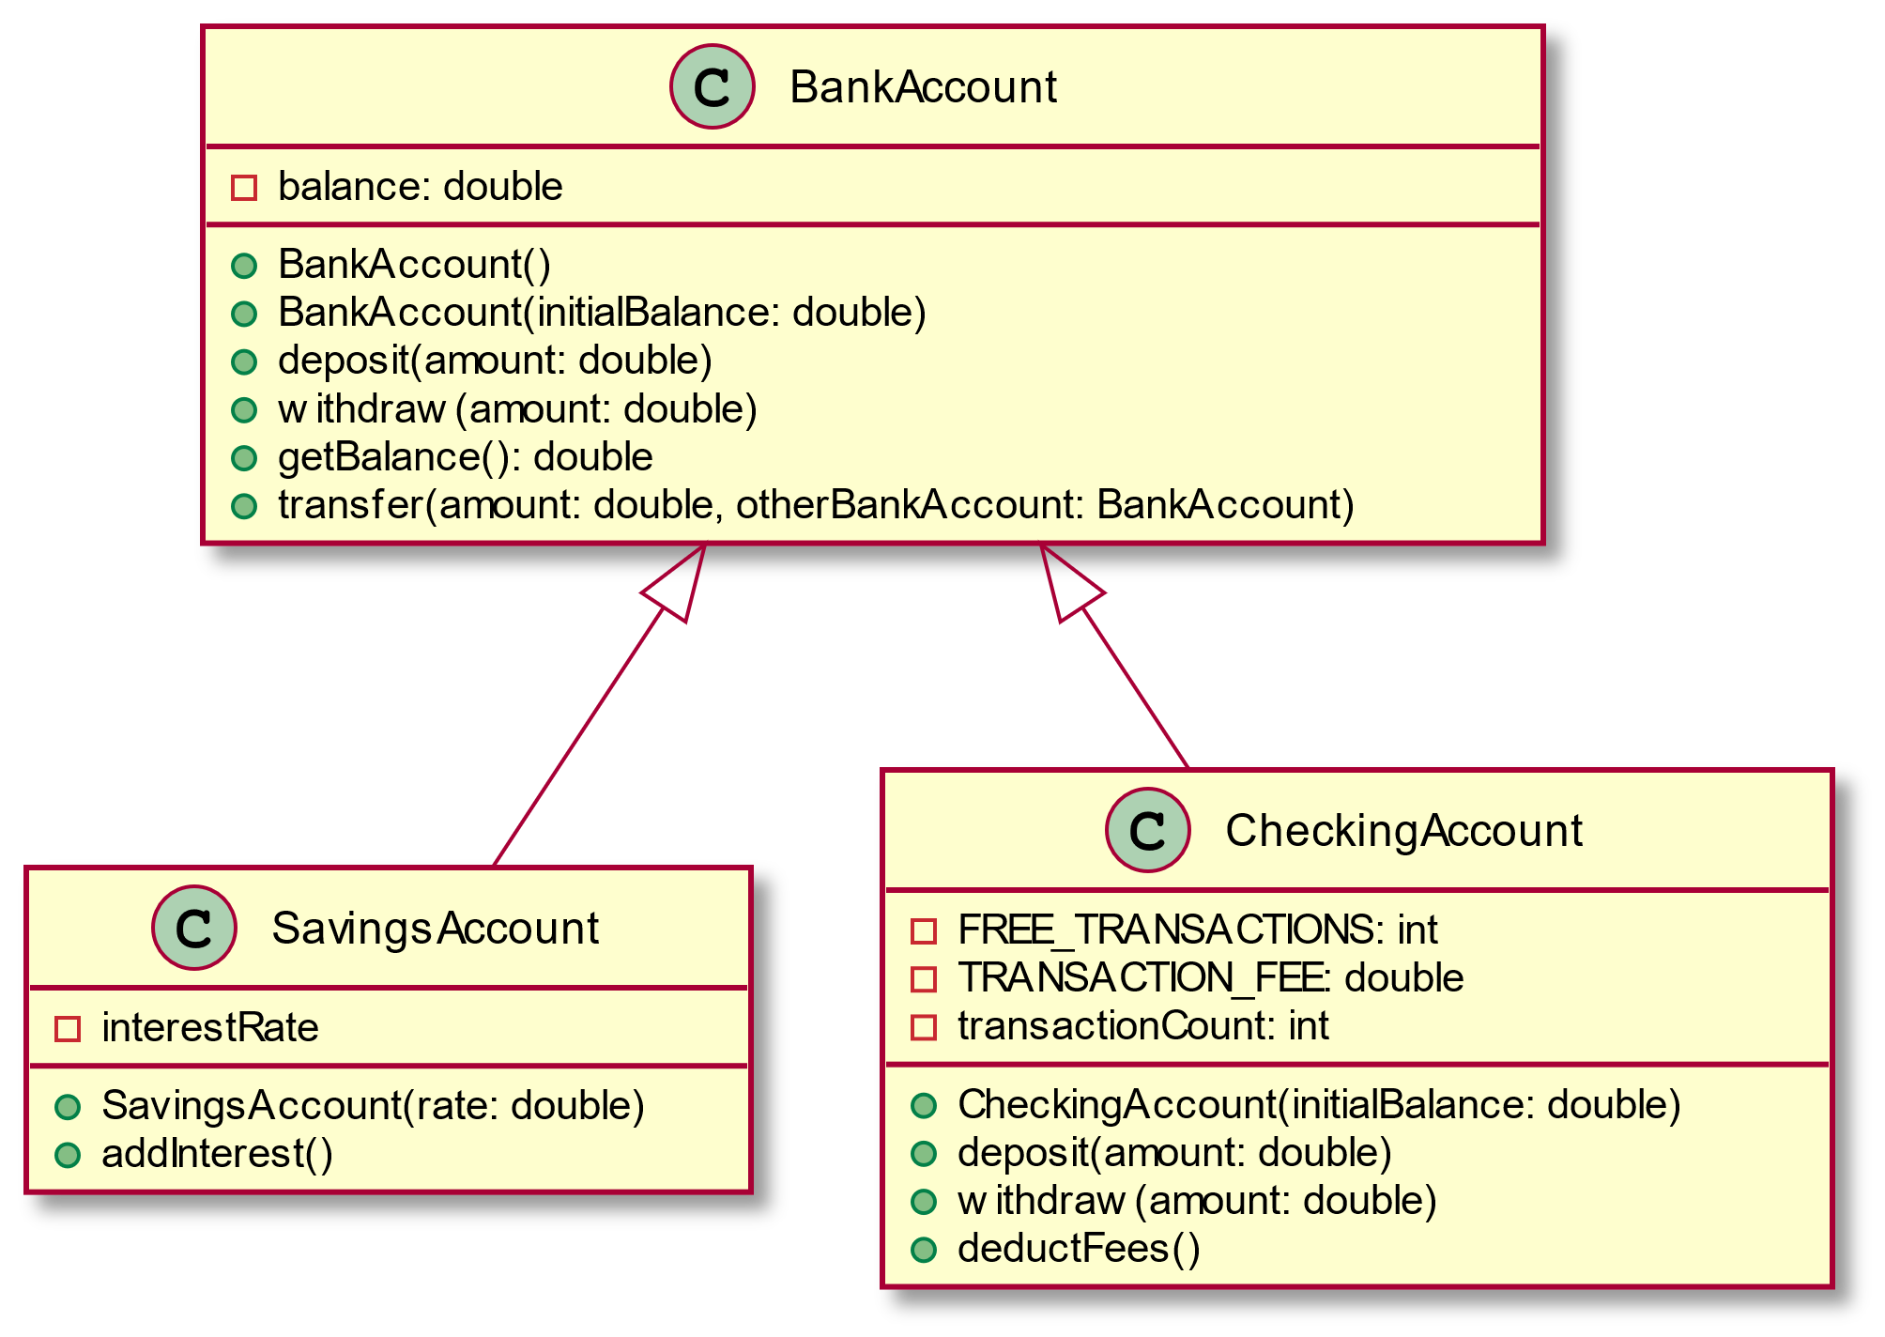
Design then Implement
plantuml

Slide 15
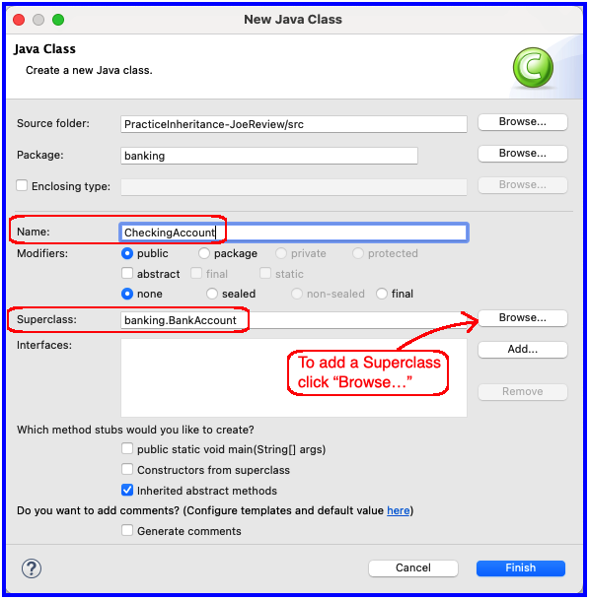
In Eclipse – new a Java Class

Slide 16
Polymorphism and Subclasses
A subclass instance is a superclass instance
Polymorphism still works!
BankAccount ba = new CheckingAccount(); ba.deposit(100.0);
BankAccount is declared type
CheckingAccount is instantiated type
The code above compiles and runs because CheckingAccount isA BankAccount
Q6
Notes:
Draw B&P diagrams. Show calls.
Why not? Because BankAccount doesn’t have an deductFees() method!

Slide 17
Polymorphism and Subclasses
This code (below) does not work
CheckingAccount ca = new BankAccount(); ca.deductFees();
CheckingAccount is the declared type
BankAccount is the instantiated type
It doesn't compile because BackAccount isNotA CheckingAccount
Q6
Notes:
Draw B&P diagrams. Show calls.
Why not? Because BankAccount doesn’t have an deductFees() method!

Slide 18
Another Example
Can use BankAccount's transfer method to transfer between different accounts:
{
SavingsAccount sa = …;
CheckingAccount ca = …;
sa.transfer(100, ca); // }
public void transfer(double amount, BankAccount o){ this.withdraw(amount); o.deposit(amount); }
Notes:
Suggest drawing B&P diagram and trace calls as practice for the exam.

Slide 19
Access Modifiers
public any code can see it
protected package and subclasses can see it
default anything in the package can see it
private only the class itself can see it
Notes:
default (i.e., modifier missing) — only code in the same package can access it
good choice for classes
Protected — like default, but subclasses also have access
sometimes useful for helper methods
Bad for fields!
Q7

Slide 20
Live coding
Let’s look at chessPieces/chessSupport
Let’s Look at King and ChessPiece
StandardBoardProvider (uncomment King lines)
Notes:
Walk through the Chess example in Inheritance project. Start by showing the King and ChessPiece interface. Implement the queen, and note to the students how we end up copying a lot of code from the King into the Queen, there has to be a better way…
It works well to just make the ChessPiece a class first and put in a System.err.println(“Implement this method!”) then show them if we forget to implement a method (Queen’s checkMove) we see that message at runtime.
At this point, they should see the justification for an abstract class, show that on next slide

Slide 21
Abstract Classes
Also look at the code in the shapes package, especially ShapesDemo (during or after class)
Hybrid of superclasses and interfaces
Like regular superclasses:
Provide implementation of some methods
Like interfaces
Just provide signatures and docs of other methods
Can’t be instantiated
Example:
public abstract class BankAccount { /** documentation here */ public abstract void deductFees(); … }
Elided methods as before
Notes:
The main reason for using Abstract classes is to force programmers to create subclasses. Declaring certain methods abstract prevents you from coming up with useless default methods that others might inherit by accident.
This also allows code reuse when only a few methods of an interface differ in implementation.
Make the ChessPiece abstract, and pull the items that don’t change into the new abstract class, and leave the other methods abstract (see solution code). Walk students through this refactor for King/Queen, then have them implement the other pieces. Remind them that the Pawn is actually the hardest, and to do that LAST.

Slide 22
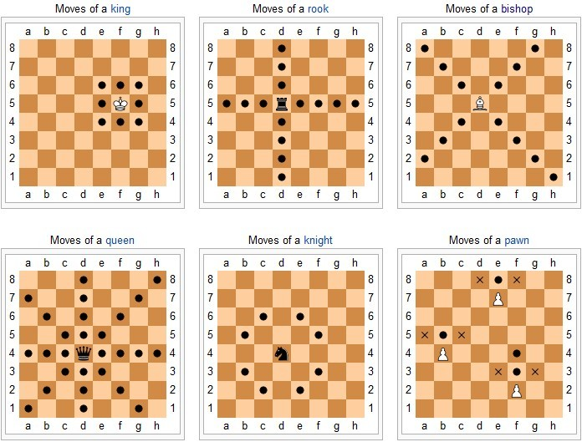
Notes:
Emphasize doing Pawn last it requires several things (hasMoved field) and needs to override the checkAttack method which is not obvious without looking at more code than they usually have to look at for the rest of the classes.
@Override
public boolean checkAttack(int dx, int dy, ChessPiece piece) {
if (this.isWhite() == piece.isWhite()) {
return false;
}
if (!movedCorrectDirection(dy)) {
return false;
}
dx = Math.abs(dx);
dy = Math.abs(dy);
return dx == 1 && dy == 1;
}

Slide 23

Upcoming Homework
RefactoringInheritance
Requires you to utilize inheritance
Careful to avoid variable shadowing
Read instructions carefully
Notes:
Consider showing working version of the solution in the private repo or playing part of the final functionality video:
https://rose-hulman.hosted.panopto.com/Panopto/Pages/Viewer.aspx?id=c6958003-1803-436a-bc65-aba6002fdeb3

Slide 24
Work Time
Chess
And to ask instructor/assistants for help
Q8-Q9

Slide 25
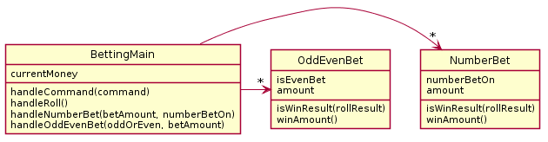
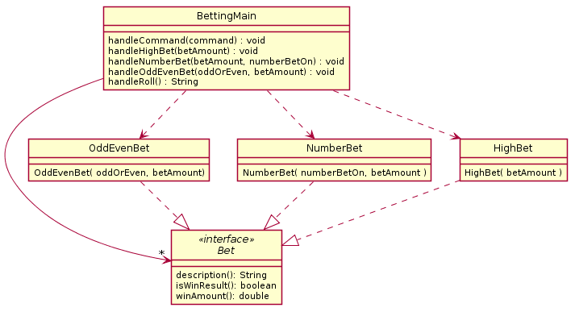
If time allows: Review of BettingMain Interface

Slide 26
Complete Final Project Survey
Posted or will be posted soon…

