Slide 1
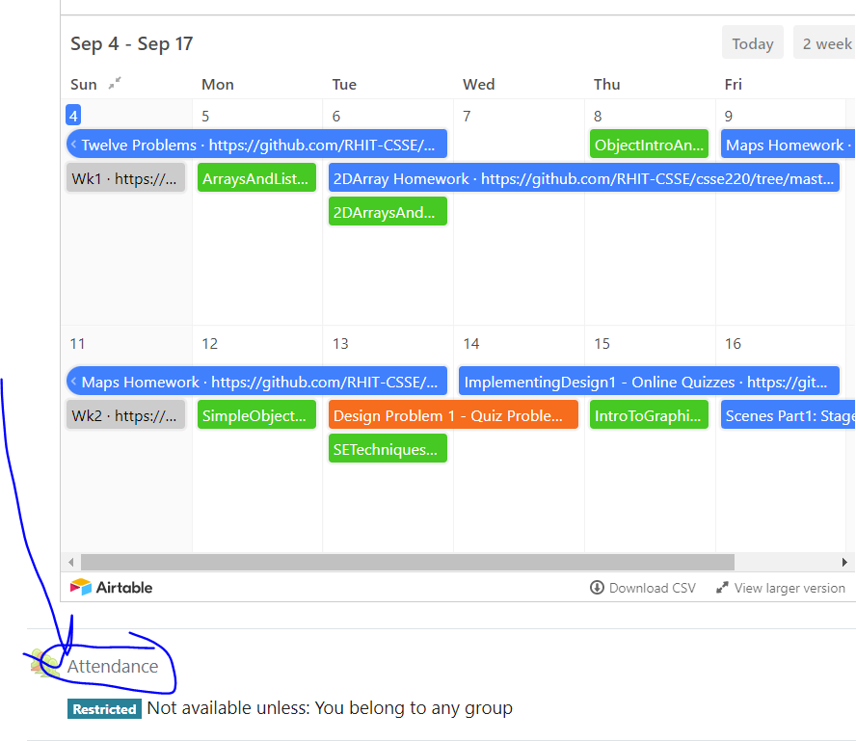
CSSE 220
Today’s Attendance password
__________
MapsHW & StudentGradebook
The git projects for today are:
PracticeSuperSimpleObjects
PracticeSuperSimpleObjectsSolution
PracticeSuperSimpleObjectsBoxAndPointers
The Quiz for today is
SimpleObjectsQuiz

Slide 2
Plan for today
Talk about object references and box and pointer diagrams
Talk about static methods
Continue working on writing your own classes
Get started on your new assignment

Slide 3
Finishing up from last time...
Complete the StudentGradebook problem in the SuperSimpleObject project (or the one from last class)
Notes:
3

