Slide 1
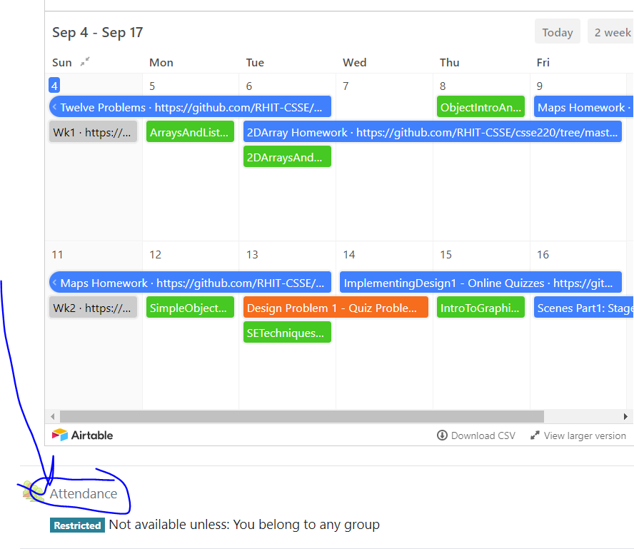
CSSE 220
Today’s Attendance password
_________
Main Game Loop with Timers
File IO
Exception Introduction
The git projects for today are:
PracticeEventBasedGameLoop
PracticeEventBasedGameLoopSolution

Slide 2
Objectives
Final Project Preparation/Kickoff
Learn how to avoid common project errors
Learn how to setup a timer to create events
Practice with live-coding
Practice interaction between game elements
Learn how to read and write from files
Practice with live-coding
Required for Milestone 1

Slide 3
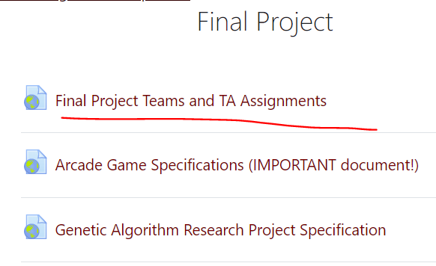
Final Project Introduction
Winter 2022-23 Team Sheet:
GARP Teams
Section XX
Add screenshots here
Section XX

Slide 4
Final Project Introduction -XX

Slide 5
Final Project Introduction - XX

Slide 6
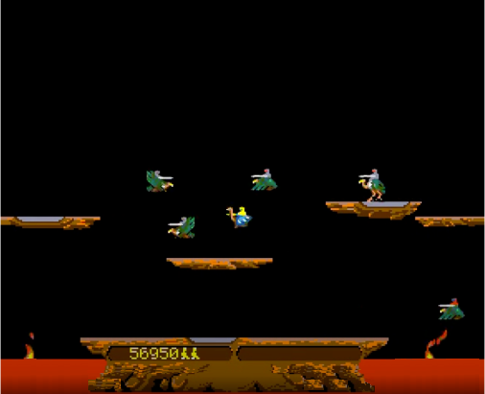
Project Specifications (Link on Moodle)
CSSE220 Joust Team Project
CSSE220 Genetic Algorithm Research Project

