Slide 1
Threads
Computers can run more than one thread of execution at the same time
Even single core processor can simulate this by timesharing (more about this in future courses)
Main starts every Java program
Graphics start a separate thread
Multiple threads can create very painful problems
Can be hard to debug (race conditions)
Example include ConcurrentModificationExceptions
Join Daniel Ignram we welcom efree agents
Notes:
Consider drawing a single diagram on the board showing separate thread of execution as lines

Slide 2
main's and Graphics' Threads
Time
Every program starts in main and begins executing one statement at a time
When a JFrame is created there is a second thread that starts running (at the same time, i.e., in parallel) and it will continue to run even if our main thread completes exits
The setting for JFrame setDefaultCloseOperation() determines if the Java Graphics thread continues to run after closing the window.
main's thread of control
Java Graphics'
thread of control
JFrame.EXIT_ON_CLOSE

Slide 3
Concurrent Modification Exceptions
Happens when you try to change something that is being used
Example:
Removing something from a list while the list is itself being iterated through (drawing/updating)
Why?
Main Thread
Java Graphics Thread
for (Item item: myList){
item.draw();
}
myList.remove(0);
Notes:
Ask students:
Imagine a list gets changed while you try to move through it, what could go wrong?
Read from bad location in memory, get into infinite loop, double visit, skip, etc.

Slide 4
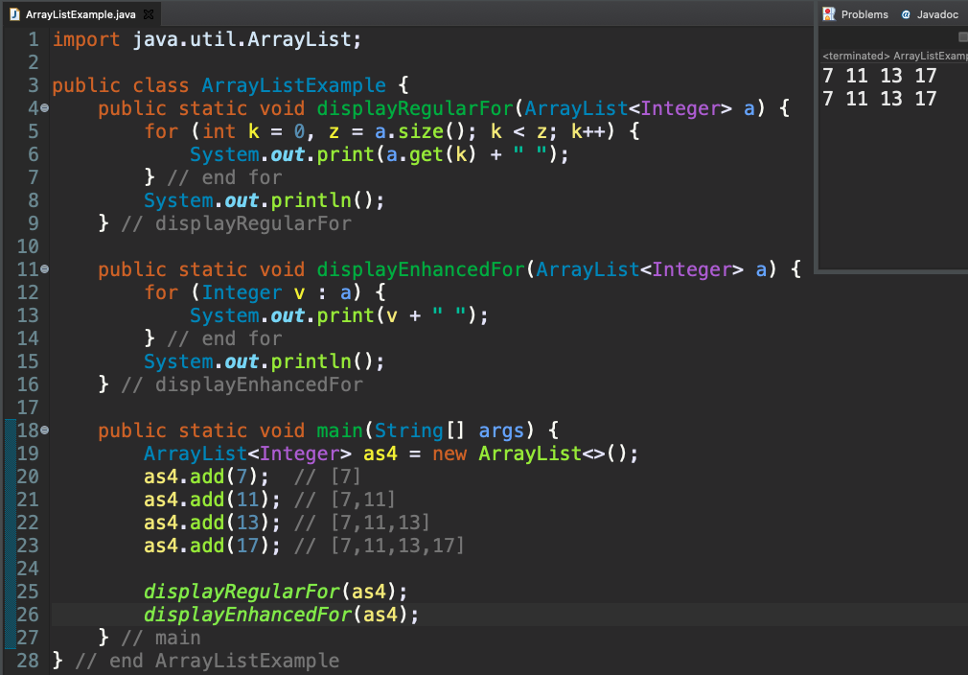
for Loops and ArrayList

Slide 5
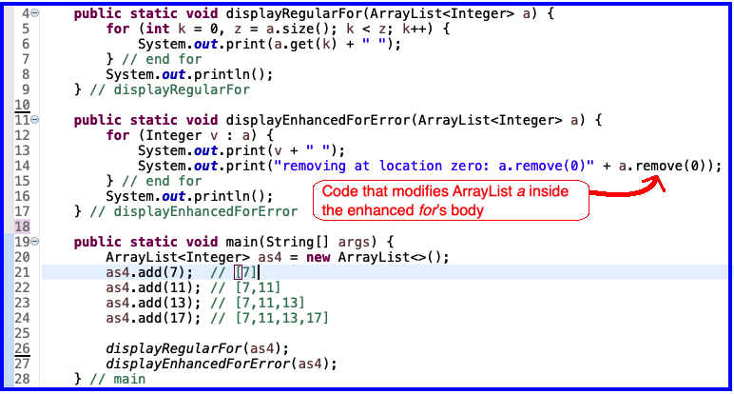
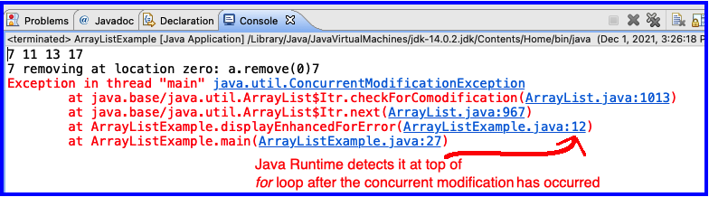
Concurrent Modification Error
This is a problem
for enhanced for
because length of 'a' has changed
But enhanced for is still using
original length of
'a'

Slide 6
Timer
An alternative to a thread that waits/sleeps
Creates events periodically
Allows main thread to finish
Designed to work in same thread as graphics
Superior approach for ArcadeGame project
Similar functionality required for GARP

Slide 7
Timer
Time
main thread
Java Graphics Thread
public void advanceOneTick() {
myComponent.updateState();
myComponent.drawScreen();
}
Exit
public void advanceOneTick() {
myComponent.updateState();
myComponent.drawScreen();
}
Each tick of the Timer
public void advanceOneTick() {
myComponent.updateState();
myComponent.drawScreen();
}

Slide 8
Live-coding
Today's import: PracticeEventBasedGameLoop
Subpackage: gameEventLoop
Notes:
* In this exercise, we develop each of these ideas.
* TODO: Replace the loop with button input to advance one tick.
* TODO: Replace the button with a timer.
* TODO: Make the button change the direction of motion.
* TODO: Add falling raindrops.
* TODO: Make the box "catch" drops that hit it.

