Slide 1
Final Project
Milestone 0
Milestone 1
Project Teamwork and Roles

Slide 2
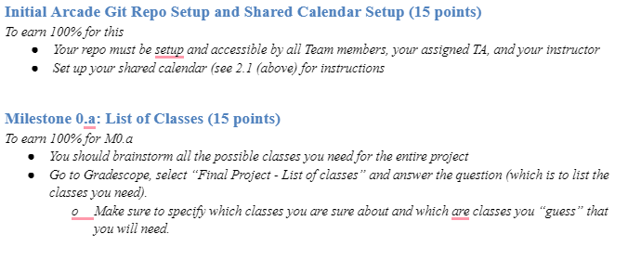
M0: UML Class Diagram & Shared Calendar Setup (50 points)

Slide 3
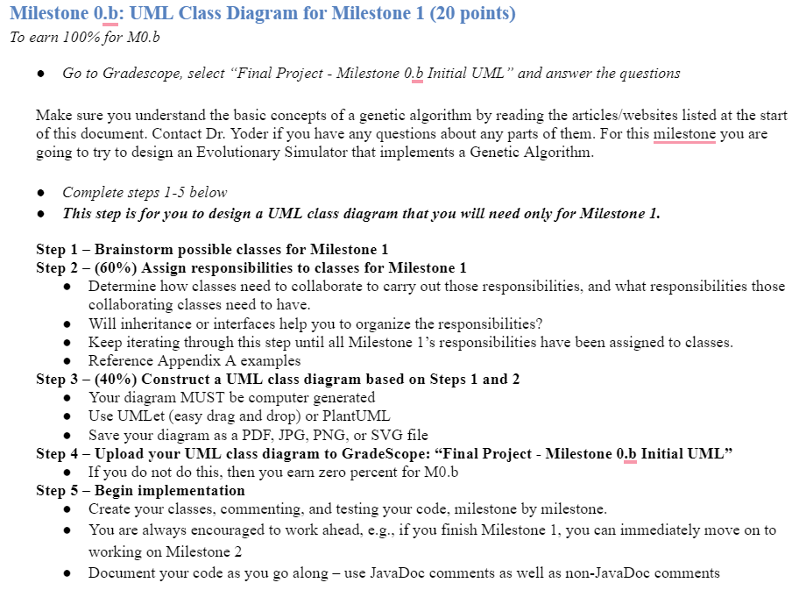
M0: UML Class Diagram & Shared Calendar Setup (50 points)

Slide 4
Plan your first meeting NOW!
What day?
What time?
Where?
Communication? (email/teams/txt/discord/imleagues/etc)
Preparation beforehand?
I’d recommend people coming with their own list of suggested nouns

Slide 5
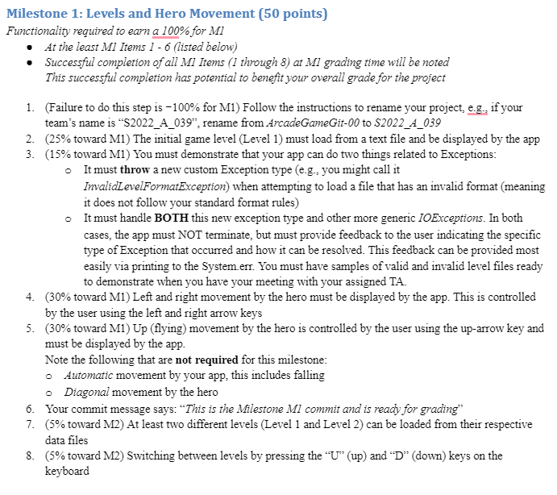
M1: Levels and Hero Movement (50 points)

Slide 6
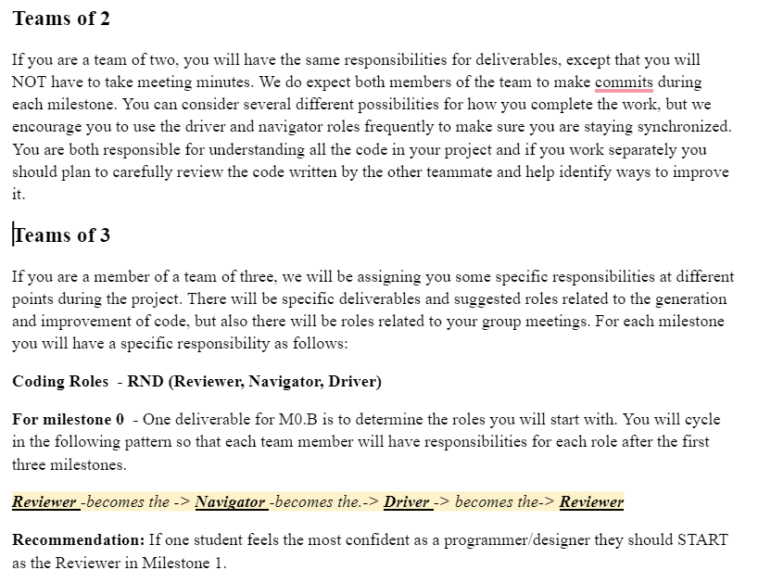
RND – Reviewer, Navigator, Driver
There is NO coding for M0. I recommend you all meet together since it is a critical part of setting up your design and you want to be in sync and in agreement as much as possible!

Slide 7
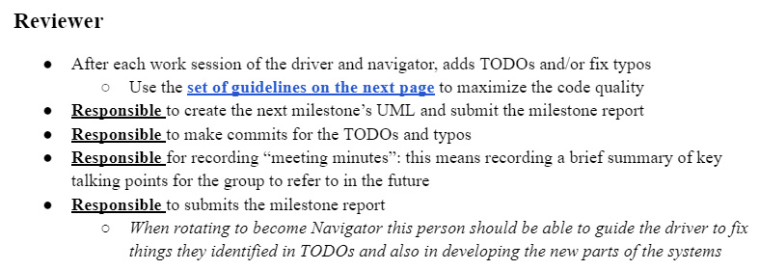
Reviewer

Slide 8
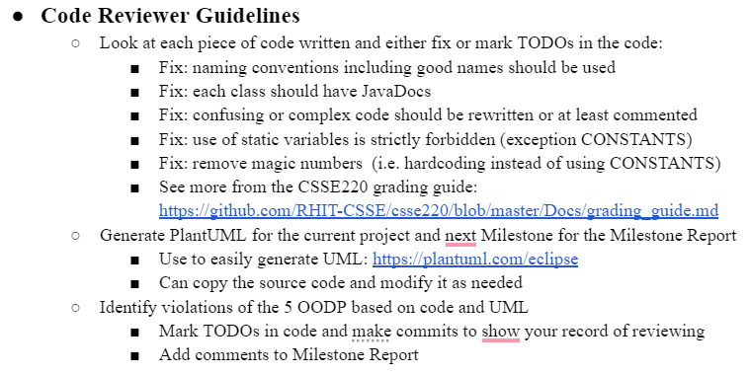
Code Review Guidelines

Slide 9
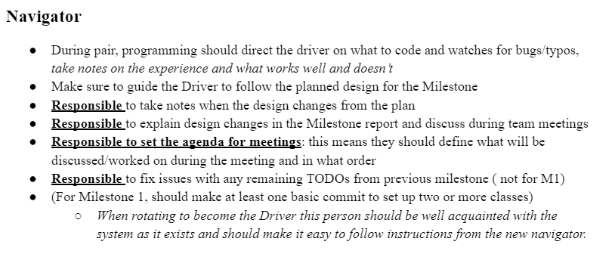
Navigator

Slide 10
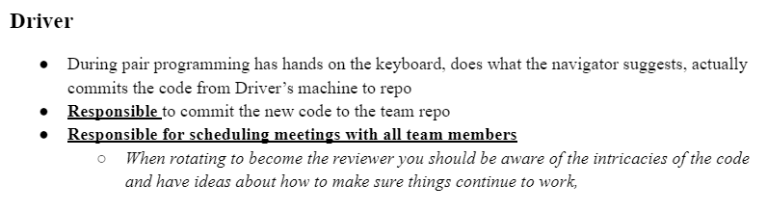
Driver

