Slide 1
CSSE 220
Console Input
The git projects for today are:
PracticeConsoleAndUnitTesting
PracticeConsoleAndUnitTestingSolution
Notes:
Bring hard copy of code from UnitTesting

Slide 2
Console input with Scanner
Creating a Scanner object
import java.util.Scanner;
Scanner inputScanner = new Scanner(System.in);
Defines methods to read from keyboard
inputScanner.nextInt();
inputScanner.nextDouble();
inputScanner.nextLine();
inputScanner.next();
Exercise: Look at UnitTesting/src/ConsoleWorker.java. Add missing methods to read from console
Q1
Notes:
Do an example with students and have them do the rest on their own.

Slide 3



Tokens
Jason Yoder CSSE 220
Repeatedly calling scanner.next() will return the next token as a String and advance the cursor to the next token
Calling scanner.nextLine() will grab the entire line at once and return as a String.

Slide 4
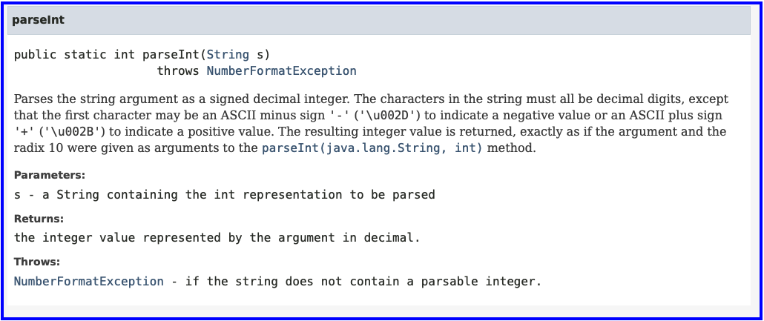
Parse Integer
String nextToken = inputScanner.next();
int x = Integer.parseInt(nextToken);
Notes:
Do an example with students and have them do the rest on their own.

Slide 5
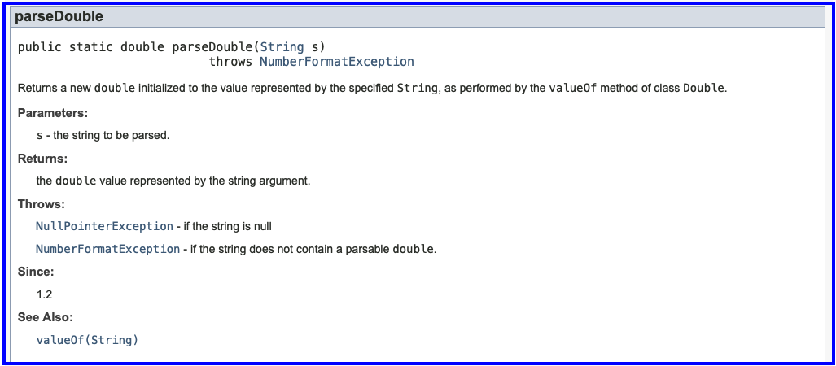
Parse Double
String nextToken = inputScanner.next();
double z = Double.parseDouble(nextToken);
Notes:
Do an example with students and have them do the rest on their own.

