Slide 1
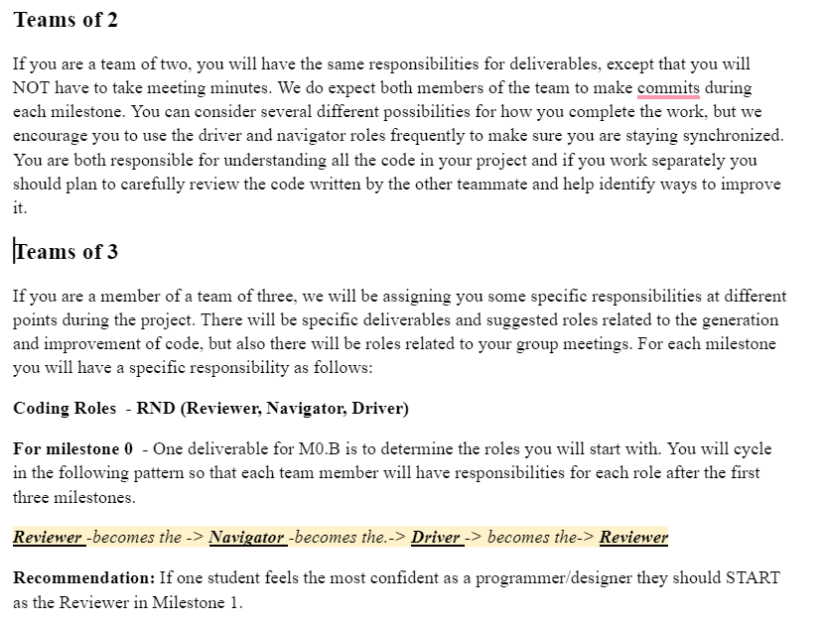
RND – Reviewer, Navigator, Driver

Slide 2
RND – Reviewer, Navigator, Driver

Slide 3
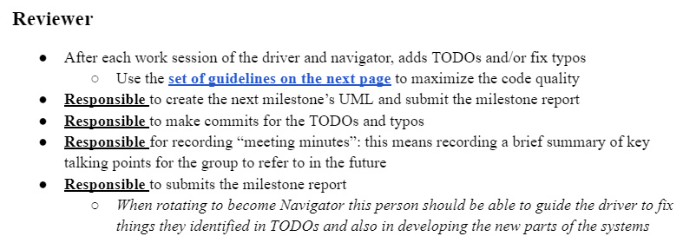

Reviewer

Slide 4
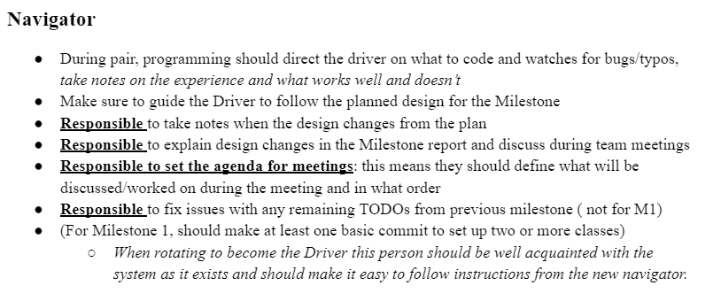

Navigator

Slide 5
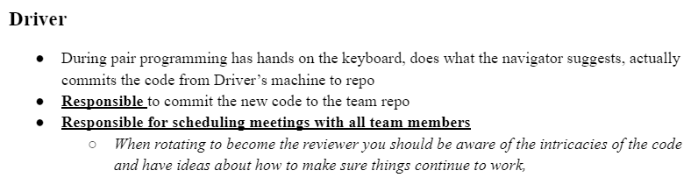

Driver

