Slide 1
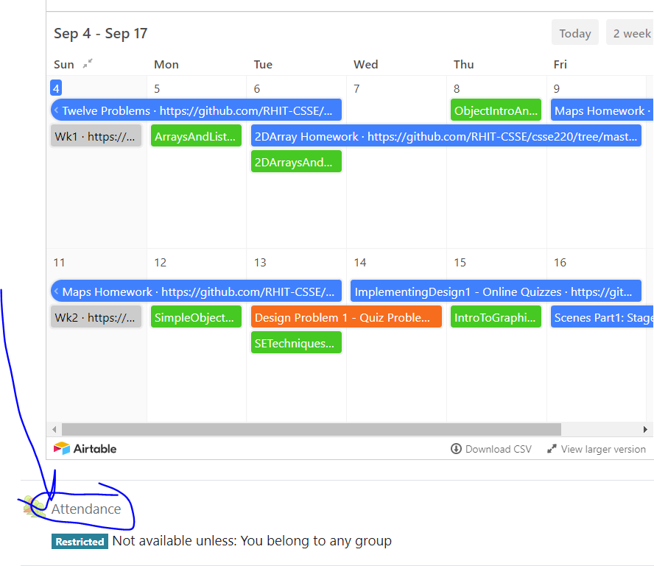
CSSE 220
Today’s Attendance password
howToTest
Variable Scope
Console Input
Unit Testing
The git projects for today are:
PracticeConsoleAndUnitTesting
PracticeConsoleAndUnitTestingSolution
The Quiz for today is:
IntroToUnitTestingQuiz
Notes:
Bring hard copy of code from UnitTesting

Slide 2
Outline
Review: Dependencies, Coupling, Cohesion
Variable Scoping
Console Input
Unit Testing

Slide 3
Review
Encapsulation
Collocate within a class data fields and the methods that work on those fields
Use private keyword for most data fields, this is called compiler enforced encapsulation

Slide 4
Review
Minimize Dependencies by (low coupling):
Using tell don’t ask – when a client of a class has an algorithm that could be located within that class (this is an ask algorithm), move that algorithm/method from client into the class (so it becomes a tell algorithm)
Don’t use message chains – instead instrument the called-on classes to provide methods to do the work
Low coupling means dependencies are minimized

Slide 5
Review
High Cohesion Rule for Classes
Make each class do one thing well
Micro-Cohesion Rules for Class Implementations
Make each operation do one thing well
Make each loop do only one thing

Slide 6
Questions about DPs thus far?
Make sure your design allows proper functionality
Must be able to store required information (one/many to one/many relationships)
Must be able to access the required information to accomplish tasks
Data should not be duplicated (id/identifiers are OK!)
Structure design around the data to be stored
Nouns should become classes
Classes should have intelligent behaviors (methods) that may operate on their data
Functionality should be distributed efficiently
No class/part should get too large
Each class should have a single responsibility it accomplishes
Minimize dependencies between objects when it does not disrupt usability or extendibility
Tell don't ask
Don't have message chains
Don't duplicate code
Similar "chunks" of code should be unified into functions
Classes with similar features should be given common interfaces
Classes with similar internals should be simplified using inheritance

Slide 7
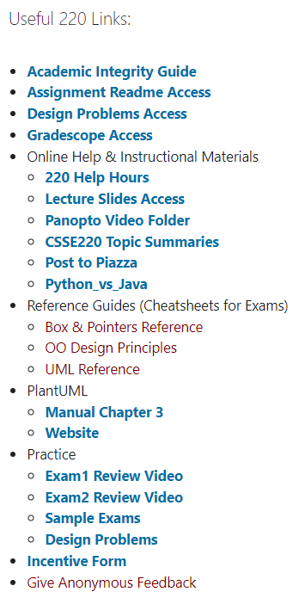
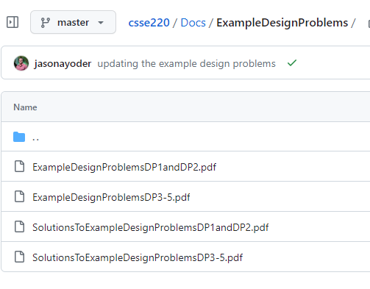

Example DPs for Practice!
https://github.com/RHIT-CSSE/csse220/tree/master/Docs/ExampleDesignProblems

Slide 8
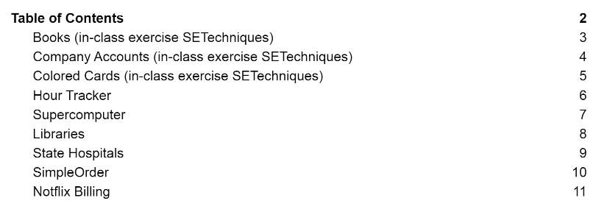
DP1 and DP2 (best as practice for Exam1)
There are a number of DP for you to practice and review (first three)

Slide 9
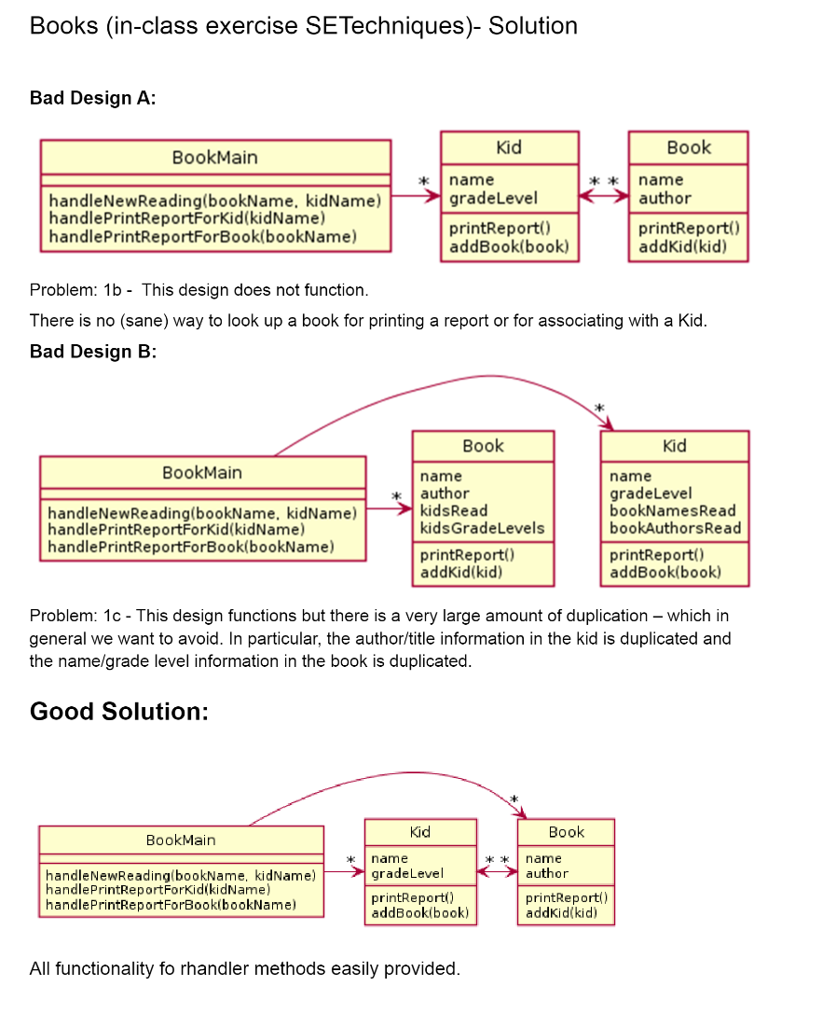
We provide explanations
in the solutions document
To maximize your benefit we recommend trying to work through the problem yourself first and then review the solution afterward.

Slide 10
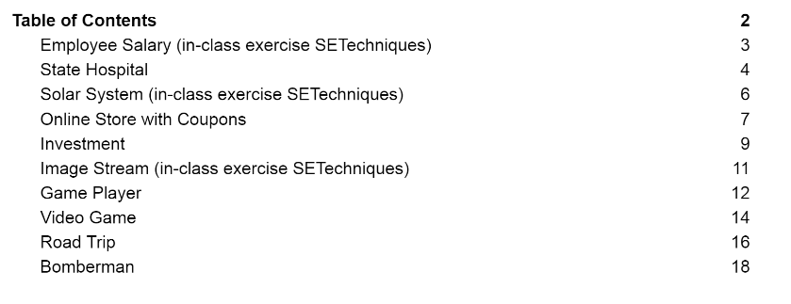
DP 3, 4, 5 (best as practice for Exam2)

