Slide 1
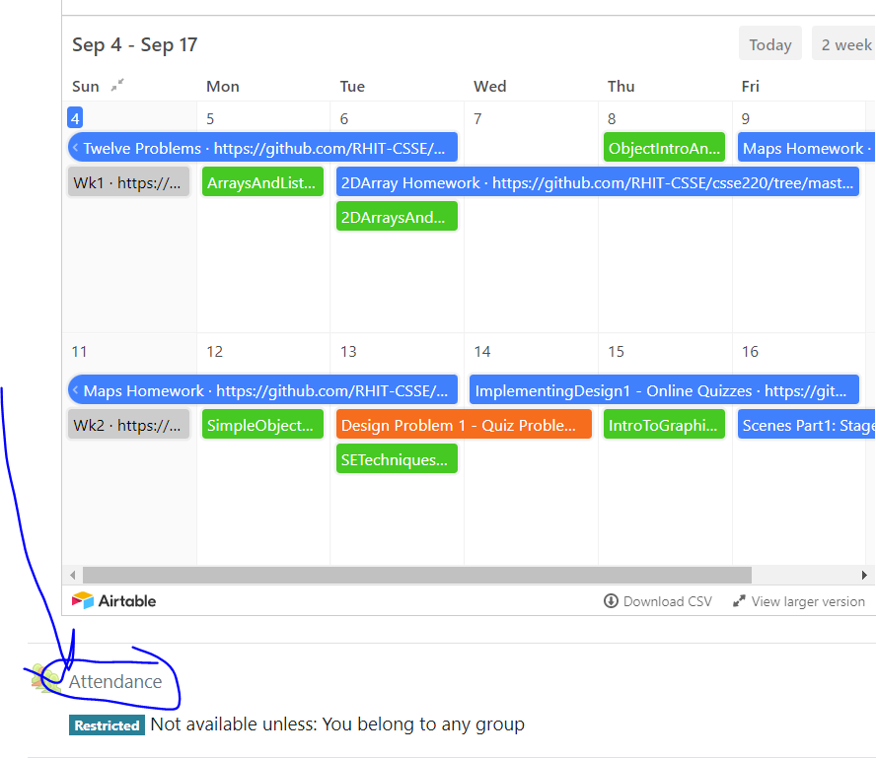
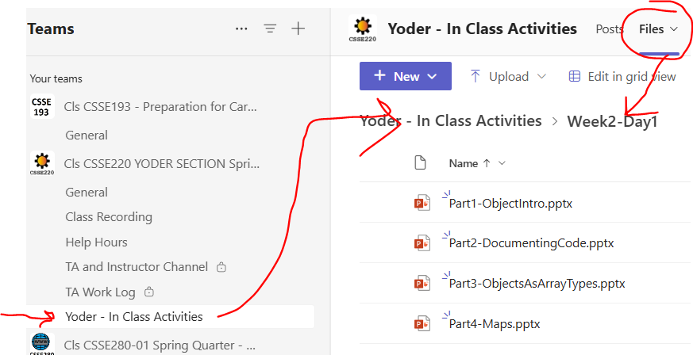
Object Introduction
Today’s Attendance password
blueprint
I updated some slides for today
The git projects for today are:
PracticeMapsAndObjectIntro
PracticeSolutionMapsAndObjectIntro

Slide 2
Using the Debugger
How is it going?
Have you used it?
Shall we practice it again?
Questions?

Slide 3
Class – What, When, Why, & How?
What:
A blueprint for a custom type
When:
Define a class when you’re representing a concept (think nouns)
When no other existing type can do what you want/need

Slide 4
Class – What, When, Why, & How?
Why:
Keep similar concepts together
Encapsulation (we’ll expand on this next time)
How:
public class ClassName {
//fields – appear here
//methods – come next
}

Slide 5
Using Objects and Methods
“Who does what, with what?”
Works just like Python:
object.method(argument, ...)
Two examples in Java:
The controlling object
is an implicit argument
passed to method
Explicit arguments always appear inside the ( and )
ArrayList<Integer> scores = new ArrayList<>();
scores.add(78); // scores is controlling object
String name = "Bob Forapples";
int nameLen = name.length(); // name is controlling object

Slide 6
Constructors – What, When, Why, How?
What:
Special method called when a new object instance of a class is created
Initializes the new object instance
Like the __init__ method in Python
When:
Define a constructor when special initialization of a class's fields is required
Otherwise, Java implicitly creates a no-argument constructor if you don’t add one, but it does not do anything

Slide 7
Constructors – What, When, Why, How?
Why:
Allows you to ensure that a new object instance is initialized exactly how it needs to be before calling other methods/fields
Puts object in a legal initial state
How: always has the same name as the class.
public class MyClass {
public MyClass() {
//init code of parameterless constructor
}
public MyClass(ParamType paramName) {
//init code of 1 parameter constructor
}
}

Slide 8
Object Constructors
int num = 5;
bool isEmpty = true;
This works for primitive data types
What about how do we initialize an “object” that is made from a class?

Slide 9
Using Constructors
This constructor's arguments specifies that the new Rectangle whose reference is stored in box should be at the origin (0, 0) with a height and width of 5.
In Java, all variables must have a type
Rectangle box = new Rectangle(0, 0, 5, 5);
Every variable must have a name.
The new operator is what actually creates the new object, in this case a new Rectangle
Q5
Notes:
Argument for main is not optional. Must be there.

Slide 10
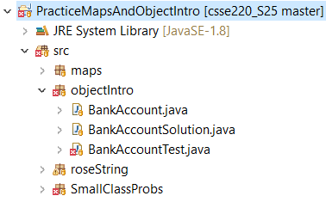


Object Constructors
Open BankAccount.java
Let’s do the first few, then work on your own
Have Eclipse help us
When you’re done and it works, solve the last quiz question

Slide 11
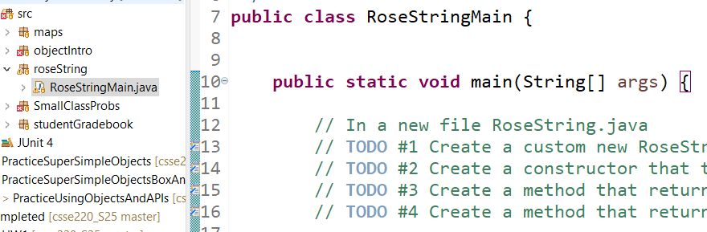
Additional Practice (1)
Create your own “RoseString” class!

Slide 12
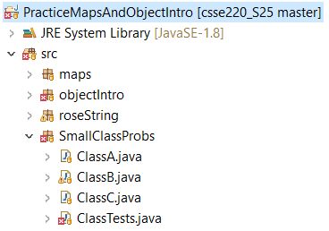

Additional Practice (2)
Work in SmallClassProbs
Finish:
ClassA.java
ClassB.java
ClassC.java
Make these classes work with the tests provided in ClassTests.java

