Slide 1
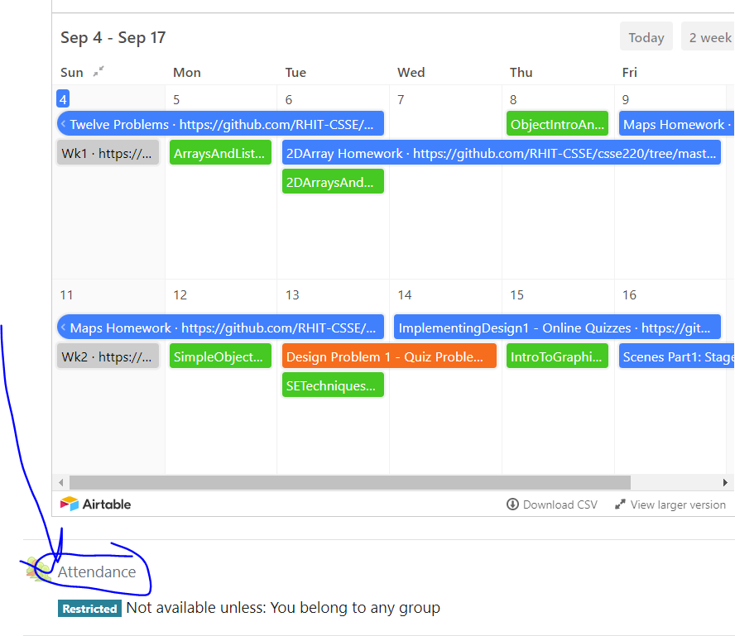
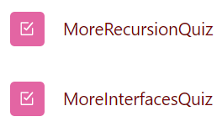
CSSE 220
Today’s Attendance password
moreFun!
More recursion
The git projects for today are:
PracticeBettingInterfaces
PracticeBettingInterfacesSolution
PracticeRecursiveHelperFunctions
PracticeRecursiveHelperFunctionsSolution
Notes:
SPECIAL TA INSTRUCTIONS:
BE SURE TO WALK AROUND while students work on recursion examples and NUDGE in the right direction
INSTRUCTOR:
Be sure to start quiz BEFORE the break
Leave 15+ minutes at the end AFTER showing UML for the refactoring of the code

Slide 2
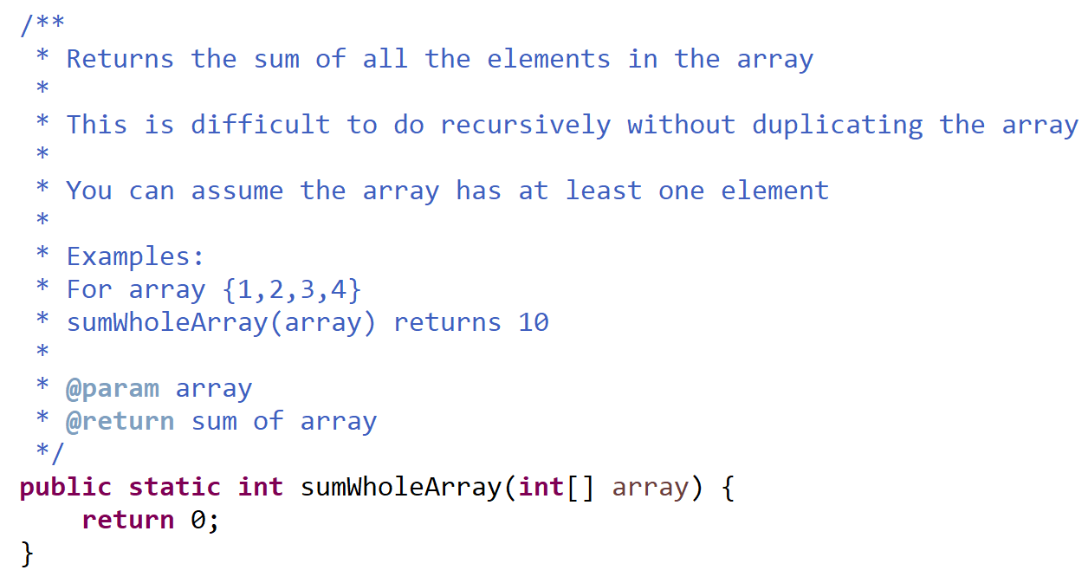
Exercise time
Solve the sumWholeArray function recursively
It’s in the RecursiveHelperFunctions project
Notes:
Let students struggle with this for 1-2 minutes TOPS and then discuss their ideas for solving it.
Its horrible to have to make a new array every time… there must be a better way

Slide 3
Recursive Helper Functions – What, When, Why, How?
What:
A recursive function that is called by another (non-recursive) function
The non-recursive function (the caller) doesn’t do much other than set up the call
When:
Additional parameters are needed
Often the initial function you’re given is not in the ideal form for a recursive solution
Return values need to be updated

Slide 4
Recursive Helper Functions – What, When, Why, How?
Why:
Makes function called by external code cleaner/easier to use
Does not rely on caller to understand how to initialize the information for the helper
Easier to understand by breaking problem down to smaller pieces
How:
Methods named coolFunction & coolFunctionHelper
90% of the code is in coolFunctionHelper

Slide 5
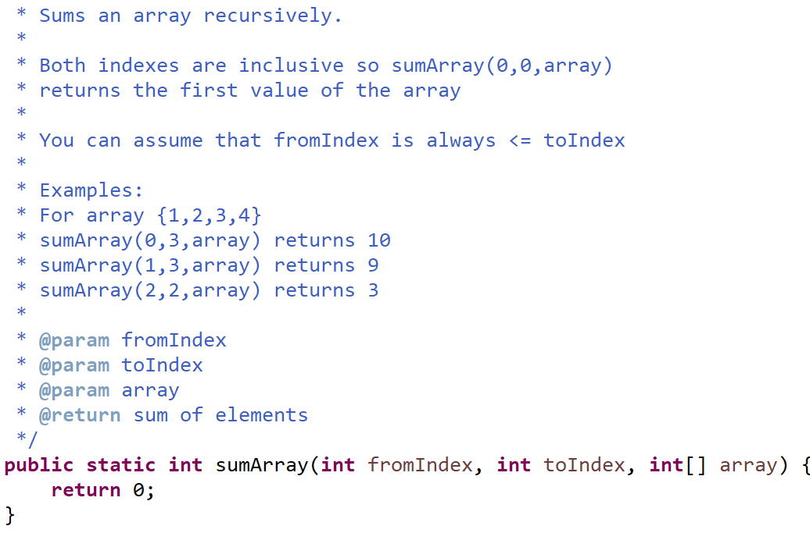
Exercise time
Solve the sumArray function recursively
You can work with a partner, but each of you should get the code working on your own computer

Slide 6
RecursiveHelperFunctions
Solve the remaining problems
all the problems will require you to create a recursive helper function
You can work with a partner but make sure both of you write the code

Slide 7
Frames for Tracing Recursive Code
1. Draw box when method starts
6. Add box for next recursive call frame. Add blank for unknown value
2. Fill in name
5. Check Condition(s)
7. Add blank for unknown value, if needed (may be box from #6)
parameters and local variables
method name (args)
base case condition(s)
return statement
4. List every local variable declared in the method, but no values yet
3. List every parameter and its argument value.
8. Step through the method, update variable values, draw new frame for new calls
Thanks to David Gries for this technique

Slide 8
What if the recursive call isn’t in the return?
Let’s start the quiz problem together, then you can finish it on your own.
Read the problem and the grading guidelines
Draw a template for the recursive operation’s Activation Record
Make first call to the operation

Slide 9
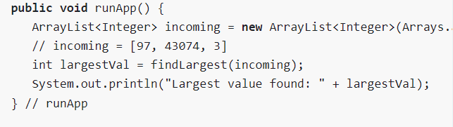
/**
* ensures: largest value in incomingA is returned or Integer.MIN_VALUE if |incomingA| = 0
* @param incomingA is cleared of its values
* decreasing: |incomingA|
* @return the largest value found in incomingA or Integer.MIN_VALUE if |incomingA| = 0
*/
public int findLargest(ArrayList<Integer> incomingA) {
int size = incomingA.size();
if (size == 0) {
// base case #1
return Integer.MIN_VALUE;
} else if (size == 1) {
// base case #2
return incomingA.remove(0);
} else {
// non-base case; Fact: size > 1
int first = incomingA.remove(0);
int lgOfRest = findLargest(incomingA);
if (first > lgOfRest) {
return first;
} else {
return lgOfRest;
} // end if
} // end if
} // findLargest

Slide 10
Recursive Fibonacci Number
Calculate f(4) …where
If n > 2 f(n) = f(n-1) + f(n-2)
Else if n is 1 or 2, then f(n) = 1
f(5) = f(4) + f(3)…
f(6)
f(4)
Repeated calculations!
f(3)
f(2)
f(2)
f(1)
f(5)
f(4)
f(3)
f(2)
f(2)
f(1)
f(3)
f(2)
f(1)

Slide 11
Recursive Fibonacci Number
f(40) ?
f(400) ?
Open up Fibber.java
(memoization package)

Slide 12
Memoization
Save every solution we find to sub-problems
Before recursively computing a solution:
Look it up
If found, use it
Otherwise do the recursive computation
Study the memoization code in the RecursiveHelperFunctions project
Notes:
[Probably should point out that the slide title is not a typo. They’ll read it as “memorization”.]
I draw out a tree of Fibonacci calls on this slide for when it’s implemented as F(n) = F(n-1) + F(n-2), usually for F(5) or something like that. Then I explain that you would create an array/hashmap/something to contain the values you’ve previously found and each time you find one save it, then check for that first. After the explanation, I show how it would reduce the tree by leaving only one calculation of each value left in the tree.

Slide 13
Memoization Improved Performance
fib(40) = 102334155
Calculated 40 Fibonacci numbers in 0.245 seconds.
fib(40) = 102334155
Calculated 40 Fibonacci numbers WITH MEMOIZATION in 0.000 seconds.

Slide 14
More Fun (as time allows)
Video Feedback Loop
Tower of Hanoi
https://www.mathsisfun.com/games/towerofhanoi.html
Notes:
Optional coding exercise for tower of Hanoi

Slide 15
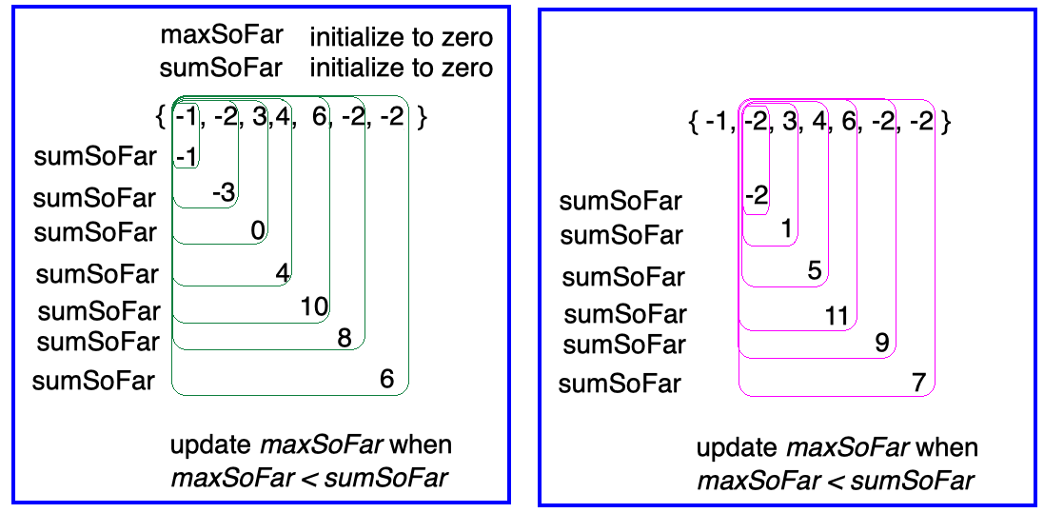
Final HW Problem
Courtesy of Dr. Hollingsworth- the diagram below might help with this problem

