Slide 1
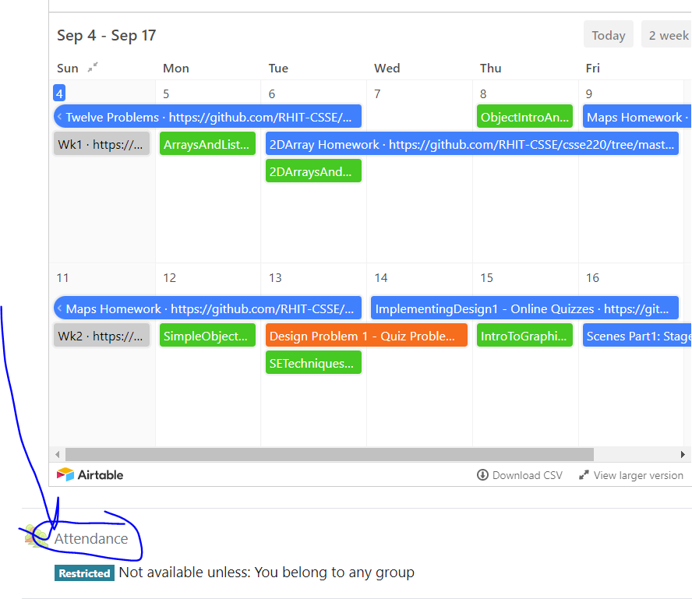
CSSE 220
Today’s Attendance password
simpleClasses
MapsHW & StudentGradebook
The git projects for today are:
PracticeSuperSimpleObjects
PracticeSuperSimpleObjectsSolution
PracticeSuperSimpleObjectsBoxAndPointers
The Quiz for today is
SimpleObjectsQuiz
Notes:
JAY: Introduce FOURTH row today (Identity Pie)
Aim to start quiz with 5+ minutes to spare in the first hour.

Slide 2
Plan for today
Talk about object references and box and pointer diagrams
Talk about static methods
Continue working on writing your own classes
Get started on your new assignment

Slide 3
Finishing up from last time...
Complete the StudentGradebook problem in the SuperSimpleObject project (or the one from last class)
Notes:
Live code the solution with them, you can intentionally leave in a bug by now initializing the HashMap and then use the debugger to trace through and see what happens
3

