Slide 1
Do the in-class activity
Constellation Problem: A particular program is designed to load constellations from datafiles and draw them on the screen. The datafiles include the names of the constellations and details about star location, size, and color as well as which stars ought to be connected to draw the constellation. Depending on the star data, each star should be drawn differently (e.g., right size, right color).
To Do #1 Identify all the primary nouns – those that are eligible to be a Java class
A primary noun is a noun in the problem that has attributes (other nouns)
Nouns that designate actors of the system (i.e., The user can click…) can be excluded
To Do #2 Write down the other nouns (attributes) associated with the primary nouns
To Do #3 Identify all the verbs
To Do #4 Identify which primary nouns are worked on by the verbs
To Do #5 Design a system using UML to handle this problem
If you do this all well, then you should hopefully be able to make classes where:
Each primary noun becomes a Class
Each attribute (other noun) becomes a field for its respective class
Each verb becomes the method for the respective class
Notes:
20-25

Slide 2
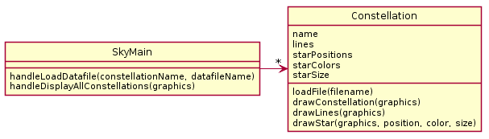
Explain the problem with the given solution.
Then start to propose a UML solution of your own.

Slide 3
3a. Constellation does everything (except maybe the parsing done by main).
Finish your own solution!

Slide 4
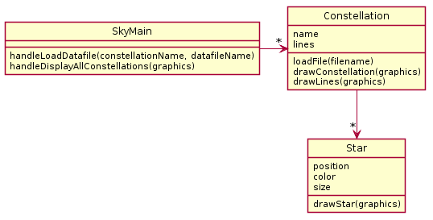
Do the in-class activity
Constellation Problem: A particular program is designed to load constellations from datafiles and draw them on the screen. The datafiles include the names of the constellations and details about star location, size, and color as well as which stars ought to be connected to draw the constellation. Depending on the star data, each star should be drawn differently (e.g., right size, right color).
If you do this all well, then you should naturally be able to make classes where:
Each primary noun becomes a Class
Each attribute (other noun) becomes a field for its respective class
Each verb becomes the method for the respective class

Slide 5
Do the in-class activity
Constellation Problem: A particular program is designed to load constellations from datafiles and draw them on the screen. The datafiles include the names of the constellations and details about star location, size, and color as well as which stars ought to be connected to draw the constellation. Depending on the star data, each star should be drawn differently (e.g., right size, right color).
If you do this all well, then you should naturally be able to make classes where:
Each primary noun becomes a Class
Each attribute (other noun) becomes a field for its respective class
Each verb becomes the method for the respective class

Slide 6
Do the in-class activity
Constellation Problem: A particular program is designed to load constellations from datafiles and draw them on the screen. The datafiles include the names of the constellations and details about star location, size, and color as well as which stars ought to be connected to draw the constellation. Depending on the star data, each star should be drawn differently (e.g., right size, right color).
If you do this all well, then you should naturally be able to make classes where:
Each primary noun becomes a Class
Each attribute (other noun) becomes a field for its respective class
Each verb becomes the method for the respective class

Slide 7
A possible solution
Often, you need to find and extract a new class when things get complex.
Here, Star class was extracted from original Constellation class

