Slide 1
Do the in-class activity
Pizza Restaurant Problem: A pizza restaurant needs to calculate the cost of orders and record what pizzas need to be made. An order consists of a number of pizzas each of which might have toppings as well as a customer’s name and an order date. Each pizza costs $8 with no toppings. The first 2 toppings cost $2 apiece. Additional toppings beyond that cost $1. If a pizza has just peppers, onions, and sausage - that's "The special" and it costs $12.
To Do #1 Identify all the primary nouns – those that are eligible to be a Java class
A primary noun is a noun in the problem that has attributes (other nouns)
Nouns that designate actors of the system (i.e., The user can click…) can be excluded
To Do #2 Write down the other nouns (attributes) associated with the primary nouns
To Do #3 Identify all the verbs
To Do #4 Identify which primary nouns are worked on by the verbs
To Do #5 Design a system using UML to handle this problem
If you do this all well, then you should hopefully be able to make classes where:
Each primary noun becomes a Class
Each attribute (other noun) becomes a field for its respective class
Each verb becomes the method for the respective class
Notes:
38-48

Slide 2
UML
What classes did you have?
Based on the primary nouns in the story problem
And their fields? Based on other nouns
What methods go in PizzaMain class?
Based on the verbs in the story problem
Where did you put the method getCostOfPizza()?
Notes:
Hopefully students answer:
Pizza and Order
Hopefully most say Pizza, ask why they chose that and if anyone chose order why they chose that

Slide 3
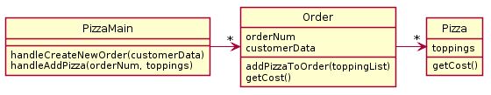
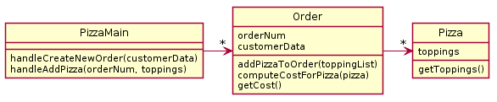
Solution A
Solution B
Which is better? Discuss with someone nearby!
Notes:
Discuss after returning from break

Slide 4
Solution A
Solution B
Conceptually, calculating costs could belong in either Order or Pizza
But Order (in Solution B) is doing a lot of stuff, and Pizza is just a dumb data holder. ("dumb" means few methods, in this case just a getter; think “inert”)
So, by moving the computeCostForPizza functionality from Order to the Pizza, we improve the design and get Solution A
This moving from the hasA class to the has'ed class is sometimes call pushing functionality down
Notes:
Solution A is better!

Slide 5
Alternate Pizza Restaurant Read Carefully!
Consider now the ability to add a discount to an order, such that a coupon can be added to an order and then it changes how the cost is calculated. A coupon may offer a discount percentage for toppings (50% off all toppings) and/or a percentage off of entire orders. In addition, there should be a way to calculate how long it takes to create a pizza based on its size and toppings.
Design a UML diagram to model this.
PAUSE HERE for 5-10 minutes!
Try to make your own improved design
Using plantuml is good practice!

Slide 6
UML
What classes did you have?
Where did you put “getCost()”?
Notes:
Hopefully students answer:
Pizza and Order
Hopefully most say Pizza, ask why they chose that and if anyone chose order why they chose that

Slide 7
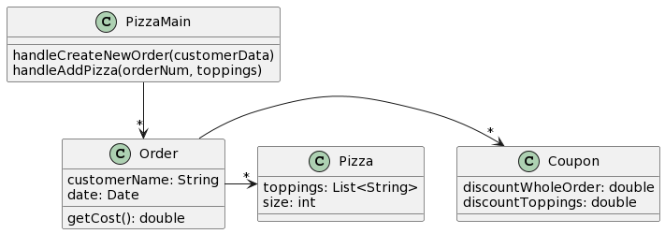
One Solution
3. Functionality should be distributed efficiently
No single part of the system should get too large
Each class should have a single responsibility it accomplishes
Notes:
Mention here that we are listing all the types explicitly, but that is not usually required
https://www.plantuml.com/plantuml/uml/JP31IiGm48RlynHXJwtO5oXILkfHgw3WUMo6tK2QASc4XOhlxXZRxLu2cVpVzuSv9i4eUV8mUap9lBbbmHTqmNp36OFrr4T2eO4khz5IhCQSX2UAJoXOhv57QmjNyLzaoDEz4Pvd5qwfXXzOrOLNxMOOSABMl4lK75WKlQYKu4JISvAgRetb_ELfLvGMLMpsrZox90__ZWwIMrJYWkn4ptdce8XrQUGSvFFCdifNDltrwUDgtNltVJIMBw7fpE7kO0eFvMmw7QmrjvC20XmfMDtkBm00

Slide 8
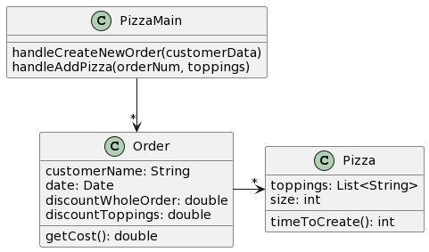
Do we need Coupon or Topping?
It depends, do the classes do anything with their data, or are the just data classes that simply all you to get and set values?
Notes:
https://www.plantuml.com/plantuml/uml/HL3DQiCm3BxhAKnFoLXUe8pGqHwtRB32pbeiMaDi5qkcaD5tdnQxgGy2V_f--BHZmIJPJp1Eo6m-tJpZExfWVk6CmKwqJuH20rq_agNKZ9abUae756mhvTNQHTV4VygG_REHUBcuSE8MRb2j5xtQtXq6zBGrNvAK1nP5FmUTO1sFCGVvFiU95j7Ms9X_fiVgMDtNnOba7rcQTaLgR6saiR9gtXpBIydjWTsimIu8YFDqZALkqnRi1leUD-bil8QkDvkdJQa3o-nw1KeGx2XOFUSV If we are planning to expand the coupon class later, then it may make sense to create a class for it to be prepared to re-use and modify the code.

Slide 9
Rule of Thumb - Avoid Data Classes!
Data class: just getters and setters
Violates a principle of OOD: encapsulation, because they aren’t in control of their own data – they are just inert repositories for other classes to use (“inert" means few methods, e.g., just getters/setters)
Usually, you can improve a data class by finding functionality to add to them, then creating a method that implements that functionality

