Slide 1

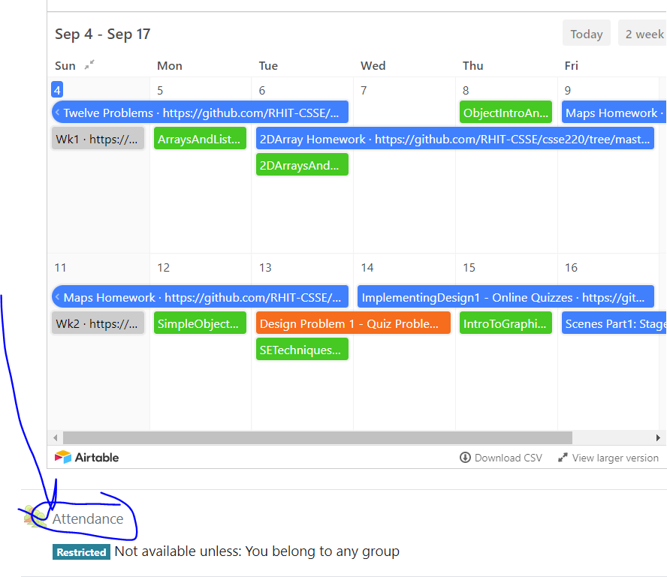
CSSE 220
Today’s Attendance password
____________
Recursion
The git projects for today are:
PracticeRecursionInClass
PracticeSolutionRecursionInClass
The Quiz for today is:
RecursionIntroductionQuiz
Notes:
Bring hardcopy of code from RecursionInClassPracticeSolution:
Sentence.java
Triangle.java
FactorialCalculator.java
It would be helpful to add line numbers to your printout for Triangle.java and FactorialCalculator.java

Slide 2
Announcements
The next few class days:
A new way to think: Recursion
A new way to break up and re-use code: Interfaces
Making interactive apps requires this

Slide 3
Recursion
A solution technique where the same computation occurs repeatedly as the problem is solved
Examples:
Sierpinski Triangle: https://en.wikipedia.org/wiki/Sierpinski_triangle
Towers of Hanoi: http://www.mathsisfun.com/games/towerofhanoi.html or search for Towers of Hanoi
recurs
Notes:
I used this slide instead of the Shapes one.
https://www.cs.cmu.edu/~cburch/survey/recurse/hanoiex.html – nice recursive simulation and pseudocode.

Slide 4
An example – Triangle Numbers
If each red block has area 1, what is the area A(n) of the Triangle whose width is n?
Answer:
A(n) = n + A(n-1)
The above holds for which n ? What is the answer for other n ?
Answer: The recursive equation holds for n >= 1. For n = 0, the area is 0.
Triangle with width 1
Triangle with width 2
Triangle with width 3
Triangle with width 4

Slide 5
Key Rules to Using Recursion
Always have a base case that doesn’t recurse, where the answer is so simple the operation can just return the answer with no computation required
Make sure recursive case always makes progress, by solving a smaller problem
You gotta believe that the base case will be reached
Trust in the recursive solution
Just consider one step at a time

Slide 6

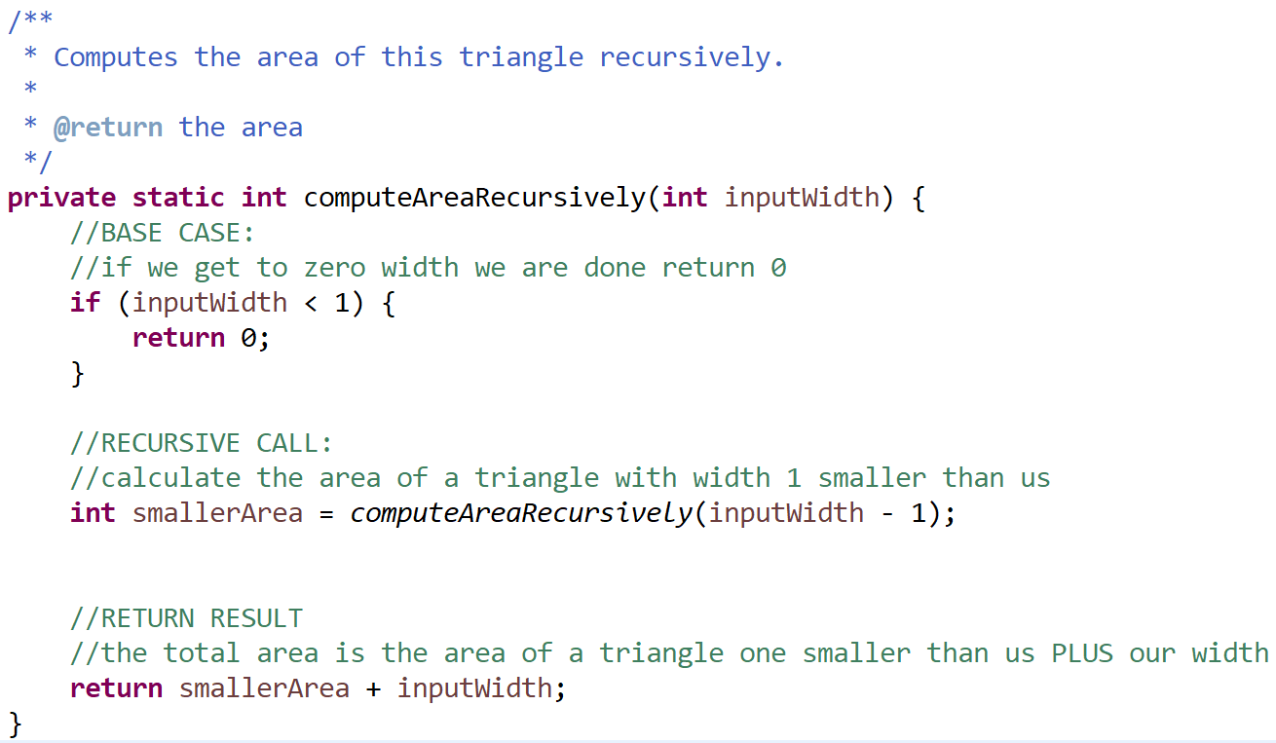
Open Eclipse

Slide 7
Frames for Tracing Recursive Code
1. Draw box when method starts
6. Add box for next recursive call frame. Add blank for unknown value
2. Fill in name
5. Check Condition(s)
7. Add blank for unknown value, if needed (may be box from #6)
parameters and local variables
method name (args)
base case condition(s)
return statement
4. List every local variable declared in the method, but no values yet
3. List every parameter and its argument value.
8. Step through the method, update variable values, draw new frame for new calls
Thanks to David Gries for this technique
Q1-Q2
Notes:
Have them look at Triangle in Eclipse (in examples package) while you project this and draw on board.
*Buffalo says* I personally had a lot of trouble with scope boxes so I just left it out.
When looking at the code, discuss “base case”, “recursive case”, and “trusting the recursion”.
Trace the Triangle Numbers example from text on board and quiz, be sure to show "return" arrows from callee to caller, labeled with return value.
Set them lose on tracing recursive factorial on quiz, comparing answers.
Show one or more of these examples in the debugger. (factorial?)

Slide 8
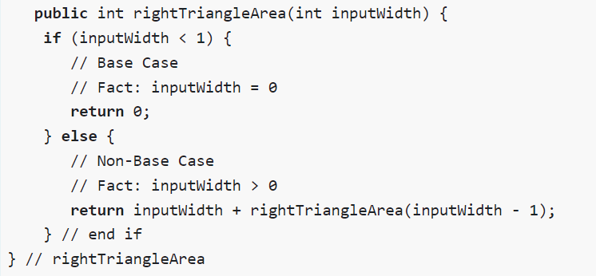
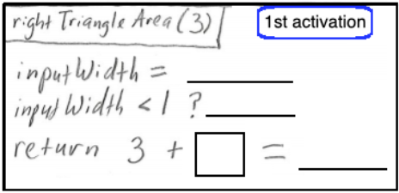
Open Today’s Quiz

Slide 9

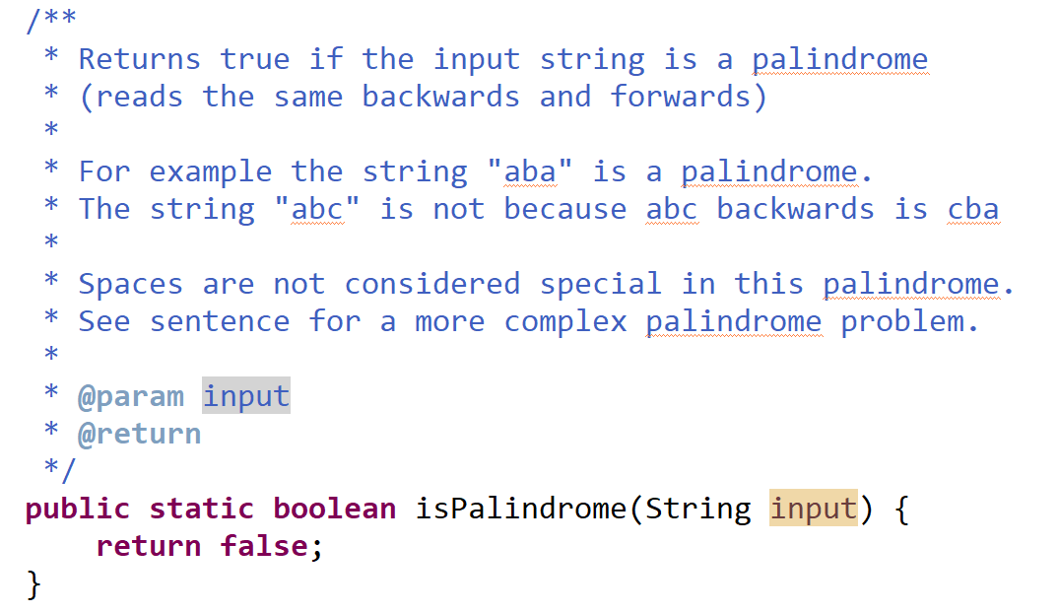
Programming Problem
Notes:
Live code the solution.
*Buffalo says* I prefer simple palindrome
- What are the simplest cases? These are the base cases.
If we aren’t in a simplest case, how can we make progress to a smaller problem?

Slide 10
Programming Problem
Add a recursive method called isPalindrome to Sentence for computing whether Sentence is a palindrome
{
Sentence s1 =
new Sentence("A nut for a jar of tuna");
System.out.print(s1.isPalindrome());
}
Sentence
String text
String toString()
boolean isPalindrome()
Notes:
Live code the solution.
*Buffalo says* I prefer simple palindrome
- What are the simplest cases? These are the base cases.
If we aren’t in a simplest case, how can we make progress to a smaller problem?

Slide 11
Practice Practice Practice
Head to http://codingbat.com/java/Recursion-1 and solve 5 problems. I personally like bunnyEars, bunnyEars2, count7, fibonacci, and noX
Get help from me if you get stuck
Then take a look at the recursion homework
Notes:
bunnyEars:
public int bunnyEars(int bunnies) {
if (bunnies == 0) {
return 0;
}
return 2 + bunnyEars(bunnies-1);
}
bunnyEars2:
public int bunnyEars2(int bunnies) {
if (bunnies==0) {
return 0;
}
if (bunnies%2==0){
return 3 + bunnyEars2(bunnies-1);
}
return 2 + bunnyEars2(bunnies-1);
}
Count7
public int count7(int n) {
if (n==0) {
return 0;
}
if (n%10 == 7) {
return 1 + count7(n/10);
}
return count7(n/10);
}
Fibonacci
public int fibonacci(int n) {
if (n==0) {
return 0;
}
if (n==1 || n==2) {
return 1;
}
return fibonacci(n-1) + fibonacci(n-2);
}
noX
public String noX(String str) {
if (str.length() == 0) {
return "";
}
char c = str.charAt(0);
if (c=='x') {
return noX(str.substring(1));
}
return c + noX(str.substring(1));
}

Slide 12
Solutions
LOOKING AT THESE BEFORE ATTEMPTING THEM WILL NOT BE LIKELY TO HELP YOU
It is OK to look if you have completed them
It is OK to look at only one if you have spent a significant time (10+ minutes) and feel stuck

Slide 13
bunnyEars
public int bunnyEars(int bunnies) {
if (bunnies == 0) {
return 0;
}
return 2 + bunnyEars(bunnies-1);
}

Slide 14
bunnyEars2
public int bunnyEars2(int bunnies) {
if (bunnies==0) {
return 0;
}
if (bunnies%2==0){
return 3 + bunnyEars2(bunnies-1);
}
return 2 + bunnyEars2(bunnies-1);
}

Slide 15
Count 7
public int count7(int n) {
if (n==0) {
return 0;
}
if (n%10 == 7) {
return 1 + count7(n/10);
}
return count7(n/10);
}

Slide 16
Fibonacci
public int fibonacci(int n) {
if (n==0) {
return 0;
}
if (n==1 || n==2) {
return 1;
}
return fibonacci(n-1) + fibonacci(n-2);
}

Slide 17
noX
public String noX(String str) {
if (str.length() == 0) {
return "";
}
char c = str.charAt(0);
if (c=='x') {
return noX(str.substring(1));
}
return c + noX(str.substring(1));
}

Slide 18
Fun Idea if Time Allows
Get in pairs with someone else who completed five problems
Pick one problem other than these listed and solve it
Write a JUnit test to thoroughly test it
We can build a collection of practice problems complete with tests!

Slide 19
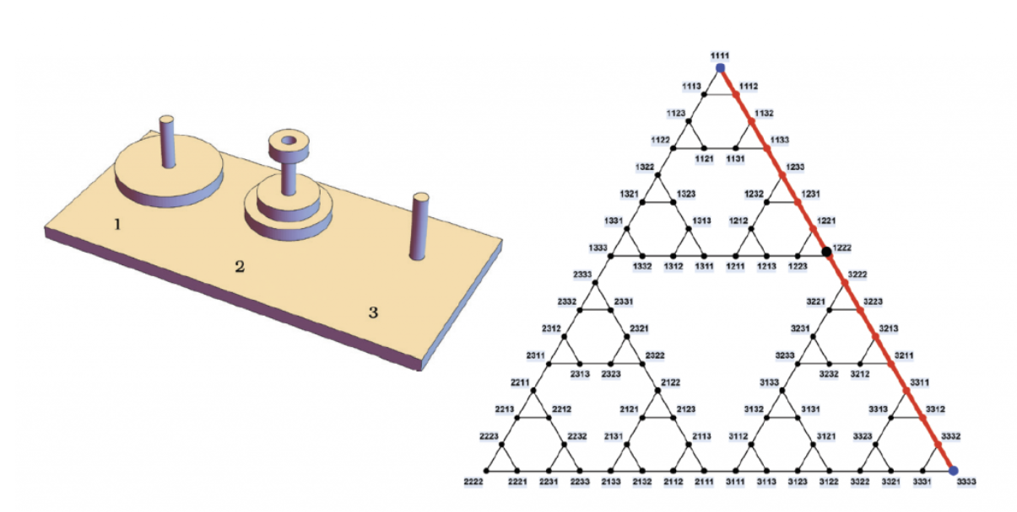
Fun Overlap
https://futurumcareers.com/solving-the-tower-of-hanoi

