Slide 1
Prompt Engineering
Notes:
https://www.promptingguide.ai/

Slide 2
Takeaways from Last Time
“I am sure in some cases these models are better or worse than each other”
“But in all cases they share similar characteristics:
OK at doing grunt work when given explicit instructions about what to do
Very reliant on particulars of prompting, files in context, etc.
Extremely overconfident and unreliable”
For prompt engineering, let’s dive into 1 & 2
Notes:
First – each model will behave slightly differently. Not much we can do there.

Slide 3
Grunt Work
“OK at doing grunt work when given explicit instructions about what to do”
What is Grunt Work?
Creating a new API endpoint
Writing a new HTML Form
Anything fairly standard and repetitive

Slide 4
Why is it good at Grunt Work?
LOTS of examples
Training data has tons of information on the easy stuff
StackOverflow (notice it now has a Captcha at times?)
Blog Tutorials
Microsoft Documentation
etc…

Slide 5
Is the Grunt Work consistently correct?
No… not at all….
Let’s look at an example

Slide 6
Scenario…
Web API for making a date prediction from an ML Model
ID is provided to the API → API looks up more data from DB
Information and predictions must be FAST (e-commerce)
Solution? Caching
Problem? Microsoft’s Caching stuff has changed since I last used it!
I’ll ask the AI!

Slide 7
Starter Prompt
Let’s start with something easy:
“Can you use Microsoft’s built in caching to cache records from the
database?”
This is “Zero-Shot Prompting”
Did this work?
Sort of…

Slide 8

Code Review
Upon Code Inspection:
Microsoft’s Caching
Generated unique cache keys
Hmm… what are all these locks?

Slide 9
A brief aside on caching and locks…
Caching
In memory storage
Cache for speed
Old things age out
Locks
Prevents concurrency
Makes processes wait
Locks + Caching = Speed Issues

Slide 10
So, what happened?
AI assumed I needed more than I did by adding:
Key management outside the cache
Clearing functionality
The locking was added around the clearing

Slide 11
Then what happened?
Me: Are you sure we need the locks?
AI: We definitely need the locks!
Me: That seems weird… Microsoft docs don’t have them
AI: Tutorial gap! YOU NEED LOCKS!
Notes:
Tell a short version of the story about going back and forth with the AI about removing locking.

Slide 12
Then what happened?
Me: What about this paragraph from the caching documentation?
Do not block asynchronous execution by calling Task.Wait or Task<TResult>.Result. Do not acquire locks in common code paths. ASP.NET Core apps perform best when architected to run code in parallel. Do not call Task.Run and immediately await it. ASP.NET Core already runs app code on normal Thread Pool threads, so calling Task.Run only results in extra unnecessary Thread Pool scheduling. Even if the scheduled code would block a thread, Task.Run does not prevent that.
AI: You’re absolutely right! Let me remove those…

Slide 13
Conversational Prompting
Probably what you use most when writing code
Can take a LONG time
Sometimes you get stuck going in circles
Doesn’t work for putting code into a programmatic tool
https://promptengineering.org/conversational-prompting-in-generative-ai/

Slide 14
What should I have done?
Be more specific!
Something like this:
“Can you implement a Microsoft ASP.NET Core IMemoryCache service to do the following:
Store database lookups for X table
Cached items should age out after one hour
Do NOT implement any other features”
How do we know how to do this? Prompt Engineering!
Notes:
The last one doesn’t match the instructions I’ve seen given, but I found I often needed to tell it to not do something, though it didn’t always listen.

Slide 15
So, What is Prompt Engineering?
“…new discipline for developing and optimizing prompts to efficiently use language models (LMs) for a wide variety of applications and research topics. Prompt engineering skills help to better understand the capabilities and limitations of large language models (LLMs).”
- https://www.promptingguide.ai/
Essentially: Design for prompts to get the best results

Slide 16
Parts of Prompt Engineering
Prompting Techniques
Like Zero-Shot, Few-Shot, Conversational, Chain-of-Thought, Prompt Chaining…
No single list… way too new!
Tasks
Classification
Code Generation
Evaluation
…and more!
Notes:
Techniques can be applied to various types of tasks. Which technique and which task are the most helpful for your task will depend on the task and trial and error, and likely the model, at least for now until the industry settles (and maybe always, we constantly have new ways to do JavaScript).

Slide 17
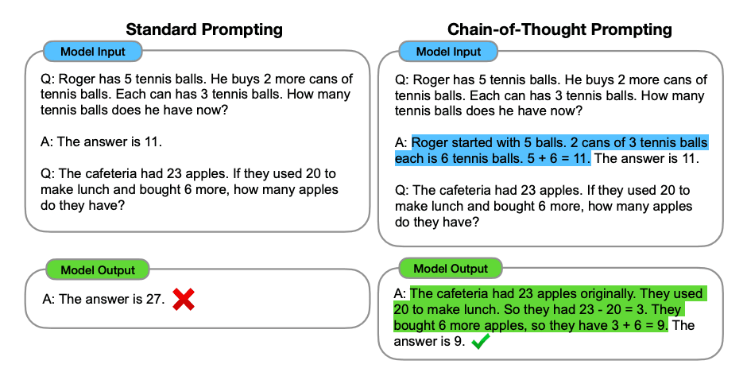
Learning about Prompt Techniques
Chain-of-Thought (CoT) Prompting [https://www.promptingguide.ai/techniques/cot]
Notes:
Point out how it shows the standard version, then it shows the difference with Chain-of-Thought prompting, where the reasoning is provided.
Not going to go into all the types of prompting techniques, as they’re going to change a lot of the next few years, better to get used to researching and reasoning through them.

Slide 18
Prompt Guidelines
Start simple and iterate
State what you want
“Write”, “Translate”, “Classify”, “Summarize”, etc.
Will take experimentation
Specificity!
https://www.promptingguide.ai/introduction/tips

Slide 19
Specificity
Avoid phrases like “not too descriptive”
Instead: “2-3 sentences”
Prompt Length vs. Specificity
Information at the beginning and end of prompts/documents is overemphasized
Context window is surprisingly small for large tasks
How do we know what to specify?
Notes:
https://www.promptingguide.ai/introduction/tips
https://news.mit.edu/2025/unpacking-large-language-model-bias-0617

Slide 20
CSSE371 to the Rescue!
CSSE371 is essentially:
Figure out what needs to be written
Learn how to write it out for someone else to implement
The AI can’t do the first part
Knowing how to do that helps protect your job

Slide 21
Assignments For Week 3 & 4
No class Week 4!
Go to / Prep For the Career Fair instead.
Combined Week 3 and 4 Assignments into 1
Assignment is prep for the Career Fair
Due Wednesday of Week 4

Slide 22
Resources
https://promptengineering.org/conversational-prompting-in-generative-ai/
https://www.promptingguide.ai/

