Slide 1
Maintenance
Course Wrap-Up
Attendance Key: bhilxp
Notes:
https://www.promptingguide.ai/

Slide 2
Attendance Code
bhilxp

Slide 3
What happens to my model over time?
Software doesn’t have a hard “done”… basically ever
Yes, you may stop writing code, but:
  Hardware changes over time
  Software you integrate with changes
  Laws change
  Customers ask for new things
And now… a new LLM model is released every other week! (ish)
  Can you keep using your old model? Maybe, ask Sam Altman, he decides!
Notes:
Point out the issues with GPT5’s release and how they said they were going to limit access to the old ones. And everyone was out of luck until there was a big enough backlash against the company, but there’s no guarantee that happens.

Slide 4
How do we deal with this?
Plan ahead!
Project plans (and risks) must include LLM model change
What does this mean?
  Potentially adjusting parameters (like reasoning) for new models
  Prompt tuning when switching models
More info: https://www.vellum.ai/blog/gpt-5-prompting-guide

Slide 5
That sounds like a lot of work…
Not that different from most software
  Operating system changes
  Security Patch Deployments
  Etc.
Key thing about Software Engineering and Software:
  They’re always changing, so there’s always a new challenge!

Slide 6
Aside: Ok, but my ML model is safe, right?
Nope!
Some ML models may be more stable than others:
  Image recognition models
    What LEGO is this?
    Is that a dog?
Some ML models may need frequent retraining
  PPE sales in 2019 vs 2020, 2021, etc.
  Outside factors will affect the data, even if the features used to train don’t change

Slide 7
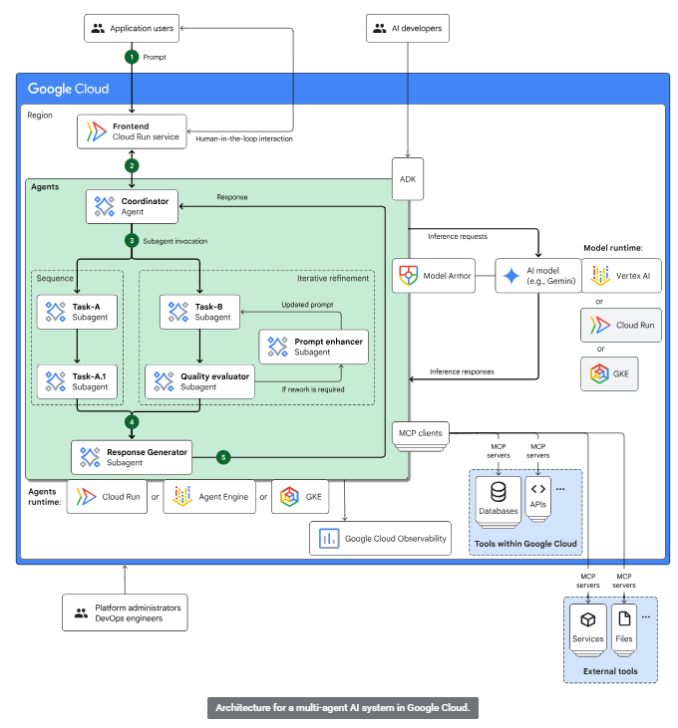
What’s next in AI?
Who knows really?
Companies are pushing multi-agent systems, such as:
  https://cloud.google.com/architecture/multiagent-ai-system
Diagram isn’t that unfamiliar
  Think multi-processing

Slide 8
Course Takeaways
What are the big things you learned this term?
Notes:
Ask students to brainstorm

Slide 9
Week 1 – The Basics
What are LLMs, and what are their strengths?
  Guessing plausible completions based on context
  Good at adapting to input from local situation
Tools Include:
  Autocompletion
    Good for repetition, also good at generating absolute nonsense
  Localized Edit
    Edit only where cursor is, good for language syntax lookups
  Interactive Agent Mode
    Go-to tool for most coding activities, but you need to write LOTS of instructions
    Give it context!
    Always review any changes it makes!

Slide 10
Week 2 – Understanding Models?
Predictive Text Generation
Rely on huge amount of input data and compute
  Data is running out
Pay attention to various models and their cost / features
  Reasoning vs. not
  Tokens = cost (tokens ~= words)
Models are good at grunt work, often overconfident and unreliable

Slide 11
Week 3 and 4 – Prompt Engineering
Prompt Engineer is essentially 371
Need to know what you want and BE SPECIFIC
There are lots of prompt types out there
  They’re changing all the time
  Read about them when you’re having difficulty
  Consider your chosen model and what may work best with it

Slide 12
Week 5 – Agent Mode
Don’t give agents lots of power
  Unless you don’t like your database
Agents mostly shovel command-line to/from LLM
  Ask my Visual Studio how well this works…
Best practices for writing code and testing?
  Write the first unit test yourself
  Be specific in your testing goals
  Give Agent a Code Coverage tool, strip out excess code

Slide 13
Week 6 – Programmatic AI
Like any other Web API Usage
  Include an API key in your system
  Make a request to their web server (usually there’s a library to help)
Each request is “fresh”
Prompts may not translate to other models
May need some additional response parsing

Slide 14
Week 7 –

Slide 15
Week 8 – LLMs as Business Tools
We can do a LOT of things we couldn’t before
  Summarization
  Data Extraction
  Parsing/formatting of plain text
For cost, reliability, and maintenance:
  Do only what you need in the LLM
  Get back to normal code ASAP

Slide 16
Week 9 – MCP Servers
Model Context Protocol
LLM friendly way for an LLM to:
  Learn about tools
  Deterministically alter the outside world
  … in a controlled manner
Helps to modify prompts to note existence of available MCP Servers
Follow REST conventions, No Side Effects, Agent Context holds State

Slide 17
Why all this review?
Course Evals!
Let’s talk about Evals for Minute!

Slide 18
Course Evaluations
Evaluations are
  Important
  Serious
  Constructive

Slide 19
How are these used?
Students fill out course/instructor evaluation (10th week)
Evaluations made available to Faculty (12th week)
Course instructor writes a course assessment report
  Recommendations for next year
Department approves course assessment report
Recommendations implemented next year

Slide 20
How are these used?
Students fill out course/instructor evaluation (10th week)
Evaluations made available to Faculty (12th week)
Faculty respond to evaluations (within 2 weeks)
Student Evaluations/Faculty response made available to Dean and Department Head
Dean and Department Head respond to student evaluations

Slide 21
What is an Evaluation?
Example:
  “___________” sucks/ is stupid/clueless (bad example)
  The instructor wasn’t effective because ….. ( better example)
  The instructor can do a) b) etc to become a better instructor (ideal)

Slide 22
What is an Evaluation?
Evaluations include
  Things that you liked about the class
  Things that you liked about the lecture
  Things that you liked about the instructor
  Things that you liked about the work done in class
  Things that you liked about the work done outside the classroom
  Things that you liked about interactions with the instructor

Slide 23
What is an Evaluation?
Evaluations include
  Things that you would like to see change about the class
  Things that you would like to see change about the lecture
  Things that you would like to see change about the instructor
  Things that you would like to see change about the work done in class
  Things that you would like to see change about the work done outside the classroom

Slide 24
Homework
Course Evals!
That’s all!

