Slide 1
Exam 1 Grades
A little lower than they have been in previous years
If I see an improvement in later exams I may well de-weight Exam 1…but note that the other exams are considered harder
If you do decide to drop, let me know sooner and I’ll figure out something for your interpreter partner

Slide 2
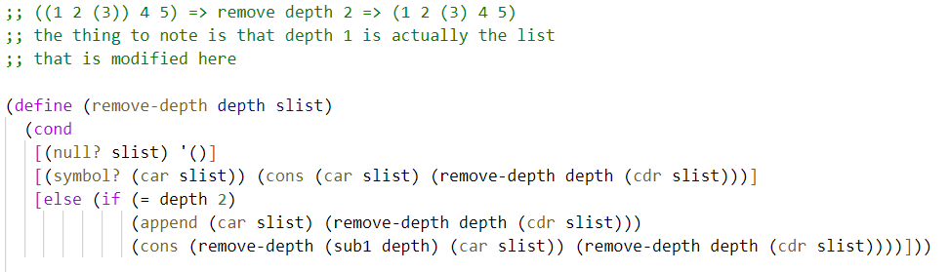

Slide 3
CSSE 304 Day 19
Environment ADT
Environment Representations
Begin the Interpreter Project Intro

Slide 4
environment ADT
We now know how environments are supposed to behave.
Next question: How can we implement them?
We may have time to do some of this today

Slide 5
Summary of EoPL Section 2.2 (details on the following slides)
Principle from Section 2.1
Environment ADT
Environment Interface
Representation/Implementation Approaches

Slide 6
Principle from Section 2.1
Data abstraction leads to representation independence
Notes:
Recall what we did with non-negative integers. We first defined the interface and understood how it worked. Then we looked at various implementations. That is what we will do today with environments.

Slide 7
Environment ADT
An environment maps a finite set of symbols to a set of associated (Scheme) values
Thus, an environment is a finite function
Logically, an environment has the form { (s₁, v₁), (s₂, v₂), … (s_{n}, v_{n}) } , where the s_{i} are all distinct.
But we need some more details in order to get the “lexical scoping” effect.

Slide 8
Environment interface
If f is an environment, and s, s₁, …, s_{k} are all symbols, then
(empty-env) ➔ ⎡∅⎤ (representation of the empty set)
(apply-env ⎡f⎤ s) ➔ f(s) (get the value associated with s in the environment f)
(extend-env '(s₁ … s_{k}) (all symbols s_{i} must be distinct,
'(v₁ … v_{k}) the v_{i} may be any Scheme values)
⎡f⎤ ) ➔ ⎡g⎤ where g(s) is
v_{i} if s=s_{i} for some i, 1 ≤ i ≤ k
f(s) otherwise
Recall that ⎡x⎤ means "the representation of the abstract object x"
empty-env and extend-env are constructors; apply-env is an observer (getter)

Slide 9
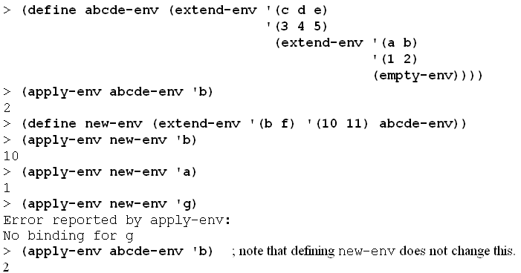
Examples
If f is an environment, and s, s₁, …, s_{k} are all symbols, then
(empty-env) ➔ ⎡∅⎤ (representation of the empty set)
(apply-env ⎡f⎤ s) ➔ f(s) (get the value associated with s in the environment f)
(extend-env '(s₁ … s_{k}) (all symbols s_{i} must be distinct,
'(v₁ … v_{k}) the v_{i} may be any Scheme values)
⎡f⎤ ) ➔ ⎡g⎤ where g(s) is
v_{i} if s=s_{i} for some i, 1 ≤ i ≤ k
f(s) otherwise
Draw the abstract “E&C” diagrams to show what the above code is doing.

Slide 10
Auxiliary procedure
; returns position of sym in los (or #f)
(define list-find-position
(lambda (sym los)
(let loop ([los los] [pos 0])
(cond [(null? los) #f]
[(eq? sym (car los)) pos]
[else (loop (cdr los)
(add1 pos))]))))

Slide 11
Representation 1
We first do an easy implementation, then aim for a more efficient one
Take advantage of Scheme's first-class procedures
Represent an environment by a procedure
Each environment procedure takes a symbol as an argument
This is straightforward
Just translate the formal definitions into code
We will do this same process later for other ADTs

Slide 12
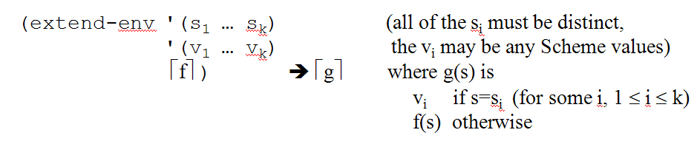
(define empty-env
(lambda ()
(lambda (sym)
(eopl:error 'apply-env
"No binding for ~s"
sym))))
(define apply-env
(lambda (env sym) (env sym)))
(define extend-env
(lambda (syms vals env)
(lambda (sym)
(let ([pos (list-find-position sym syms)])
(if (number? pos)
(list-ref vals pos)
(apply-env env sym))))))

Slide 13
Representation 2
Use data structures to represent environments.
in particular, variant records created using define-datatype
Note that the actual code for looking up symbols is the same as before, but now it is in apply-env.

Slide 14
Define the environment datatype
(define-datatype environment environment?
[empty-env-record]
[extended-env-record
(syms (list-of symbol?))
(vals (list-of scheme-value?))
(env environment?)])
How should scheme-value? be defined?
(define scheme-value?

Slide 15
Define the environment datatype
(define-datatype environment environment?
[empty-env-record]
[extended-env-record
(syms (list-of symbol?))
(vals (list-of scheme-value?))
(env environment?)])
How should scheme-value? be defined?
(define scheme-value?
(lambda (v) #t))

Slide 16
Implementation 2 - the two constructors
(define empty-env
(lambda ()
(empty-env-record)))
(define extend-env
(lambda (syms vals env)
(extended-env-record syms
vals
env)))

Slide 17
Implementation 2: The observer (accessor) procedure
(define apply-env
(lambda (env sym)
(cases environment env
[empty-env-record ()
(errorf 'apply-env
"No binding for ~s" sym)]
[extended-env-record (syms vals env)
(let ([pos (list-find-position sym
syms)])
(if (number? pos)
(list-ref vals pos)
(apply-env env sym)))])))
Comparisons of the two representations?

Slide 18
Representation 3 Represent environment as a list of lists
<env-rep> ::= () ::= ((({<symbol>}*) ({<value>}*)) . <env-rep>)
Three examples:
(((a b) (3 4)) ((c) (2)))
(((a b) (3 4)) ((c a x) (2 3 #f)))
()
(define empty-env
(lambda ()
'()))
(define extend-env
(lambda (syms vals env)
(cons (list syms vals) env)))
(define apply-env
(lambda (env sym)
(if (null? env)
(eopl:error 'apply-env "No binding for ~s" sym)
(let ((syms (car (car env)))
(vals (cadr (car env)))
(env (cdr env)))
(let ((pos (rib-find-position sym syms)))
(if (number? pos)
(list-ref vals pos)
(apply-env env sym)))))))
(define rib-find-position list-find-position)
*Code that is green will change in Representation 4 (a slight variation of Representation 3)
Sometimes called a "ribcage" structure

Slide 19
Representation 4 adds two improvements
Make each rib a single pair instead of a list
saves space and lookup time
Replace the list of values in each rib by a vector of values
So we can replace linear-time list-ref by constant-time vector-ref
Rep 3 (((a b) (3 4)) ((c a x) (2 3 #f)))
Rep 4 (((a b). #(3 4)) ((c a x). #(2 3 #f)))

Slide 20
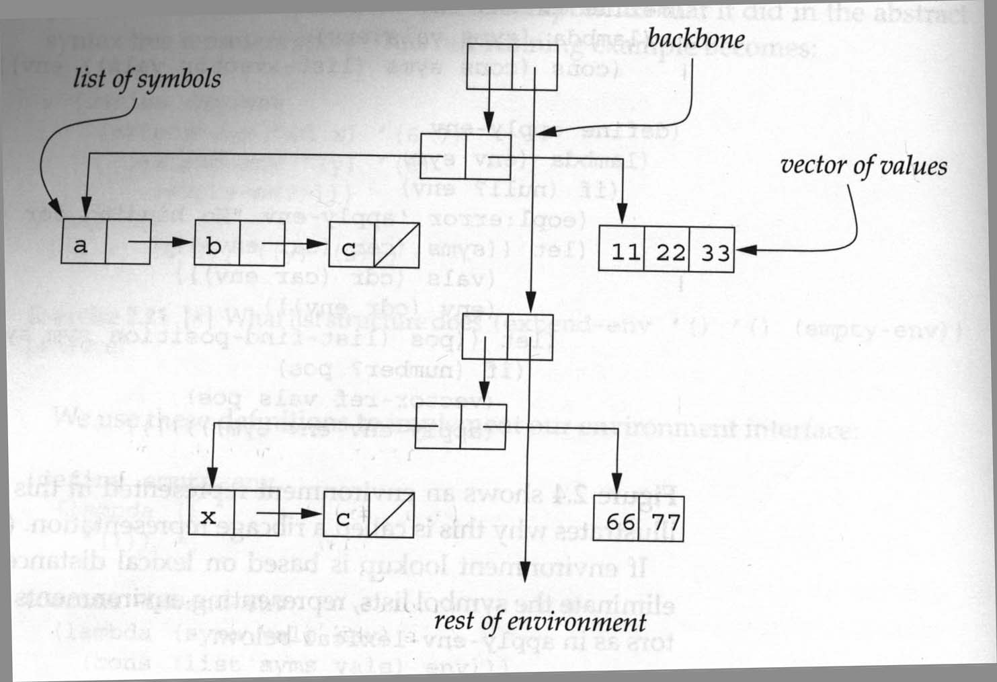
Representation 4 Ribcage structure with these improvements

Slide 21
Implementing the ribcage (slide 1)
(define empty-env
(lambda ()
'()))
(define extend-env
(lambda (syms vals env)
(cons (cons syms (list->vector vals)) env)))

Slide 22
Implementing the ribcage (slide 2)
(define apply-env
(lambda (env sym)
(if (null? env)
(error 'apply-env "No binding for ~s" sym)
(let ((syms (car (car env)))
(vals (cdr (car env)))
(env (cdr env)))
(let ([pos (rib-find-position sym syms)])
(if (number? pos)
(vector-ref vals pos)
(apply-env env sym)))))))

Slide 23
Compare with “List of lists” implementation
(define apply-env
(lambda (env sym)
(if (null? env)
(error 'apply-env "No binding for ~s" sym)
(let ((syms (car (car env)))
(vals (cadr (car env)))
(env (cdr env)))
(let ([pos (rib-find-position sym syms)])
(if (number? pos)
(list-ref vals pos)
(apply-env env sym)))))))

Slide 24
Implementation 5 callbacks (continuations)
This is what I use in the interpreter code.
Change the interface so apply-env expects:
An environment
A symbol, the variable to be looked up
A "succeed" callback function, applied to the value of the variable if the variable is found
A "fail" callback function, applied ot no arguments if the variable is not found.

Slide 25
apply-env with callbacks
This is a modification of Representation 2; we could modify Representation 3 or 4 in a similar way.
(define apply-env
(lambda (env sym succeed fail)
(cases environment env
[empty-env-record
(fail)]
[extended-env-record (syms vals env)
(let ([pos (list-find-position sym syms)])
(if (number? pos)
(succeed (list-ref vals pos))
(apply-env env sym succeed fail)))])))

Slide 26
Interpreter Project Introduction

Slide 27
Ready to write an interpreter!
We have
A parser that produces abstract expression trees
error checking
Environments implementations
lexical-address
A knowledge of how closures and environments work
Soon we will also have CPS
The rest is mostly details

Slide 28
Assignments weeks 6-10
Assignment | Tentative due date | Emphasis
13 (team) | Day 22 | primitive procedures, literals, lambda, let, if
14 (team) | Day24 | expand-syntax, cond, and, or, while etc.
15 (individual) | Day 26 | CPS, memoize, multi-value returns
16 (team) | Day 28 | letrec, named let, while loop as syntax expansion
17 (team) | Days 32 and 33 | define, set!, reference parameters
18 (team) | Days 35 and 37 | CPS with data structure continuations, call/cc, advanced features
19 (individual) | Day 39 | Imperative form
Extra credit 150 points | Demo it by 2:00 PM Wednesday of exam week | TBA

Slide 29
Interpreter project
Why do I have you write an interpreter?
What is an interpreter?
A mapping from __source code___ to _____meaning___ .

Slide 30
Major parts of an interpreter
Front-end Analysis
Lexical analysis (scanning) What are the pieces (tokens) of the program?
Syntax analysis (parsing, lexical address) How do the pieces fit together (AST)?
Type checking/coercion. (not in Scheme) Are the types of things consistent with their uses?
Optimization of the code
We will not discuss this much (Take CSSE 404)
Evaluation
This is the part that we will focus on
You have already done most of the analysis (A10, A11).
We will use the environment ADT.

Slide 31
Language
Why is Scheme … the implementation language?
In CSSE 404, …
… the source language?
They do it differently in the EoPL book.
Notes:
In 404 you will probably get to choose the implementation language
Source language:
Removes some low-level details.
Makes testing easier.

Slide 32
Load everything up!
; evaluator for simple expressions. Possible starting
; point for first interpreter assignment. In file main.ss
; ;
; Claude Anderson. Last modified January, 2020
(load "chez-init.ss")
(define load-all ; make it easy to reload the files
(lambda () ; when you are testing
(load "datatypes.ss")
(load "parse-procs.ss")
(load "syntax-expand.ss")
(load "env-procs.ss")
(load "continuations.ss")
(load "interpreter.ss")))
(load-all)
Code is linked from the Schedule page. There is also a single-file version.

Slide 33
CSSE 304 Interpreter
Read-eval-print (rep) loop:
Print a prompt
Read the next form (e.g., expression) to be evaluated.
Parse the form to give an abstract syntax tree (AST). A11b
Syntax-expand the AST to produce an AST that only has core forms. A14
Evaluate the expanded AST to produce a value. A13, A16, A17, A18
Print the value (if not void) and repeat all of these steps.
Imperative form A14
Alternate interface for grading program:
(eval-one-exp <exp>)

Slide 34
read-eval-print loop
The main driver for the interactive interpreter. The major part that is left for you to write is top-level-eval (and the procedures that it calls).
(define rep ; "read-eval-print" loop
(lambda ()
(display "--> ") ; new prompt on purpose
(let ([answer
(top-level-eval ; this calls eval-exp
(parse-expression (read)))])
(eopl:pretty-print answer)
; TODO: are there answers that
; should display differently?
(rep))))
; tail-recursive, stack doesn't grow

Slide 35
top-level-eval
(define top-level-eval
(lambda (parsed-form)
(eval-exp parsed-form)))
Later we'll add some syntactic forms that are not expressions; for example, (define var exp)
eval-exp may not be sufficient for those forms, so we may need to add other cases to top-level-eval.

Slide 36
representing procedures
(define-datatype proc-val proc-val?
[prim-proc ; primitive procedure
(name symbol?)])
; Datatype for procedures.
; At first we have only one kind of procedure,
; but more kinds will be added later.
; The first kind that we will add: ; closures created by eevaluation of lambda

Slide 37
eval-exp – how it works
What it returns depends on the type of expression.
If it’s a literal expression …
If it’s a variable reference …
If it’s an application …

Slide 38
eval-exp code
; eval-exp "is" the interpreter
(define eval-exp
(lambda (exp)
(cases expression exp
[lit-exp (datum) datum]
[var-exp (id) ; look up its value.
(apply-env init-env id)] [app-exp (rator rands)
(let ([proc-value (eval-exp rator)]
[args (eval-rands rands)])
(apply-proc proc-value args))]
[else (eopl:error 'eval-exp "Bad abstract syntax: ~s" exp)])))

Slide 39
eval-rands and apply-proc
(define eval-rands ; evaluate all of the args
(lambda (rands) ; return a list of values
(map eval-exp rands)))
; Apply a procedure to its arguments.
; At this point, only primitive procedures.
; User-defined procedures (closures) will be added later.
(define apply-proc
(lambda (proc-value args)
(cases proc-val proc-value
[prim-proc (op) (apply-prim-proc op args)]
[else (eopl:error 'apply-proc
"Attempt to apply bad procedure:"
proc-value)])))

Slide 40
apply-prim-proc
; Usually an interpreter must define each built-in
; (primitive) procedure individually.
(define apply-prim-proc
(lambda (prim-proc args)
(case prim-proc
[(+) (+ (1st args) (2nd args))]
; better?: (apply + args)
[(-) (- (1st args) (2nd args))]
[(*) (* (1st args) (2nd args))]
[(add1) (+ (1st args) 1)]
[(sub1) (- (1st args) 1)]
[(cons) (cons (1st args) (2nd args))]
[(=) (= (1st args) (2nd args))]
[else (eopl:error 'apply-prim-proc
"Bad primitive procedure name:"
prim-op)])))
Notes:
Why do we use Scheme procedures to represent most of our primitive procedures?

Slide 41
build the initial environment
(define *prim-proc-names*
'(+ - * add1 sub1 cons =))
(define init-env ; initial environment only
(extend-env ; contains primitive procedures.
*prim-proc-names* ; Recall that an environment
; associates values
(map prim-proc ; (not expressions) with variables.
*prim-proc-names*)
(empty-env)))

