Slide 1
CSSE 304 Day 5
Instructor intro, part 2
Reflexive? solution
Lambda is magnificent
Recursion practice (letrec, named let?)
What questions do you have?

Slide 2
Guy Steele Discussion
In breakout rooms
Each student, about 1 minute:
What about this video made the biggest impression on you

Slide 3
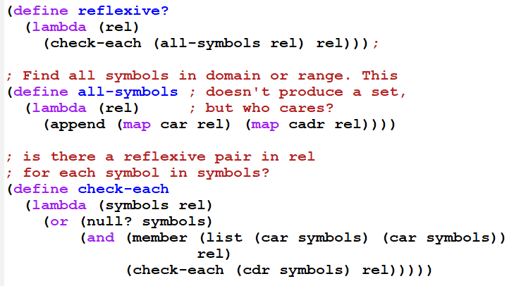
reflexive? solution

Slide 4
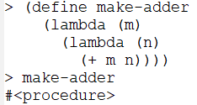
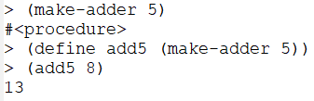
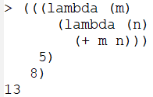
Lambda is magnificent!
A procedure can create and return a new procedure
Make-adder is a “curried” procedure.
Procedures can be anonymous

Slide 5
A first-class data object
Can be stored in a data structure
Can be passed as an argument to a procedure
Can be returned by a procedure
In Scheme, procedures are first-class. In some other languages, they are “second-class citizens”.

Slide 6
Breakout rooms
Work with the other group members to try to write the largest-in-lists code.
Along the way, experiment with letrec and/or named let.

Slide 7
Exercise
Write largest-in-lists, which takes a list of lists of numbers and finds the largest number. Returns #f if there are no numbers in any of the lists. Try to create at least one of your recursive procedures using use letrec or named let
(largest-in-lists '((1 3 5) () (4) (2 6 1) (4))) ➔ 6
(largest-in-lists '(() ())) ➔ f #f
Work with another student or two. Pair program. Test cases available on the PLC grading server.
There is also a file with test code:
Live-in-class/Day05

