Slide 1
CSSE 304 Day 5
Lambda is magnificent!
Let and let*
Just the Facts (letrec) More box-and-pointer diagrams
(if time) More map and apply
Announcements are online

Slide 2
Day 5 CSSE 304
A solution from A3
Another look at sorted?
let and let*
Just the facts! (letrec)
Mutation, with box-and-pointer diagrams
(More map and apply)
(define choose
(lambda (n k) (/ (fact n) (fact (- n k)) (fact k))))

Slide 3
Need help on assignments? It's OK!
What percentage of the class do I expect to get most of the problems without talking to anyone else?
10 – 20 %
I don't see learning as a solo activity
If you don't have people to talk to, try the student assistants or me. For now! But also work on finding another student to work with. Do not copy other students' work!
If you are stuck on a problem for more than a few minutes, talk to someone!

Slide 4
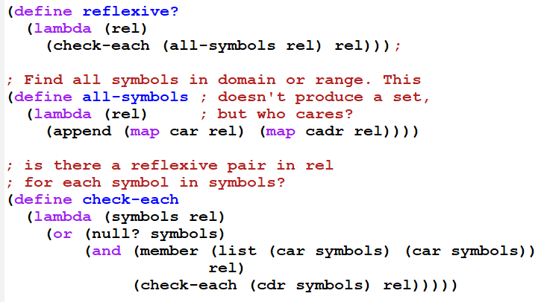
reflexive? solution

Slide 5
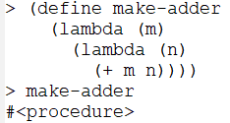
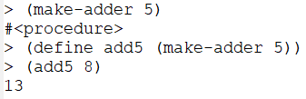
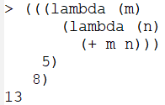
Lambda is magnificent!
A procedure can create and return a new procedure
Make-adder is a “curried” procedure.
Procedures can be anonymous

Slide 6
A first-class data object
Can be stored in a data structure
Can be passed as an argument to a procedure
Can be returned by a procedure
In Scheme, procedures are first-class. In some other languages, they are “second-class citizens”.

Slide 7
Translation of let
(define L '(4 3 2))
(let ([first (car L)]
[second (cadr L)])
(list (+ first second) (- first second)))
The let expression is equivalent to
((lambda (first second)
(list (+ first second) (- first second)))
(car L)
(cadr L))
let and cond are both examples of “syntactic sugar”, as are and and or.

Slide 8
more on let
(define xxx
(lambda (L)
(let ([a (car L)]
[b (cdr L)]
[c (car b)])
(list c a))))
What goes wrong if we evaluate (xxx '(1 2 3))?
Translate the let expression to an application of lambda
Notes:
DO the translation on the board.
Tell them that one of the problems in A4 is to do this translation automatically.

Slide 9
let*
What we really wanted was
(define xxx
(lambda (L)
(let* ([a (car L)]
[b (cdr L)]
[c (car b)])
(list c a))))
which translates into
(define xxx
(lambda (L)
(let ([a (car L)])
(let ([b (cdr L)])
(let ([c (car b)])
(list c a))))))

Slide 10
Just the facts …
As a means of studying local variables, we look at several procedures that calculate factorials
You can find the code under day05 in the "Live in class" folder, linked from Resources column of the Schedule Page: Session 1

Slide 11
Another Factorial Example
>(define fact
(lambda (n)
(if (zero? n)
1
(* n (fact (- n 1))))))
>(define f fact)
>(f 5)
>(define fact
(lambda (n)
″Abe Lincoln elected President″))
>(fact 1860)
>(f 1860)
Perhaps we can avoid the problem by not having the recursion depend on a global name.
While we are at it, let’s try to make the recursion more efficient.
Try it in Scheme! Day05-fact-examples.ss

Slide 12
local factorial definition
(define fact
(let ([fact-tail (lambda (n prod)
(if (zero? n)
prod
(fact-tail (- n 1)
(* n prod))))])
(lambda (n) (fact-tail n 1))))
Try it in Scheme!

Slide 13
Solution - letrec
(define fact
(letrec ([fact-tail
(lambda (n prod)
(if (zero? n)
prod
(fact-tail (- n 1)
(* n prod))))])
(lambda (n) (fact-tail n 1))))
Could we replace the name fact-tail by fact?

Slide 14
Another letrec example: mutual recursion
(define odd?
(letrec ([odd? (lambda (n)
(if (zero? n)
#f
(even? (- n 1))))]
[even? (lambda (n)
(if (zero? n)
#t
(odd? (- n 1))))])
(lambda (n)
(odd? n))))
We can simplify this part by doing an eta-reduction.

Slide 15
Named let
(define fact
(lambda (n)
(let fact-tail ([x n] [prod 1])
(if (zero? x)
prod
(fact-tail (- x 1)
(* prod x))))))
It's an abbreviation for …
(Help me write it on the board)
“fact-tail" is the "name" in this named-let. It is not a Scheme keyword; it’s just a name that I used here.

Slide 16
Interlude (possibly postlude!)
Some words are just too negative …
"How I met my wife" by Jack Winter
Published 25 July 1994 - The New Yorker
It had been a rough day, so when I walked into the party I was very chalant, despite my efforts to appear gruntled and consolate.
I was furling my wieldy umbrella for the coat check when I saw her standing alone in a corner. She was a descript person, a woman in a state of total array. Her hair was kempt, her clothing shevelled, and she moved in a gainly way.
I wanted desperately to meet her, but I knew I'd have to make bones about it since I was traveling cognito. Beknownst to me, the hostess, whom I could see both hide and hair of, was very proper, so it would be skin off my nose if anything bad happened. And even though I had only swerving loyalty to her, my manners couldn't be peccable. Only toward and heard-of behavior would do.

Slide 17
Fortunately, the embarrassment that my maculate appearance might cause was evitable. There were two ways about it, but the chances that someone as flappable as I would be ept enough to become persona grata or a sung hero were slim. I was, after all, something to sneeze at, someone you could easily hold a candle to, someone who usually aroused bridled passion.
So I decided not to risk it. But then, all at once, for some apparent reason, she looked in my direction and smiled in a way that I could make heads or tails of.
I was plussed. It was concerting to see that she was communicado, and it nerved me that she was interested in a pareil like me, sight seen. Normally, I had a domitable spirit, but, being corrigible, I felt capacitated -- as if this were something I was great shakes at – and forgot that I had succeeded in situations like this only a told number of times. So, after a terminable delay, I acted with mitigated gall and made my way through the ruly crowd with strong givings.
Nevertheless, since this was all new hat to me and I had no time to prepare a promptu speech, I was petuous. Wanting to make only called-for remarks,
I started talking about the hors d'oeuvres, trying to abuse her of the notion that I was sipid, and perhaps even bunk a few myths about myself.

Slide 18
She responded well, and I was mayed that she considered me a savory character who was up to some good. She told me who she was. "What a perfect nomer," I said, advertently. The conversation become more and more choate, and we spoke at length to much avail. But I was defatigable, so I had to leave at a godly hour. I asked if she wanted to come with me. To my delight, she was committal. We left the party together and have been together ever since. I have given her my love, and she has requited it.

Slide 19
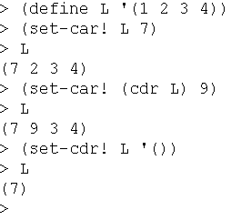
List mutation
You are still not allowed to use mutation in any form on the early assignments.
But we introduce the concept today.
We will occasionally use it later

Slide 20
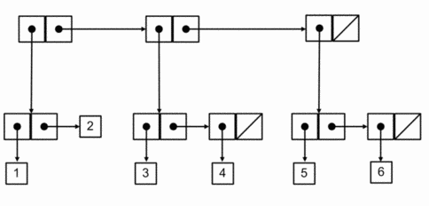
More complex box-and-pointer diagrams
How would Scheme output this? How would you write code to construct it? (without using quote)
Should the numbers be in the boxes (like my previous drawings), or should there be references to them (as here)?
More examples like this for later practice: http://courses.cms.caltech.edu/cs1/assignments/lab5/

Slide 21
Draw box-and-pointer diagrams
… that show the situation after executing this code. Then show what the write statements would print. How many pairs are created altogether?
(define v (cons 'a 'b))
(define w (list 'a 'b))
(define x '((1 2) 3 (4 5)))
(define y (cons (car x) (cdr x)))
(define z (cons (cdr x ) x))
(write v) (newline)
(write w) (newline)
(write x) (newline)
(write y) (newline)
(write z) (newline) ; What would happen if we then… (set-cdr! v v)
(write v) (newline)
Work with one or two other students

Slide 22
More map and apply examples
(define ms-size
(lambda (ms)
(apply + (map cadr ms))))
(define sorted? ; with-normal-less
(lambda (lon)
(or (null? lon)
(apply <= lon))))

Slide 23
Examples: map and apply
(map < '(1 5 7) '(2 4 6))
(map list '(1 5 7) '(2 4 6) '(0 8 3))
(apply cons '(2 3))
(list '()) (map list '()) (apply list ‘())
(define ms-size (lambda (ms) (apply + (map cadr ms))
(define cube (lambda(x) (* x x x)))
(define (apply-many functions arg) (map (lambda (function) (apply function (list arg))) functions))
(apply-many (list - cube (lambda (x) (/ x 2))) 3)
(apply-many '(- cube (lambda (x) (/ x 2))) 3)
(apply-many `(,- ,cube ,(lambda (x) (/ x 2))) 3)
(apply + 1 2 '(3 4 5)) ; a different form of apply?

Slide 24
Hidden
(define largest-in-lists
(lambda (L) ; list of lists of numbers
(let ([larger (lambda (n1 n2)
(if (or (eq? n2 #f)
(> n1 n2))
n1
n2))])
(let list-loop ([outer-L L]
[largest #f])
(if (null? outer-L)
largest
(let item-loop ([inner-L (car outer-L)]
[largest largest])
(if (null? inner-L)
(list-loop (cdr outer-L) largest)
(item-loop (cdr inner-L) (larger (car inner-L)
largest)))))))))

