Slide 1
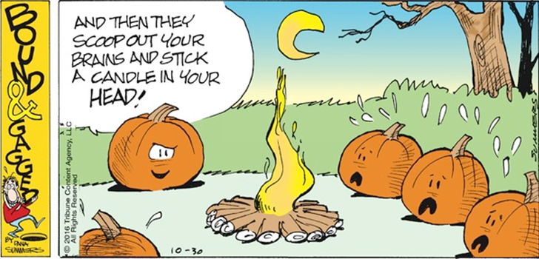
CSSE 304 Day 31-33
Data Structure continuations
Interpreter in CPS
Add call/cc to the interpreted language

Slide 2
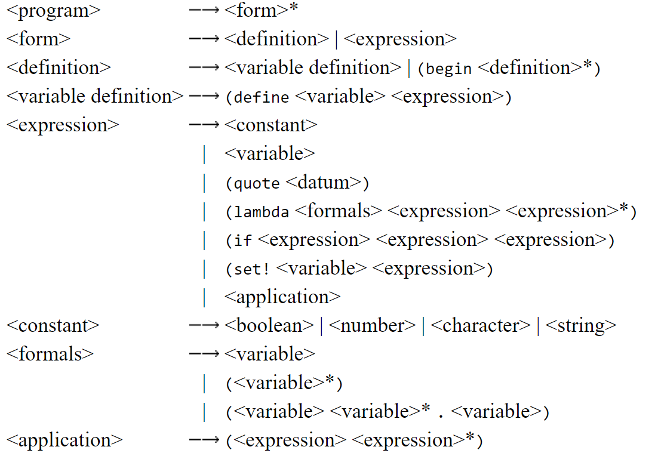
Core forms reminder (affects define implementation)

Slide 3
Back to writing CPS code
This time we represent continuations by our variant-record datatypes

Slide 4
Recap: Environment representations
(define apply-env
(lambda (env sym) (env sym)))
(define empty-env
(lambda ()
(lambda (sym)
(eopl:error 'apply-env "No binding for ~s" sym))))
(define extend-env
(lambda (syms vals env)
(lambda (sym)
(let ([pos (list-find-position sym syms)])
(if (number? pos)
(list-ref vals pos)
(apply-env env sym))))))
Use Scheme procedures as environments
Use environment datatype
(define-datatype environment environment?
[empty-env-record]
[extended-env-record
(syms (list-of symbol?))
(vals (list-of scheme-value?))
(env environment?)])
(define empty-env
(lambda ()
(empty-env-record)))
(define extend-env
(lambda (syms vals env)
(extended-env-record syms
vals
env)))
(define apply-env
(lambda (env sym)
(cases environment env
[empty-env-record ()
(errorf 'apply-env
"No binding for ~s" sym)]
[extended-env-record (syms vals env)
(let ([pos
(list-find-position sym syms)])
(if (number? pos)
(list-ref vals pos)
(apply-env env sym)))])))

Slide 5
Continutaion representations Two possibilities
Use Scheme procedures as your continuations (as we have done previously)
Use the continuation datatype
With many variants and a complex apply-k procedure
You should understand both, but you only have to use the continuation datatype in your A18 interpreter (and, yes, you must use it)

Slide 6
Advantages of continuation datatype
You can "see into" the continuations
Thus easier to debug. "trace" will let you see "what's inside" the continuations.
And easier to use this exercise as a means of understanding what continuations are all about.
You can implement continuations in a language that does not have first-class procedures. And more efficiently in a language that does have them.

Slide 7
Advantage of Scheme Procedure Continuations
It's more like what we did with CPS before.
All of the information needed for the continuation is in the procedure definitions, so understanding the code requires less mental "jumping around".

Slide 8
Convert example CPS code to datatype rep of continuations
We represent continuations by our variant-record datatypes

Slide 9
(define read-flatten-print
(lambda ()
(display "enter slist to flatten: ")
(let ([slist (read)])
(unless (eq? slist 'exit)
(flatten-cps slist
(make-k (lambda (val)
(pretty-print val)
(read-flatten-print))))))))
(define flatten-cps
(lambda (ls k)
(if (null? ls)
(apply-k k ls)
(flatten-cps (cdr ls)
(make-k (lambda (v) (if (list? (car ls))
(flatten-cps (car ls)
(make-k (lambda (u) (append-cps u v k))))
(apply-k k (cons (car ls) v))))))))
(define append-cps
(lambda (L1 L2 k)
(if (null? L1)
(apply-k k L2)
(append-cps (cdr L1)
L2
(make-k (lambda (appended-cdr)
(apply-k k (cons (car L1)
appended-cdr))))))))
Starting code
Transformations:
Live coding
Notes:
Details are in a Word document in the SlidesPPT folder. Stating code and solution are in Resources folder (Day 34 as of Spring 2014). Before class only display the starting code.

Slide 10
Interpreter in CPS
with data-structure continuations

Slide 11
Preview: What does a CPS interpreter do for us?
A step toward knowing that we could implement the interpreter in a language without
first-class procedures
recursion
The ability to provide first-class continuations to the user
by implementing call/cc.
If every expression-evaluation includes an explicit continuation, it's easy to reify it and make it available.
Notes:
Gives us the ability to easily write the interpreter in a way that does not require recursion or first-class procedures in the implementation language.
Since the interpreter always has the current continuation explicitly, it makes it easy to provide continuations as a first-class data type in the language, just as Scheme does via the call/cc procedure.

Slide 12
Convert our Interpreter to CPS
The interpreter (eval-exp) will now take three arguments:
current expression to evaluate
current local environment
current continuation

Slide 13
Convert our Interpreter to CPS
(define eval-exp
(lambda (exp env)
(cases expression exp ; look at typical cases
[lit-exp (datum) datum]
[var-exp (id) (apply-env env id)]
[lambda-exp (formals body)
(closure formals body env)]
[app-exp (rator rands)
(let ([proc-value (eval-exp rator env)]
[args (eval-rands rands env)])
(apply-proc proc-value args))]
[let-exp (vars exps bodies)
(eval-bodies body
(extend-env vars
(eval-rands exps env)
env))]
; there are more cases not shown here
)))

Slide 14
Some changes to eval-exp
(define eval-exp ;cps-version
(lambda (exp env k)
(cases expression exp ; look at typical cases
[lit-exp (datum) (apply-k k datum)]
[var-exp (id) (apply-env env id k fail-proc))]
[lambda-exp (formals bodies)
(apply-k k (closure formals bodies env))]
[app-exp (rator rands)
(eval-exp rator
env
(rator-k rands env k))]
...)))

Slide 15
Continuations in the interpreter
(define eval-exp
(lambda (exp env k)
(cases expression exp
[literal-exp (datum)
(apply-k k datum)]
; skip some of the other cases for now
[if-exp (test-exp then-exp else-exp)
(eval-exp test-exp
env
(test-k then-exp else-exp env k))]
; skip some more cases
)))
applies the current continuation
creates a test-k continuation object

Slide 16
Representing Continuations by Data Types
(define-datatype continuation continuation? [test-k (then-exp expression?) (else-exp expression?) (env environment?) (k continuation?)] ; we will add other continuation variants. )
(define apply-k (lambda (k val) (cases continuation k [test-k (then-exp else-exp env k) (if val (eval-exp then-exp env k) (eval-exp else-exp env k))] ; we will add other continuation variants. )))

Slide 17
continuation datatype
(define-datatype continuation continuation?
(test-k (then-exp expression?)
(else-exp expression?)
(env environment?)
(k continuation?))
(rator-k (rands (list-of? expression?))
(env environment?)
(k continuation?))
(rands-k (proc-value proc-val?)
(k continuation?)) ; etc

Slide 18
apply-k
(define apply-k
(lambda (k val)
(cases continuation k
[test-k (then-exp else-exp env k)
(if val
(eval-exp then-exp env k)
(eval-exp else-exp env k))]
[rator-k (rands env k)
(eval-rands rands
env
(rands-k val k))]
[rands-k (proc-value k)
(apply-proc proc-value val k)])) ; etc

Slide 19
Exercise :
How should the CPS version of this clause be written?
[let-exp (vars exps bodies)
(eval-bodies bodies
(extend-env vars
(eval-rands exps env)
env))]
Beginning of answer:
[let-exp (vars exps bodies)
(eval-rands exps env
(let-exps-k vars bodies env k)]
Applying let-exps-k will call extend-env. Applying extend-env's continuation will call apply-bodies.

Slide 20
fact with call/cc
An interesting call/cc example

Slide 21
Another call/cc example
> (define abc)
> (define fact
(lambda (n)
(cond [(= n 1)
(call/cc (lambda (k)
(set! abc k)
(k 1)))]
[else
(* n (fact (- n 1)))])))
> (fact 4)
24
> (abc 2)
48

Slide 22
More of the fact call/cc example
Back to the café in Paris… the waiter may look a little older, we might be heavier, but we experience the same things as before.
> (trace fact)
(fact)
> (fact 6)
|(fact 6)
| (fact 5)
| |(fact 4)
| | (fact 3)
| | |(fact 2)
| | | (fact 1)
| | | 1
| | |2
| | 6
| |24
| 120
|720
720
> (abc 11)
| | | 11
| | |22
| | 66
| |264
| 1320
|7920
7920
(define fact
(lambda (n)
(cond [(= n 1)
(call/cc (lambda (k)
(set! abc k)
(k 1)))]
[else
(* n (fact (- n 1)))])))

Slide 23
Add call/cc to our interpreted language
Details on the handout and on the board.
Some questions?
What is a (user) continuation? How to represent?
Where in the code should call/cc implementation be? What does it do?
What happens when a continuation is applied? Where should this go in the interpreter? What should the code be?

Slide 24
Add call/cc to the interpreter
Why do we want to start with the CPS version of the interpreter?
What should a continuation be?
Which variant record type should continuation belong to?
(define-datatype proc-val proc-val?
[prim-proc
(name symbol?)]
[closure
(formals (list-of symbol?))
(body expression?)
(env environment?)]
What goes here?)
Notes:
Because that way we always "know" the current continuation.
An Abstract Data Type
proc-val?

Slide 25
Add call/cc to the interpreter
Why do we want to start with the CPS version of the interpreter?
What should a continuation be?
Which variant record type should continuation belong to?
(define-datatype proc-val proc-val?
[prim-proc
(name symbol?)]
[closure
(formals (list-of symbol?))
(body expression?)
(env environment?)]
[continuation-proc (k continuation?)])
Notes:
Because that way we always "know" the current continuation.
An Abstract Data Type
proc-val?

Slide 26
Add call/cc to the interpreter
What should call/cc be?
A primitive procedure
What do we do when it is called?
(define apply-prim-proc
(lambda (prim-proc args k)
(case prim-proc
[(+) (apply-k k (apply + args))]
[(-) (apply-k k (apply - args))]
. . .
[(call/cc) what goes here? ] … )))
Notes:
Because that way we always "know" the current continuation.
An Abstract Data Type
proc-val?

Slide 27
Add call/cc to the interpreter
(define apply-prim-proc
(lambda (prim-proc args k)
(case prim-proc
[(+) (k (+ (1st args) (2nd args)))]
[(-) (k (- (1st args) (2nd args)))]
. . .
[(call/cc)
(apply-proc (car args) (list (continuation-proc k))
k) ] … )))
Notes:
Because that way we always "know" the current continuation.
An Abstract Data Type
proc-val?

Slide 28
Add call/cc to the interpreter
What else do we need to change?
define apply-proc
(lambda (proc-value args k)
(cases proc-val proc-value
. . .
[continuation-proc (k)
What goes here? ]
. . . )))

Slide 29
Add call/cc to the interpreter
What else do we need to change?
(define apply-proc
(lambda (proc-value args k)
(cases proc-val proc-value
. . .
[continuation-proc (k)
(apply-k
k
(car args))]
. . . )))
What about the original k?

