Slide 1
CSSE 304 Day 33
Interpreter in CPS
Add call/cc to the interpreted language
Another call/cc example.
(introduce imperative form example)

Slide 2
Interpreter in CPS
with data-structure continuations

Slide 3
What does a CPS interpreter do for us?
A step toward knowing that we could write the interpreter in a language without
first-class procedures
recursion
The ability to provide first-class continuations to the user
by implementing call/cc.
If every expression-evaluation has an explicit continuation, it's easy to capture and apply it later.
Notes:
Gives us the ability to easily write the interpreter in a way that does not require recursion or first-class procedures in the implementation language.
Since the interpreter always has the current continuation explicitly, it makes it easy to provide continuations as a first-class data type in the language, just as Scheme does via the call/cc procedure.

Slide 4
Convert our Interpreter to CPS
The interpreter (eval-exp) will now take three arguments:
current expression to evaluate
current local environment
current continuation
Continuation abstract data type
A constructor for each type of continuation that the interpreter uses.
(apply-k k v), a procedure that applies the continuation k to the value v .

Slide 5
Interpreter to Convert to CPS
(define eval-exp
(lambda (exp env)
(cases expression exp ; look at typical cases
[lit-exp (datum) datum]
[var-exp (id) (apply-env env id)]
[lambda-exp (formals body)
(closure formals body env)]
[app-exp (rator rands)
(let ([proc-value (eval-exp rator env)]
[args (eval-rands rands env)])
(apply-proc proc-value args))]
[let-exp (vars exps bodies)
(eval-bodies body
(extend-env vars
(eval-rands exps env)
env))]
; there are more cases not shown here
)))

Slide 6
Some changes to eval-exp
(define eval-exp ;cps-version
(lambda (exp env k)
(cases expression exp ; look at typical cases
[lit-exp (datum) (apply-k k datum)]
[var-exp (id) (apply-env env id k fail-proc))]
[lambda-exp (formals bodies)
(apply-k k (closure formals bodies env))]
[app-exp (rator rands)
(eval-exp rator
env
(rator-k rands env k))]
...)))

Slide 7
Continuations in the interpreter
(define eval-exp
(lambda (exp env k)
(cases expression exp
[literal-exp (datum)
(apply-k k datum)]
; skip some of the other cases for now
[if-exp (test-exp then-exp else-exp)
(eval-exp test-exp
env
(test-k then-exp else-exp env k))]
; skip some more cases
)))
applies the current continuation
creates a test-k continuation object

Slide 8
Representing Continuations by Data Types
(define-datatype continuation continuation? [test-k (then-exp expression?) (else-exp expression?) (env environment?) (k continuation?)] ; we will add other continuation variants. )
(define apply-k (lambda (k val) (cases continuation k [test-k (then-exp else-exp env k) (if val (eval-exp then-exp env k) (eval-exp else-exp env k))] ; we will add other continuation variants. )))
As in our implementation of environments as datatypes, most of the work is now in apply-k; the constructors are almost trivial

Slide 9
continuation datatype
(define-datatype continuation continuation?
(test-k (then-exp expression?)
(else-exp expression?)
(env environment?)
(k continuation?))
(rator-k (rands (list-of? expression?))
(env environment?)
(k continuation?))
(rands-k (proc-value scheme-value?)
(k continuation?)) ; etc

Slide 10
apply-k
(define apply-k
(lambda (k val)
(cases continuation k
[test-k (then-exp else-exp env k)
(if val
(eval-exp then-exp env k)
(eval-exp else-exp env k))]
[rator-k (rands env k)
(eval-rands rands
env
(rands-k val k))]
[rands-k (proc-value k)
(apply-proc proc-value val k)])) ; etc

Slide 11
Exercise :
How should the CPS version of this clause be written?
[let-exp (vars exps bodies)
(eval-bodies bodies
(extend-env vars
(eval-rands exps env)
env))]
Beginning of answer:
[let-exp (vars exps bodies)
(eval-rands exps env
(let-exps-k vars bodies env k)]
Applying let-exps-k will call extend-env. Applying extend-env's continuation will call apply-bodies.

Slide 12
Add call/cc to our interpreted language
Details on the handout and on the board.
Some questions?
What is a (user) continuation? How to represent?
Where in the code should call/cc implementation be? What does it do?
What happens when a continuation is applied? Where should this go in the interpreter? What should the code be?

Slide 13
Add call/cc to the interpreter
Why do we want to start with the CPS version of the interpreter?
What should a continuation be?
Which variant record type should continuation belong to?
(define-datatype proc-val proc-val?
[prim-proc
(name symbol?)]
[closure
(formals (list-of symbol?))
(body expression?)
(env environment?)]
What goes here?)
Notes:
Because that way we always "know" the current continuation.
An Abstract Data Type
proc-val?

Slide 14
Add call/cc to the interpreter
Why do we want to start with the CPS version of the interpreter?
What should a continuation be?
Which variant record type should continuation belong to?
(define-datatype proc-val proc-val?
[prim-proc
(name symbol?)]
[closure
(formals (list-of symbol?))
(body expression?)
(env environment?)]
[continuation-proc (k continuation?)])
Notes:
Because that way we always "know" the current continuation.
An Abstract Data Type
proc-val?

Slide 15
Add call/cc to the interpreter
What should call/cc be?
A primitive procedure
What do we do when it is called?
(define apply-prim-proc
(lambda (prim-proc args k)
(case prim-proc
[(+) (apply-k k (apply + args))]
[(-) (apply-k k (apply - args))]
. . .
[(call/cc) what goes here? ] … )))
Notes:
Because that way we always "know" the current continuation.
An Abstract Data Type
proc-val?

Slide 16
Add call/cc to the interpreter
(define apply-prim-proc
(lambda (prim-proc args k)
(case prim-proc
[(+) (k (+ (1st args) (2nd args)))]
[(-) (k (- (1st args) (2nd args)))]
. . .
[(call/cc)
(apply-proc (car args) (list (continuation-proc k))
k) ] … )))
Notes:
Because that way we always "know" the current continuation.
An Abstract Data Type
proc-val?

Slide 17
Add call/cc to the interpreter
What else do we need to change?
define apply-proc
(lambda (proc-value args k)
(cases proc-val proc-value
. . .
[continuation-proc (k)
What goes here? ]
. . . )))

Slide 18
Add call/cc to the interpreter
What else do we need to change?
(define apply-proc
(lambda (proc-value args k)
(cases proc-val proc-value
. . .
[continuation-proc (k)
(apply-k
k
(car args))]
. . . )))
What about the original k?

Slide 19
Another call/cc example
> (define abc)
> (define fact
(lambda (n)
(cond [(= n 1)
(call/cc (lambda (k)
(set! abc k)
(k 1)))]
[else
(* n (fact (- n 1)))])))
> (fact 4)
24
> (abc 2)
48

Slide 20
More of the fact call/cc example
Back to the café in Paris… the waiter may look a little older, we might be heavier, but we experience the same things as before.
> (trace fact)
(fact)
> (fact 6)
|(fact 6)
| (fact 5)
| |(fact 4)
| | (fact 3)
| | |(fact 2)
| | | (fact 1)
| | | 1
| | |2
| | 6
| |24
| 120
|720
720
> (abc 11)
| | | 11
| | |22
| | 66
| |264
| 1320
|7920
7920
(define fact
(lambda (n)
(cond [(= n 1)
(call/cc (lambda (k)
(set! abc k)
(k 1)))]
[else
(* n (fact (- n 1)))])))

Slide 21
Imperative form
Today we do the concept and background (if there is time),
Next time we examine the details

Slide 22
Implementation environment
Scheme is a great language to use when implementing an interpreter.
But does it do too much for us?
Could we easily write the Assignment 18 interpreter in another language?
One without first-class procedures?

Slide 23
A simple example
The interpreter involves a lot of code, so we will look at transforming a simple example.
The same ideas will work to transform the interpreter.

Slide 24
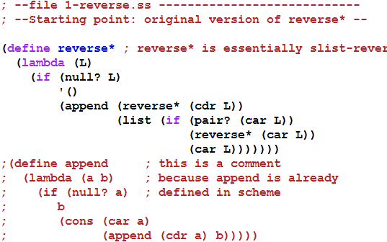

A simple example
Next: convert to CPS

Slide 25
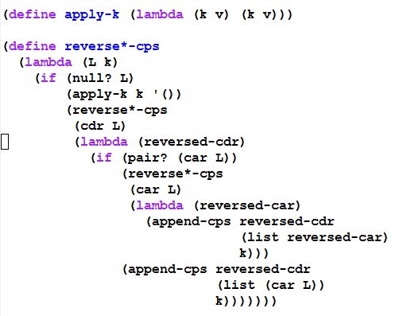
Convert to CPS form – part 1 Represent continuations as Scheme procedures

Slide 26
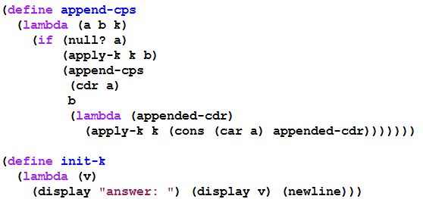
Convert to CPS form – part 2 Represent continuations as Scheme procedures

Slide 27
with tracing
(trace-define reverse*-cps
(lambda (L k)
(if (null? L)
(k '())
(reverse*-cps
(cdr L)
(trace-lambda cdr-k (reversed-cdr)
(if (pair? (car L))
(reverse*-cps
(car L)
(trace-lambda car-k (reversed-car)
(append-cps
reversed-cdr
(list reversed-car)
k)))
(append-cps reversed-cdr
(list (car L))
k)))))))
(trace-define append-cps
(lambda (a b k)
(if (null? a)
(k b)
(append-cps
(cdr a)
b
(trace-lambda append-k (appended-cdr)
(k (cons (car a) appended-cdr)))))))
(trace-define init-k
(lambda (v)
(display "answer: ") (display v) (newline)))

Slide 28
the trace
> (reverse*-cps '(a (b () ((c) d))) init-k)
|(reverse*-cps (a (b () ((c) d))) #<procedure>)
|(reverse*-cps ((b () ((c) d))) #<procedure>)
|(reverse*-cps () #<procedure>)
|(apply-k #<procedure> ())
|(cdr-k ())
|(reverse*-cps (b () ((c) d)) #<procedure>)
|(reverse*-cps (() ((c) d)) #<procedure>)
|(reverse*-cps (((c) d)) #<procedure>)
|(reverse*-cps () #<procedure>)
|(apply-k #<procedure> ())
|(cdr-k ())
|(reverse*-cps ((c) d) #<procedure>)
|(reverse*-cps (d) #<procedure>)
|(reverse*-cps () #<procedure>)
|(apply-k #<procedure> ())
|(cdr-k ())
|(append-cps () (d) #<procedure>)
|(apply-k #<procedure> (d))
|(cdr-k (d))
|(reverse*-cps (c) #<procedure>)
|(reverse*-cps () #<procedure>)
|(apply-k #<procedure> ())
|(cdr-k ())
|(append-cps () (c) #<procedure>)
|(apply-k #<procedure> (c))
|(car-k (c))
|(append-cps (d) ((c)) #<procedure>)
|(append-cps () ((c)) #<procedure>)
|(apply-k #<procedure> ((c)))
|(append-k ((c)))
|(apply-k #<procedure> (d (c)))
|(car-k (d (c)))
|(append-cps () ((d (c))) #<procedure>)
|(apply-k #<procedure> ((d (c))))
|(cdr-k ((d (c))))
|(append-cps ((d (c))) (()) #<procedure>)
|(append-cps () (()) #<procedure>)
|(apply-k #<procedure> (()))
|(append-k (()))
|(apply-k #<procedure> ((d (c)) ()))
|(cdr-k ((d (c)) ()))
|(append-cps ((d (c)) ()) (b) #<procedure>)
|(append-cps (()) (b) #<procedure>)
|(append-cps () (b) #<procedure>)
|(apply-k #<procedure> (b))
|(append-k (b))
|(apply-k #<procedure> (() b))
|(append-k (() b))
|(apply-k #<procedure> ((d (c)) () b))
|(car-k ((d (c)) () b))
|(append-cps () (((d (c)) () b)) #<procedure>)
|(apply-k #<procedure> (((d (c)) () b)))
|(cdr-k (((d (c)) () b)))
|(append-cps (((d (c)) () b)) (a) #<procedure>)
|(append-cps () (a) #<procedure>)
|(apply-k #<procedure> (a))
|(append-k (a))
|(apply-k #<procedure> (((d (c)) () b) a))
|(init-k (((d (c)) () b) a))
answer: (((d (c)) () b) a)
This lets us see the flow of control as the CPS procedures execute, but we can't see the details that are hidden inside #<procedure>

Slide 29
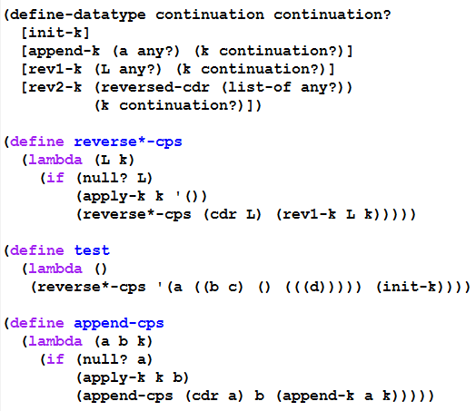
Second Continuation representation part 1 (using define-datatype)

Slide 30
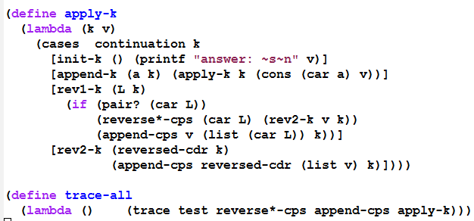

Second Continuation representation part 2 (using define-datatype)

Slide 31
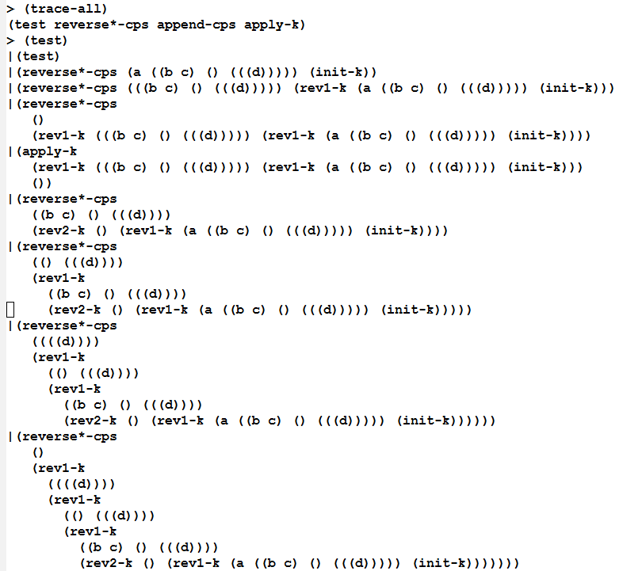
Beginning of a trace (you can generate the rest yourself, using the on-line files)

Slide 32
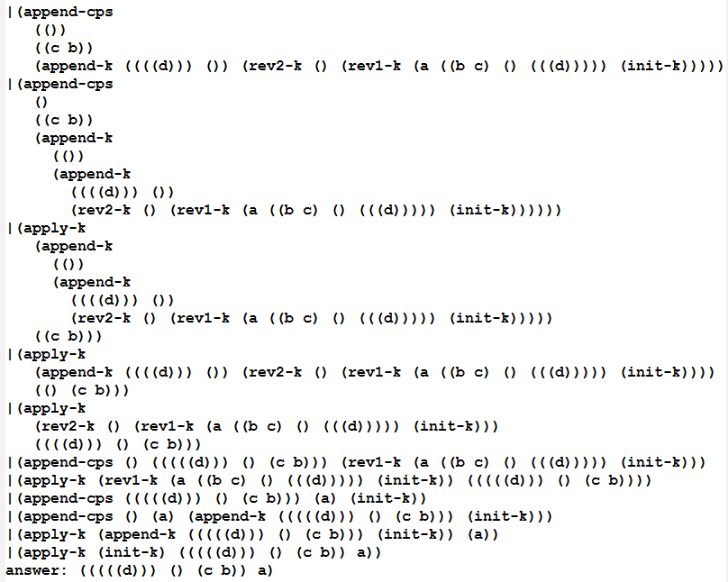
End of the trace (you can generate the whole trace yourself using the on-line files)

Slide 33
What do we have now?
Using this style, we could write the interpreter in any language that provides a means of creating records.
But it would be inefficient if that language's compiler does not handle tail-recursion properly
Could even result in a stack overflow.
So we transform to a style in which the flow of control is really just assignments, BEGINs, IFs, and GOTOs:

Slide 34
Transform to Imperative form
All non-primitive procedures will be called in tail-position, so they do not need to return.
All non-primitive procedures will be thunks (procedures that take no arguments), thus no need for stack frames.
Thus a procedure call is equivalent to a "goto"
This can be implemented in almost any language.

