Slide 1
CSSE 304 Day 26
About next week’s exam
Add set! to our interpreter
Description of A17
Multi-value returns

Slide 2
Exam 2 format
Exam 2 is Tuesday, week 8
Three parts:
E&C – already done (25 points)
Written part (estimate: 15-30 points) Will include interpreter questions (how did you implement …? how would you add …)
Know your interpreter well.
Comp. part, possibly including interpreter problem(s), CPS, OOP (estimate: 65-80 points)

Slide 3
Potential Topics for Exam 2
environments and closures diagrams (read ‘em, not write ‘em)
programming with lists (and nested lists)
Map and apply
grammars (and code that follows the grammar)
processing s-lists, procedural abstraction
curried procedures, procedures that return procedures
How mutation works (set!, set-car!, set-cdr!)
persistent data (OO-approach, and memoization)
case-lambda
define-syntax (and difference between syntactic extension & procedure definition)
abstract data types: interface, representation & implementation
Abstract data types, representation-independence, define-datatype and cases
free & bound variable occurrences, lexical address
Parsing, working with parsed expressions
Enhance interpreter (you need to bring your working interpreter code for comp part)
Continuations, write code in CPS (both continuation representations)
Multi-value returns (values, call-with-values, with-values, mvlet)
Show that you are a good programmer/problem solver.
If you have questions about old exam problems or solutions, ask them on Piazza so everyone can see the conversation.
Notes:
I don't have to try to make the exam difficult.
With this list of topics, I have to try hard to keep it from being impossible!

Slide 4
Another CPS example
We will not do it in class
It is part of HW 15
cps-list-recur (next slide)

Slide 5
cps-list-recur
Not a cps procedure itself,
but produces cps procedures
Arguments: A base-value a cps-procedure
> (define +-cps ; you will generalize
(lambda (a b k) ; this in make-cps (A15)
(apply-k k (+ a b))))
> (define list-sum-cps
(cps-list-recur 0 +-cps))
> (list-sum-cps '(1 2 3 4)
(make-k (lambda (v) (+ v 1000))))
1010
Notes:
(define cps-list-recur
(lambda (base proc-cps)
(letrec ([helper
(lambda (ls k)
(if (null? ls)
(k base)
(helper (cdr ls)
(lambda (cdr-result)
(proc-cps (car ls) cdr-result k)))))])
helper)))
(define list-sum-cps
(cps-list-recur 0 (lambda (x y k) (k (+ x y)))))
(list-sum-cps '( 4 0 2 5 1) list)

Slide 6
Interpreter Next Step
Add set! to the interpreted language

Slide 7
Binding vs. Assignment
A binding creates a new name and associated value.
In Scheme, accomplished by define, let, letrec, or application of a closure
An assignment changes the value of a variable an existing binding.
set!, or top-level define of an already-defined variable.

Slide 8
Add set! to the interpreter
r-values vs l-values
x = x + 1;
We need a way of changing the value of a bound variable
Why doesn't the current setup support this?
How can we fix this?
Add references.

Slide 9
Add set! to the interpreter
ADT approach: Add a new environment observer and a new datatype:
(apply-env-ref env var) returns a reference to the variable in question. (so it is the reference constructor).
(deref ref) gets the value stored in the location that is referenced by ref.
(set-ref! ref value) sets the value stored there
If we have apply-env-ref, then apply-env does not have to be a basic operation of the environment datatype:
(define apply-env
(lambda (env var)
(deref (apply-env-ref env var))))
but it may be more efficient to implement apply-env directly (in a representation-dependent way).
This code is representation-indepedent

Slide 10
Implementing set!
Once we have references, it is easy. A new clause for eval-exp's cases:
[set!-exp (id exp) (set-ref! (apply-env-ref env id) (eval-exp exp env))]
All that is left to do is to implement references! (we'll look at multiple approaches)
(apply-env-ref env var) returns a reference to the variable in question. (so it is the reference constructor).
(deref ref) gets the value stored in the location that is referenced by ref.
(set-ref! ref value) sets the value stored there.

Slide 11
Implementing apply-env-ref, deref, set-ref!, extend-env
Use a cell abstract data type.
(cell value) creates a cell containing the value.
(cell-ref cell) gives us the value in the cell.
(cell-set! cell value) replaces the value in the cell.
(cell? obj) asks if an object is a cell.
Use these to implement references. Then
First step: In the extend-env implementation, replace vals with (map cell vals)
Second step: In the previous code, change the name of apply-env to apply-env-ref
Third step: Use the representation-independent implementation of apply-env from an earlier slide.
Notes:
(define cell (lambda (val) (cons val 'this-is-a-cell)))
(define cell-ref car)
(define cell-set! set-cdr!)
(define cell? (lambda (c) (and (pair? c) (eq? (cdr c) 'this-is-a-cell))))))

Slide 12
A summary of the ADTs that we have so far:
Environment
(empty-env)
(extend-env vars vals env)
(apply-env env id)
(apply-env-ref env id)*
Reference
(deref ref)
(set-ref! ref val)
Cell
(cell val)
(cell-ref cell)
(cell-set! cell val)
(cell? obj)
We use references to implement the new environment interface.
We use cells to implement references within an environment.
Now we need to implement cells.
representation? code?
*This is the constructor for the reference type.
Notes:
(define cell (lambda (x) (cons x 'this-is-a-cell)))
Write the names of the four procedures on the board before leaving this slide.

Slide 13
Implementing the cell ADT
A17a: You will add set! and top-level define to your interpreter
Use define-datatype.
Use a pair for each cell.
Use Chez Scheme box data type . See the Chez Scheme Users Guide
Cell ADT | Box implementation
(cell value) | (box value)
(cell? obj) | (box? obj)
(cell-ref cell) | (unbox cell)
(cell-set! cell value) | (set-box! cell value)

Slide 14
Can we do mutation in other ways?
Alternative approach using the ribcage with vectors approach to environment implementation
See the ribcage diagram on next slide.
A reference is a datatype whose fields are a vector and an index. I recommend that you investigate this one.
deref is implemented using vector-ref
set-ref! is implemented using vector-set!
A“normal” memory model . . .
A single vector for all vaues
A reference is an index (an address)
Allocation and Garbage Collection?
Notes:
Give students a few minutes to do this one

Slide 15
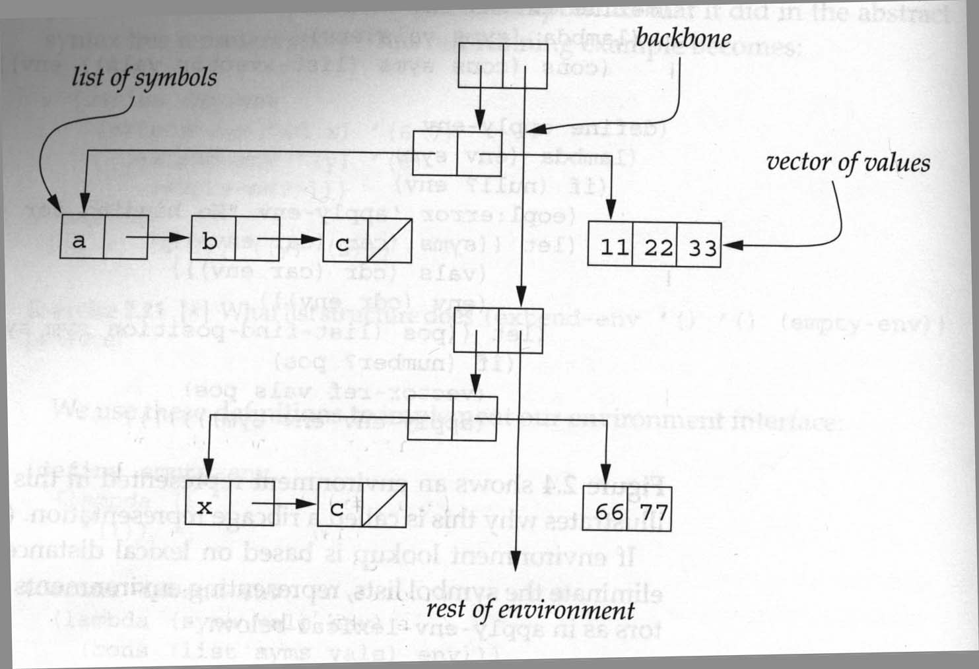
Ribcage structure

Slide 16
Top-level define
Note that define and set! do very different things
dynamic global environment vs static local environments
Should local environments extend the global environment?
If you do it, be careful!
If you do it, I do not want to help you with debugging that requires tracing!

Slide 17
Multiple Return Values
Call-with-values, with-values, mv-let

Slide 18
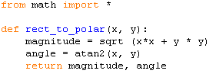
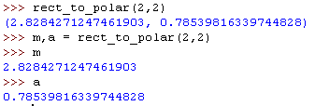
Wouldn't it be nice …
if a procedure could return multiple values?
Like in Python:
Notes:
In a functional environment it's a little bit trickier.
We have to have a way of providing the context in which the multiple values will be used.

Slide 19
values, call-with-values, with-values, mvlet
Multi-value returns in a functional programming context

Slide 20
Ongoing Example
Suppose we want to calculate list-average using just one traversal of the non-empty list.
First approach Helper procedure returns a list of the sum and the length.
(define list-average
(letrec ([helper (lambda (L)
(if (null? L)
(list 0 0) ; sum, length
(let ([return (helper (cdr L))])
(list (+ (car return) (car L))
(+ 1 (cadr return))))))])
(lambda (L)
(apply / (helper L)))))

Slide 21
values, call-with-values
The values procedure returns multiple values.
the call-with-values procedure provides a context for the reception of multiple return values.
(values v1 ...) returns the values v1 ...
(call-with-values producer consumer)
producer is a procedure that is allowed to be applied to zero arguments, and
consumer is a procedure that can be applied to the number of values that will be returned by producer. The producer will usually use values to return its values.

Slide 22
call-with-values examples
Simple example:
>(call-with-values (lambda () (values 3 4))
cons)
(3 . 4)
Unusual examples that illustrate how call-with-values works
> (call-with-values values (lambda args args))
> (call-with-values + list)
> (call-with-values list list)

Slide 23
call-with-values examples
Simple example:
> (call-with-values (lambda () (values 3 4)) list)
(3 4)
Unusual examples that illustrate how call-with-values works.
> (call-with-values values (lambda args args))
()
> (call-with-values + list)
(0)
> (call-with-values list list)
(())
Notes:
Don't print put the answers in the PDF!

Slide 24
A simple example from TSPL
Split a list into elements from even and odd positions of original list.
(define split
(lambda (ls)
(if (or (null? ls) (null? (cdr ls)))
(values ls '())
(call-with-values
(lambda () (split (cddr ls)))
(lambda (odds evens)
(values (cons (car ls) odds)
(cons (cadr ls) evens)))))))
> (split '(a b c d e f))
(a c e)
(b d f)
> (list (split '(a b c d e f)))
Exception: returned two values to single value return context
> (call-with-values (lambda () (split '(a b c d e f))) list)
((a c e) (b d f))
Notes:
The two calls illustrate what happens when the result of calling values is returned to the REP context, and when the values are passed to a procedure (list).

Slide 25
Version of list-average that uses call-with-values
(define list-average
(letrec ([helper (lambda (L)
(if (null? L)
(values 0 0) ; sum, length
(call-with-values
(lambda () (helper (cdr L)))
(lambda (sum len)
(values (+ sum (car L)) (+ 1 len))))))])
(lambda (L)
(call-with-values (lambda ()(helper L))
/))))

Slide 26
with-values
Most of the time when we use call-with-values, the
(lambda () ...) is just a wrapper for the code we really want to execute
We can define a new syntactic form to simplify this.
(define-syntax with-values
(syntax-rules ()
[(_ expr consumer)
(call-with-values (lambda () expr)
consumer)]))
Why can't with-values be a procedure?
Example of with-values:
> (with-values (split '(a b c d e f)) list)
((a c e) (b d f))

Slide 27
Shorter version of list-average that uses with-values
(define list-average
(letrec ([helper
(lambda (L)
(if (null? L)
(values 0 0) ; sum, length
(with-values
(helper (cdr L))
(lambda (sum len)
(values (+ sum (car L)) (+ 1 len))))))])
(lambda (L)
(with-values (helper L) / ))))
Notes:
This cuts out two uses of (lambda () …)

Slide 28
mv-let (mv is for multiple-valued)
For the frequent case where the consumer is also defined by (lambda ...), here is another convenient abbreviation:
(define-syntax mvlet
(syntax-rules ()
((_ ((x ...) e0) e1 e2 ...)
(with-values e0
(lambda (x ...) e1 e2 ...)))))

Slide 29
list-average using mv-let
(define list-average
(letrec
([helper
(lambda (L)
(if (null? L)
(values 0 0) ; sum, length
(mvlet ((sum len)
(helper (cdr L)))
(values (+ sum (car L))
(+ 1 len)))))])
(lambda (L)
(with-values (helper L) / ))))

Slide 30
Some practice exercises
Use call-with-values or one of the simplified versions to write:
(subst-leftmost s1 s2 slist) substitutes the symbol s1 for the leftmost occurrence of the symbol s2 in slist; all later occurrences of s2 are left unchanged. No subpart of slist is traversed more than once, and once (if ever) the leftmost occurrence of s2 has been found, previously untraversed portions of slist are not traversed.
(max-interior bintree) from the homework.

Slide 31
Preview
The rest of the slides are a preview of the next class session.

Slide 32
Warm-up for call/cc
Loosely based the book Scheme and the Art of Programming by George Springer and Daniel Friedman.
Receivers
Escape procedures
call/cc involves both receivers and escape procedures, so we look at both of those first

Slide 33
Review of Continuations
Consider the evaluation of the expression:
(let ([x (+ y 2)]) (if (< x 4) 5 (- x 6))
What is the continuation of (+ y 2) ? 6 ? (- x 6) ? (< x 4) ?
Notes:
I plan to go slow. Please don't let anything go over your head today. We can revisit anything!

Slide 34
Receivers
A receiver is an argument (which happens to also be a procedure) passed to a procedure, with the intention that the procedure will eventually pass values to that receiver.
Example: The continuations that we pass to CPS procedures are receivers.
Sometimes receivers are called "callbacks"

Slide 35
Old Receiver Example: call-with-values
> (call-with-values (lambda () (values 3 4)) list) (3 4)
list is a receiver (we previously called it the consumer)

Slide 36
new receiver example
From TSPL: The following shows the use of call-with-output-file to write a list of objects (the value of list-to-be-printed), separated by newlines, to the file named by "myfile.ss."
(call-with-output-file "myfile.ss" (lambda (p) ; this is the "receiver"
(let f ([ls list-to-be-printed]) (if (not (null? ls)) (begin (write (car ls) p) (newline p) (f (cdr ls)))))))
The receiver expects to receive an output port as its argument
(define call-with-output-file (lambda (filename proc) (let ((p (open-output-file filename))) (let ((v (proc p))) (close-output-port p) v))))

Slide 37
An escape procedure
Suppose that we have a procedure escape-+ that adds its arguments and returns this sum as the final answer, no matter what the context.
(* (escape‑+ 5 6) 3) ➔
(escape-+ (escape-+ 2 4) 5) ➔
Notes:
We can say that escape-+ ignores the current continuation, or "escapes from" the current continuation.
Answers: 11, 6

Slide 38
Escaper (a mostly fictitious procedure)
More generally, suppose that we have a procedure escaper that takes a procedure as an argument and returns an equivalent escape procedure.
(escaper +) creates a procedure that is equivalent to escape-+
(+ 3 ((escaper +) 4 5)) ➔
(+ ((escaper (lambda (x) (- (* x 3) 7))) 5) 4) ➔
Notes:
Answers: 9, 8

Slide 39
You can experiment with escaper
If you want to experiment with escaper, you can define it by loading escaper.ss in the following way:
escaper.ss is linked from the schedule page
C:\Users\anderson>cd C:\SVN\304\www\Resources
C:\SVN\304\www\Resources>petite escaper.ss
Petite Chez Scheme Version 9.5
Copyright 1984-2017 Cisco Systems, Inc.
> ((call/cc receiver-4))
escaper is defined
> (cdr ((escaper cdr) '(4 5 6)))
(5 6)
>
Notes:
Do it.

Slide 40
Escape Procedures
Let p be a procedure. If an application of p abandons the current continuation and does something else instead, we call p an escape procedure.
An example of a Scheme escape procedure that we have already used:
Is escaper an escape procedure?
Notes:
Answers: error, exit

