Slide 1
CSSE 304 Day 25
CPS Pitfalls
Add letrec to the interpreted language
Reminder: Submit your interesting test cases to the interpreter-project folder on Piazza.

Slide 2
CPS tips
The one thing to avoid:
A call to a substantial procedure in a non-tail position.
apply-k is a substantial procedure; make-k is not.
Whenever you get an answer without doing a substantial call, don’t forget to call apply-k.
Ask "what happens next", and put it on the outside of the remaining code, with later things "inside", as part of the continuation.
If you think the continuation of a recursive call should be (lambda(v) v), or init-k in the case of datatype continuations, there's a good chance that your code is not actually in tail form.
Regardless of what the server says, no credit if code is not in tail form

Slide 3
Some incorrect CPS code
All of this code was submitted by students in previous terms.
(define set?-cps
(lambda (ls k)
(cond
[(null? ls) (apply-k k #t)]
[(member?-cps (car ls)
(cdr ls)
(make-k (lambda (v) v)))
(apply-k k #f)]
[else (set?-cps (cdr ls) k)])))
Which calls to substantial procedures are not in tail-position?

Slide 4
Some incorrect CPS code
All of this code was submitted by students in previous terms.
(define andmap-cps
(lambda (pred?-cps ls k)
(cond
[(null? ls) (apply-k k #t)]
[(pred?-cps (car ls)
(make-k (lambda (v) v)))
(andmap-cps pred?-cps
(cdr ls)
k)]
[else (apply-k k #f)])))
Which call(s) to non-primitive procedures is/are not in tail-position?

Slide 5
Some incorrect CPS code
(define identity (make-k (lambda (k) k)))
(define matrix?-cps
(lambda (m k)
(if (list?-cps m identity)
(if (not (null? m))
(if (not (null? (car m)))
(if (andmap-cps list?-cps m identity)
(if (andmap-cps
(make-cps
(lambda (L)
(= (length-cps L identity)
(length-cps (car m) identity))))
(cdr m)
identity)
(apply-k k #t)
(apply-k k #f))
(apply-k k #f))
(apply-k k #f))
(apply-k k #f))
(apply-k k #f))))
Which call(s) to non-primitive procedures is/are not in tail-position?

Slide 6
Some incorrect CPS code
Which call(s) to non-primitive procedures is/are not in tail-position?
(define matrix?-cps
(lambda (ls k)
(if (not (list?-cps ls
(make-k (lambda (v) v))))
(apply-k k #f)
(if (null? ls)
(apply-k k #f)
(if (null? (car ls))
(apply-k k #f)
(if (not (andmap-cps list?-cps ls
(make-k (lambda (v) v))))
(apply-k k #f)
(if (not (andmap-cps
(make-cps
(lambda (L)
(length-cps L
(lambda (v)
(= v (length-cps (car ls)
(make-k (lambda (v) v))))))))
(cdr ls)
(lambda (v) v)))
(apply-k k #f)
(apply-k k #t))))))))
What is common to all of the non-tail recursion "CPS calls" in all of these examples?

Slide 7
CPS and the future of 304
Practice writing CPS code (A15)
Add other features to interpreter (no CPS) (A16-17)
(In class weeks 7-8) Learn how call/cc works.
Convert interpreter to CPS (A 18a)
Use the data-structures representation of continuations in your interpreter
Use CPS interpreter to add call/cc to our interpreted language. (A 18b)
Convert CPS code to imperative form, check code for tail form (A 19)

Slide 8
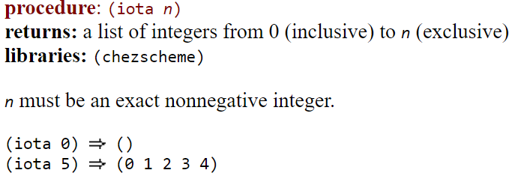

iota
From CSUG:
From Wikipedia:
For practice later: Use iota to write range:
(range 5 9) ➔ (5 6 7 8 9)

Slide 9
Add letrec to the interpreted language
Limited version of letrec
One that’s like the way letrec SHOULD always be used.
(letrec ([var <lambda-exp>] ... ) body body2 ... )
could be parsed into [letrec-exp
(proc-names (list-of symbol?))
(idss (list-of (list-of symbol?)))
(bodiess (list-of (list-of expression?)))
(letrec-bodies (list-of expression?)]
This is one possible way of parsing it. 0thers are also acceptable.

Slide 10
Example of a parsed letrec expression
[letrec-exp
(proc-names (list-of symbol?))
(idss (list-of (list-of symbol?)))
(bodiess (list-of (list-of expression?)))
(letrec-bodies (list-of expression?))]
This is one possible way of parsing it. 0thers are also accepta-ble.
(define odd?
(letrec ([odd? (lambda (n)
(if (zero? n)
#f
(even? (- n 1))))]
[even? (lambda (m)
(if (zero? m)
#t
(odd? (- m 1))))])
(lambda (x)
(odd? x))))
Parsed from of the blue code:
(letrec-exp
(odd? even?)
((n) (m))
(((if-exp (app-exp (var-exp zero?) (var-exp n)) …))
((if-exp (app-exp (var-exp zero?) (var-exp m)) …)))
((lambda-exp (x) ((app-exp (var-exp odd?) (var-exp x))))))

Slide 11
letrec Evaluation
Closures are created and added to the letrec environment
bodies of the letrec are evaluated in order
When one of the letrec closures is applied
new environment must extend the letrec environment
If it were let instead of letrec,
the new environment would extend the enclosing environment instead

Slide 12
How to evaluate letrec?
(define eval-exp
(lambda (exp env)
(cases expression exp
. . .
[letrec-exp (proc-names idss bodiess letrec-bodies)
(eval-bodies letrec-bodies
(extend-env-recursively
proc-names idss bodiess env))]
. . .
So the question becomes: how do we implement extend-env-recursively?
We saw when we drew
environment and closure diagrams that we need a recursive environment here

Slide 13
Extend-env-recursively: Three possible approaches
0. Implement extend-env-recursively in terms of Scheme's letrec. Nope!
1. No mutation: A new kind of environment extension: recursively-extended-env-record
2. Mutation: A normal extended environment, then use set-car! or vector-set! to implement the circularity.
Notes:
I really don't like 0.

Slide 14
Disclaimer
The succeed and fail arguments to the apply-env procedure
Add to the usability
but not to the initial understandability of the code when you see new environment approaches.
So I won't include them here.
Easy to add back in, once you understand each of these approaches to letrec implementation.

Slide 15
datatype for no-mutation approach
(define-datatype environment environment?
[empty-env-record]
[extended-env-record
(syms (list-of symbol?))
(vals (list-of scheme-value?))
(env environment?)]
[recursively-extended-env-record
(proc-names (list-of symbol?))
(idss (list-of (list-of symbol?)))
(bodiess (list-of (list-of expression?)))
(old-env environment?)])
We already had these two variants

Slide 16
Recursive extension without mutation
(define extend-env-recursively
(lambda (proc-names idss bodiess old-env)
(recursively-extended-env-record
proc-names idss bodiess old-env)))

Slide 17
(define apply-env
(lambda (env sym)
(cases environment env
[empty-env-record ()(apply-global-env sym)]
[extended-env-record (syms vals env)
(let ((pos (list-find-position sym syms)))
(if (number? pos)
(list-ref vals pos)
(apply-env env sym)))]
[recursively-extended-env-record
(procnames idss bodiess old-env)
(let ([pos (list-find-position sym procnames)])
(if (number? pos)
(closure (list-ref idss pos)
(list-ref bodiess pos)
env)
(apply-env old-env sym)))])))
What is the disadvantage of this approach?
Why not simply do it like let environments?
Notes:
Disadvantage: We have to re-create the closures every time we apply one of the letrec-bound procedures.

Slide 18
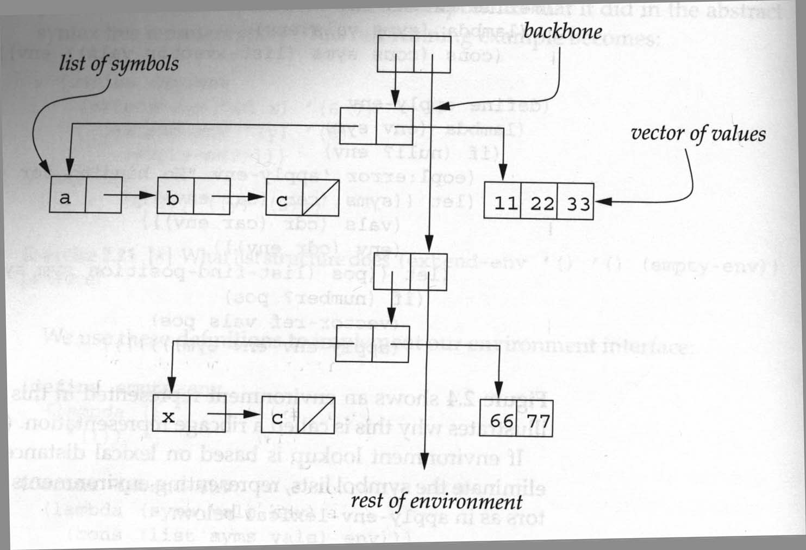
Mutation solution: Uses the ribcage implementation of environments.

Slide 19
Mutation solution: Uses the ribcage implementation of environments.
(define extend-env-recursively
(lambda (proc-names idss bodiess old-env)
(let ([len (length proc-names)])
(let ([vec (make-vector len)])
(let ([env (extended-env-record
proc-names vec old-env)])
(for-each
(lambda (pos ids bodies)
(vector-set! vec
pos (closure ids bodies env)))
(iota len) idss bodiess)
env)))))
With this representation, we can use the original extended-env-record and apply-env; it does not need the additional case for recursive environments.
This let has two bodies
(iota 4) ➔ (0 1 2 3)
You can easily write the code…

Slide 20
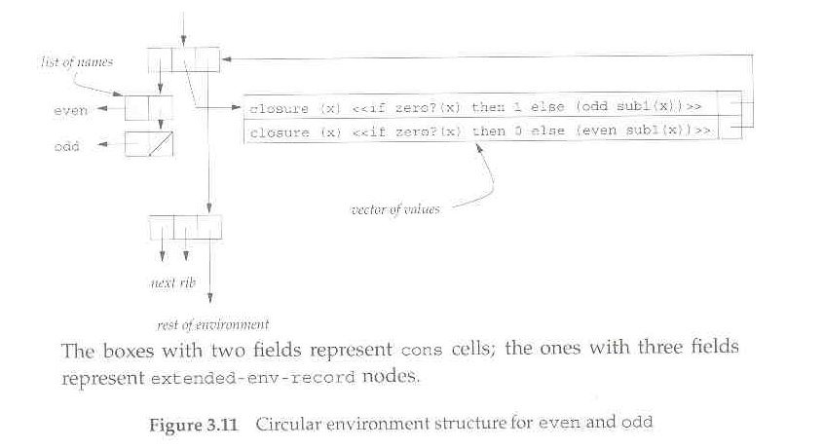
Note that in this mutation approach, we do not need recursively-extended-env-records, and we do not have to change apply-env at all.

Slide 21
Another Mutation solution: Expand the source code using syntax-expand.
(define odd?
(letrec ([o? (lambda (n)
(if (zero? n)
#f
(e? (- n 1))))]
[e? (lambda (m)
(if (zero? m)
#t
(o? (- m 1))))])
o?))
How can we expand this to an expression involving let and set! ?
Notes:
Write the translation to let with set! on the boaard

Slide 22
Onward to set! implementation.
We may will not get here on Monday.

Slide 23
Binding vs. Assignment
A binding creates a new name and associated value.
In Scheme, accomplished by define, let, letrec, or application of a closure
An assignment changes the value of a variable an existing binding.
set!, or top-level define of an already-defined variable.

Slide 24
Add set! to the interpreter
r-values vs l-values
x = x + 1;
We need a way of changing the value of a bound variable
Why doesn't the current setup support this?
How can we fix this?

Slide 25
Add set! to the interpreter
ADT approach: Add a new environment observer:
(apply-env-ref env var) returns a reference to the variable in question.
(deref ref) gets the value stored in the location that is referenced by ref.
(set-ref! ref value) changes the value stored there
If we have apply-env-ref, then apply-env does not have to be a basic operation of the environment datatype:
(define apply-env
(lambda (env var)
(deref (apply-env-ref env var))))
but it may be more efficient to implement apply-env directly (in a representation-dependent way).

Slide 26
Implementing set!
Once we have references, it is easy. A new clause for eval-exp's cases:
[set!-exp (id exp) (set-ref! (apply-env-ref env id) (eval-exp exp env))]
All that is left to do is to implement references! (we'll look at multiple approaches)

