Slide 1
CSSE 304 Day 25
More CPS procedures
succeed and fail continuations
CPS Pitfalls

Slide 2
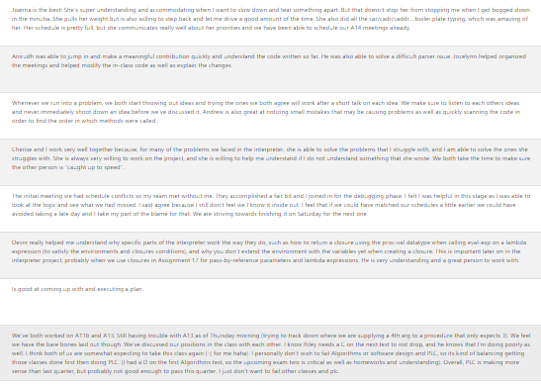

Slide 3
Succeed and fail continuations
(define prod-cps ; fill in the continuations at the end
(lambda (L succeed fail)
(cond [(null? L) (apply-k succeed 1)]
[(zero? (car L)) (apply-k fail)]
[else (prod-cps (cdr L)
Code that uses prod-cps:
(define print-list-product
(lambda (list)
(prod-cps list
(make-k(lambda (prod)
(printf "The product is ~s~n" prod)))
(make-k (lambda ()
(printf "zero found, product is 0”)))))
(define apply-k
(lambda (k . vals)
(apply k vals)))

Slide 4
Subst-leftmost with continuations
What does subst-leftmost do?
Why was it hard?

Slide 5
(define substitute-leftmost
(lambda (new old slist)
(subst-left-cps
new
old
slist
(make-k (lambda (v) v))
; succeed continuation
(make-k (lambda () slist))
; fail continuation
)))
(define subst-left-cps
(lambda (new old slist changed unchanged)
(let loop ([slist slist]
[changed changed]
[unchanged unchanged])
(cond
[(null? slist) (apply-k unchanged)]
; fill in the rest (next slide)
A solution with succeed and fail continuations may be better…

Slide 6
(define subst-left-cps ; changed and unchanged are continuations
(lambda (new old slist changed unchanged)
(let loop ([slist slist] [changed changed] [unchanged unchanged])
(cond
[(null? slist) (apply-k unchanged)]
[(symbol? (car slist))
(if (eq? (car slist) old)
(apply-k changed (cons new (cdr slist)))
(loop (cdr slist)
(make-k (lambda (substituted-cdr)
(apply-k changed
(cons (car slist) substituted-cdr))))
unchanged))]
[else ; car is an s-list
(loop (car slist)
(make-k (lambda (substituted-car)
(apply-k changed (cons substituted-car (cdr slist)))))
(make-k (lambda ()
(loop (cdr slist)
(make-k (lambda (substituted-cdr)
(apply-k changed
(cons (car slist) substituted-cdr))))
unchanged))))]))))
(define apply-k
(lambda (k . vals)
(apply k vals)))
Green boxes: changed continuations Red boxes: unchanged continuations
Notes:
Hide this slide when making PDF for students, then unhide for class

Slide 7
Some incorrect CPS code
All of this code was submitted by students in previous terms.
(define set?-cps
(lambda (ls k)
(cond
[(null? ls) (apply-k k #t)]
[(member?-cps (car ls)
(cdr ls)
(make-k (lambda (v) v)))
(apply-k k #f)]
[else (set?-cps (cdr ls) k)])))
Which call(s) to non-primitive procedures is/are not in tail-position?

Slide 8
Some incorrect CPS code
All of this code was submitted by students in previous terms.
(define andmap-cps
(lambda (pred?-cps ls k)
(cond
[(null? ls) (apply-k k #t)]
[(pred?-cps (car ls)
(make-k (lambda (v) v)))
(andmap-cps pred?-cps
(cdr ls)
k)]
[else (apply-k k #f)])))
Which call(s) to non-primitive procedures is/are not in tail-position?

Slide 9
Some incorrect CPS code
(define identity (make-k (lambda (k) k)))
(define matrix?-cps
(lambda (m k)
(if (list?-cps m identity)
(if (not (null? m))
(if (not (null? (car m)))
(if (andmap-cps list?-cps m identity)
(if (andmap-cps
(make-cps
(lambda (L)
(= (length-cps L identity)
(length-cps (car m) identity))))
(cdr m)
identity)
(apply-k k #t)
(apply-k k #f))
(apply-k k #f))
(apply-k k #f))
(apply-k k #f))
(apply-k k #f))))
Which call(s) to non-primitive procedures is/are not in tail-position?

Slide 10
Some incorrect CPS code
Which call(s) to non-primitive procedures is/are not in tail-position?
(define matrix?-cps
(lambda (ls k)
(if (not (list?-cps ls
(make-k (lambda (v) v))))
(apply-k k #f)
(if (null? ls)
(apply-k k #f)
(if (null? (car ls))
(apply-k k #f)
(if (not (andmap-cps list?-cps ls
(make-k (lambda (v) v))))
(apply-k k #f)
(if (not (andmap-cps
(make-cps
(lambda (L)
(length-cps L
(lambda (v)
(= v (length-cps (car ls)
(make-k (lambda (v) v))))))))
(cdr ls)
(lambda (v) v)))
(apply-k k #f)
(apply-k k #t))))))))
What is common to all of the non-tail recursion "CPS calls" in all of these examples?

Slide 11
CPS and the future of 304
Practice writing CPS code (A15)
Add other features to interpreter (no CPS) (A16-17)
Learn about data structures representation of continuations.
Convert interpreter to CPS (A 18)
Use the data-structures representation of continuations in your interpreter
Use CPS interpreter to add call/cc to our interpreted language. (A 18)
Convert CPS code to imperative form, check code for tail form (A 19)

Slide 12
Another CPS example
We will not do it in class
It is part of HW 15
cps-list-recur (next slide)

Slide 13
cps-list-recur
Not a cps procedure itself,
but produces cps procedures
Arguments: A base-value a cps-procedure
> (define +-cps ; you will generalize
(lambda (a b k) ; this in make-cps (A15)
(apply-k k (+ a b))))
> (define list-sum-cps
(cps-list-recur 0 +-cps))
> (list-sum-cps '(1 2 3 4)
(make-k (lambda (v) (+ v 1000))))
1010
Notes:
(define cps-list-recur
(lambda (base proc-cps)
(letrec ([helper
(lambda (ls k)
(if (null? ls)
(k base)
(helper (cdr ls)
(lambda (cdr-result)
(proc-cps (car ls) cdr-result k)))))])
helper)))
(define list-sum-cps
(cps-list-recur 0 (lambda (x y k) (k (+ x y)))))
(list-sum-cps '( 4 0 2 5 1) list)

Slide 14
Back to Writing the interpreter
We interrupt our CPS-ing to resume the interpreter discussion, so you can get started on A16. You should work on A16 with your partner while you work on A15 yourself.
Next we add letrec to the interpreted language…

Slide 15
Add letrec to the interpreted language
Limited version of letrec
One that’s like the way letrec SHOULD always be used.
(letrec ([var <lambda-exp>] ... ) body body2 ... )
could be parsed into [letrec-exp
(proc-names (list-of symbol?))
(idss (list-of (list-of symbol?)))
(bodiess (list-of (list-of expression?)))
(letrec-bodies (list-of expression?)]
This is one possible way of parsing it. 0thers are also acceptable.

Slide 16
Example of a parsed letrec expression
[letrec-exp
(proc-names (list-of symbol?))
(idss (list-of (list-of symbol?)))
(bodiess (list-of (list-of expression?)))
(letrec-bodies (list-of expression?))]
This is one possible way of parsing it. 0thers are also acceptable.
(define odd?
(letrec ([odd? (lambda (n)
(if (zero? n)
#f
(even? (- n 1))))]
[even? (lambda (m)
(if (zero? m)
#t
(odd? (- m 1))))])
(lambda (x)
(odd? x))))
Parsed form of the blue code:
(letrec-exp
(odd? even?)
((n) (m))
(((if-exp (app-exp (var-exp zero?) (var-exp n)) …))
((if-exp (app-exp (var-exp zero?) (var-exp m)) …)))
((lambda-exp (x) ((app-exp (var-exp odd?) (var-exp x))))))

Slide 17
letrec Evaluation
Closures are created and added to the letrec environment
bodies of the letrec are evaluated in order
When one of the letrec closures is applied
new environment must extend the letrec environment
If it were let instead of letrec,
the new environment would extend the enclosing environment instead

Slide 18
How to evaluate letrec?
We saw when we drew
environment and closure diagrams that we need a recursive environment here
(define eval-exp
(lambda (exp env)
(cases expression exp
. . .
[letrec-exp
(proc-names idss bodiess letrec-bodies)
(eval-bodies letrec-bodies
(extend-env-recursively
proc-names idss bodiess env))]
…
So the question becomes: how do we implement extend-env-recursively?

Slide 19
Extend-env-recursively: Three possible approaches
0. Implement extend-env-recursively in terms of Scheme's letrec. Nope!
1. No mutation: A new kind of environment extension: recursively-extended-env-record
2. Mutation: A normal extended environment, then use vector-set! to fix things up.
Notes:
I really don't like 0.

Slide 20
Disclaimer
The succeed and fail arguments to the apply-env procedure
Add to the usability
but not to the initial understandability of the code when you see new environment approaches.
So I won't include them here.
Easy to add back in, once you understand each of these approaches to letrec implementation.

Slide 21
datatype for no-mutation approach
(define-datatype environment environment?
[empty-env-record]
[extended-env-record
(syms (list-of symbol?))
(vals (list-of scheme-value?))
(env environment?)]
[recursively-extended-env-record
(proc-names (list-of symbol?))
(idss (list-of (list-of symbol?)))
(bodiess (list-of (list-of expression?)))
(env environment?)])
We already had these two variants

Slide 22
Recursive extension without mutation
(define extend-env-recursively
(lambda (proc-names idss bodiess old-env)
(recursively-extended-env-record
proc-names idss bodiess old-env)))

Slide 23
What is the disadvantage of this approach?
(define apply-env
(lambda (env sym)
(cases environment env
[empty-env-record ()(apply-global-env sym)]
[extended-env-record (syms vals env)
(let ((pos (list-find-position sym syms)))
(if (number? pos)
(list-ref vals pos)
(apply-env env sym)))]
[recursively-extended-env-record
(procnames idss bodiess old-env)
(let ([pos (list-find-position sym procnames)])
(if (number? pos)
(closure (list-ref idss pos)
(list-ref bodiess pos)
env)
(apply-env old-env sym)))])))
Notes:
Disadvantage: We have to re-create the closures every time we apply one of the letrec-bound procedures.

Slide 24
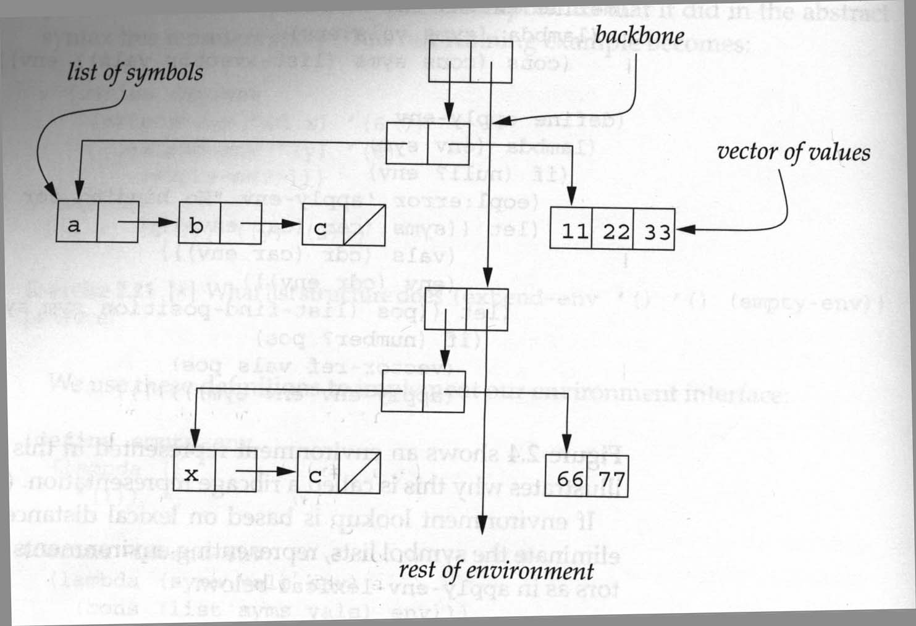
Mutation solution: Uses the ribcage implementation of environments.

Slide 25
Mutation solution: Uses the ribcage implementation of environments.
With this representation, we can use the original extended-env-record and apply-env; it does not need the additional case for recursive environments.
(define extend-env-recursively
(lambda (proc-names idss bodiess old-env)
(let ([len (length proc-names)])
(let ([vec (make-vector len)])
(let ([env (extended-env-record
proc-names vec old-env)])
(for-each
(lambda (pos ids bodies)
(vector-set! vec
pos (closure ids bodies env)))
(iota len) idss bodiess)
env)))))
This let has two bodies
(iota 4) ➔ (0 1 2 3)
You can easily write the code…

Slide 26
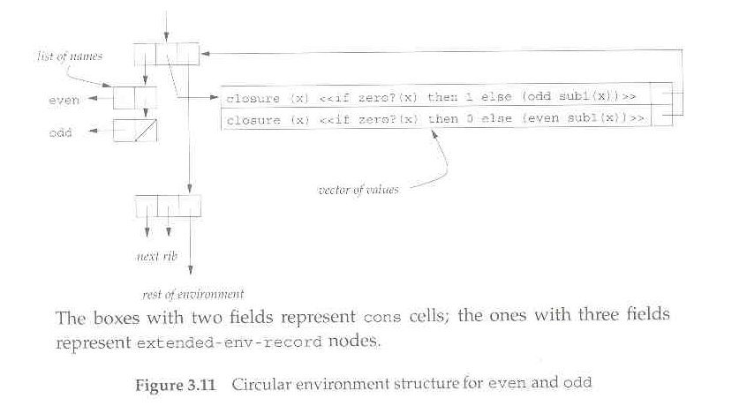

Slide 27
Another Mutation solution: Expand the source code using syntax-expand.
(define odd?
(letrec ([o? (lambda (n)
(if (zero? n)
#f
(e? (- n 1))))]
[e? (lambda (m)
(if (zero? m)
#t
(o? (- m 1))))])
o?))
How can we expand this to an expression involving let and set! ?
Notes:
Write the translation to let with set! on the boaard

