Slide 1
CSSE 304 Days 27 - 29
Receivers
Escape procedures
Call-with- procedures
Review continuations
Intro to call/cc
call/cc examples
Notes:
To add:
Good and bad code for letrec
To take:
Springer/Friedman excerpt to read

Slide 2
Warm-up for call/cc
Receivers
Escape procedures Continuations
call/cc involves both receivers and escape procedures, so we first define both of those.
Then we review continuations.

Slide 3
My discussion of call/cc is loosely based the book Scheme and the Art of Programming by George Springer and Daniel Friedman.

Slide 4
Review of Continuations
Consider the evaluation of the expression:
(let ([x (+ y 2)]) (if (< x 4) 5 (- x 6))
What is the continuation of 6 ? (+ y 2) ? (- x 6) ? (< x 4)
Notes:
I plan to go slow. Please don't let anything go over your head today. We can revisit anything!

Slide 5
Receivers
A receiver is an argument (which also happens to also be a procedure) passed to a procedure, with the intention that the procedure will eventually apply that receiver to some values; i.e. pass values to that receiver.
Example: When we represent continuations by Scheme procedures, those continuations that we pass to CPS procedures are receivers. (lambda (v) …) They expect to receive a value for v.
Sometimes receivers are called callbacks.

Slide 6
Old Receiver Example: call-with-values
> (call-with-values (lambda () (values 3 4)) list) (3 4)
list is a receiver (we previously called it the consumer)

Slide 7
new receiver example
From TSPL: The following shows the use of call-with-output-file to write a list of objects (the value of list-to-be-printed), separated by newlines, to the file named "myfile.ss."
(call-with-output-file "myfile.ss" (lambda (p) ; this is the "receiver"
(let f ([ls list-to-be-printed]) (if (not (null? ls)) (begin (write (car ls) p) (newline p) (f (cdr ls)))))))
The receiver expects to receive an output port as its argument
(define call-with-output-file (lambda (filename proc) (let ((p (open-output-file filename))) (let ((v (proc p))) (close-output-port p) v))))

Slide 8
An escape procedure
Pretend that we have a procedure escape-+ that adds its arguments and returns this sum as the final answer, no matter what the context.
(* (escape‑+ 5 6) 3) ➔
(escape-+ (escape-+ 2 4) 5) ➔
Notes:
We can say that escape-+ ignores the current continuation, or "escapes from" the current continuation.
Answers: 11, 6

Slide 9
An escape procedure
Pretend that we have a procedure escape-+ that adds its arguments and returns this sum as the final answer, no matter what the context.
(* (escape‑+ 5 6) 3) ➔ 11
(escape-+ (escape-+ 2 4) 5) ➔ 6
Notes:
We can say that escape-+ ignores the current continuation, or "escapes from" the current continuation.
Answers: 11, 6

Slide 10
Escaper (a mostly fictitious procedure)
More generally, suppose that we have a procedure escaper that takes any procedure as an argument and returns an equivalent escape procedure.
Thus (escaper +) creates a procedure that is equivalent to escape-+
(+ 3 ((escaper +) 4 5)) ➔
(+ ((escaper (lambda (x) (- (* x 3) 7))) 5) 4) ➔
Notes:
Answers: 9, 8

Slide 11
Escaper (a mostly fictitious procedure)
More generally, suppose that we have a procedure escaper that takes a procedure as an argument and returns an equivalent escape procedure.
(escaper +) creates a procedure that is equivalent to escape-+
(+ 3 ((escaper +) 4 5)) ➔ 9
(+ ((escaper (lambda (x) (- (* x 3) 7))) 5) 4) ➔ 8
Notes:
Answers: 9, 8

Slide 12
You can experiment with escaper
You can define escaper in Chez Scheme by loading escaper.ss in the following way (from the command line):
escaper.ss is linked from the schedule page
sliderule 1:12pm > petite escaper.ss
Petite Chez Scheme Version 6.7
Copyright (c) 1985-2001 Cadence Research Systems
> ((call/cc receiver-4))
"escaper is defined"
> (cdr ((escaper cdr) '(4 5 6)))
(5 6)
Notes:
Do it.

Slide 13
Escape Procedures
Let p be a procedure. If an application of p abandons the current continuation and does something else instead, we call p an escape procedure.
An example of a Scheme escape procedure that we have already used:
Is escaper an escape procedure?
Notes:
Answer: error

Slide 14
"call-with" procedures
(call-with-values producer consumer)
The receiver is the consumer.
It receives the values returned by a call to the producer.
(call-with-output-file filename proc)
The receiver is proc.
It receives the output port obtained by opening the output file whose name is filename.
(call-with-current-continuation receiver)
The receiver receives the current continuation.

Slide 15
dining out example from Springer and Friedman, Part 5 intro
(define dine-out
(lambda (restaurant)
(enter restaurant)
(read-menu)
(let ([food-I-ordered
(order-some-food)])
(eat food-I-ordered)
(pay-for food-I-ordered restaurant)
(exit restaurant))))
For future reference:
A photograph corresponds to a continuation.
“Taking a photograph” corresponds to applying call/cc to a receiver.
The receiver receives the photograph (continuation).
Rubbing a photograph and escaping corresponds to applying a continuation to an argument.
I will read an excerpt from the book

Slide 16
Call/cc definition and exampleS

Slide 17
call/cc
call/cc is an abbreviation for call‑with‑current‑continuation .
call/cc is a procedure that takes one argument; the argument is a receiver.
this receiver is a procedure that takes one argument; that argument (in this case) is a continuation.
A continuation is a procedure (that takes one argument); that continuation embodies the context of the application of call/cc. The continuation is an escape procedure.
The application (call/cc receiver) has the same effect as (receiver continuation), where the continuation is
an escape procedure that embodies the execution context of the entire call/cc expression.

Slide 18
call/cc definition summary
(call/cc receiver) ➔ (receiver current-continuation),
Hence the name: call‑with‑current‑continuation.
Rephrasing it: What is that continuation? If c (for context) is a procedure that represents the execution context of this application of call/cc, then the continuation is equivalent to (escaper c).
call/cc does not create the continuation. It “reifies” it.

Slide 19
call/cc example
(call/cc receiver) ➔ (receiver continuation)
a) (+ 3 (call/cc (lambda (k) (* 2 (k 5)))))
The receiver is
The context is
The continuation is
Thus (+ 3 (call/cc (lambda (k) (* 2 (k 5))))) is equivalent to

Slide 20
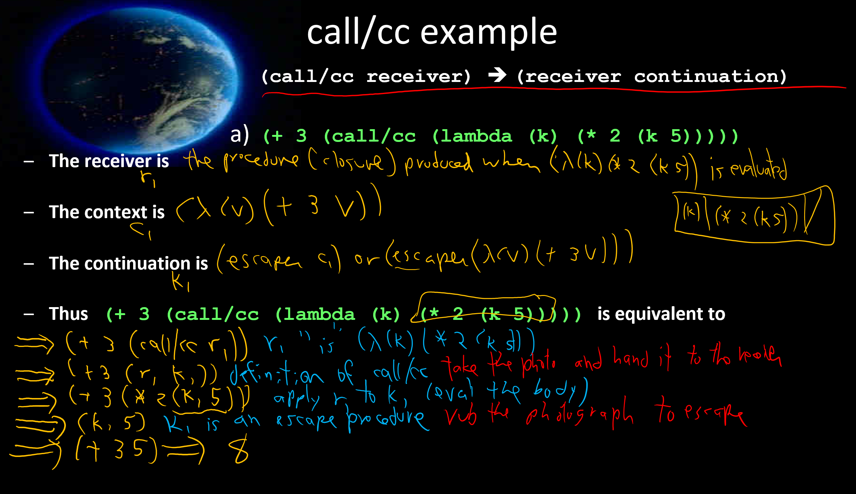

Slide 21
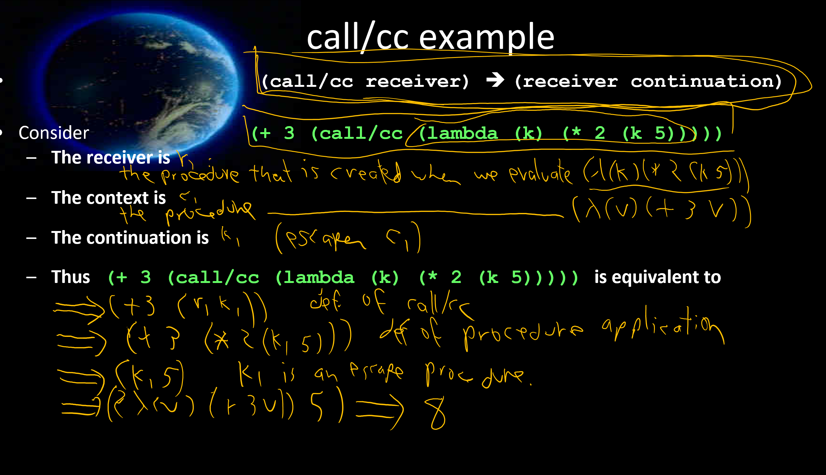

Slide 22
More call/cc examples
(call/cc receiver) ➔ (receiver continuation)
a) (+ 3 (call/cc (lambda (k) (* 2 (k 5)))))
b) (+ 3 (call/cc (lambda (k) (* 2 5))))
c) (+ 3 (call/cc (lambda (k) (k (* 2 5)))))
Notes:
Next day questions (use RSG):
What is a receiver?
Is call/cc a procedure, or syntax?
IS call/cc an escape procedure?
What does call/cc expect as its argument?
What is call/cc an abbreviation for?
What does the receiver receive?

Slide 23
More call/cc examples
(call/cc receiver) ➔ (receiver continuation)
d) (define xxx #f)
(+ 5 (call/cc (lambda (k)
(set! xxx k) 2))) ; xxx is equivalent to?
(* 7 (xxx 4))
Notes:
Next day questions (use RSG):
What is a receiver?
Is call/cc a procedure, or syntax?
IS call/cc an escape procedure?
What does call/cc expect as its argument?
What is call/cc an abbreviation for?
What does the receiver receive?

Slide 24
More call/cc examples
(call/cc receiver) ➔ (receiver continuation)
d) (define xxx #f)
(+ 5 (call/cc (lambda (k) take the photograph
(set! xxx k) save the photograph 2))) ; xxx is equivalent to?
(* 7 (xxx 4)) rub the photograph

Slide 25
A simple call/cc example (call/cc receiver) ➔ (receiver continuation)
e) (call/cc procedure?)

Slide 26
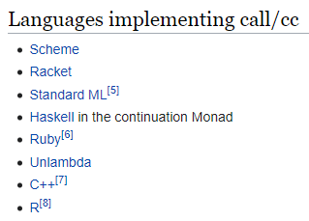
call/cc in other languages
https://en.wikipedia.org/wiki/Call-with-current-continuation#Languages_implementing_call/cc What you will find there:

Slide 27
f) List-index
But "standard recursion" seems so much more natural!
Standard approach: (define (list-index item L) (cond [(null? L) -1] [(eq? (car L) item) 0] [else (+ 1 (list-index item (cdr L)))]))
Can we use call/cc to escape with the -1 answer?
What is the problem with this?
One solution: accumulator approach

Slide 28
f) (define list-index
(lambda (sym L)
(call/cc
(lambda (answer)
(let loop ([L L])
(cond [(null? L) (answer -1)]
[(eqv? sym (car L)) 0]
[else (+ 1 (loop (cdr L)))]))))))
> (list-index 'a '(b a c))
1
> (list-index 'a '(b d c))
-1

Slide 29
(call/cc receiver) ➔ (receiver continuation)
g) ((car (call/cc list))
(list cdr 1 2 3))

Slide 30
Interlude: quotes
Premature optimization is the root of all evil in programming. - C.A.R. Hoare Do you know what he is famous for?
There is no code so big, twisted, or complex that maintenance can't make it worse. - Gerald Weinberg
Computer Science is the only discipline in which we view adding a new wing to a building as being maintenance. – Jim Horning

Slide 31
All this from that short code?
(call/cc receiver) ➔ (receiver continuation)
h) (let ([f #f] [i 0])
(call/cc (lambda (k) (set! f k)))
(printf "~a~n" i)
(set! i (+ i 1))
(if (< i 10) (f "ignore")))

Slide 32
Strange indeed!
i) (define strange1
(lambda (x)
(display 1)
(call/cc x)
(display 2)))
(strange1 (call/cc (lambda (k) k)))

Slide 33
“mondo bizarro” example
j)
(define strange2
(lambda (x)
(display 1)
(call/cc x)
(display 2)
(call/cc x)
(display 3)))
(strange2 (call/cc (lambda (k) k)))
We may not do this one in class; good practice for you.

