Slide 1
Who is this guy in front of the class?

Slide 2
Instructor Intro
Spent my first 18 years in Virginia.
Education
B.S. Caltech (Mathematics) 1975
Ph.D. Illinois (Mathematics) 1981
M.S. Indiana (Computer Science) 1987
Teaching
6 years at Wilkes University (at that time it was Wilkes college*)
31.3 years at Rose-Hulman
7 years part-time teaching in graduate school
* John Ciardi had something interesting to say about colleges vs universities.

Slide 3
Largest Consulting Gigs
Illinois Power (1981)
Pennsylvania Funeral Directors Association (1982-1988)
Navistar International (1994-95)
Beckman Coulter (1996-98)
ANGEL Learning (2005-2008)

Slide 4
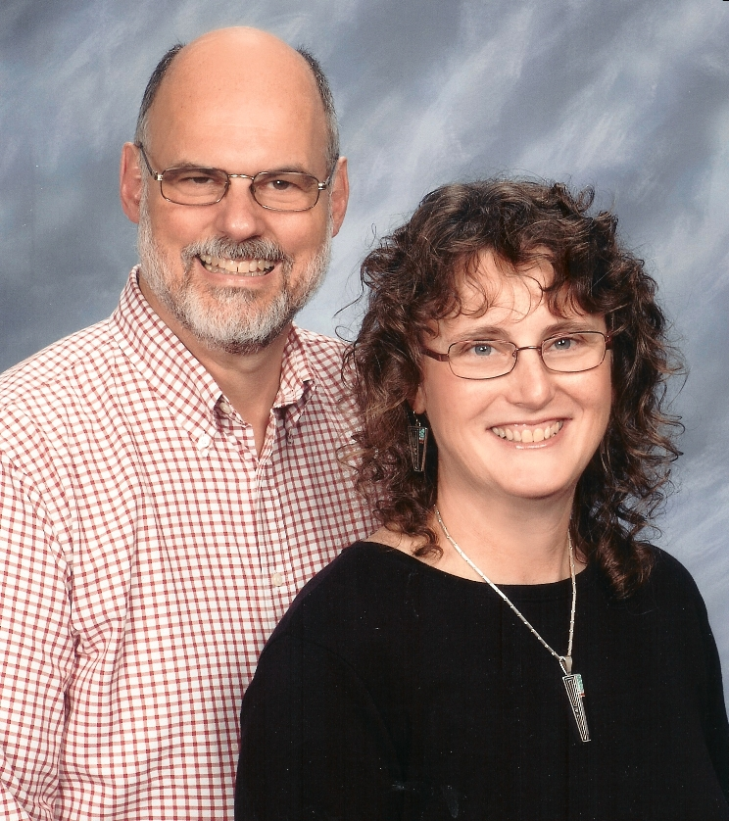
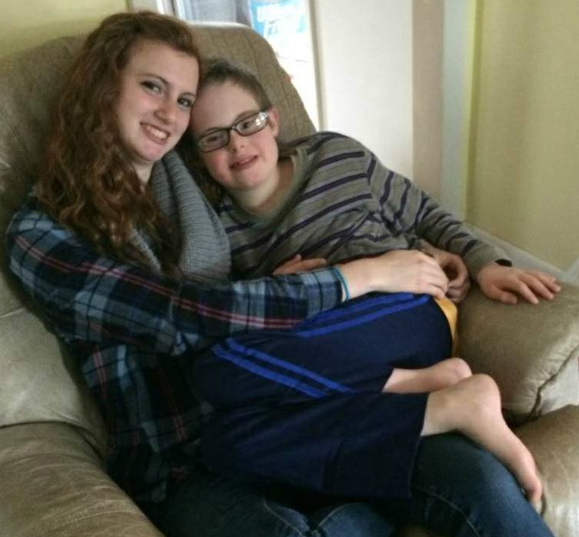
My Family (as of June 2018)
Nine children, aged 38-17
All home-schooled K-12
2 in college, 6 already graduated
Youngest, John, has Down Syndrome
13grandchildren, ages 12 years-23 days

Slide 5
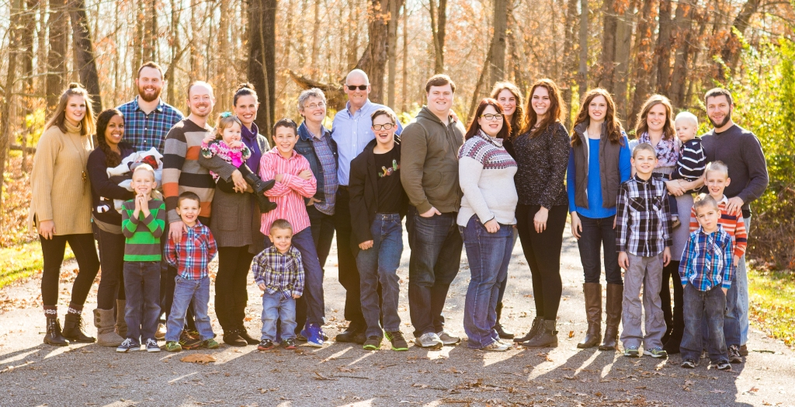
November, 2017

Slide 6
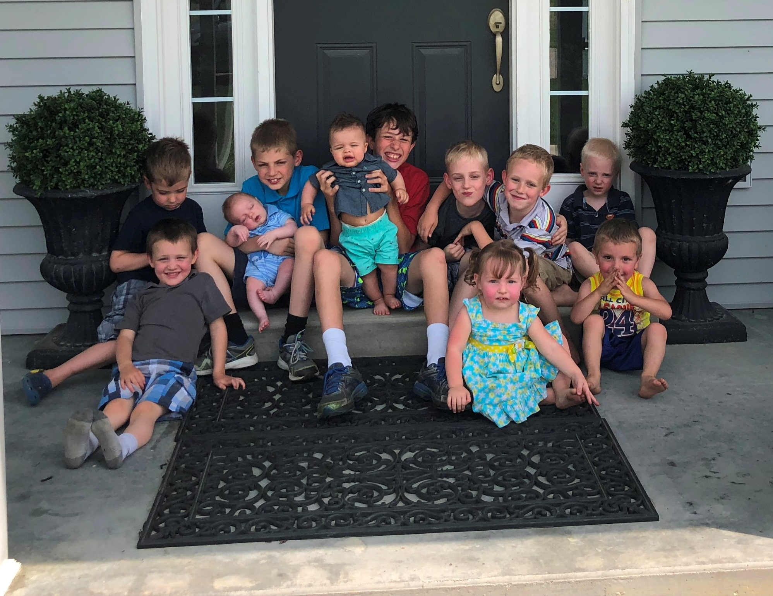
May, 2018

Slide 7
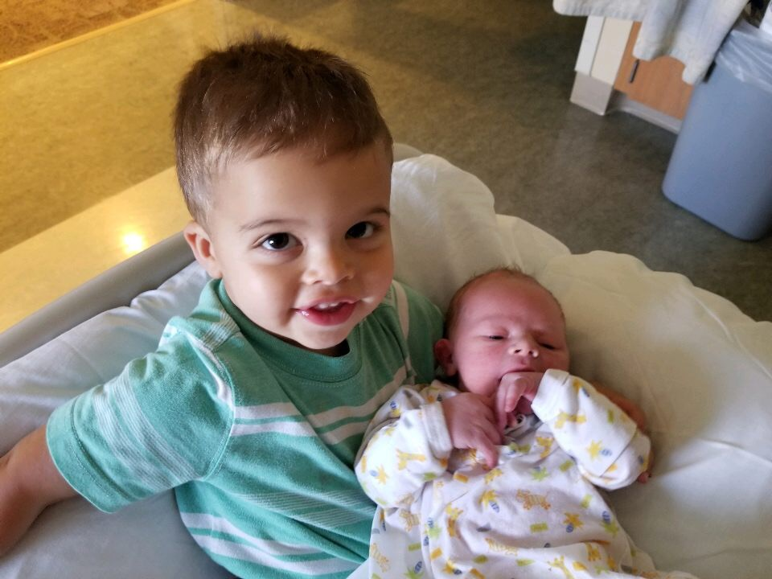
September, 2019

Slide 8
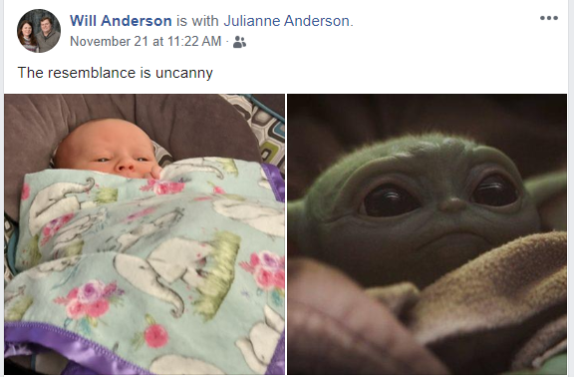
November, 2019

Slide 9
A Few Random Claude Facts
2019-20 is my 32nd year at Rose-Hulman.
Have taught about 22 different courses
I live very close to campus.
In 2010 I was diagnosed with a very rare connective tissue disease, scleromyxedema.
2-day IVIG infusions every 4-5 weeks. (incl. 10th week)
Despite ugly prognosis, I still know that God's in control.
I really like it when you put the course number as part of the subject line in your email to me.

Slide 10
A few of my favorite things
Jesus Christ's resurrection and his grace toward me (though I don't deserve it)
Rocky Mtn. National Park, Colorado & Nashville, Indiana
Kimchi, kombucha, fresh squeezed orange juice (in case you're thinking of bribes! ☺)
JRR Tolkien, CS Lewis, Robert Jordan, Ted Dekker, David McCullough, John Piper, David Baldacci, Laura Hillenbrand, Isaac Asimov, John Le Carre
Eric Metaxas

Slide 11
A few more of my favorite things
Mozart, Phil Keaggy, David Grisman, Bob Bennett, Vivaldi, MarchFourth Marching Band, Haydn, Herbie Mann, 4 King and Country
The Blind Side, Return of the King, The Mission, What's Up Doc, Saving Mr. Banks, Knight and Day, Woodlawn, Mom's Night Out, Return to Me, The Empire Strikes Back, War Room
Splitting wood to heat our house
Overdrive (thousands of free audiobooks and ebooks, RHIT students can join VCPL)
and Rose-Hulman, of course!

Slide 12
Another important thing about me (a surprising fact from my junior year at Caltech), …
… will be saved for another day so we have more time for course intro and Scheme today.
Stay tuned!

