Slide 1
CSSE 304 Day 3
Puzzle:
Can we overwrite lambda? I.e. (define (lambda n) (* n n)) ?
Announcements Call Roll
Instructor Intro
Course Intro
Recursion practice

Slide 2
Instructor Intro (More details on Moodle video)
Spent my first 18 years in Virginia.
Education
B.S. Caltech (Mathematics) 1975
Ph.D. Illinois (Mathematics) 1981
M.S. Indiana (Computer Science) 1987
Teaching
6 years at Wilkes University (née Wilkes college*)
29 years at Rose-Hulman
7 years part-time teaching in graduate school
* “A university is what a college becomes when the faculty loses interest in students. ” John Ciardi

Slide 3
A Few Random Claude Facts
2018-19 is my 31st year at Rose-Hulman
Have taught about 22 different courses
I live very close to campus
In 2010 I was diagnosed with a very rare connective tissue disease, scleromyxedema.
2-day infusions every 4 -5 weeks. Next ones Oct 1 and 3, and again later in the term.
Despite ugly prognosis, I still know that God's in control.
I really like it when you put 304 as part of the subject line in your email to me.

Slide 4
Largest Consulting Gigs
Illinois Power (1981)
Pennsylvania Funeral Directors Association (1982-1988)
Navistar International (1994-95)
Beckman Coulter (1996-98)
ANGEL Learning (2005-2008)

Slide 5
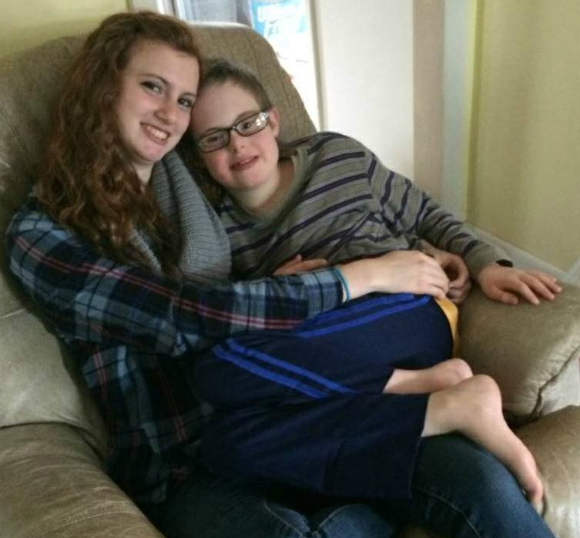
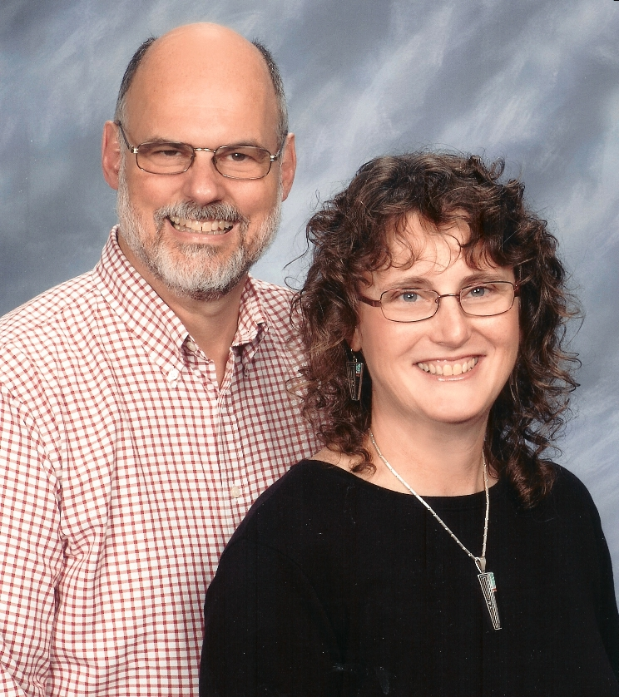
My Family
Nine children, aged 37-16
All home-schooled
1 in college, 6 graduated, 2 younger
Youngest, John, has Down Syndrome
11 grandkids

Slide 6
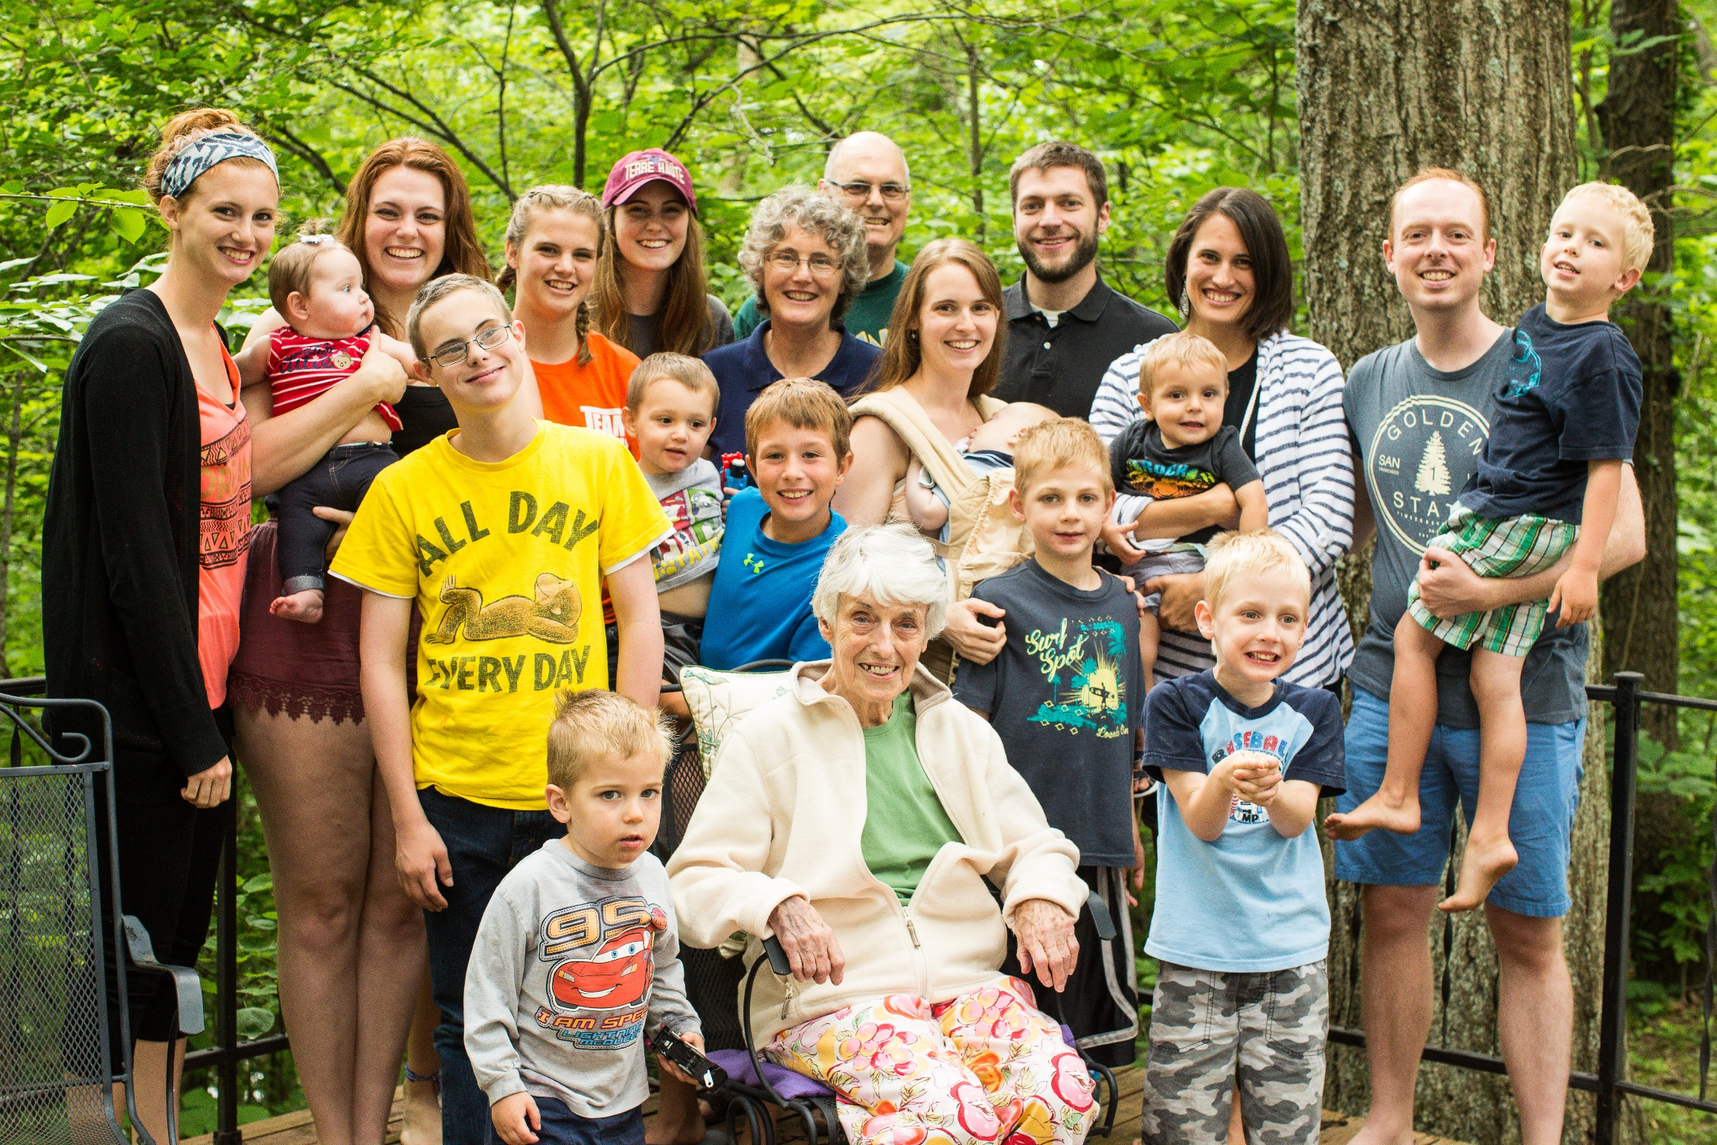

Slide 7
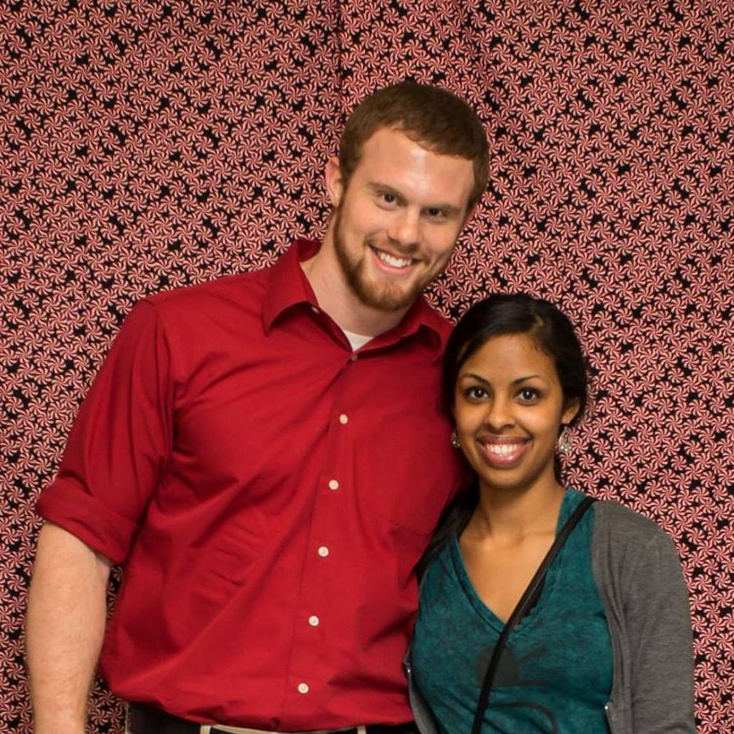
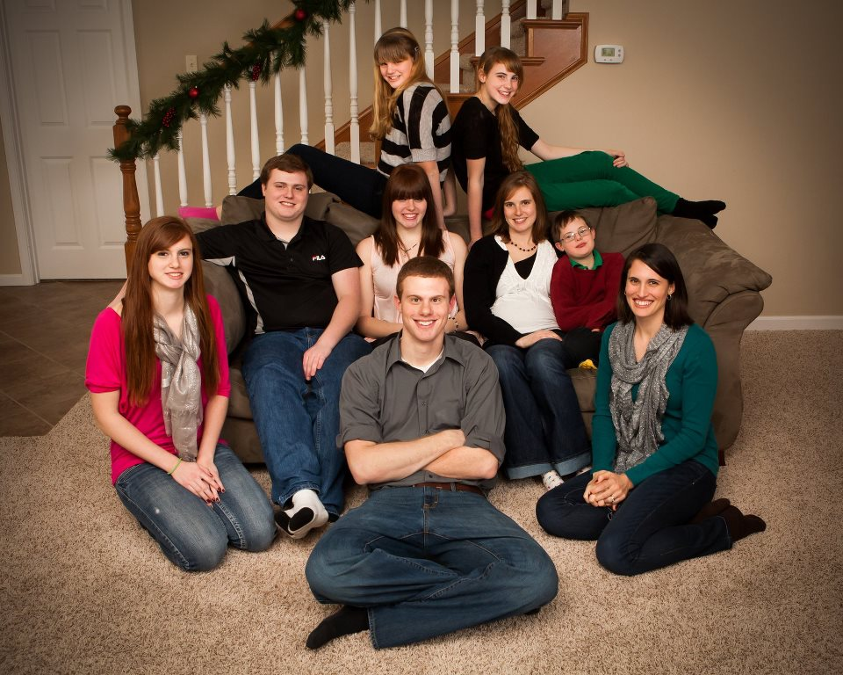


Slide 8
A few of my favorite things
Jesus Christ's resurrection and his grace toward me (though I don't deserve it)
Rocky Mtn. National Park & Nashville, Indiana
Kimchi, kombucha, fresh squeezed orange juice (in case you're thinking of bribes! ☺)
JRR Tolkien, CS Lewis, Robert Jordan, Ted Dekker, David McCullough, John Piper, David Baldacci
Mozart, Phil Keaggy, David Grisman, Bob Bennett, Vivaldi, MarchFourth Marching Band, Haydn
The Blind Side, Return of the King, The Mission, What's Up Doc, Saving Mr. Banks, Knight and Day, Woodlawn, Mom's Night Out, Return to Me
Splitting wood to heat our house
Overdrive (thousands of free audiobooks, join VCPL)
and Rose-Hulman, of course

Slide 9
Another important thing about me (a surprising fact from my junior year at Caltech), …
… will be saved for another day so we have some time for Scheme today.
Stay tuned!

Slide 10
Rumors about the course
You may have heard these:
I like to teach it
It’s impossibly difficult
Actual grade distribution spring, 2017
A | B+ | B | C+ | C | D+ | D | F
33 | 9 | 7 | 2 | 8 | 0 | 4 | 2
Notes:
The first one is true. And according to the evaluations from the 18 or so times I have taught this, most of the students like it too!
On Senior exit surveys, one question we ask is "What is your favorite CSSE course?" Every year, this one gets the most votes.
Full dusclosure: It usually also gets one or two votes for least favorite course
The second one is true only if you don't keep up!
In Spring of 2009, 61 students. 28 A's and 10 B+'s
Unfortunately, every time I teach the course a few students get behind and can never catch up.
Decide now that this will not be you!
On most assignments, you will spend a lot of time writing a little bit of code, and you will learn a lot. The assignments are key. They are cumulative. Do not miss any,

Slide 11
Course Intro
Education is not a spectator sport.
You can only learn a little bit by watching me.
Most of what you learn will be because of what you read for yourself, think for yourself, code for yourself.
Don't take the "Here I am, teach me!" approach!
Notes:
I hope to give you some background, then assign a lot of problems that will lead you into the real learning.
Don't bypass them.
Welcome them.

Slide 12
What the course is NOT called:
Let's superficially learn about 5 new languages.
Which ones should we study?
Which are going to be most important in 20 years? 40 years?
How many people think you will program in C, C++, Python, PHP, or Java in 2050?
Actually, you probably will!
Old languages never die, they just mutate to include new paradigms.
Notes:
The "PLC" course I took at Illinois was like that.
Not worthless, but not great either.
Taking a course like this one at IU was one of my great "CS enlightenment" times.
Hundreds of RHIT students have had a similar experience. Most have thought it was very beneficial.

Slide 13
I want you to become a linguist
A linguist usually knows only few languages well, but she knows bits and pieces of other languages.
What distinguishes the linguist is knowing principles behind languages.
My dictionary defines linguist as "a person who studies the history and structure of language."

Slide 14
What to cover?
"PLC" is such a broad area that we could easily offer 3 courses on just the elementary concepts central to programming languages today, with almost no intersection. (PLP)
Some hard choices have to be made
Will you like my choices?
No matter what choices I make, many important things will be left out.
Notes:
In fact, we do have a second course, PLP, which is being resurrected next year.
I, like you, will be disappointed by some of the things that we won't discuss.
I hope that you, like I, will be happy to have discussed the things that we do discuss.

Slide 15
Anatomy vs. Physiology
from Encyclopedia Americana:
Physiology is the study of processes common to all living organisms, as well as those special to particular groups of animals and plants.
Traditionally physiology has focused on the FUNCTIONS of these processes, relying on experimental methods to observe the processes under controlled conditions.
A visit to the zoo:
Feeding the animals vs. making a giraffe-tiger
Notes:
We feed the animals so we can learn about them by seeing how they react.

Slide 16
Why Scheme for CSSE304?
In PLC, Scheme is not an end in itself.
Scheme will serve two purposes in this course:
A place to see new programming concepts without having to learn syntax of lots of languages.
A laboratory environment in which to better understand PL concepts by implementing them in our own interpreters.
After a steep initial language learning curve, the overhead cost of introducing each new programming concept or paradigm in Scheme is low.
Notes:
I am not "selling scheme" I am not saying it is the best language. I do believe it’s the best language for this course.
To me, “does scheme get used a lot”? Is a peripheral question for this course.

Slide 17
Why start the course with Scheme?
In an introductory Chemistry lab, the first couple of weeks would mainly involve
Learning to use the lab equipment efficiently and safely
while doing a little bit of real chemistry
Scheme-a-thon in this course is similar.
At the end of that time, you should be comfortable with the Lab Equipment
Scheme should then be a springboard (not a barrier) when we use it later
During the Scheme introduction, we'll also encounter several important new PL concepts

Slide 18
Read the textbooks
Most of TSPL is easy to read. But there are exceptions.
Multiple passes through some parts of EoPL .
Perhaps a few days between readings.
Reading assignments are usually a little bit ahead of lectures.
Because of the above.
Notes:
You'll probably need to read some parts of EoPL multiple times before you'll “get it”.
Not because the book isn’t good, but because some of the ideas are deep.
Perhaps you will need a few days between readings.
I will often assign readings a few days before we discuss things so that you have an opportunity to read it a second time if necessary.

Slide 19
I won't pretend!
This is a difficult course for some people.
Intellectual level is high.
Don't let it get away from you.
You’ll have to "keep at it".
as I should have done in Math 120 at Caltech. More on that soon!
Especially if it was a real struggle for you to earn a B in CSSE 230.
OOTH, some people who did not do well in 230 do very well in 304!
Notes:
Perhaps the intellectual level is as high as any undergraduate course at Rose-Hulman.

Slide 20
Easy and hard problems
Some problems are easy, some are hard.
In some RHIT courses, there seems to be the expectation that all students will get all of the problems. Not here!
In this class, I expect that all students will get most of the problems if they work hard at them.
But there will be a few problems that only a few students will get.
All students will learn something by trying all problems.
You will sometimes need to cry "uncle" and move on to a different problem.
Don't give up too easily, but don't be afraid to get help or to simply move on occasionally.

Slide 21
Thinking outside the box
Different languages support many approaches (paradigms) to programming.
Develop a mindset that welcomes and evaluates new paradigms.
"If it's not in Java, …" 1975 – 1997 - 2014
Notes:
Don't think, "this is different than anything I ever saw before, thus not worthwhile."
In 1997 I went to the "Java One" conference. This was at the time of the release of Java 1.5. Some eople were clamoring for first-class procedures in Java.

Slide 22
The best language is ______
If you leave this course thinking that there is, will be, or ought to be a "holy grail" of languages--a language that will be all things for all people for all purposes…
… then I will have failed.
Notes:
At the beginning: Everyone knows what is the best language. I am going to count to three, and everyone say it all together.
One, two three.

Slide 23
Delayed reactions
Over the years, many alumni have come to me and said:
I didn't 'get it' while I was taking 304,
but soon after graduation I used many of the things from this course.
Then I understood the value of it.

Slide 24
Some of my goals for you
I want you to learn some PL terminology
I want you to learn to ask (and sometimes answer) the "why" questions about language features
I want you to come out of this course saying, "I have had the opportunity to think about programming in some very new ways"

Slide 25
You have things to contribute
Many of you have used languages that I have not used
or language features that I have not used
Your perspectives may add to the BoK (Body of Knowledge) in this course
Please don't be stingy!
Share your perspectives, ask questions, etc.

Slide 26
End of Course Intro
Back to our regularly scheduled Scheme intro…

Slide 27
Recap - Predicates
What's a predicate?
How can you usually recognize that a given procedure is a predicate?
eq? vs equal?
eqv? From TSPL:
eq? cannot be used to compare numbers and characters reliably. Although every inexact number is distinct from every exact number, two exact numbers, two inexact numbers, or two characters with the same value may or may not be identical (i.e., not eq?)
eq? is cheaper than eqv?

Slide 28
What is common to all procedures?
What is it that every procedure application always does?
evaluates procedure and arguments first
In which order?
Not necessarily true of non-procedures.
(quote x) ; x is not evaluated.
(define x 3) ; x is not evaluated.
(if x y z) ; either y or z is not evaluated.
(or x y z) ; y and z may not be evaluated.
(lambda (x) (+ x 3)) ; x is not evaluated.
Notes:
One thing lambda says is
"remember and parameterize this code, but don't execute it now."
Evaluation a lambda expression NEVER causes its body to be evaluated.
Ask students about the order of evaluation …in scheme, java
Mwntiob that this is the kind of question that you may not have been asking before that I want you to learn to ask.

Slide 29
Cond
Similar to if-elif-…-else in other languages.
(define member?
(lambda (a ls)
(cond
[(null? ls) #f]
[(eq? (car ls) a) #t]
[else (member? a (cdr ls))])
))
Notes:
Mention the difference between member and member? Is what member does inefficient?

Slide 30
; cond is like if ... else if ... else
(define largest-in-list
(lambda (L)
(cond [(null? L)
(errorf 'largest-in-list
"empty list has ~s "
" no largest element")]
[(null? (cdr L)) (car L)]
[else (max (car L)
(largest-in-list
(cdr L)))])))
; What's the efficiency issue with this?

Slide 31
; more efficient:
(define largest-in-list
(lambda (ls)
(if (null? ls)
(errorf 'largest-in-list
"list cannot be empty")
(largest-in-non-empty ls))))
(define largest-in-non-empty
(lambda (ls)
(if (null? (cdr ls))
(car ls)
(let ([largest-in-cdr (largest-in-non-empty (cdr ls))])
(if (> (car ls) largest-in-cdr)
(car ls)
largest-in-cdr)))))
Using max is simpler, but this is how we could do it if we did not have max.

Slide 32
; Now define another version with an accumulator
; (that is also more robust)
(define largest-in-list
(lambda (ls)
(if (null? ls)
(errorf 'largest-in-list "list cannot be empty")
(largest-in-list-acc (cdr ls) (car ls)))))
(define largest-in-list-acc
(lambda (ls largest-so-far)
(cond [(null? ls) largest-so-far]
[(not (number? (car ls)))
(errorf 'largest-in-list
"everything in the list must be a number")]
[(> (car ls) largest-so-far)
(largest-in-list-acc (cdr ls) (car ls))]
[else (largest-in-list-acc (cdr ls)
largest-so-far)])))

Slide 33
More recursive procedures
Sum of squares of the first n non-negative integers
(square-all ls) returns a list of the squares of the numbers in ls.
(make-list n obj) returns a list of n "copies" of obj. [If obj is a 'by-reference" object, such as a list, it makes n copies of the reference].
We may not get to some (and maybe all) of this slide today. If that is the case, I suggest trying them for some simple recursion practice.
Notes:
On the board, like the previous one:
(define square-sum
(lambda (n)
(if (zero? n)
0
(+ (* n n) (square-sum (- n 1))))))
This one is on the quiz. Let them have about 3 minutes to work on it. Ask if everyone has it. If so, then move on, and don't go over it.
(define square-all
(lambda (ls)
(if (null? ls)
'()
(cons (* (car ls) (car ls))
(square-all (cdr ls))))))
On the board, like the previous one:
(define make-list
(lambda (n obj)
(if (zero? n)
'()
(cons obj (make-list (- n 1))))))

