Slide 1
CSSE 304 Day 3
Puzzle:
Can we overwrite lambda? I.e. (define (lambda n) (* n n)) ?

Slide 2
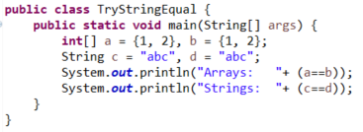


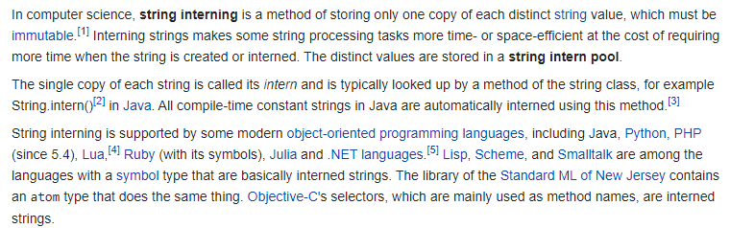
The “similar example in Java” Question from A0 hand-in
https://en.wikipedia.org/wiki/String_interning

Slide 3
Which is better?
(cadr x) or (list-ref x 1)?
(cadr x) or (car (cdr x)) ?
Local define or let?
By tomorrow, I plan to post a video on let, let*, letrec, and named let.

Slide 4
Recap - Predicates
What's a predicate?
How can you usually recognize that a given procedure is a predicate?
eq? vs equal?
eqv? From TSPL:
eq? cannot be used to compare numbers and characters reliably. Although every inexact number is distinct from every exact number, two exact numbers, two inexact numbers, or two characters with the same value may or may not be identical (i.e., not eq?)
eq? is cheaper than eqv?

Slide 5
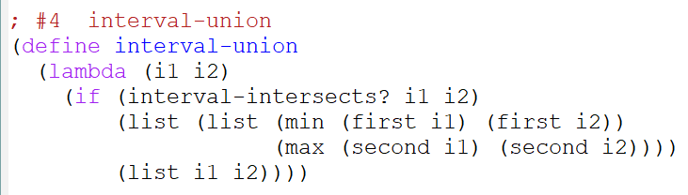
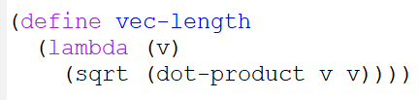
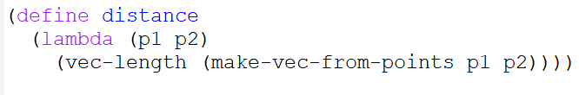
Some A1 solutions

Slide 6
What is common to all procedures?
What is it that every procedure application always does?
evaluates procedure and arguments first
In which order?
Not necessarily true of non-procedures.
(quote x) ; x is not evaluated.
(define x 3) ; x is not evaluated.
(if x y z) ; either y or z is not evaluated.
(or x y z) ; y and z may not be evaluated.
(lambda (x) (+ x 3)) ; x is not evaluated.
Notes:
One thing lambda says is
"remember and parameterize this code, but don't execute it now."
Evaluation a lambda expression NEVER causes its body to be evaluated.
Ask students about the order of evaluation …in scheme, java
Mwntiob that this is the kind of question that you may not have been asking before that I want you to learn to ask.

Slide 7
fact example 1
> (trace fact fact2 fact-acc)
(fact fact2 fact-acc)
> (fact 4)
|(fact 4)
| (fact 3)
| |(fact 2)
| | (fact 1)
| | |(fact 0)
| | |1
| | 1
| |2
| 6
|24
24
> (define fact
(lambda (n)
(cond
[(zero? n) 1]
[else (* n (fact (- n 1)))])))
> (fact 4)
24
> (fact -2)
C-c C-c
break>q
Escape from infinite loop by repeatedly pressing ctrl-c

Slide 8
Fact example 2
> (define fact2
(lambda (n)
(if (or (negative? n)
(not (integer? n)))
"error"
(fact-acc n 1))))
> (define fact-acc
(lambda (n acc)
(if (zero? n)
acc
(fact-acc (- n 1)
(* n acc)))))
> (trace fact fact2 fact-acc)
(fact fact2 fact-acc)
> (fact2 4)
|(fact2 4)
|(fact-acc 4 1)
|(fact-acc 3 4)
|(fact-acc 2 12)
|(fact-acc 1 24)
|(fact-acc 0 24)
|24
24

Slide 9
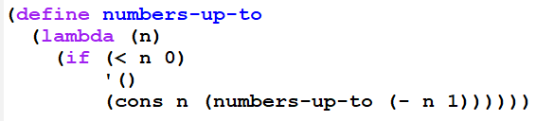


From the “more recursive functions” video:
What if we want them in increasing order?
Notes:
(define (numbers-up-to-increasing n)
(numbers-up-to-with-accumulator n '()))
(define (numbers-up-to-with-accumulator n acc)
(if (< n 0)
acc
(numbers-up-to-with-accumulator (- n 1)
(cons n acc))))

Slide 10
Work in small groups
Introduce yourselves
Work on a problem from Assignment 3
I suggest #3, but you can pick any problem.
If one group member has finished the problem you work on
Thar student can act as “coach” while the others write and test the code.
If no one in your group has finished A2, feel free to work on an A2 problem instead.

