Slide 1
CSSE 304 Day 3
Recall that (define (f n) (+ 3 n))is an abbreviation for (define f (lambda (n) (+ 3 n)))
Puzzle:
On Day 1, we overwrote built-in procedure /.
Can we overwrite lambda? I.e. does (define (lambda n) (* n n)) work?
What questions do you have?

Slide 2
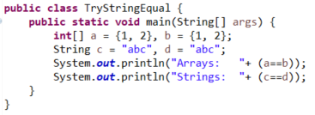


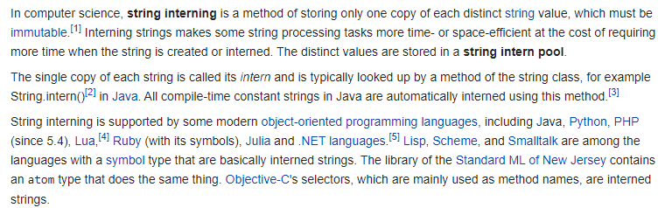
The “similar example in Java” Question from A0 hand-in
https://en.wikipedia.org/wiki/String_interning

Slide 3
Need help on assignments? It's OK!
What percentage of the class do I expect to solve most of the problems without talking to anyone else?
10 – 20 %
I don't see learning as a solo activity
If you don't have people to talk to, try the student assistants or me. For now! But also work on finding another student to work with. Do not copy other students' work!
If you are stuck on a problem for more than a few minutes, talk to someone!

Slide 4
Go for Simple!
Some students wrote
(define first (lambda (x) (car x)))
Simpler:
(define first car)
“eta-reduction”

Slide 5
Which is better?
(cadr x) or (list-ref x 1)?
(cadr x) or (car (cdr x)) ?
Local define or let?

Slide 6
Recap - Predicates
What's a predicate?
How can you usually recognize that a given procedure is a predicate?
eq? vs equal?
eqv? From TSPL:
eq? cannot be used to compare numbers and characters reliably. Although every inexact number is distinct from every exact number, two exact numbers, two inexact numbers, or two characters with the same value may or may not be identical (i.e., not eq?)
eq? is cheaper than eqv?

Slide 7
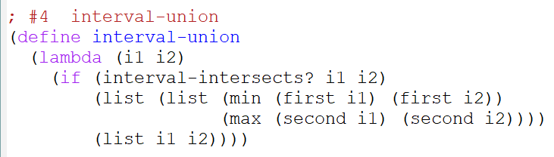
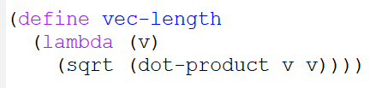
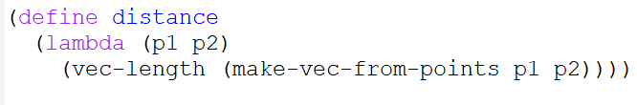
Some A1 solutions

Slide 8
What is common to all procedures?
What is it that every procedure application always does?
evaluates procedure and arguments first
In which order?
Not necessarily true of non-procedures.
(quote x) ; x is not evaluated.
(define x 3) ; x is not evaluated.
(if x y z) ; either y or z is not evaluated.
(or x y z) ; y and z may not be evaluated.
(lambda (x) (+ x 3)) ; x is not evaluated.
Notes:
One thing lambda says is
"remember and parameterize this code, but don't execute it now."
Evaluation a lambda expression NEVER causes its body to be evaluated.
Ask students about the order of evaluation …in scheme, java
Mwntiob that this is the kind of question that you may not have been asking before that I want you to learn to ask.

Slide 9
fact example 1
> (trace fact fact2 fact-acc)
(fact fact2 fact-acc)
> (fact 4)
|(fact 4)
| (fact 3)
| |(fact 2)
| | (fact 1)
| | |(fact 0)
| | |1
| | 1
| |2
| 6
|24
24
> (define fact
(lambda (n)
(cond
[(zero? n) 1]
[else (* n (fact (- n 1)))])))
> (fact 4)
24
> (fact -2)
C-c C-c
break>q
Escape from infinite loop by repeatedly pressing ctrl-c

Slide 10
Fact example 2
> (define fact2
(lambda (n)
(if (or (negative? n)
(not (integer? n)))
"error"
(fact-acc n 1))))
> (define fact-acc
(lambda (n acc)
(if (zero? n)
acc
(fact-acc (- n 1)
(* n acc)))))
> (trace fact fact2 fact-acc)
(fact fact2 fact-acc)
> (fact2 4)
|(fact2 4)
|(fact-acc 4 1)
|(fact-acc 3 4)
|(fact-acc 2 12)
|(fact-acc 1 24)
|(fact-acc 0 24)
|24
24

Slide 11
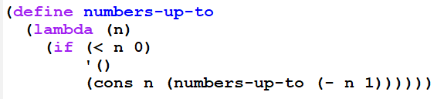


From the “more recursive functions” video:
What if we want them in increasing order?
Notes:
(define (numbers-up-to-increasing n)
(numbers-up-to-with-accumulator n '()))
(define (numbers-up-to-with-accumulator n acc)
(if (< n 0)
acc
(numbers-up-to-with-accumulator (- n 1)
(cons n acc))))

Slide 12
Translation of let
(define L '(4 3 2))
(let ([first (car L)]
[second (cadr L)])
(list (+ first second) (- first second)))
The let expression is equivalent to
((lambda (first second)
(list (+ first second) (- first second)))
(car L)
(cadr L))
let and cond are both examples of “syntactic sugar”, as are and and or.

Slide 13
more on let
(define xxx
(lambda (L)
(let ([a (car L)]
[b (cdr L)]
[c (car b)])
(list c a))))
What goes wrong if we evaluate (xxx '(1 2 3)) ?
Translate the let expression to an application of lambda
one of the problems in A6 asks you to do the let → application of lambda translation automatically.
Notes:
DO the translation on the board.
Tell them that one of the problems in A4 is to do this translation automatically.

Slide 14
let*
What we really wanted was
(define xxx
(lambda (L)
(let* ([a (car L)]
[b (cdr L)]
[c (car b)])
(list c a))))
which translates into
(define xxx
(lambda (L)
(let ([a (car L)])
(let ([b (cdr L)])
(let ([c (car b)])
(list c a))))))
one of the problems in A6 asks you to do the let* → nested lets translation automatically.
Why not always use let* instead of let?

Slide 15
Work in small groups
Introduce yourselves
Work on these problems:
(positives lon) returns a list of the positive numbers in lon. (positives '(3 -1 0 2 -5) ➔ (3 2) .
(all-positive? lon) returns a boolean value. Note that positive? is a built-in procedure.

