Slide 1
Scheme Prelude: A Puzzle
This puzzle should reveal something about Scheme syntactic expansion and variable binding.
What does execution of the following code do? Try to figure it out yourself, rather than simply entering it into Scheme. Hint: It does NOT produce an error.
(define mystery (lambda 'x 'x))
Talk with someone near you and try to figure it out.
Can you write some code that applies this mystery procedure in such a way that it returns a value (not an error)?
(mystery )
; you fill in the argument(s)

Slide 2
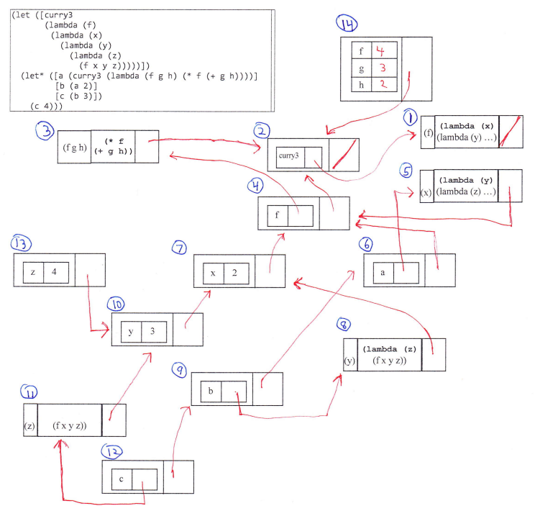
CSSE 304 Days 16-17
Environments and Closures

Slide 3
Use a bintree datatype object
(define-datatype bintree bintree?
[leaf-node
(datum number?)]
[interior-node
(key symbol?)
(left bintree?)
(right bintree?)])
cases is new syntax, defined in chez-init.ss (it is not the same as case)
>(define leaf-sum
(lambda (tree)
(cases bintree tree
[leaf-node (datum) datum]
[interior-node (key left right)
(+ (leaf-sum left)
(leaf-sum right))])))

Slide 4
Parse: From list to bintree
Parsing the list form of a binary tree
(define t2 (list->bintree
'(a (b 1 2) (c (d 3 4) 5))))
>(define list->bintree
(lambda (t)
(cond
[(number? t)
(leaf-node t)]
[(symbol? (car t))
(interior-node
(car t)
(list->bintree (cadr t))
(list->bintree (caddr t)))]
[else (eopl:error 'list->bintree
"improper data format")]))
Given the list representation of a binary tree, produce a bintree datatype structure
define-datatype automatically makes a constructor for each variant
Notes:
Do this live.
Why these records are transparent.

Slide 5
define-datatype example
Inorder traversal of interior nodes of a binary tree
>(define inorder
(lambda (tree)
(cases bintree tree ; let's write it
(define-datatype bintree bintree?
[leaf-node
(datum number?)]
[interior-node
(key symbol?)
(left bintree?)
(right bintree?)])

Slide 6
inorder solution
Inorder traversal of interior nodes of a binary tree
>(define inorder
(lambda (tree)
(cases bintree tree ; let's write it
[leaf-node (datum) '()]
[interior-node (key left right)
(append (inorder left) (list key) (inorder right))])))
(define-datatype bintree bintree?
[leaf-node
(datum number?)]
[interior-node
(key symbol?)
(left bintree?)
(right bintree?)])
Notes:
Don't put this slide online

Slide 7
s-list datatype (for A11a)
(define-datatype symbol-exp symbol-exp?
[symbol-symbol-exp
(data symbol?)]
[s-list-symbol-exp
(data s-list?)])
(define-datatype s-list s-list?
[an-s-list
(data (list-of symbol-exp?))])
(define list-of ; defined in chez-init.ss
(lambda (pred)
(lambda (val)
(or (null? val)
(and (pair? val)
(pred (car val))
((list-of pred) (cdr val)))))))
What does the type of list-of have to be?

Slide 8
Programs as data
A program in any language really is data
to be interpreted by …
Scheme makes the relationship more explicit.
Same syntax for programs and data
eval (which you are not allowed to use in your interpreter ☺ )
(let loop ()
(display "-->")
(let* ([exp (read)]
[val (eval exp)])
(pretty-print val)
(loop)))
Interpreter project solution – not!
Notes:
… hardware and/or software

Slide 9
datatype for λ-calculus expressions
I use slightly different names than the textbook, to be consistent with the homework documents and files.
(define-datatype expression expression?
[var-exp
(id symbol?)]
[lambda-exp
(id symbol?)
(body expression?)]
[app-exp
(rator expression?)
(rand expression?)])
You will enhance this type to include other expressions (such as multi-arg, multi-body lambda, if, etc)
Let's add set!, multiple rands. You'll add others in A11b

Slide 10
concrete vs. abstract syntax
parser
(app-exp
(lambda-exp
(x)
((if-exp
(var-exp x)
(var-exp y)
(var-exp z))
(var-exp x))
((app-exp
(lambda-exp
(y e)
((app-exp
(var-exp +)
((var-exp e)
(lit-exp 3)))))
((lit-exp 2)))))
concrete syntax
Two parens because a lambda can have more than one body
(parse-exp
'((lambda (x)
(if x y z)
x)
((lambda (y e)
(+ e 3))
2)))
abstract syntax

Slide 11
Parse lambda-calculus Expressions
I.e., translate concrete syntax to abstract syntax
(define parse-exp
(lambda (datum)
(cond
[(symbol? datum) (var-exp datum)]
[(pair? datum)
(cond
[(eqv? (car datum) 'lambda)
(lambda-exp (caadr datum)
(parse-exp (caddr datum)))]
[else
(app-exp (parse-exp (car datum))
(parse-exp (cadr datum)))])]
[else (eopl:error 'parse-exp
"Invalid concrete syntax ~s"
datum)])))
You will add several other cases (if, etc.)
Let's add set!,
You'll add others in A11b
Notes:
Ask: In the second case, why don't we call parse-exp on (caadr datum)?

Slide 12
Using Parsed Lambda-Calculus Expressions
Note that unparse-exp is simpler than parse-exp. Why?
(define unparse-exp
(lambda (exp)
(cases expression exp
[var-exp (id) id]
[lambda-exp (id body)
(list 'lambda (list id)
(unparse-exp body))]
[app-exp (rator rand)
(list (unparse-exp rator)
(unparse-exp rand) )])))
Notes:
Why is it simpler?
Because parsed expressions have a regular structure without so many cases.
How might this be useful?
A sanity check that you have written parse correctly.
If you can't unparse and get back the original code, then you may have lost some info when you did parse.
A debugging tool when writing the interpreter.
Abstract syntax is easier for a computer to process; not easier for a human to read.

Slide 13
About the parse problem in A11b
Add additional features to the parseable language
and modify the code for the basic features
Add error checking.
Important: To report an error:
(eopl:error 'parse-exp "bad let*: ~s" exp)
Figuring out all of the possible errors to check for is a major part of this assignment.
Be sure to plan time for it.
In order for the grading program to recognize your error reports, you must use 'parse-exp as the first argument to eopl:error

Slide 14
How I will test your parse program
Test some cases that should return an error
to make sure that your code actually detects the error (and reports it according to the previous slide)
Test-cases that call (unparse-exp (parse-exp 'some-legal-expression))
to see if you return the original expression
If you get zero points from the PLC server on either 1 or 2, you will also earn zero on the other part .
Notes:
Why? Because it would be possible to write something trivial that gives points on one or the other without really parsing successfully.
Why won't I simply call parse-exp and compare it to my answer?

Slide 15
occurs-free? for parsed expressions
(define occurs-free?
(lambda (var exp)
(cases expression exp
[var-exp (id) (eqv? id var)]
[lambda-exp (id body)
(and (not (eqv? id var))
(occurs-free? var body))]
[app-exp (rator rand)
(or (occurs-free? var rator)
(occurs-free? var rand))]
)))
Notes:
Clearer than old version that uses car, cdr, etc to pick out parts of an expression.

Slide 16
Syntax → Semantics
define-datatype and parse-exp give us a way to get from a concrete representation of program syntax to a more abstract one.
Now we want to get the meaning (interpretation).
How do we implement lexical scoping with first-class procedures?
First question: How to represent the bindings of data to variables?
We will spend a couple of class days taking an abstract look at this, then we will look at concrete implementations of environments

Slide 17
environments and closures
Some data structures behind Scheme's execution mechanism
Many students have found this to be a difficult topic. We will spend today, the next class meeting, and perhaps part of the one after that on it.
Don't allow yourself to get lost during either class! Ask instead!

Slide 18
Variable bindings and environments
An environment is a table of variable names (symbols) and their associated values
a | #t
xyz | "xyz"
i | 4
j | 7
Notes:
In the picture, be sure to include + and list in the global environment.

Slide 19
Variable bindings and environments
The global (top-level) environment is dynamic; symbols are added to the environment via define
the values of symbols are changed via set!
However car proc is represented
car
+
However + proc is represented
Notes:
In the picture, be sure to include + and list in the global environment.

Slide 20
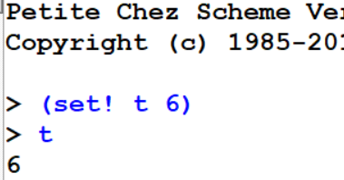
Variable bindings and environments
TSPL section 2.9 says: Variables must be defined before they can be assigned
But in many Scheme versions (including Chez) ,
a set! of a previously undefined variable actually defines it.
Thus at the top level, define and set! seem to be equivalent, although really they should be used for different things.
Your interpreter will only be required to implement set! for defined variables.
Notes:
In the picture, be sure to include + and list in the global environment.

Slide 21
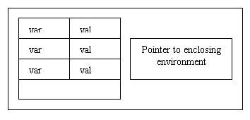
local environments
When a lambda-defined procedure is applied to arguments (also when a let, let*, or letrec is executed), a new local environment is created to hold the bindings of the variables that are defined at that level.
When Scheme evaluates an expression, there is always a current local environment. If the expression is outside of all lambdas, lets, let*s, and letrecs, letrecs, that current local env. is null.
. . .

Slide 22
Evaluate a let expression
Evaluate (in the current local environment) the expressions to get the values to be assigned to the let variables
Create a new local environment with bindings for the let variables. Its "enclosing environment" pointer points to the current environment.
Evaluate the body of the let in this new environment.
> (define a 5)
> (let ([z (+ a 3)]
[t 7]) (let ([y (+ z a)]) (list a t z y)))
“Evaluate exp in env” means “evaluate exp, with env as the current environment.”

Slide 23
Interlude
Tom Swifties (most are from Wikipedia):
"Who left the toilet seat down?" Tom asked peevishly.
"I'll never again put my arm in a lion's mouth," Tom said off-handedly.
"Can I go looking for the Holy Grail again?" Tom requested.
"I unclogged the drain with a vacuum cleaner," Tom said succinctly.
"We just struck oil!" Tom gushed.
"They had to amputate them both at the ankles," Tom said defeatedly.
"Who discovered radium?" asked Marie curiously.
"Hurry up and get to the back of the ship," Tom said sternly.
"Who put the moss in the bog again?" asked Tom repeatedly.
"A word that contains all five English vowels plus y? And I suppose you want them to appear in alphabetical order!" said Tom facetiously.
"The robber is coming down the stairs", Tom said condescendingly.
"Nnnn", Tom murmured forensically.
Notes:
Hidden for 200930

Slide 24
Procedures (closures)
When a lambda-expression is evaluated, what is returned?
When does the body of a lambda-expression get evaluated?
What kind of info needs to be stored in a procedure?
What happens when a procedure is applied?
(Answers on the next few slides)
Notes:
Closure is another name for "user-defined procedure"

Slide 25

Procedures (closures)
Whenever a lambda expression is evaluated, a procedure (also known as a closure) is created
A closure consists of three parts.
Note that a lambda expression is not a procedure. What is it?
Is the body of a lambda expression ever evaluated during the evaluation of the lambda?
Notes:
A lambda-expression is a piece of code, which, when it gets evaluated, creates a procedure.

Slide 26
Procedure application
The expressions for the procedure and arguments are evaluated.
A new local environment is created:
Each variable from the procedure's formal parameter list is bound to the corresponding value from the actual argument list.
The new local environment's "pointer to an enclosing local environment" is set to be a copy of the local environment pointer that is the third part of the closure.
The body of the procedure is evaluated in this new local environment. If a variable is not found in local environment, look in the global environment.
Simple Example:
> (define add2 (lambda (car) (+ car 2)))
> (add2 17)
I will draw pictures on the board and verbally describe what is going on. Much of that verbal explanation appears on the next two slides. You should read them later.

Slide 27

Simple Example
(define add2 (lambda (car) (+ car 2)))
The evaluation of the lambda-expression produces a closure like this:
Because the lambda-expression has no lexically-enclosing bindings, the environment pointer in this closure is null.
The define adds an entry for add2 to the global environment, whose value is this procedure.
Draw picture on the board …

Slide 28
Simple Example (continued)
(add2 17) What happens when the procedure is applied?
First, the value of add2 is looked up in the (global) environment. The value of 17 is itself.
Now we create a new local environment, binding the local variable car to the value 17. The enclosing environment pointer for this local environment is a copy of the closure's null environment pointer.
Now we evaluate the body.
There is no + in the local environment, and there is no enclosing environment, so we find + in the global environment.
the value of car ( which is 17) is found in the local environment.
17 is added to 2 (primitive procedures such as + are applied without making any new environments).

Slide 29
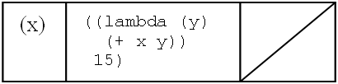
Diagram notation (use it!)
Begin Day 17 (Fall, 2019)
A local environment has two parts:
a table of bindings of variables to values
A pointer to the enclosing local environment
A closure has three parts
List of parameter names
Code (the procedure's body)
A pointer to the environment that was current when the closure was created.

Slide 30
Summary/Review questions
What happens when a lambda-expression is executed?
When is a new local environment created?
What is the initial value of the current local environment?
When we evaluate a let expression, to what does the "env pointer" in the new local environment point?
When we evaluate a lambda expression, to what does the "env pointer" in the resulting closure point?
When we apply a closure, where does the new local environment get its "enclosing env" pointer?

Slide 31
Summary/Review questions
What happens when a lambda expression is executed?
A closure is created and returned
When is a new local environment created?
When Scheme (a) executes a let (or letrec) or (b) applies a closure
What is the initial value of the current local environment?
Empty environment
When we evaluate a let, to what does the "env pointer" in the new local environment point?
The current local environment
When we evaluate a lambda expression, to what does the "env pointer" in the resulting closure point?
The current local environment.
When we apply a closure, where does the new local environment get its "enclosing env" pointer?
A copy of the closure's environment pointer

Slide 32
Recap: Procedures (closures)
Whenever a lambda expression is evaluated, a procedure (also known as a closure) is created
A closure consists of three parts.
Note that a lambda expression is not a procedure. What is it?
Is the body of a lambda expression ever evaluated during the evaluation of the lambda?
Notes:
A lambda-expression is a piece of code, which, when it gets evaluated, creates a procedure.

Slide 33
Recap: Procedure application
The expressions for the procedure and arguments are evaluated.
A new local environment is created:
Each variable from the procedure's formal parameter list is bound to the corresponding value from the actual argument list.
The new environment's "pointer to an enclosing environment" is set to be a copy of the local environment pointer that is the third part of the closure.
The body of the procedure is evaluated, using this new local environment. If a variable is not found in local environment, look in the global environment.
Simple Example:
> (define add2 (lambda (car) (+ car 2)))
> (add2 17)
I will draw pictures on the board and verbally describe what is going on. Much of that verbal explanation appears on the next two slides. You should read them later.

Slide 34
A More Complex Example
((lambda (x)
((lambda (y)
(+ x y))
15))
20)
First, the outer lambda-expression is evaluated to produce this closure:
What happens next? (Draw it on the board)

Slide 35
Another Environments and Closures Example
The following three Scheme expressions are evaluated (in the order shown here):
>(define fact
(lambda (n)
(fact2 n 1))
>(define fact2
(lambda (n acc)
(if (zero? n)
acc
(fact2 (- n 1) (* n acc)))))
>(fact 2)
Draw a diagram showing all closures and local environments that are created during this execution
(with arrows indicating when one of these objects contains a reference to another one). Use words to describe the process.

Slide 36
Evaluate letrec expressions
Create a new local environment, similar to a let environment, except that:
The “enclosing environment" pointers of all closures that are bound to the letrec variables point to the new environment, not the enclosing environment.
Evaluate the body of the letrec in this new environment.

Slide 37
Yet Another E&C Example
>(define odd?
(letrec ([odd? (lambda (n)
(if (zero? n)
#f
(even? (- n 1))))]
[even? (lambda (m)
(if (zero? m)
#t
(odd? (- m 1))))])
(lambda (x)
(odd? x))))
>(odd? 2)
Notes:
Change the code on the quiz to include x and m

Slide 38
Interlude
Quote from Richard Feynman(1918-1988), Caltech physicist and Nobel Prize winner:
There are 10¹¹ stars in the galaxy. That used to be a huge number. But it's only a hundred billion. It's less than the national deficit! We used to call them astronomical numbers. Now we should call them economical numbers.
What does a trillion dollars look like?
http://articles.mercola.com/sites/articles/archive/2009/04/07/What-Does-a-Trillion-Dollars-Look-Like.aspx

Slide 39
Final E&C Example
The following two Scheme expressions are evaluated (in the order shown here):
>(define f
(lambda (x)
(let ([a (lambda (y z)
(+ x y z))])
(lambda (b)
(a (+ 5 b) x))))
>((f 3) 4)

