Slide 1
CSSE 304 Day 13
What questions do you have?
Syntax expansion (Macros)
Scheme’s define-syntax
Datatypes review (If there is time)
Notes:
Unhide the second "What do programming languages allow us to define?" slide after making the PDF.

Slide 2
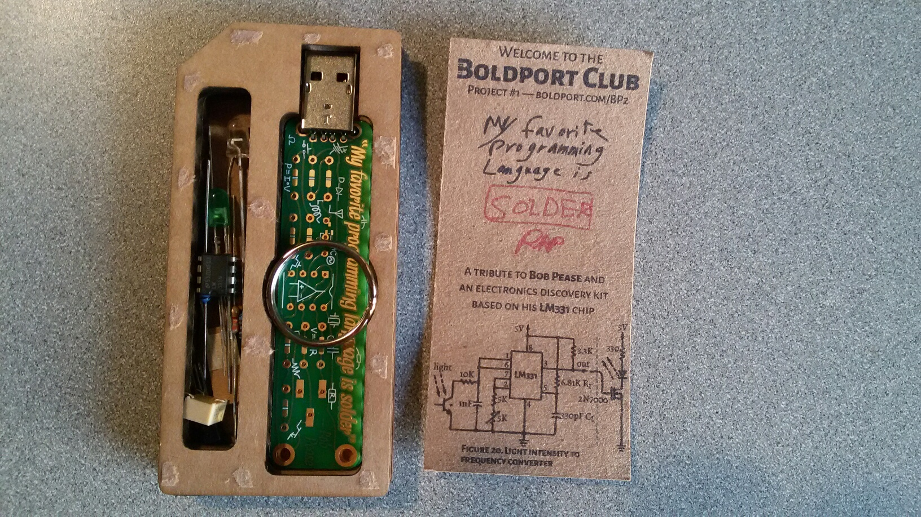

Slide 3
Syntactic extension
A mechanism for adding new syntax to a programming language.

Slide 4
The “macro” of “macro-assembler”
A “macro” is a “super-instruction”, a.k.a pseudo-instruction.
An instruction that the assembler translates into a sequence of machine instructions.
macros are an example of syntactic extension.
Vax-MACRO
Example in MIPS: la $t1 <address>
is translated into something like
lui $t1, <address>
ori $t1, $t1, <address+4>
http://en.wikibooks.org/wiki/MIPS_Assembly/Pseudoinstructions

Slide 5
Syntactic extension in C
#define square(x) ((x) * (x))
#define max(x, y) (((x)>(y)) ? (x) : (y))
#include <stdio.h>
int main () {
int n = 5, m = 7;
double y = 6.17;
printf("%d\n", square(m + 7*n/3));
printf("%lf %d\n", max(n,y), max(m,n));
}
Note that #define does not define procedures; it defines syntactic transformation rules (macros). This can be seen by running the C pre-processor:

Slide 6
output from CPP
printf("%d\n", square(m + 7*n/3));
printf("%lf %d\n", max(n,y), max(m,n));
gets replaced by (without the extra line breaks that I added for readability)
printf("%d\n", (( m + 7*n/3 ) * ( m + 7*n/3 )) );
printf("%lf %d\n", ((( n ) > ( y )) ?
( n ) : ( y )) ,
((( m ) > ( n )) ? ( m ) : ( n )) );
Notes:
point out why we want the parentheses

Slide 7
Syntactic extension in Scheme
lambda is a core syntactic form; let is not.
Expressions involving let may be syntactically transformed into applications of lambda-expressions (as you did in the let->application procedure).
There are many syntactic forms in Scheme
most are not core forms, but are transformed into core forms before execution.

Slide 8
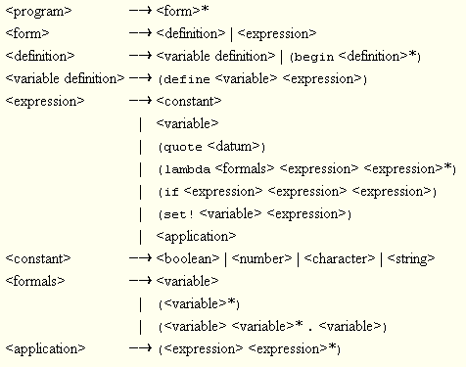
Scheme core forms
Not everyone agrees on which forms are core forms.
Here is Kent Dybvig’s list (TSPL section 3.1):

Slide 9
The syntactic expansion process
expansion happens before interpretation.
The syntax expander is called on each top-level form.
If the form is a syntactic extension, it is expanded, and the expander is called again on the new form.
If it is a core form, the expander is called on any subforms (e.g. the body of a lambda form).
This continues until the form consists only of core forms. Then the form is interpreted.

Slide 10
Recap define-syntax syntax
General form:
(define-syntax <identifier>
(syntax-rules ( {<keyword>}* )
{ [pattern template] }⁺ ))
What gets expanded
How to expand it
Notes:
Usually there are no extra keywords.
Exception: cond as part of else.

Slide 11
define-syntax and syntax-rules
my-let is equivalent to (unnamed) let
(define-syntax my-let
(syntax-rules ()
[(_ ((x v) ...) e1 e2 ...)
((lambda (x ...) e1 e2 ...) v ...)]))
pattern
assumed to be the name of the form, no matter what you put here
replace my-let expression with an application of a lambda expression
template

Slide 12
Live coding time
my-let
my-if
++
++-post
my-and
for loop (a couple of versions)

Slide 13
Abstract Datatypes
and define-datatype
If not today, next time!

Slide 14
What is Data?
bits
interpretation
Notes:
This should be a review of material from CSSE 220 or 230

Slide 15
datatype
What is an (abstract) data type?
interface
representation
implementation
In EoPL notation, ⎡x⎤ means “the representation of x”.
Important example: non-negative integers.
⎡n⎤ means the representation of the integer n.

Slide 16
Interface for "non-negative integer" datatype
(zero) = ⎡0⎤
( iszero? ⎡n⎤ ) = #t if ⎡n⎤ is the representation of zero, #f otherwise.
( succ ⎡n⎤ ) = ⎡n+1⎤ ( ∀n ≥ 0)
( pred ⎡n+1⎤ ) = ⎡n⎤ ( ∀n ≥ 0)
These operations define the datatype.
Other operations can be derived from them.
Example:
(define add
(lambda (m n)
(if (iszero? n)
m
(add (succ m) (pred n)))))
Next we will look at some different implementations of this ADT.
Notes:
Do an example: (add 3 2)

Slide 17
Implementation 1: Unary representation of non-negative integers
⎡0⎤ = ( ) ; the empty list
⎡n+1⎤ = (cons #t ⎡n⎤ )
Define the integer operations.
iszero? succ pred
There is a (slightly) more efficient implementation of add (than the one from the last slide) if we base it on the implementation instead of the ADT. Can you see what it is?
Notes:
answer: append

Slide 18
Implementation 2: Another representation of non-negative integers
See also the bigits example and exercise, EoPL page 34
Represent each number by a binary string
Base Cases: ⎡0⎤ = “0” ⎡1⎤ = “1”
Other case: If n>0, there are unique integers q and r such that r is 0 or 1, and n = 2*q + r
Then ⎡n⎤ is the string concatenation of ⎡q⎤ with ⎡r⎤ .
Example ⎡13⎤ = concat ( ⎡6⎤ , ⎡1⎤ ) = …
succ and pred are more complex than in the unary representation ( easier if bits in number are reversed)
but add is faster than in the unary representation! Can you write it?
Notes:
I typically give this exercise as a CSE 220 programming exercise

Slide 19
Implementation 3: Another representation of non-negative integers
Represent each number by the corresponding Scheme integer
⎡0⎤ = 0
iszero? = zero?
succ = (lambda (x) (+ x 1))
pred = (lambda (x) (- x 1))
What is a more efficient implementation of add?
(define add +)

Slide 20
Implementation 4: Another representation of non-negative integers
Represent numbers by lambda calculus expressions:
⎡0⎤ = (lambda (x) (lambda (y) y))
⎡1⎤ = (lambda (x) (lambda (y)(x y)))
⎡2⎤ = (lambda (x) (lambda (y)(x (x y))))
⎡3⎤ = (lambda (x) (lambda (y)(x (x (x y)))))
succ = (lambda (x) (lambda (y) (lambda (z) (y ((x y) z))))) We will skip the details of how this works.
isZero? = (lambda (k) (k ((true false) true))
where true is (lambda (x) (lambda (y) x)) and false is (lambda (x) (lambda (y) y)) .
We will not look at the details of this.

Slide 21
Implementations 5 and 6: Two more representations of non-negative integers
Bignums
Diff-trees
See Pages 34-35 of EoPL . and
In the past I have assigned programming problems related to these.

