Slide 1
CSSE 304 Day 13
Your questions ?
Lexical Address examples
Syntactic extension
Notes:
Make a handout of slides 14-17. Take it to class.

Slide 2
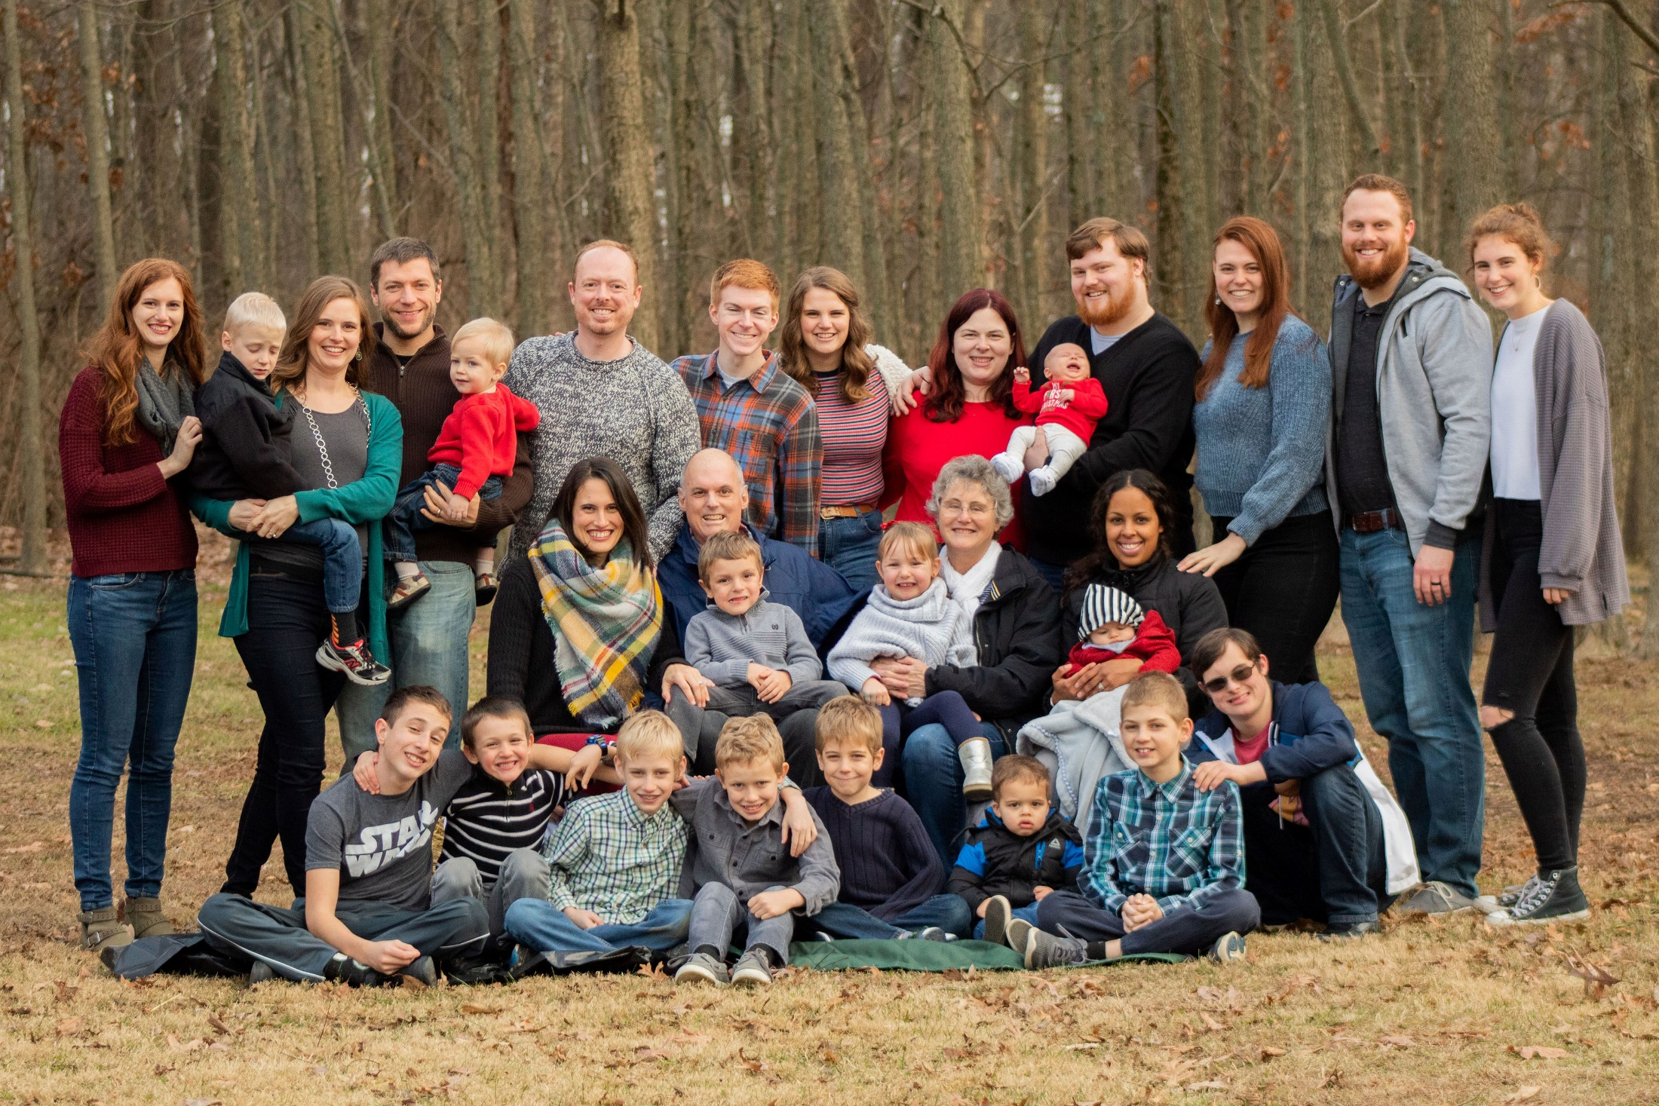

Slide 3
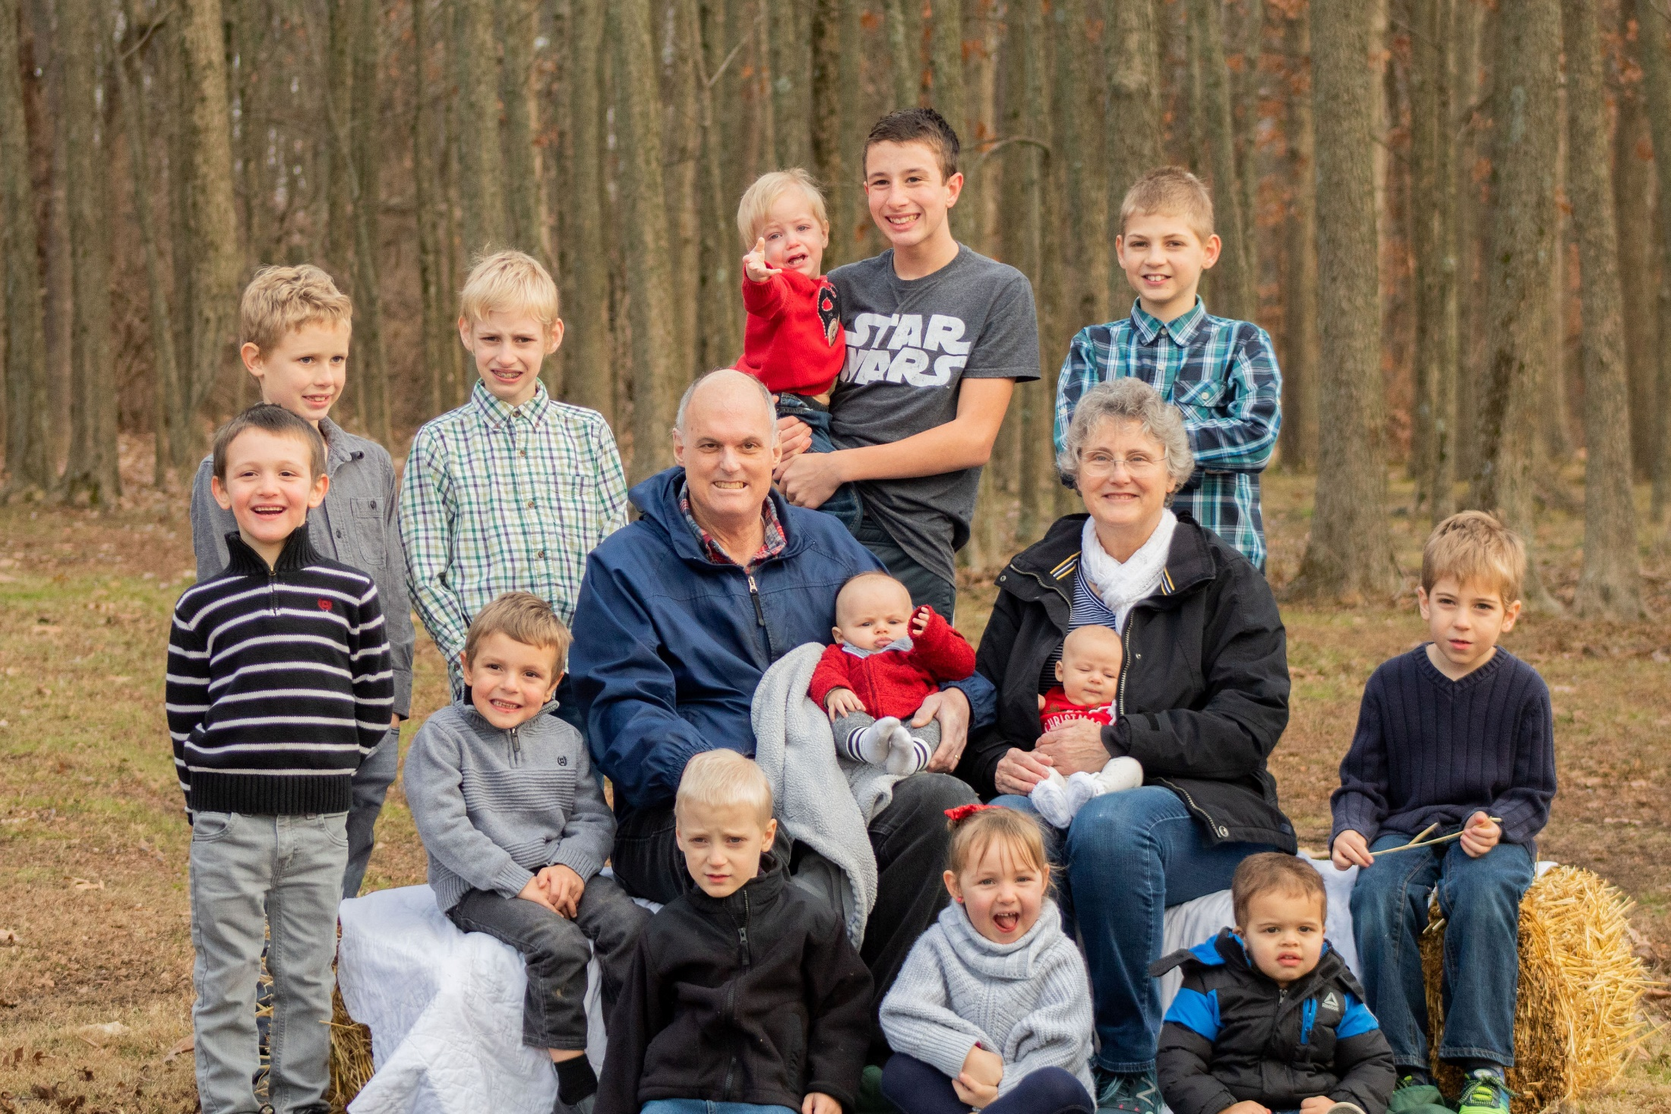

Slide 4
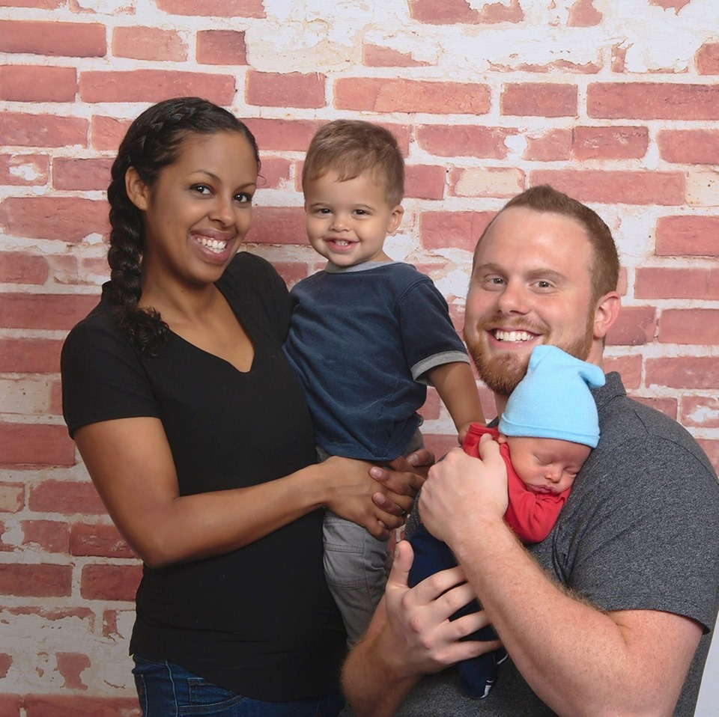

Slide 5
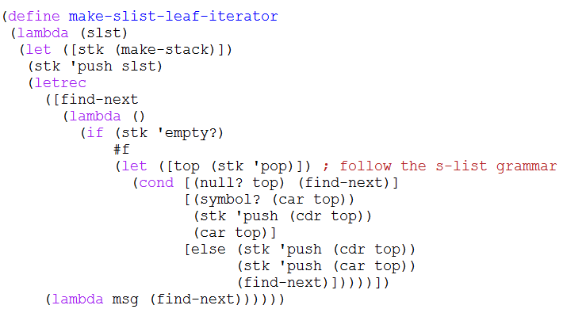

Slide 6
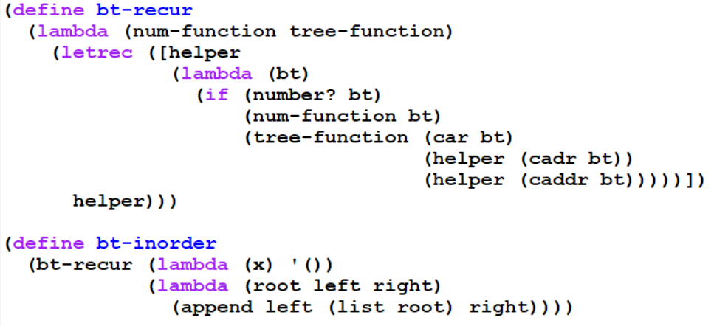

Slide 7
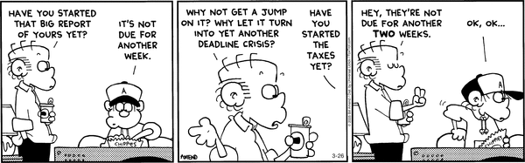
Interlude

Slide 8
Partners for interpreter project
It’s best if team members are in the same class section.
But you are allowed to choose someone from another section.
And I may also do so if necessary (especially due to time zones)
Teams will have two or three students.
I will only consider letting you do the project solo if your Exam 1 total is at least 86/90 (96%).
And you still have to have a good reason
You will fill out a Team Preference Survey soon after the break.

Slide 9
Partner preferences
Mutually selected teams generally work best.
Typically 60-80% of students arrange their own teams. That means that I do not have a lot of flexibility when forming other teams.
Teams with similar skills and commitments to the project often work better than teams who are friends.
How did you do on the exam?
How many late days do you have now?
What time of day works best for meetings?
Are you okay with not getting an A grade for this project?
Do you prefer to lead or follow?
Do you want to meet (or want to avoid meeting) in person?
How will we work out time zone differences?
.

Slide 10
Teams that don’t work so well!
One or two students are doing very well in the course and the other is barely surviving.
One team member has 0 late days left, thus is not accustomed to submitting on time. The other students have earned an extra late day on almost every assignment.
Two team members are/were in a romantic relationship, or one of them wishes they were in a romantic relationship with someone else on the team.
Put them on your “no” list on the team preference survey.

Slide 11
Questions on the survey
Are you part of a mutually-chosen group of students?
If so, who are the other student(s)?
If you are in a time zone that is more than one hour separated from Terre Haute time, where are you?
What was your total score on exam 1?
How many late days do you have at this point?
List up to five students whom you’d like to work with.
Are there students whom you’d prefer not to work with?
Is there anything else you want to tell me?

Slide 12
A plea from me and your potential partners
Disclaimer: I am not trying to persuade anyone that they should drop the course, or even that they should immediately decide whether or not to stay.
I only ask that if you do know that you are dropping at the time of the partner survey, let me know so I do not put you on a team.
Would you want to be on a team where one member drops the course before the project gets going, or doesn’t put much effort into it because they know they are going to drop?

Slide 13
lexical address solution
(lexical-address
'((lambda (x y)
(((lambda (z)
(lambda (w y)
(+ x z w y)))
(list w x y z))
(+ x y z)))
(y z))) ➔
((lambda (x y)
(((lambda (z)
(lambda (w y)
((: free +) (: 2 0) (: 1 0) (: 0 0) (: 0 1))))
((: free list) (: free w) (: 0 0) (: 0 1) (: free z)))
((: free +) (: 0 0) (: 0 1) (: free z))))
((: free y) (: free z)))
(: depth position)

Slide 14
lexical address solution 2
(lexical-address '(let ([a 3] [b 4])
(let ([a (+ b 2)] [c a])
(+ a b c)))) ➔
(let ((a 3) (b 4))
(let ((a ((: free +) (: 0 1) 2))
(c (: 0 0)))
((: free +) (: 0 0) (: 1 1) (: 0 1))))

Slide 15
Growing the Scheme language
Introduction to define-syntax

Slide 16
What kinds of things do languages allow us to define (give names to)?
constants
variables
Procedures/methods
classes
interfaces
types
syntactic forms
Notes:
Ask students, write their answers on the board, then reveal the first animation.
Ask, "Is that all?" then the second one.

Slide 17
Syntactic extension
A mechanism for adding new syntax to a programming language.

Slide 18
The “macro” of “macro-assembler”
A “macro” is a “super-instruction”, a.k.a pseudo-instruction.
An instruction that the assembler translates into a sequence of machine instructions.
macros are an example of syntactic extension.
Vax-MACRO
Example in MIPS: la $t1 <address>
is translated into something like
lui $t1, <address>
ori $t1, $t1, <address+4>
http://en.wikibooks.org/wiki/MIPS_Assembly/Pseudoinstructions

Slide 19
Syntactic extension in C
#define square(x) ((x) * (x))
#define max(x, y) (((x)>(y)) ? (x) : (y))
#include <stdio.h>
int main () {
int n = 5, m = 7;
double y = 6.17;
printf("%d\n", square(m + 7*n/3));
printf("%lf %d\n", max(n,y), max(m,n));
}
Note that #define does not define procedures; it defines syntactic substitutions (macros). This can be seen by running the C pre-processor:

Slide 20
output from CPP
#define square(x) ((x) * (x))
#define max(x, y) (((x)>(y)) ? (x) : (y))
printf("%d\n", square(m + 7*n/3));
printf("%lf %d\n", max(n,y), max(m,n));
gets replaced by (without the extra line breaks that I added for readability)
printf("%d\n", (( m + 7*n/3 ) * ( m + 7*n/3 )) );
printf("%lf %d\n", ((( n ) > ( y )) ?
( n ) : ( y )) ,
((( m ) > ( n )) ? ( m ) : ( n )) );
Notes:
point out why we want the parentheses

Slide 21
Syntactic extension in Scheme
lambda is a core syntactic form; let is not.
Expressions involving let may be syntactically transformed into applications of lambda-expressions (as you did in the let->application HW procedure).
There are many syntactic forms in Scheme
most are not core forms, but are transformed into core forms before execution.

Slide 22
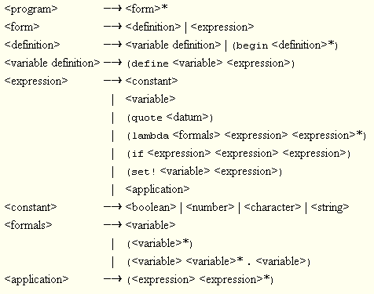
Scheme core forms
Not everyone agrees on which forms are core forms.
Here is Kent Dybvig’s list (TSPL section 3.1):

Slide 23
The syntactic expansion process
syntactic expansion happens before interpretation.
The syntax expander is called on each top-level form.
If the form is a syntactic extension, it is expanded, and the expander is called again on the expanded form.
If it is a core form, the expander is called on any subforms (e.g. the body of a lambda form).
This continues until the form consists only of core forms. Then the form is interpreted.

Slide 24
No class meeting tomorrow
Watch the define-syntax video instead.
It would take 50 minutes in class. On the video I edited it to be much shorter.
It is the basis for one of the problems on A11a.

Slide 25
define-syntax and syntax-rules
General form:
(define-syntax <identifier>
(syntax-rules ( {<keyword>}* )
{ [pattern template] }⁺ ))
What gets expanded
How to expand it
Notes:
Usually there are no extra keywords.
Exception: cond as part of else.

Slide 26
define-syntax and syntax-rules
my-let is equivalent to (unnamed) let
(define-syntax my-let
(syntax-rules ()
[(_ ((x v) ...) e1 e2 ...)
((lambda (x ...) e1 e2 ...) v ...)]))
pattern
keyword list is empty
assumed to be the name of the form, no matter what you put here
replace my-let expression with an application of a lambda expression
template

Slide 27
Live coding time
my-let
my-if
++
++-post
my-and
for loop (a couple of versions)

Slide 28
Computation in lambda calculus
Key ideas:
beta reduction
alpha conversion
eta reduction
Number representation 0 := λ f x. x 1 := λ f x. f x 2 := λ f x. f (f x) 3 := λ f x. f (f (f x))
Operations
SUCC := λ n f x. f (n f x)
PLUS := λ m n f x. n f (m f x)
MULT := λ m n. m (PLUS n) 0
AND := λ p q. p q p
OR := λ p q. p p q
NOT := λ p a b. p b a
IFTHENELSE := λ p a b. p a b
http://en.wikipedia.org/wiki/Lambda_calculus#Arithmetic_in_lambda_calculus http://safalra.com/science/lambda-calculus/integer-arithmetic/
Notes:
Tell students that they don't have to know the details of any of this; it is just a little "cultural foray" in to language theory.

Slide 29
λ-calculus and Turing completeness
The untyped lambda-calculus is Turing complete (meaning that we can compute anything with it that we can compute with any other accepted formal model of computation)
http://en.wikipedia.org/wiki/Turing_completeness
This article may also be helpful:
http://en.wikipedia.org/wiki/Lambda_calculus

Slide 30
Combinators

Slide 31
Expressions with no free variables …
… are called combinators (lambda (f g) (lambda (x) (f (g x))))
A famous combinator, Y, is the “recursion maker”.
What is a good name for this combinator?

Slide 32
The Y-combinator
http://dangermouse.brynmawr.edu/cs245/ycomb_jim.html
http://www.ece.uc.edu/~franco/C511/html/Scheme/ycomb.html

Slide 33
Y-combinator ("recursion maker")
(define Y
(lambda (f)
((lambda (x)
(f (lambda (t)
((x x) t))))
(lambda (x)
(f (lambda (t)
((x x) t)))))))
Note that while Y is unusual, there is nothing that looks recursive about it.

Slide 34
Y-combinator can be applied to …
(define H
(lambda (g)
(lambda (n)
(if (zero? n)
1
(* n (g (- n 1)))))))
Note that there is nothing recursive about H. We simply pass in g and possibly call it.
But ...
> ((Y H) 5)
120
(for example)
Note: This is the "applicative-order Y-combinator" which works in Scheme.
In the pure lambda-calculus, in which parameters are passed "by name".
the Y-combinator is simpler.

Slide 35
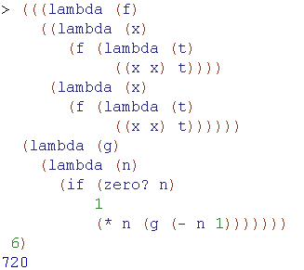
Y-combinator generates “recursion” without using define or other naming mechanisms
Notes:
no define, no letrec. It's truly an anonymous recursive procedure.

