Slide 1
CSSE 304
Day 35-36
Imperative form
Engines
(coroutines)
There is no class notes page for day 35
Has your mind been stretched so far this term?

Slide 2
2-Days' Agenda
Exam specifications
Imperative form
Engines
(Coroutines)

Slide 3
Some PL Concepts a.k.a. final exam review list
binding (via lambda, let, letrec, named‑let)
variable‑arity procedure interface (lambda x ...)
syntactic extension (e.g., let can be written in terms of lambda)
procedure vs syntactic form
predicate
application of a procedure
higher‑order procedure
read-eval-print-loop
lambda-calculus expressions
free variables
syntactic extension
abstract datatypes
representation-independent code
mapping a procedure over a list
dynamic vs static typing of variables.
vectors vs lists
sublist‑sharing
anonymous procedure
first‑class procedure
currying
short‑circuit evaluation
Backus‑Naur Form (BNF), a.k.a. context‑free grammars
Kleene star and plus
syntactic derivation from a BNF grammar
multi-value returns
receivers

Slide 4
Some PL Concepts a.k.a. final exam review list
bound variables
static (lexical) scope
lexical distance (a.k.a.lexical address)
environment
closure
abstract syntax vs. concrete syntax
parsing
functional programming (values of variables never change)
mutation
tail‑recursion
variant records
memoization
pass-by-reference
procedural abstraction (list-recur, bt-recur, snlist-recur, etc.)
parser
interpreter
recursive environment extension
escape procedure
continuation
continuation: DS representation
continuation-passing style (CPS)
call/cc
iterator
imperative form
engine
coroutine
abstraction
representation-independent

Slide 5
Final exam notes
Wednesday Nov 14, 6 PM. 2nd floor Crapo
G219 (A-Geng), 221(Glave-P), 222 (S-Z)
Much emphasis on materials related to A15-19.
Including interpreters and continuations (especially call/cc), also functional programing (e.g. use of map and apply), define-syntax.
A few other things from throughout the course.
A bit harder than previous exams.

Slide 6
Final exam logistics
Format: Similar to Exam 2
Written part – various questions.
Written part, modify the interpreter
Computer part – non-interpreter
Computer part – interpreter
Bring:
Writing instruments,
textbook, notes, etc. (for parts 3 and 4 only)
Drink and/or snack if you wish.
Printouts of your A17 (basic, no refs or lex needed) and A18 (CPS) interpreters.
Print 2-sided, staple. At the front of each, write your name, partner’s name and which interpreter it is. Number the pages.
Submission order
Submit 1 before using your interpreter printouts
Submit 2 before using your computer, notes, etc.
Submit each of parts 3 and 4 papers as soon as you have finished it.

Slide 7
Imperative form
As close to C or Assembly Language as we can get in Scheme

Slide 8
Implementation environment
Scheme is a great language to use when implementing an interpreter.
But does it do too much for us?
Could we easily write the Assignment 18 interpreter in another language?
One without first-class procedures?

Slide 9
A simple example
The interpreter involves a lot of code, so we will look at transforming a simple example.
The same ideas will work to transform the interpreter.
The code in these slides is linked from today’s Resources column the Schedule Page.

Slide 10
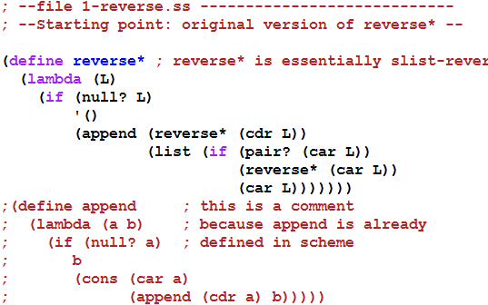

A simple example
Next: convert to CPS

Slide 11
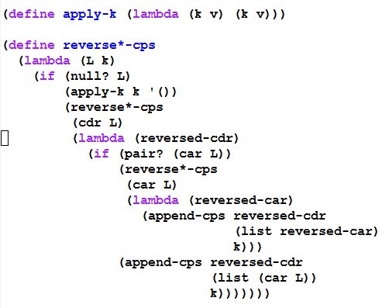
Convert to CPS form – part 1 Represent continuations as Scheme procedures

Slide 12
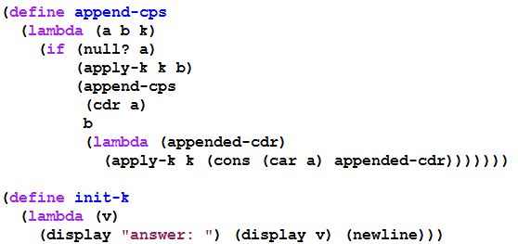
Convert to CPS form – part 2 Represent continuations as Scheme procedures

Slide 13
with tracing
(trace-define reverse*-cps
(lambda (L k)
(if (null? L)
(k '())
(reverse*-cps
(cdr L)
(trace-lambda cdr-k (reversed-cdr)
(if (pair? (car L))
(reverse*-cps
(car L)
(trace-lambda car-k (reversed-car)
(append-cps
reversed-cdr
(list reversed-car)
k)))
(append-cps reversed-cdr
(list (car L))
k)))))))
(trace-define append-cps
(lambda (a b k)
(if (null? a)
(k b)
(append-cps
(cdr a)
b
(trace-lambda append-k (appended-cdr)
(k (cons (car a) appended-cdr)))))))
(trace-define init-k
(lambda (v)
(display "answer: ") (display v) (newline)))

Slide 14
the trace
> (reverse*-cps '(a (b () ((c) d))) init-k)
|(reverse*-cps (a (b () ((c) d))) #<procedure>)
|(reverse*-cps ((b () ((c) d))) #<procedure>)
|(reverse*-cps () #<procedure>)
|(apply-k #<procedure> ())
|(cdr-k ())
|(reverse*-cps (b () ((c) d)) #<procedure>)
|(reverse*-cps (() ((c) d)) #<procedure>)
|(reverse*-cps (((c) d)) #<procedure>)
|(reverse*-cps () #<procedure>)
|(apply-k #<procedure> ())
|(cdr-k ())
|(reverse*-cps ((c) d) #<procedure>)
|(reverse*-cps (d) #<procedure>)
|(reverse*-cps () #<procedure>)
|(apply-k #<procedure> ())
|(cdr-k ())
|(append-cps () (d) #<procedure>)
|(apply-k #<procedure> (d))
|(cdr-k (d))
|(reverse*-cps (c) #<procedure>)
|(reverse*-cps () #<procedure>)
|(apply-k #<procedure> ())
|(cdr-k ())
|(append-cps () (c) #<procedure>)
|(apply-k #<procedure> (c))
|(car-k (c))
|(append-cps (d) ((c)) #<procedure>)
|(append-cps () ((c)) #<procedure>)
|(apply-k #<procedure> ((c)))
|(append-k ((c)))
|(apply-k #<procedure> (d (c)))
|(car-k (d (c)))
|(append-cps () ((d (c))) #<procedure>)
|(apply-k #<procedure> ((d (c))))
|(cdr-k ((d (c))))
|(append-cps ((d (c))) (()) #<procedure>)
|(append-cps () (()) #<procedure>)
|(apply-k #<procedure> (()))
|(append-k (()))
|(apply-k #<procedure> ((d (c)) ()))
|(cdr-k ((d (c)) ()))
|(append-cps ((d (c)) ()) (b) #<procedure>)
|(append-cps (()) (b) #<procedure>)
|(append-cps () (b) #<procedure>)
|(apply-k #<procedure> (b))
|(append-k (b))
|(apply-k #<procedure> (() b))
|(append-k (() b))
|(apply-k #<procedure> ((d (c)) () b))
|(car-k ((d (c)) () b))
|(append-cps () (((d (c)) () b)) #<procedure>)
|(apply-k #<procedure> (((d (c)) () b)))
|(cdr-k (((d (c)) () b)))
|(append-cps (((d (c)) () b)) (a) #<procedure>)
|(append-cps () (a) #<procedure>)
|(apply-k #<procedure> (a))
|(append-k (a))
|(apply-k #<procedure> (((d (c)) () b) a))
|(init-k (((d (c)) () b) a))
answer: (((d (c)) () b) a)
This lets us see the flow of control as the CPS procedures execute, but we can't see the details that are hidden inside #<procedure>

Slide 15
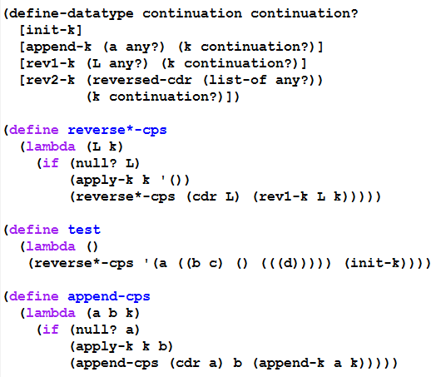
Second Continuation representation part 1 (using define-datatype)

Slide 16
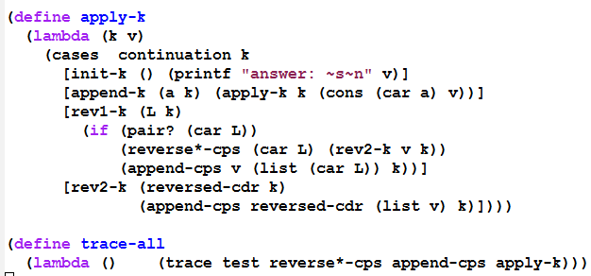

Second Continuation representation part 2 (using define-datatype)

Slide 17
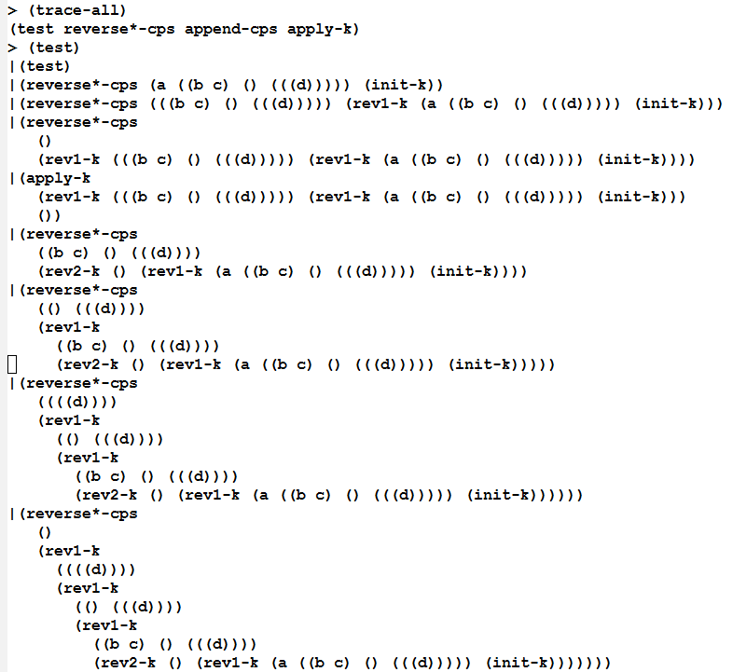
Beginning of a trace (you can generate the rest yourself, using the on-line files)

Slide 18
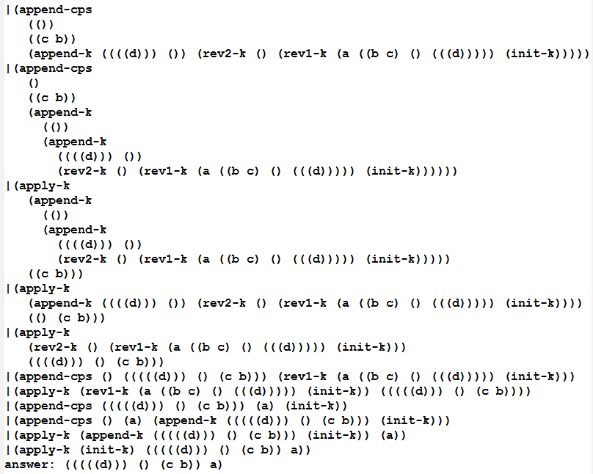
End of the trace (you can generate the whole trace yourself using the on-line files)

Slide 19
What do we have now?
Using this style, we could write the interpreter in any language that provides a means of creating records.
But it would be inefficient if that language's compiler does not handle tail-recursion properly
Could even result in a stack overflow.
So we transform to a style in which the flow of control is really just assignments, BEGINs, IFs, and GOTOs:

Slide 20
Transform to Imperative form
All non-primitive procedures will be called in tail-position, so they do not need to return.
All non-primitive procedures will be thunks (procedures that take no arguments), thus no need for stack frames.
Thus a procedure call is equivalent to a "goto"
This can be implemented in almost any language.

Slide 21
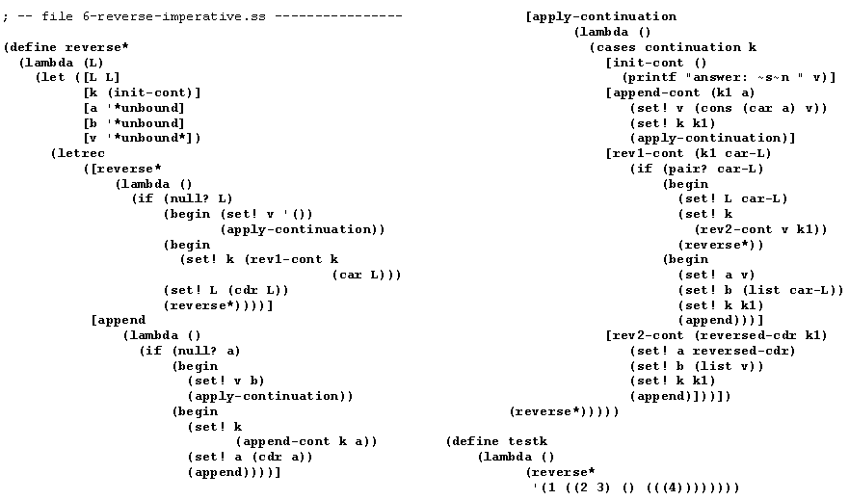
This brings us to Imperative form
We can do the same set of transformations to our interpreter (but we won’t. )

Slide 22

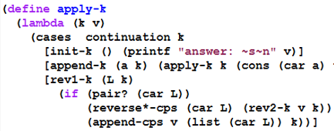
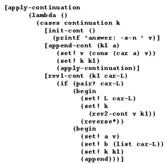
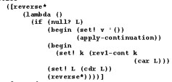
Details of a transformation

Slide 23
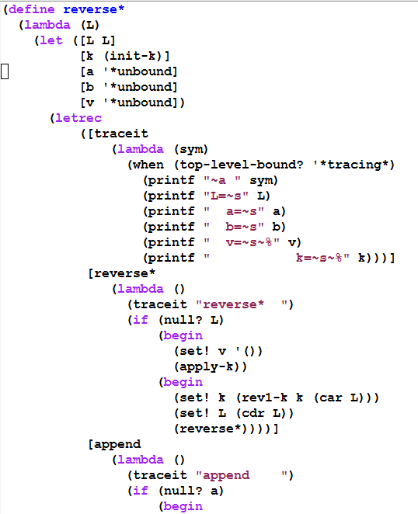
Tracing this Imperative-form program

Slide 24
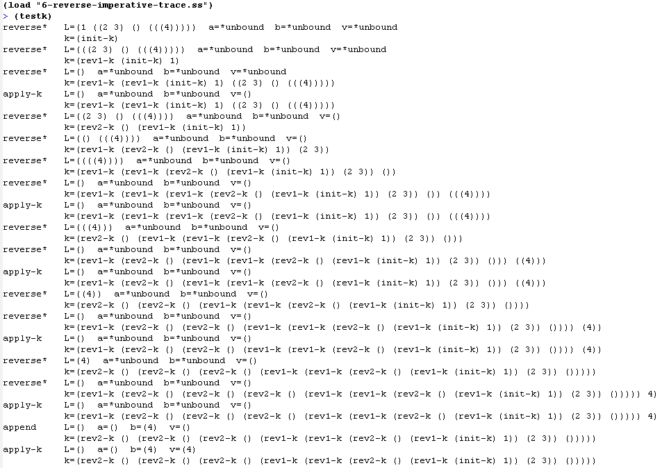

Slide 25
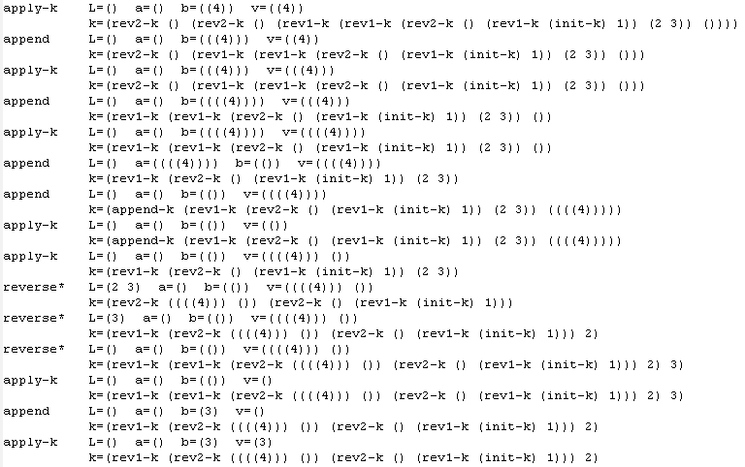

Slide 26
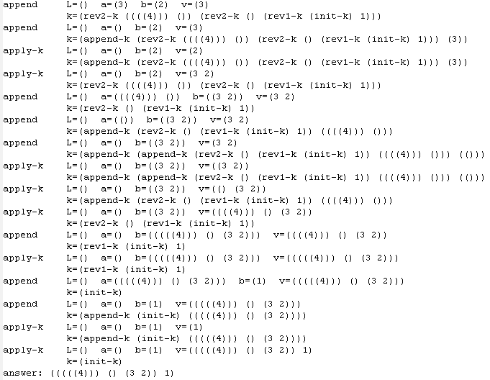

Slide 27
Where does this leave us?
All we really need in order to implement things in this style:
implementations of the basic data types (numbers, lists, etc.) and prim-procs
record structures
variable assignment
if
go to
begin
Then we could implement our interpreter in almost any language.

Slide 28
Exercise
Start with another small piece of recursive code, and apply all of these transformations to get it into imperative form.
You may be asked to do this on the final exam.
One practice possibility: Start with the code we wrote Days 31-32, transforming to data-structures continuations.

Slide 29
Another call/cc example
> (define abc)
> (define fact
(lambda (n)
(cond [(= n 1)
(call/cc (lambda (k)
(set! abc k)
(k 1)))]
[else
(* n (fact (- n 1)))])))
> (fact 4)
24
> (abc 2)
48

Slide 30
More of the fact call/cc example
Back to the café in Paris… the waiter may look a little older, we might be heavier, but we experience the same things as before.
> (trace fact)
(fact)
> (fact 6)
|(fact 6)
| (fact 5)
| |(fact 4)
| | (fact 3)
| | |(fact 2)
| | | (fact 1)
| | | 1
| | |2
| | 6
| |24
| 120
|720
720
> (abc 11)
| | | 11
| | |22
| | 66
| |264
| 1320
|7920
7920
(define fact
(lambda (n)
(cond [(= n 1)
(call/cc (lambda (k)
(set! abc k)
(k 1)))]
[else
(* n (fact (- n 1)))])))

Slide 31
Engine intro
See the engine-intro.ss file
Engines abstract timed pre-emption.
Introduced into Scheme by Haynes and Friedman
A simpler implementation by Dybvig and Hieb is built into Chez Scheme.
engines do not have to be Scheme built-ins, but can be built using call/cc.
Documented in TSPL (near the end of http://www.scheme.com/tspl4/examples.html#./examples:h11 ). You should be able to use that code to make engines work in other Scheme environments.

Slide 32
How engines work
(make-engine thunk) creates an engine that will, when applied to three arguments
activate a timer-interrupt mechanism and then
evaluate the body of thunk.
A thunk is simply a procedure that takes no arguments

Slide 33
How Engines work
The three arguments passed to an engine are:
ticks: a positive integer specifying the amount of "fuel" given to the engine.
complete: a procedure that specifies what to do if the evaluation of thunk finishes before the fuel expires.
complete is a procedure of two arguments: amount of fuel "left over" and the result of the computation.
expire: a one-argument procedure to be executed if the computation runs out of fuel before it completes.
The argument that will be passed to expire is a new engine that can finish the computation from where it left off.
Notes:
return and expeire are like succeed and fail continuations

Slide 34
Example
Engine arguments:
ticks (initial amount of fuel)
complete (receives # remaining ticks and answer if computation finishes)
expire (receives engine capable of completing the computation if fuel expires before computation finishes)
(define fib
(lambda (n)
(cond [(zero? n) 0]
[(= n 1) 1]
[else (+ (fib (- n 1))
(fib (- n 2)))])))
(define engine-fib
(lambda (n)
(make-engine
(lambda () (fib n)))))
> (define eng (engine-fib 6))
> (eng 50 cons (lambda (new-eng) (set! eng new-eng)))
> (eng 50 cons (lambda (new-eng) (set! eng new-eng)))
> (eng 50 cons (lambda (new-eng) (set! eng new-eng)))
> (eng 50 cons (lambda (new-eng) (set! eng new-eng)))
> (eng 50 cons (lambda (new-eng) (set! eng new-eng)))
(47 . 8)
Notes:
How many ticks were needed to complete the computation?
Answer 250 – 47 = 203

Slide 35
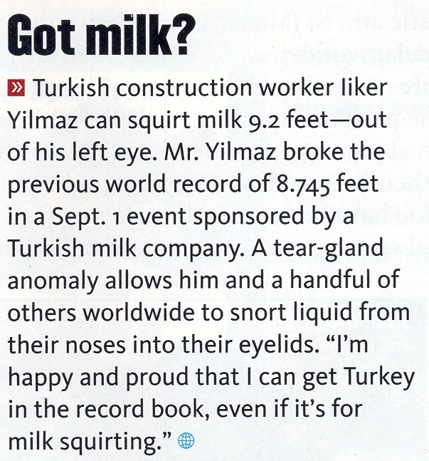
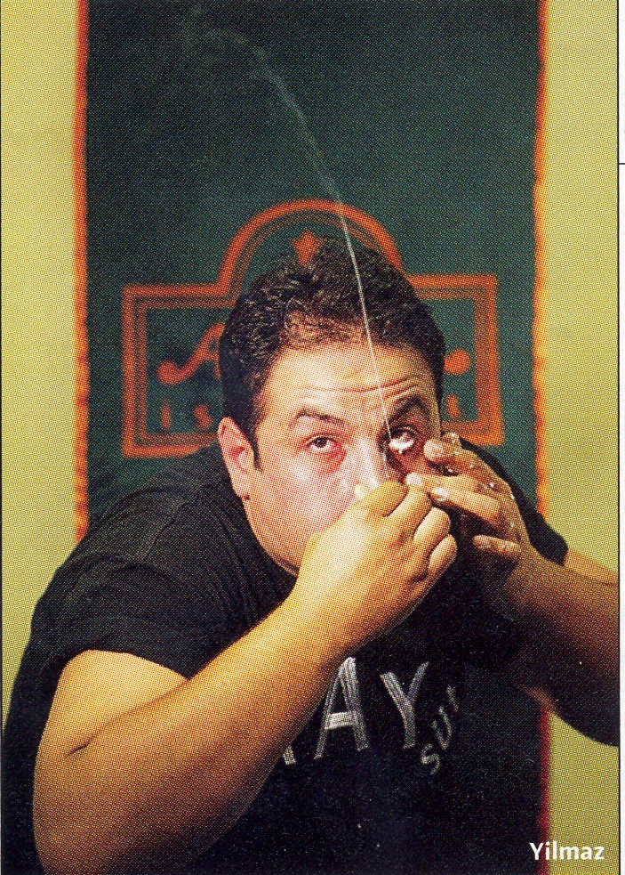
Interlude
Note: It's ilker, not liker

Slide 36
round robin example
(define round-robin
(let ([snoc (lambda (L x) (append L (list x)))])
(lambda (list-of-engines)
(if (null? list-of-engines)
'()
((car list-of-engines) ;run 1st engine in list.
1 ; it's only allowed to run for one tick.
(lambda (ticks value) ; complete procedure
(cons value (round-robin (cdr list-of-engines))))
(lambda (new-engine) ; expire procedure
(round-robin (snoc (cdr list-of-engines)
new-engine))))))))
> (round-robin (map engine-fib
'(3 7 11 4 12 9 1 6 10 8 2 5)))
Engine arguments:
Ticks complete
expire

Slide 37
round robin example
(define round-robin
(let ([snoc (lambda (L x) (append L (list x)))])
(lambda (list-of-engines)
(if (null? list-of-engines)
'()
((car list-of-engines) ;run 1st engine in list.
1 ; it's only allowed to run for one tick.
(lambda (ticks value) ; complete procedure
(cons value (round-robin (cdr list-of-engines))))
(lambda (new-engine) ; expire procedure
(round-robin (snoc (cdr list-of-engines)
new-engine))))))))
> (round-robin (map engine-fib
'(3 7 11 4 12 9 1 6 10 8 2 5)))
(1 1 2 3 5 8 13 21 34 55 89 144)
Engine arguments:
Ticks complete
expire
Notes:
This slide should not be part of the PDF.
ASK: What if we replaced the 1 by 10000?
What if we replaced the 1 by 100? (first couple in order given, others close to sorted order).

Slide 38
A more complex example
Simulating a multi-tasking operating system.

Slide 39
; Simulating a multi-tasking operating system
(load "queue.ss")
(define time-slice (lambda () (add1 (random 100))))
(define kernel
(lambda (proc)
(define ready-queue (make-queue))
(define start
(lambda (proc)
(enqueue (make-engine (lambda () (proc trap)))
ready-queue)))
(define restart
(lambda (k v)
(enqueue (make-engine (lambda () (k v)))
ready-queue)))
(define trap
(lambda (msg arg)
(call/cc
(lambda (k)
(engine-return
(lambda ()
(case msg
(uninterruptible
(restart k (arg)))
(start-process
(start arg)
(restart k #f))
(stop-process #f))))))))

Slide 40
(start proc)
(let dispatch ()
(if (empty-queue? ready-queue)
'finished
((dequeue ready-queue)
(time-slice)
(lambda (ticks trap-handler)
(trap-handler)
(dispatch))
(lambda (engine)
(enqueue engine ready-queue)
(dispatch)))))))

Slide 41
; An example that uses this multi-tasking simulator
(define amoeba
(lambda (generation final)
(lambda (trap)
(when (< generation final)
(trap 'uninterruptible
(lambda ()
(writeout generation)))
(trap 'start-process (amoeba (+ generation 1) final))
(trap 'start-process (amoeba (+ generation 1) final)))
(trap 'stop-process #f))))
(define writeln (lambda x (for-each display x) (newline)))
(define writeout
(let ([count 0])
(lambda (n)
(printf "~s " n)
(set! count (+ count (if (< n 10) 2 3)))
(when (>= count 77) (newline) (set! count 0)))))

Slide 42
> (kernel (amoeba 0 9))
0 1 2 1 3 2 2 2 4 3 4 3 3 3 3 5 4 3 4 3 5 4 4 6 5 5 5 4 4 4 4 5 6
4 4 5 4 5 4 7 6 6 6 5 5 5 5 4 6 5 4 6 5 6 5 5 5 5 8 7 7 7 6 7 7 5
5 6 6 6 5 6 6 5 5 6 5 5 5 8 7 7 7 6 6 5 7 6 6 6 5 6 6 5 7 7 6 6 5
5 8 8 7 7 7 8 8 7 6 6 7 7 7 6 6 6 7 6 6 6 6 6 6 6 6 6 6 8 8 8 7 8
8 8 8 7 6 7 7 7 7 6 7 7 7 6 7 7 6 6 6 6 8 7 7 7 6 6 8 8 8 8 7 7 6
7 6 7 6 8 8 8 8 7 7 7 7 6 6 7 5 7 6 8 8 7 7 7 7 7 6 7 6 8 8 8 8 7
7 6 8 8 8 8 8 7 7 7 8 7 7 8 7 8 7 7 7 7 6 8 7 8 7 7 7 7 7 8 7 8 7
8 7 6 6 6 6 7 7 8 8 8 8 8 8 7 8 7 7 7 8 8 8 8 8 8 7 7 7 8 8 8 8 8
7 8 7 8 7 8 7 7 7 7 8 8 8 8 7 8 7 8 7 7 7 8 8 8 8 8 7 8 8 7 8 8 7
7 8 8 8 8 8 8 7 8 8 7 8 7 8 8 7 7 6 6 8 8 8 7 8 8 8 8 8 8 8 8 8 8
8 7 7 7 8 8 7 8 7 8 8 8 8 8 7 8 8 8 7 8 8 8 8 8 8 8 8 7 8 8 8 7 7
7 8 8 8 8 7 8 8 8 7 8 8 8 8 8 8 7 7 7 7 7 8 8 8 7 8 8 8 8 8 8 8 8
8 7 8 8 8 8 8 8 8 8 8 8 7 8 8 7 8 8 8 8 8 8 8 8 8 8 8 8 8 8 8 8 8
8 8 8 8 8 8 8 8 8 8 8 8 8 8 8 8 8 7 7 8 8 8 8 8 8 8 8 7 8 8 8 8 8
8 8 8 8 8 8 8 8 8 8 8 8 8 8 8 8 8 8 7 8 8 8 8 8 8 8 8 8 8 8 8 8 8
8 8 8 8 8 8 8 8 8 8 8 8 8 8 8 8 finished

Slide 43
Coroutines
Free the enslaved subroutines!

Slide 44
A reference
Teach Yourself Scheme in Fixnum days by Dorai Sitaram
Coroutine presentation somewhat similar to this one.
http://www.ccs.neu.edu/home/dorai/t-y-scheme/t-y-scheme-Z-H-15.html#node_chap_13

Slide 45
Coroutine vs. subroutine
Master-slave vs. equal partners
Apply a procedure vs. resume a coroutine
Monopoly analogy
Coroutines do not involve concurrency

Slide 46
Example to illustrate coroutines
(make-coroutine receiver) creates a coroutine that executes the code in receiver.
(resume cor value) resumes the cor coroutine.
Examples are in coroutines.ss
Running the first example:
>(example)
1-a 33 2-a 34 1-b 35 2-b 36 1-c 37

Slide 47
Coroutine example adapted from EoPL, first edition, Chapter 9
(define example
(lambda ()
(call/cc
(lambda (return-cont)
(let ([co1 'undefined]
[co2 'undefined])
(set! co1 (make-coroutine
(lambda (init-val1)
(display " 1-a ")
(display init-val1)
(set! init-val1
(resume co2 (+ 1 init-val1)))
(display " 1-b ")
(display init-val1)
(set! init-val1
(resume co2 (+ 1 init-val1)))
(display " 1-c ")
(return-cont init-val1))))
(set! co2 (make-coroutine
(lambda (init-val2)
(display " 2-a ")
(display init-val2)
(set! init-val2
(resume co1 (+ 1 init-val2)))
(display " 2-b ")
(display init-val2)
(set! init-val2
(resume co1 (+ 1 init-val2)))
(display " 2-c "))))
(co1 33))))))
;; >(example)
;; 1-a 33 2-a 34 1-b 35 2-b 36 1-c 37

Slide 48
Coroutine Implementation
You don’t need to understand all of the details
(define resume 'resume-undefined)
(define make-coroutine
(lambda (body)
(let ([local-continuation 'local-continuation-undefined])
(letrec
([newcoroutine
(lambda (value) (local-continuation value))]
[localresume
(lambda (continuation value)
(let ([value
(call/cc (lambda (k)
(set! local-continuation k)
(continuation value)))])
(set! resume localresume)
value))])
(call/cc
(lambda (exit)
(body (localresume exit newcoroutine))
(error 'coroutine
"fell off end of coroutine")))))))

Slide 49
Same-fringe problem
same-fringe takes two sn-lists and determines whether their leaf nodes (in a pre-order traversal) are the same (and in the same order).
See next slide for examples.
Note that a slight extension of sn-lists is allowed, where the “sn-list” can just be a single number or symbol.

Slide 50
same-fringe examples
> (same-fringe '((1 2 (3) () () 4)) '(1 (((2 ((3) 4))))))
#t
> (same-fringe '((1 2 (3) () () 4)) '(1 (((2 ((3) 5))))))
#f
> (same-fringe '((1 2 (3) () () 4)) '(1 (((2 ((3) ))))))
#f
> (same-fringe '((1 2 (3) () () 4)) '(1 (((2 ((3) 4 5))))))
#f
> (same-fringe '2 '3)
#f
> (same-fringe '2 '2)
#t

Slide 51
A short, simple way to write same-fringe
How would you write it if you only had 1 minute to do it?

Slide 52
A short, simple way to write same-fringe
How would you write it if you only had 1 minute to do it?
Why doesn’t the story end here?
Notes:
(define same-fringe
(lambda (s1 s2)
(equal? (flatten s1) (flatten s2))))

Slide 53
A traditional approach to same-fringe
For each tree, create an iterator that gives each tree element “on-demand”
Iterator behavior is just like Java iterators, but in a functional language, we can make the interface simpler.

Slide 54
Example of iterator behavior
> (define iter (make-slist-leaf-iterator '(((1 (2) (()) (3 4))))))
> (iter)
1
> (iter)
2
> (iter)
3
> (iter)
4
> (iter)
#f
> (iter)
#f

Slide 55
Once we can make iterators, same-fringe is relatively easy.
Same-fringe first creates an iterator for each s-list. It then repeatedly asks each iterator for the next leaf from its s-list, comparing the results, until a list runs out or the leaves are different.
Code on next slide.

Slide 56
same-fringe code
(define same-fringe
(lambda (s1 s2)
(let ([iter1 (make-slist-leaf-iterator s1)]
[iter2 (make-slist-leaf-iterator s2)])
(let loop ()
(let ([leaf1 (iter1)]
[leaf2 (iter2)])
(if (eq? leaf1 leaf2)
(if leaf1
(loop)
#t)
#f)))))))
You wrote the iterator code. Each iterator has its own stack which we must explicitly manage,

Slide 57
Writing the iterator
The next three slides review the ideas of the assignment in which you wrote make-slist-leaf-iterator.
They are for reference; we will not go over them in class

Slide 58
Writing a preorder iterator
It’s easy to write a complete preorder traversal recursively.
Not so easy to write an iterator recursively.
Why?
Soon, we’ll see that call/cc allows us write it simply and recursively.
How did we do the non-recursive iterator in CS 230?
We can use a stack to keep track of the parts of the tree not yet traversed
The algorithm that I use comes form the Weiss DS book Data Structures and Problem Solving With Java, 3rd Edition, pages 621-622.

Slide 59
(define make-slist-leaf-iterator
(lambda (slst)
(let ([stk (make-stack)]) ; Now define two local functions.
(define find-initial-leaf ; first go "left" as far as possible.
(lambda (slst)
(cond [(pair? slst) (stk 'push (cdr slst)) ; leave a trail.
(find-initial-leaf (car slst))]
[(null? slst) (find-next-leaf)] ; no non-empty leaf in
; "car branch";
; so we try the cdr.
[else slst])))
(define find-next-leaf ; Go up a level, to the right,
(lambda () ; and then as far left as possible.
(if (stk 'empty?)
#f ; all leaves have already been visited.
(find-initial-leaf (stk 'pop)))))
(let ([current-element (find-initial-leaf slst)]) ; This puts
; stuff on stk.
(lambda () ; The actual iterator function that we'll return.
(let ([return-val current-element])
(set! current-element (find-next-leaf))
return-val))))))

Slide 60
For completeness, I show the stack constructor
(define make-stack
(lambda ()
(let ([stk '()])
(lambda (msg . args )
(case msg
[(empty?) (null? stk)]
[(push) (set! stk (cons (car args)
stk))]
[(pop) (let ([top (car stk)])
(set! stk (cdr stk))
top)]
[else (error 'stack
"illegal message to stack object: ~a"
msg)])))))

Slide 61
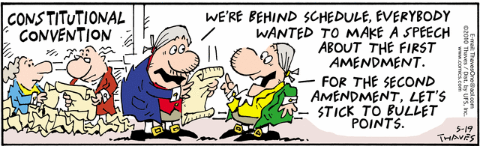
Interlude

Slide 62
A more natural approach
Naturally recursive approach to same-fringe?
Natural, because it just uses "normal" recursion and the runtime stack to keep track of where we are in the computation. We do not have to manage the stack ourselves. We can just do traversals and pause them when a leaf is found.
Coroutines

Slide 63
same-fringe via coroutines

Slide 64
(define same-fringe
(lambda (tree1 tree2)
(call/cc
(lambda (return-cont)
(let ([co1 '()] [co2 '()] [driver '()])
(set! driver
(make-coroutine
(lambda (init-value)
(let loop ()
(let ([leaf1 (resume co1 'whocares)]
[leaf2 (resume co2
'whocare2)])
(if (equal? leaf1 leaf2)
(if leaf1
(loop) (return-cont #t))
(return-cont #f)))))))
(set! co1 (make-sf-coroutine driver tree1))
(set! co2 (make-sf-coroutine driver tree2))
(driver 'Whatsittoya?))))))
(define make-sf-coroutine
(lambda (driver tree)
(make-coroutine
(lambda (init-value)
(letrec ([traverse
(lambda (tree)
(if (pair? tree)
(begin
(traverse (car tree))
(if (pair? (cdr tree))
(traverse (cdr tree))))
(resume driver tree)))])
(traverse tree)
(resume driver #f))))))
Note that the body of a sf-coroutine is like a normal preorder traversal; no iterators required.

