Slide 1
CSSE 304
Day 35
call/cc in the interpreted language
Imperative form
Has your mind been stretched this term?

Slide 2
Add call/cc to our interpreted language
Details on the handout and on the board.
Some questions:
What is a (user) continuation? How to represent?
Where in the code should call/cc implementation be? What does it do?
What happens when a continuation is applied? Where should this go in the interpreter? What should the code be?

Slide 3
Imperative form
As close to C or Assembly Language as we can get in Scheme

Slide 4
Implementation environment
Scheme is a great language to use when implementing an interpreter.
But does it do too much for us?
Could we easily write the Assignment 18 interpreter in a simpler language?
One without first-class procedures?

Slide 5
A simple example
The interpreter involves a lot of code, so we will look at transforming a simple example.
The same ideas will work to transform the interpreter, but most of you don’t have time to do that this term.
The code in these slides is linked from today’s Resources column in the Schedule Page.

Slide 6
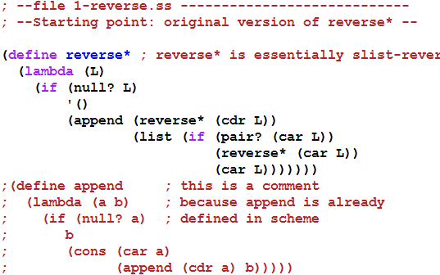

A simple example
Next: convert to CPS

Slide 7
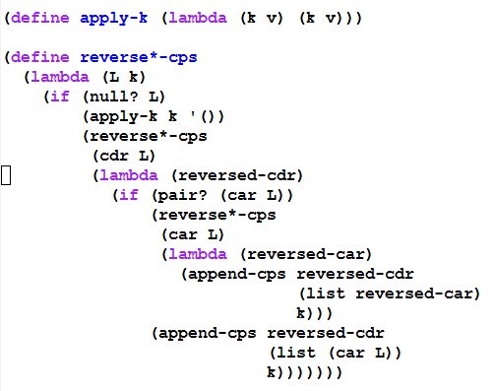
Convert to CPS form – part 1 Represent continuations as Scheme procedures

Slide 8
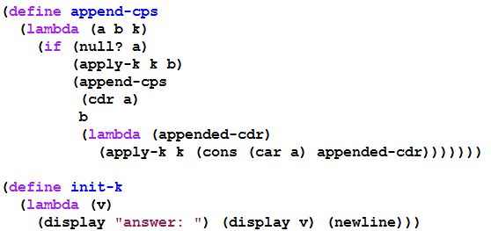
Convert to CPS form – part 2 Represent continuations as Scheme procedures

Slide 9
with tracing
(trace-define reverse*-cps
(lambda (L k)
(if (null? L)
(k '())
(reverse*-cps
(cdr L)
(trace-lambda cdr-k (reversed-cdr)
(if (pair? (car L))
(reverse*-cps
(car L)
(trace-lambda car-k (reversed-car)
(append-cps
reversed-cdr
(list reversed-car)
k)))
(append-cps reversed-cdr
(list (car L))
k)))))))
(trace-define append-cps
(lambda (a b k)
(if (null? a)
(k b)
(append-cps
(cdr a)
b
(trace-lambda append-k (appended-cdr)
(k (cons (car a) appended-cdr)))))))
(trace-define init-k
(lambda (v)
(display "answer: ") (display v) (newline)))

Slide 10
the trace
> (reverse*-cps '(a (b () ((c) d))) init-k)
|(reverse*-cps (a (b () ((c) d))) #<procedure>)
|(reverse*-cps ((b () ((c) d))) #<procedure>)
|(reverse*-cps () #<procedure>)
|(apply-k #<procedure> ())
|(cdr-k ())
|(reverse*-cps (b () ((c) d)) #<procedure>)
|(reverse*-cps (() ((c) d)) #<procedure>)
|(reverse*-cps (((c) d)) #<procedure>)
|(reverse*-cps () #<procedure>)
|(apply-k #<procedure> ())
|(cdr-k ())
|(reverse*-cps ((c) d) #<procedure>)
|(reverse*-cps (d) #<procedure>)
|(reverse*-cps () #<procedure>)
|(apply-k #<procedure> ())
|(cdr-k ())
|(append-cps () (d) #<procedure>)
|(apply-k #<procedure> (d))
|(cdr-k (d))
|(reverse*-cps (c) #<procedure>)
|(reverse*-cps () #<procedure>)
|(apply-k #<procedure> ())
|(cdr-k ())
|(append-cps () (c) #<procedure>)
|(apply-k #<procedure> (c))
|(car-k (c))
|(append-cps (d) ((c)) #<procedure>)
|(append-cps () ((c)) #<procedure>)
|(apply-k #<procedure> ((c)))
|(append-k ((c)))
|(apply-k #<procedure> (d (c)))
|(car-k (d (c)))
|(append-cps () ((d (c))) #<procedure>)
|(apply-k #<procedure> ((d (c))))
|(cdr-k ((d (c))))
|(append-cps ((d (c))) (()) #<procedure>)
|(append-cps () (()) #<procedure>)
|(apply-k #<procedure> (()))
|(append-k (()))
|(apply-k #<procedure> ((d (c)) ()))
|(cdr-k ((d (c)) ()))
|(append-cps ((d (c)) ()) (b) #<procedure>)
|(append-cps (()) (b) #<procedure>)
|(append-cps () (b) #<procedure>)
|(apply-k #<procedure> (b))
|(append-k (b))
|(apply-k #<procedure> (() b))
|(append-k (() b))
|(apply-k #<procedure> ((d (c)) () b))
|(car-k ((d (c)) () b))
|(append-cps () (((d (c)) () b)) #<procedure>)
|(apply-k #<procedure> (((d (c)) () b)))
|(cdr-k (((d (c)) () b)))
|(append-cps (((d (c)) () b)) (a) #<procedure>)
|(append-cps () (a) #<procedure>)
|(apply-k #<procedure> (a))
|(append-k (a))
|(apply-k #<procedure> (((d (c)) () b) a))
|(init-k (((d (c)) () b) a))
answer: (((d (c)) () b) a)
This lets us see the flow of control as the CPS procedures execute, but we can't see the details that are hidden inside #<procedure>

Slide 11
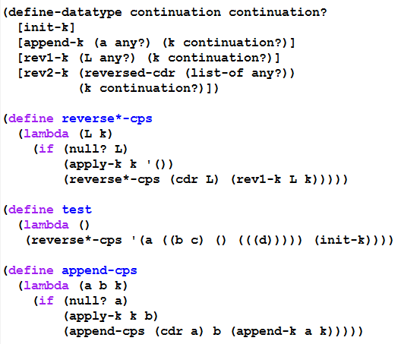
Second Continuation representation part 1 (using define-datatype)

Slide 12
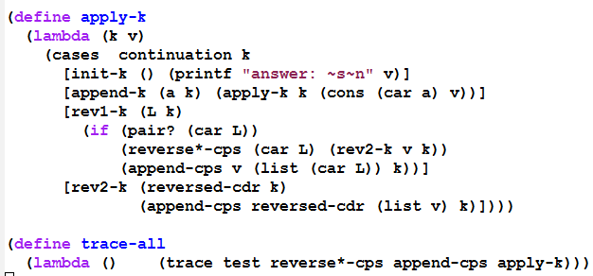

Second Continuation representation part 2 (using define-datatype)

Slide 13
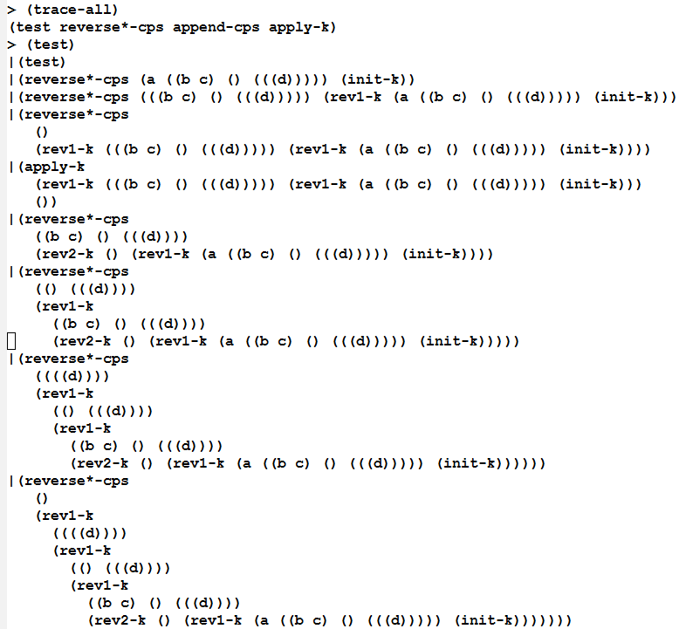
Beginning of a trace (you can generate the rest yourself, using the on-line files)

Slide 14
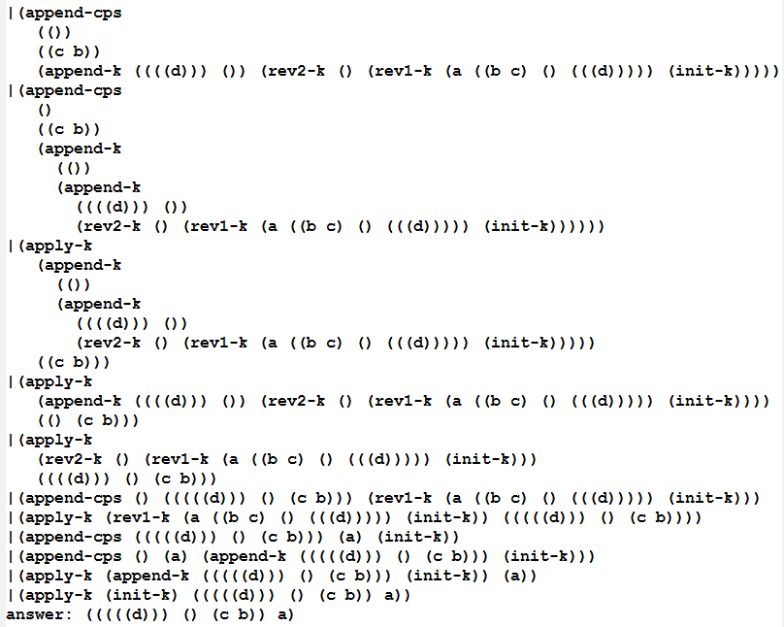
End of the trace (you can generate the whole trace yourself using the on-line files)

Slide 15
What do we have now?
Using this style, we could write the interpreter in any language that provides a means of creating records.
But it would be inefficient if that language's compiler does not handle tail-recursion properly
Could even result in a stack overflow.
So we transform to a style in which the flow of control is really just assignments, BEGINs, IFs, and GOTOs:

Slide 16
Transform to Imperative form
All substantial procedures will be called in tail-position, so they do not need to return.
All substantial procedures will be thunks (procedures that take no arguments), thus there is no need for stack frames.
Thus a substantial procedure call is equivalent to a "goto"
This can be implemented in almost any language.

Slide 17
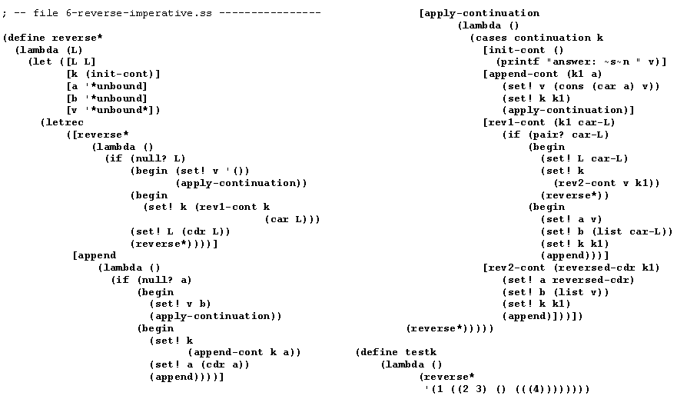
Imperative form
We can do the same set of transformations to our interpreter (but we won’t. )
We could use global variables and procedures instead of let and letrec

Slide 18

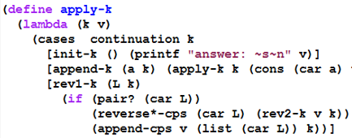
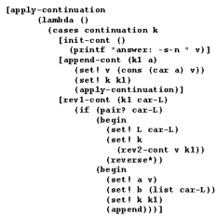
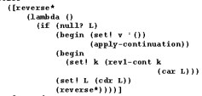
Details of a transformation

Slide 19
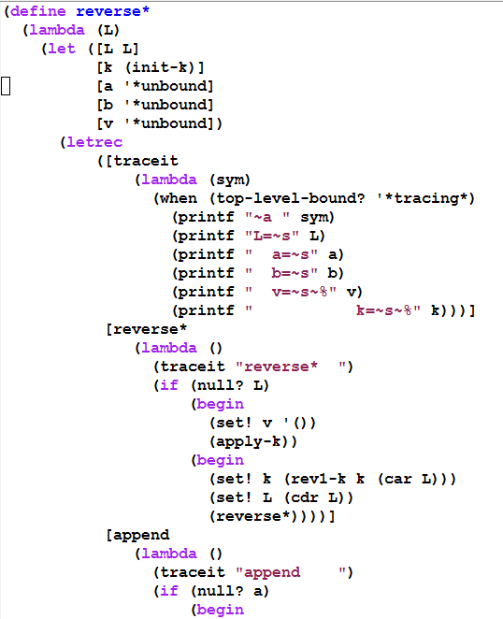
Tracing this Imperative-form program

Slide 20
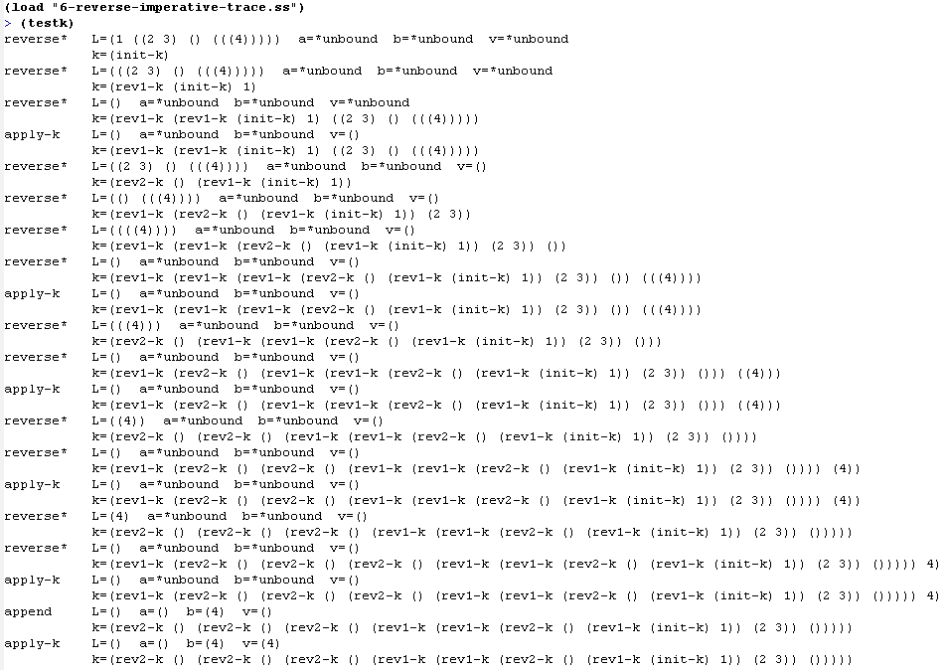

Slide 21
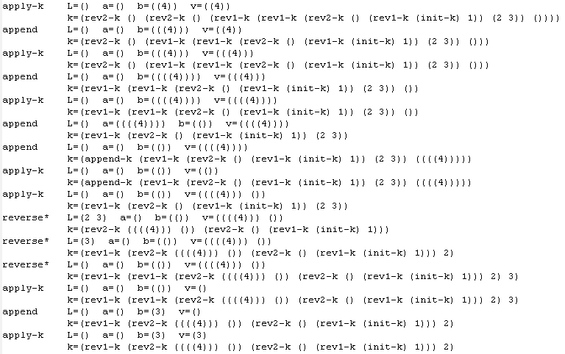

Slide 22
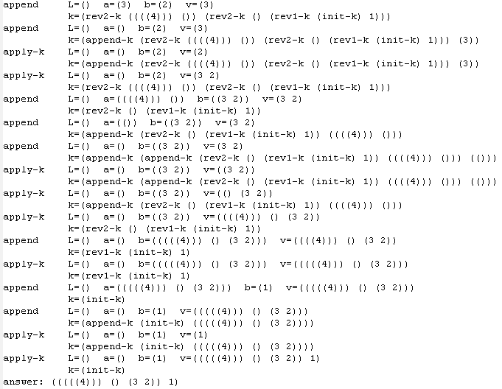

Slide 23
Where does this leave us?
All we really need in order to implement things in this style:
implementations of the basic data types (numbers, lists, etc.) and prim-procs
record structures
variable assignment
if
go to
begin
Then we could implement our interpreter in almost any language.

Slide 24
Exercise
Start with another small piece of recursive code, and apply all of these transformations to get it into imperative form.
You may be asked to do this on the final exam.
One practice possibility: Start with the code we wrote Days 31-32, imperative form.

