Slide 1
CSSE 304
Day 34
Imperative form
Has your mind been stretched so far this term?

Slide 2
Imperative form
As close to C or Assembly Language as we can get in Scheme

Slide 3
Implementation environment
Scheme is a great language to use when implementing an interpreter.
But does it do too much for us?
Could we easily write the Assignment 18 interpreter in a simpler language?
One without first-class procedures?

Slide 4
A simple example
The interpreter involves a lot of code, so we will look at transforming a simple example.
The same ideas will work to transform the interpreter, but most of you don’t have time to do that this term.
The code in these slides is linked from today’s Resources column in the Schedule Page.

Slide 5
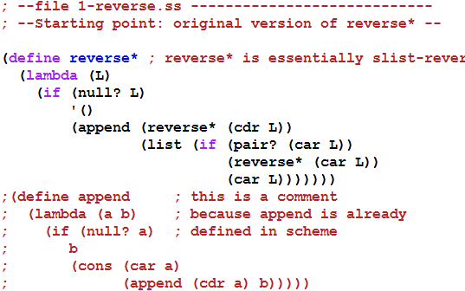

A simple example
Next: convert to CPS

Slide 6
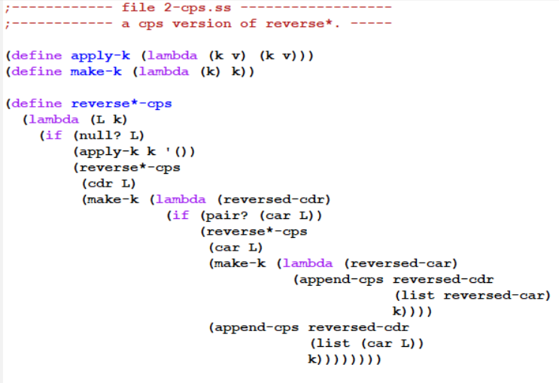
Convert to CPS form – part 1 Represent continuations as Scheme procedures

Slide 7
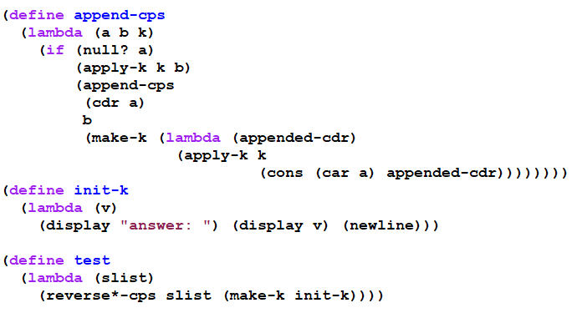

Convert to CPS form – part 2 Represent continuations as Scheme procedures

Slide 8
with tracing
(trace-define reverse*-cps
(lambda (L k)
(if (null? L)
(k '())
(reverse*-cps
(cdr L)
(trace-lambda cdr-k (reversed-cdr)
(if (pair? (car L))
(reverse*-cps
(car L)
(trace-lambda car-k (reversed-car)
(append-cps
reversed-cdr
(list reversed-car)
k)))
(append-cps reversed-cdr
(list (car L))
k)))))))
(trace-define append-cps
(lambda (a b k)
(if (null? a)
(k b)
(append-cps
(cdr a)
b
(trace-lambda append-k (appended-cdr)
(k (cons (car a) appended-cdr)))))))
(trace-define init-k
(lambda (v)
(display "answer: ") (display v) (newline)))

Slide 9
the trace
> (reverse*-cps '(a (b () ((c) d))) init-k)
|(reverse*-cps (a (b () ((c) d))) #<procedure>)
|(reverse*-cps ((b () ((c) d))) #<procedure>)
|(reverse*-cps () #<procedure>)
|(apply-k #<procedure> ())
|(cdr-k ())
|(reverse*-cps (b () ((c) d)) #<procedure>)
|(reverse*-cps (() ((c) d)) #<procedure>)
|(reverse*-cps (((c) d)) #<procedure>)
|(reverse*-cps () #<procedure>)
|(apply-k #<procedure> ())
|(cdr-k ())
|(reverse*-cps ((c) d) #<procedure>)
|(reverse*-cps (d) #<procedure>)
|(reverse*-cps () #<procedure>)
|(apply-k #<procedure> ())
|(cdr-k ())
|(append-cps () (d) #<procedure>)
|(apply-k #<procedure> (d))
|(cdr-k (d))
|(reverse*-cps (c) #<procedure>)
|(reverse*-cps () #<procedure>)
|(apply-k #<procedure> ())
|(cdr-k ())
|(append-cps () (c) #<procedure>)
|(apply-k #<procedure> (c))
|(car-k (c))
|(append-cps (d) ((c)) #<procedure>)
|(append-cps () ((c)) #<procedure>)
|(apply-k #<procedure> ((c)))
|(append-k ((c)))
|(apply-k #<procedure> (d (c)))
|(car-k (d (c)))
|(append-cps () ((d (c))) #<procedure>)
|(apply-k #<procedure> ((d (c))))
|(cdr-k ((d (c))))
|(append-cps ((d (c))) (()) #<procedure>)
|(append-cps () (()) #<procedure>)
|(apply-k #<procedure> (()))
|(append-k (()))
|(apply-k #<procedure> ((d (c)) ()))
|(cdr-k ((d (c)) ()))
|(append-cps ((d (c)) ()) (b) #<procedure>)
|(append-cps (()) (b) #<procedure>)
|(append-cps () (b) #<procedure>)
|(apply-k #<procedure> (b))
|(append-k (b))
|(apply-k #<procedure> (() b))
|(append-k (() b))
|(apply-k #<procedure> ((d (c)) () b))
|(car-k ((d (c)) () b))
|(append-cps () (((d (c)) () b)) #<procedure>)
|(apply-k #<procedure> (((d (c)) () b)))
|(cdr-k (((d (c)) () b)))
|(append-cps (((d (c)) () b)) (a) #<procedure>)
|(append-cps () (a) #<procedure>)
|(apply-k #<procedure> (a))
|(append-k (a))
|(apply-k #<procedure> (((d (c)) () b) a))
|(init-k (((d (c)) () b) a))
answer: (((d (c)) () b) a)
This lets us see the flow of control as the CPS procedures execute, but we can't see the details that are hidden inside #<procedure>

Slide 10
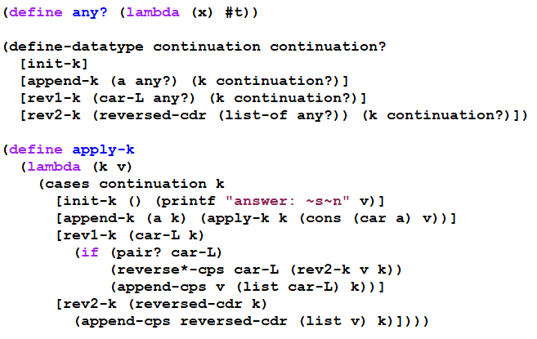
Second Continuation representation part 1 (using define-datatype)

Slide 11
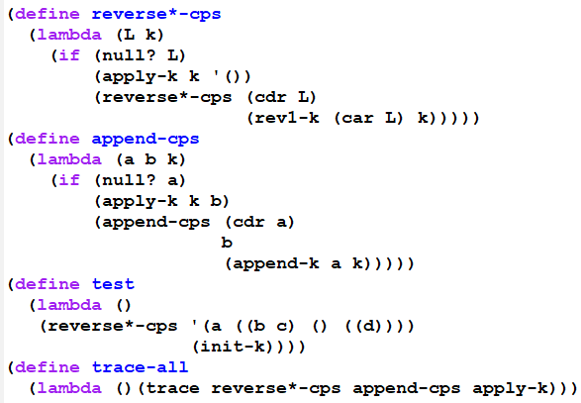

Second Continuation representation part 2 (using define-datatype)

Slide 12
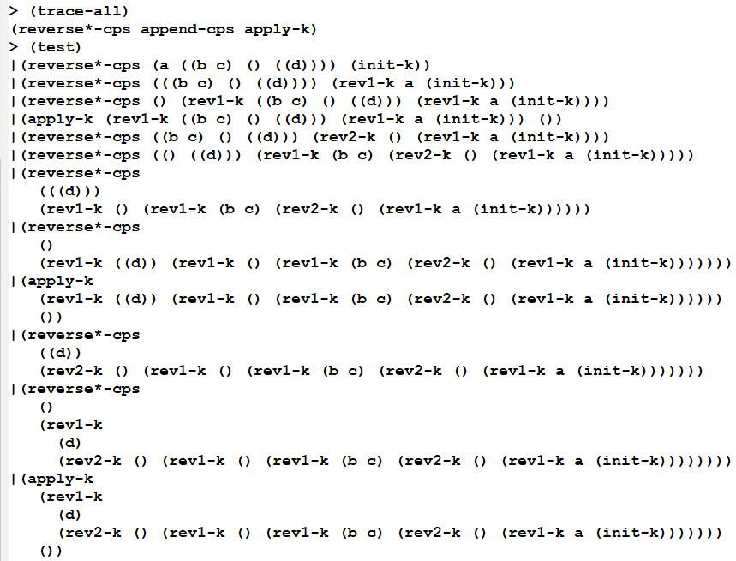
Beginning of a trace (you can generate the rest yourself, using the on-line files)

Slide 13
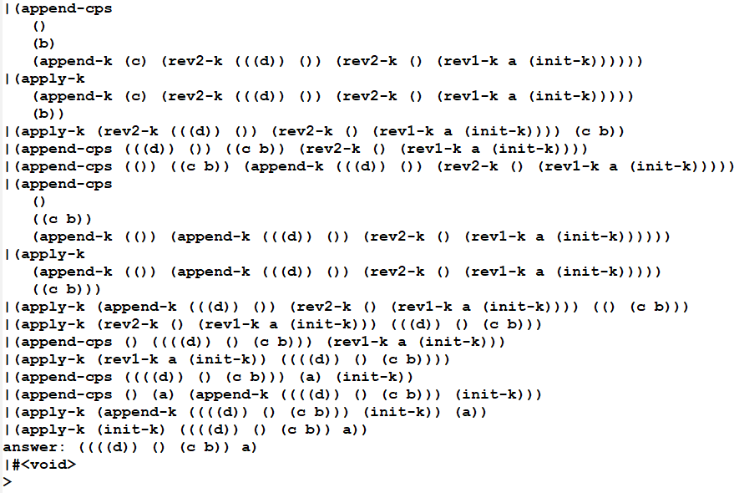
End of the trace (you can generate the whole trace yourself using the on-line files)

Slide 14
What do we have now?
Using this style, we could write the interpreter in any language that provides a means of creating records.
But it would be inefficient if that language's compiler does not handle tail-recursion properly
Could even result in a stack overflow.
So we transform to a style in which the flow of control is really just assignments, BEGINs, IFs, and GOTOs:

Slide 15
Transform to Imperative form
All substantial procedures will be called in tail-position, so they do not need to return.
All substantial procedures will be thunks (procedures that take no arguments), thus there is no need to have stack frames that hold parameters.
Thus each substantial procedure call is equivalent to a "goto"
This can be implemented in almost any language.

Slide 16
Transform to imperative form
Get the code for your section from Live-in-class.
Transform to imperative form.
Be sure to look at the tracing mechanism.
Notes:
Solution code is in SVN/304/SchemeSource/imperative-form.

Slide 17
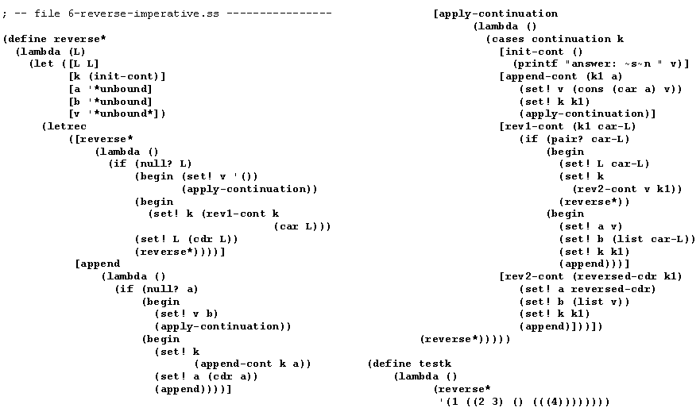
Imperative form
We can do the same set of transformations to our interpreter (but we won’t. )
We could use global variables and procedures instead of let and letrec

Slide 18

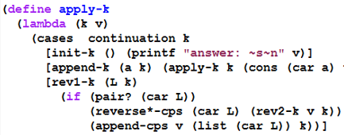
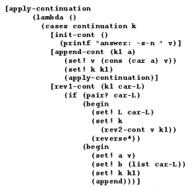
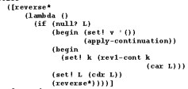
Details of a transformation

Slide 19
Where does this leave us?
All we really need in order to implement things in this style:
implementations of the basic data types (numbers, lists, etc.) and prim-procs
record structures
variable assignment
if
go to
begin
Then we could implement our interpreter in almost any language.

Slide 20
Exercise
Start with another small piece of recursive code, and apply all of these transformations to get it into imperative form.
You may be asked to do this on the final exam.
You’ll write imperative-form code for A19.
A19 is an individual assignment

Slide 21
Implementing Reference parameters
For definiteness, I use an “each value in an environment is in a cell” approach.

Slide 22
Solution to “ref params” from A17
For your eyes only. Here and now.
Photographing these slides will be considered Academic Misconduct

Slide 23
(let ([a 3]
[b 4]
[rotate (lambda (x (ref y) (ref z))
(let ([temp x])
(set! x y)
(set! y z)
(set! z temp)
(list x y z)))])
(let ([result (rotate a b (+ a b))])
(list a b result)))
What interpreter changes are needed before we call apply-proc? Mainly a change to eval-rands: return list of cells.
What interpreter changes are needed in the apply-proc closure case? If it’s not a ref param, put the corresponding argument value in a new cell.
Notes:
Draw the diagram on the board

Slide 24
A change to extend-env
This works for the “cell” representation of references. It’s slightly more complex for the ribcage representation without cells.
First, modify extend-env so that its second argument is a list of cells containing the values. Thus the values are put into the cells before calling extend-env.
Each level of extended environment will still contain a list or vector of cells, but these cells will not be created by extend-env.

Slide 25
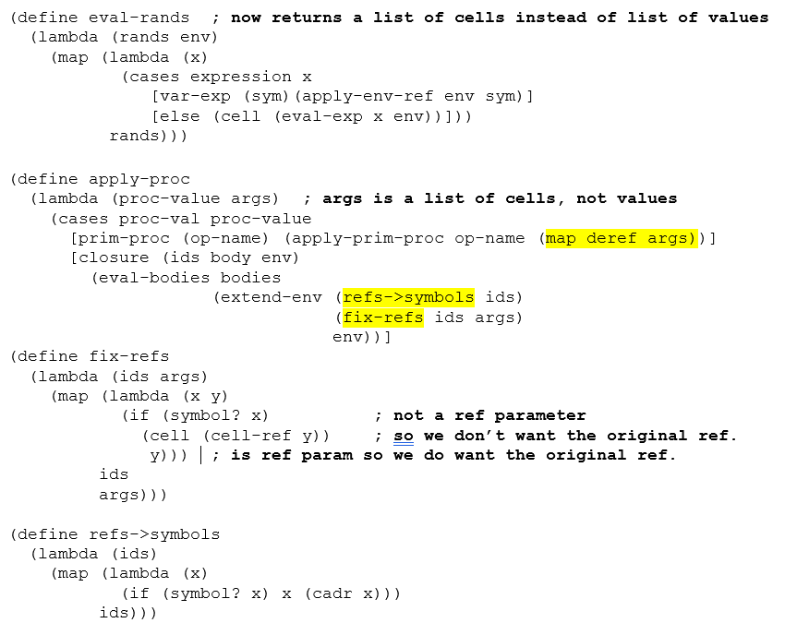
(define extend-env
(lambda (vars cells env)
(extended-env-record
vars cells env)))

