Slide 1
CSSE 304 Day 36
What questions do you have?
Finish Imperative form
Engines
Reference parameters
This was supposed to be for Day 35, but it was postponed due to instructor illness.
Notes:
Do not include second round-robin slide in PDF.
Find an interlude?

Slide 2
Transform to Imperative form
All substantial procedures will be called in tail-position, so they do not need to return.
All substantial procedures will be thunks (procedures that take no arguments), thus there is no need to have stack frames that hold parameters.
Thus each substantial procedure call is equivalent to a "goto"
This can be implemented in almost any language.
(second day) Finish the live demo.

Slide 3
Engines intro
See the engine-intro.ss file
Engines abstract timed pre-emption.
Introduced to Scheme by Haynes and Friedman
A simpler implementation by Dybvig and Hieb is built into Chez Scheme.
engines do not have to be Scheme built-ins, but can be built on top of call/cc.
Documented in TSPL. You should be able to use that code to make engines work in other Scheme environments.

Slide 4
How Engines work 1
(make-engine thunk) creates an engine that will, when applied to three arguments
activate a timer-interrupt mechanism and then
evaluate the body of thunk.
A thunk is simply a procedure that takes no arguments

Slide 5
How Engines work 2
The three arguments passed to an engine are:
ticks: a positive integer specifying the amount of "fuel" given to the engine.
complete: a procedure that specifies what to do if the evaluation of thunk finishes before the fuel expires.
complete is a procedure of two arguments: amount of fuel "left over" and the result of the computation.
expire: a one-argument procedure to be executed if the computation runs out of fuel before it completes.
The argument that will be passed to expire is a new engine that can finish the computation from where it left off.
Notes:
return and expire are similar to succeed and fail continuations

Slide 6
Example
Engine arguments:
ticks (initial amount of fuel)
complete (receives # remaining ticks and answer if computation finishes)
expire (receives engine capable of completing the computation if fuel expires before computation finishes)
(define fib
(lambda (n)
(cond [(zero? n) 0]
[(= n 1) 1]
[else (+ (fib (- n 1))
(fib (- n 2)))])))
(define engine-fib
(lambda (n)
(make-engine
(lambda () (fib n)))))
> (define eng (engine-fib 7))
> (eng 50 cons (lambda (new-eng) (set! eng new-eng)))
> (eng 50 cons (lambda (new-eng) (set! eng new-eng)))
> (eng 50 cons (lambda (new-eng) (set! eng new-eng)))
> (eng 50 cons (lambda (new-eng) (set! eng new-eng)))
> (eng 50 cons (lambda (new-eng) (set! eng new-eng)))
> (eng 50 cons (lambda (new-eng) (set! eng new-eng)))
(9 . 13)
Notes:
How many ticks were needed to complete the computation?
Answer 300 – 9 = 293

Slide 7
mileage
(define mileage ; count the ticks
(lambda (thunk)
(let loop ([eng (make-engine thunk)]
[total-ticks 0])
(eng 50
(lambda (ticks value)
(+ total-ticks (- 50 ticks)))
(lambda (new-engine)
(loop new-engine (+ 50 total-ticks)))))))
> (mileage (lambda () (fib 13)))
5359
> (mileage (lambda () (fib 14)))
8676
> (mileage (lambda () (fib 15)))
14043
> (mileage (lambda () (fib 10)))
1259
> (mileage (lambda () (fib 11)))
2042
> (mileage (lambda () (fib 12)))
3309

Slide 8
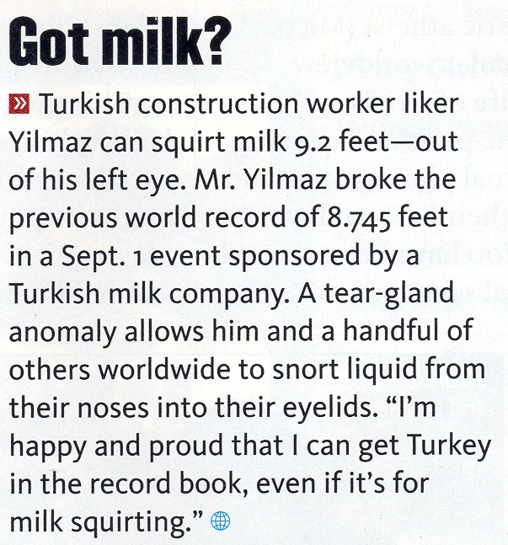
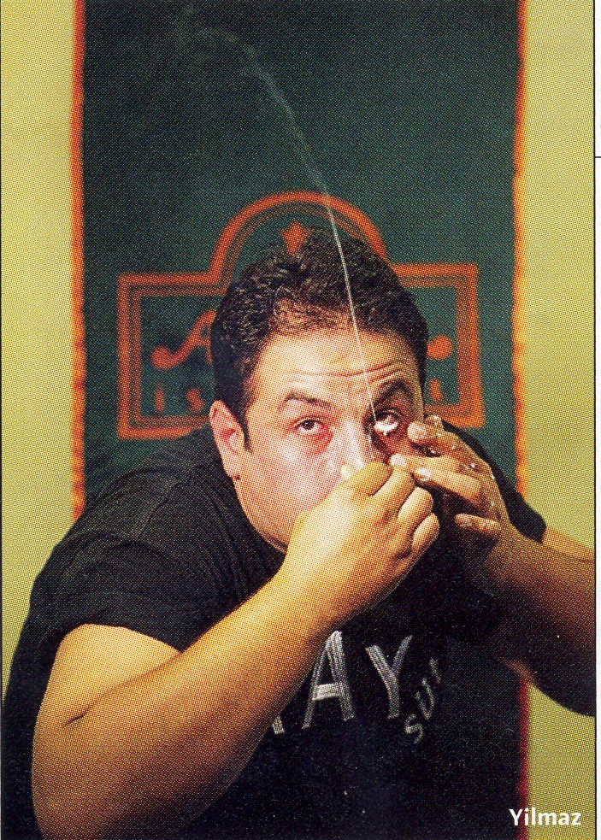
Interlude
Note: It's ilker, not liker

Slide 9
Round Robin Example
Engine arguments:
ticks complete
expire
(define round-robin
(lambda (queue-of-engines)
(if (queue-of-engines 'empty?)
'()
(let ([first-engine (queue-of-engines 'dequeue!)])
(first-engine
1 ; it's only allowed to run for one tick each time.
(lambda (ticks value) ; complete procedure
(cons value (round-robin queue-of-engines)))
(lambda (new-engine) ; expire procedure
(queue-of-engines 'enqueue! new-engine)
(round-robin queue-of-engines)))))))
> (let* ([q (make-queue)]
[nums '(3 7 11 4 12 9 2 6 10 8 1 5)]
[engine-list (map engine-fib nums)])
(for-each (lambda (eng) (q 'enqueue! eng))
engine-list)
(round-robin q)) ; what will the output be?
(define engine-fib
(lambda (n)
(make-engine
(lambda () (fib n)))))
What if we change the number of ticks from 1 to 150?
What will the output be?

Slide 10
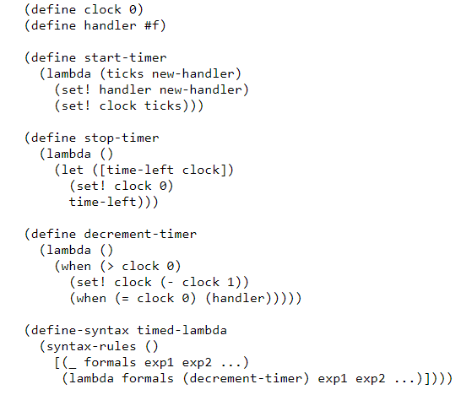
Implement make-engine using call/cc 1

Slide 11
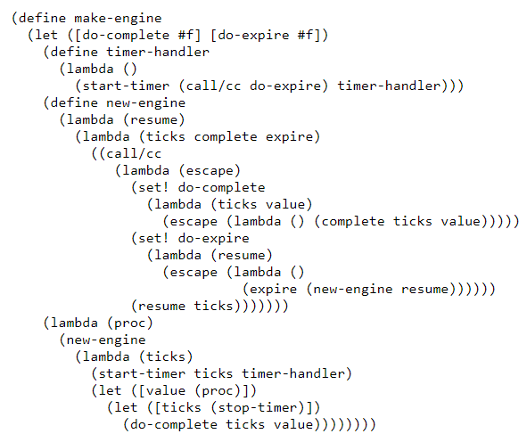
Implement make-engine using call/cc 2

Slide 12
A more complex example
Simulate a multi-tasking operating system.

Slide 13
(load “ooq")
(define time-slice (lambda () (add1 (random 100))))
(define kernel
(lambda (proc)
(define ready-queue (make-queue))
(define start
(lambda (proc)
(enqueue (make-engine (lambda () (proc trap)))
ready-queue)))
(define restart
(lambda (k v)
(enqueue (make-engine (lambda () (k v)))
ready-queue)))
(define trap
(lambda (msg arg)
(call/cc
(lambda (k)
(engine-return
(lambda ()
(case msg
(uninterruptible
(restart k (arg)))
(start-process
(start arg)
(restart k #f))
(stop-process #f))))))))
Simulate a multi-tasking operating system
(start proc)
(let dispatch ()
(if (empty-queue? ready-queue)
'finished
((dequeue ready-queue)
(time-slice)
(lambda (ticks trap-handler)
(trap-handler)
(dispatch))
(lambda (engine)
(enqueue engine ready-queue)
(dispatch)))))))

Slide 14
; An example that uses this multi-tasking simulator
(define amoeba
(lambda (generation final)
(lambda (trap)
(when (< generation final)
(trap 'uninterruptible
(lambda ()
(writeout generation)))
(trap 'start-process (amoeba (+ generation 1) final))
(trap 'start-process (amoeba (+ generation 1) final)))
(trap 'stop-process #f))))
(define writeln (lambda x (for-each display x) (newline)))
(define writeout
(let ([count 0])
(lambda (n)
(printf "~s " n)
(set! count (+ count (if (< n 10) 2 3)))
(when (>= count 77) (newline) (set! count 0)))))

Slide 15
> (kernel (amoeba 0 9))
0 1 2 1 3 2 2 2 4 3 4 3 3 3 3 5 4 3 4 3 5 4 4 6 5 5 5 4 4 4 4 5 6
4 4 5 4 5 4 7 6 6 6 5 5 5 5 4 6 5 4 6 5 6 5 5 5 5 8 7 7 7 6 7 7 5
5 6 6 6 5 6 6 5 5 6 5 5 5 8 7 7 7 6 6 5 7 6 6 6 5 6 6 5 7 7 6 6 5
5 8 8 7 7 7 8 8 7 6 6 7 7 7 6 6 6 7 6 6 6 6 6 6 6 6 6 6 8 8 8 7 8
8 8 8 7 6 7 7 7 7 6 7 7 7 6 7 7 6 6 6 6 8 7 7 7 6 6 8 8 8 8 7 7 6
7 6 7 6 8 8 8 8 7 7 7 7 6 6 7 5 7 6 8 8 7 7 7 7 7 6 7 6 8 8 8 8 7
7 6 8 8 8 8 8 7 7 7 8 7 7 8 7 8 7 7 7 7 6 8 7 8 7 7 7 7 7 8 7 8 7
8 7 6 6 6 6 7 7 8 8 8 8 8 8 7 8 7 7 7 8 8 8 8 8 8 7 7 7 8 8 8 8 8
7 8 7 8 7 8 7 7 7 7 8 8 8 8 7 8 7 8 7 7 7 8 8 8 8 8 7 8 8 7 8 8 7
7 8 8 8 8 8 8 7 8 8 7 8 7 8 8 7 7 6 6 8 8 8 7 8 8 8 8 8 8 8 8 8 8
8 7 7 7 8 8 7 8 7 8 8 8 8 8 7 8 8 8 7 8 8 8 8 8 8 8 8 7 8 8 8 7 7
7 8 8 8 8 7 8 8 8 7 8 8 8 8 8 8 7 7 7 7 7 8 8 8 7 8 8 8 8 8 8 8 8
8 7 8 8 8 8 8 8 8 8 8 8 7 8 8 7 8 8 8 8 8 8 8 8 8 8 8 8 8 8 8 8 8
8 8 8 8 8 8 8 8 8 8 8 8 8 8 8 8 8 7 7 8 8 8 8 8 8 8 8 7 8 8 8 8 8
8 8 8 8 8 8 8 8 8 8 8 8 8 8 8 8 8 8 7 8 8 8 8 8 8 8 8 8 8 8 8 8 8
8 8 8 8 8 8 8 8 8 8 8 8 8 8 8 8 finished

Slide 16
Implementing Reference parameters
For definiteness, I use an “each value in an environment is in a cell” approach.

Slide 17
(let ([a 3]
[b 4]
[rotate (lambda (x (ref y) (ref z))
(let ([temp x])
(set! x y)
(set! y z)
(set! z temp)
(list x y z)))])
(let ([result (rotate a b (+ a b))])
(list a b result)))
What interpreter changes are needed before we call apply-proc? Mainly a change to eval-rands: return a list of cells instead of a list of values.
What interpreter changes are needed in the apply-proc closure case? If it’s not a ref param, put the corresponding argument value in a new cell.
A small change to the expression datatype definition.
No changes to parse-exp or syntax-expand
Notes:
Draw the diagram on the board

Slide 18
A change to extend-env
This works for the “cell” representation of references. It’s slightly more complex for the ribcage representation without cells.
First, modify extend-env so that its second argument is a list of cells containing the values. Thus the values are put into the cells before calling extend-env.
Each level of extended environment will still contain a list or vector of cells, but these cells will not be created by extend-env.

Slide 19
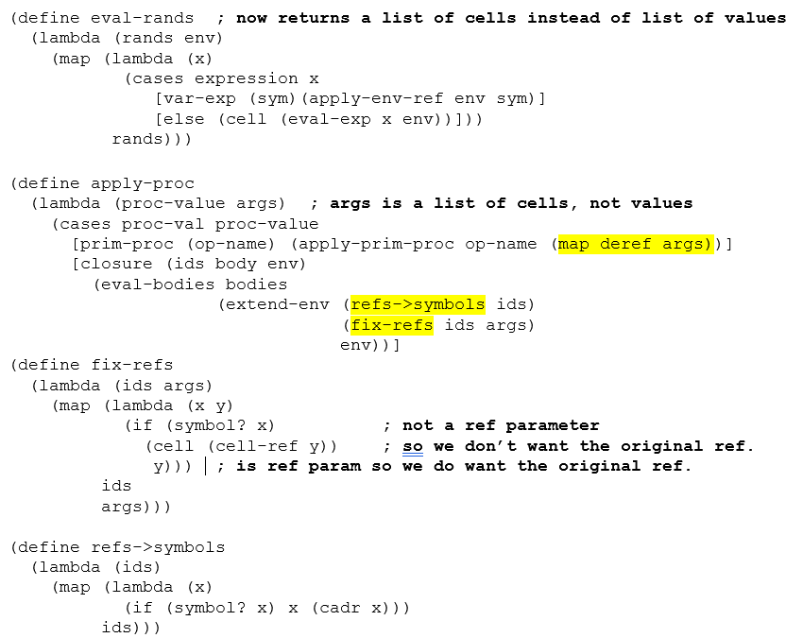
(define extend-env
(lambda (vars cells env)
(extended-env-record
vars cells env)))

