Slide 1
CSSE 304 Day 36
Exam concepts
Ref parameters implementation
Engines
What questions do you have?
Notes:
Do not include second round-robin slide in PDF.
Find an interlude?

Slide 2
Some PL Concepts from 304
binding (via lambda, let, letrec, named‑let)
variable‑arity procedure interface (lambda x ...)
syntactic extension (e.g., let can be written in terms of lambda)
procedure vs syntactic form
predicate
application of a procedure
higher‑order procedure
read-eval-print-loop
lambda-calculus expressions
free variables
syntactic extension
abstract datatypes
representation-independent code
mapping a procedure over a list
dynamic vs static typing of variables.
vectors vs lists
sublist‑sharing
anonymous procedure
first‑class procedure
currying
short‑circuit evaluation
Backus‑Naur Form (BNF), a.k.a. context‑free gramars
Kleene star and plus
syntactic derivation from a BNF grammar
Returning multiple values
Receivers

Slide 3
Some PL Concepts from 304
bound variables
static (lexical) scope
lexical distance (a.k.a.lexical address)
environment
closure
abstract syntax vs. concrete syntax
parsing
functional programming (values of variables never change)
mutation
tail‑recursion
variant records
memoization
procedural abstraction (list-recur, bt-recur, snlist-recur, etc.)
parser
interpreter
recursive environment extension
escape procedure
Continuation
Continuation datatype
Continuation-passing Style
Call/cc
Iterator
Engine
Coroutine
Abstraction
Imperative form

Slide 4
Solution to “ref params” part of A17
For your eyes only. Here and now.
Photographing these slides will be considered Academic Misconduct
This works for the “cell” representation of references. It’s slightly more complex for ribcage representation without cells.
Modify extend-env so that its second argument is a list of cells containing the values

Slide 5
(let ([a 3]
[b 4]
[rotate (lambda (x (ref y) (ref z))
(let ([temp x])
(set! x y)
(set! y z)
(set! z temp)
(list x y z)))])
(let ([result (rotate a b (+ a b))])
(list a b result)))
What interpreter changes are needed before we call apply-proc? Mainly a change to eval-rands: return list of cells.
What interpreter changes are needed in the apply-proc closure case? If it’s not a ref param, put the corresponding argument value in a new cell.
Notes:
Draw the diagram on the boadr

Slide 6
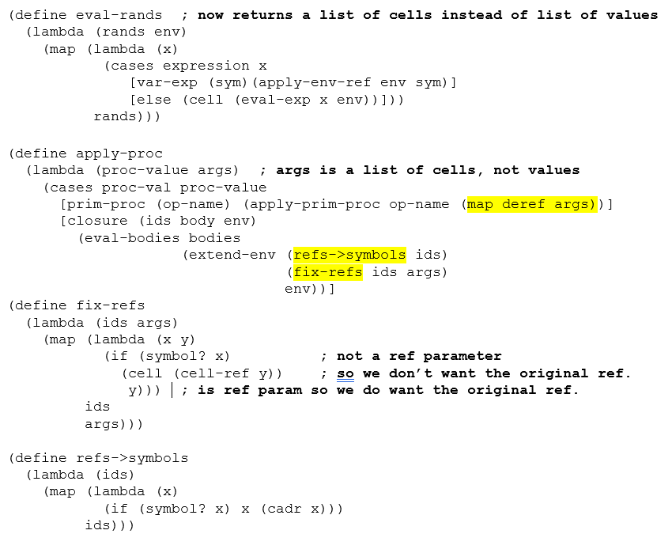
(define extend-env
(lambda (vars cells env)
(extended-env-record
vars cells env)))
Do not share this info with others. You can come to my office to see it again if you wish.

Slide 7
Engine intro
See the engine-intro.ss file
Engines abstract timed pre-emption.
Introduced to Scheme by Haynes and Friedman
A simpler implementation by Dybvig and Hieb is built into Chez Scheme.
engines do not have to be Scheme built-ins, but can be built on top of call/cc.
Documented in TSPL. You should be able to use that code to make engines work in other Scheme environments.

Slide 8
How engines work
(make-engine thunk) creates an engine that will, when applied to three arguments
activate a timer-interrupt mechanism and then
evaluate the body of thunk.
A thunk is simply a procedure that takes no arguments

Slide 9
How Engines work
The three arguments passed to an engine are:
ticks: a positive integer specifying the amount of "fuel" given to the engine.
complete: a procedure that specifies what to do if the evaluation of thunk finishes before the fuel expires.
complete is a procedure of two arguments: amount of fuel "left over" and the result of the computation.
expire: a one-argument procedure to be executed if the computation runs out of fuel before it completes.
The argument that will be passed to expire is a new engine that can finish the computation from where it left off.
Notes:
return and expire are similar to succeed and fail continuations

Slide 10
Example
Engine arguments:
ticks (initial amount of fuel)
complete (receives # remaining ticks and answer if computation finishes)
expire (receives engine capable of completing the computation if fuel expires before computation finishes)
(define fib
(lambda (n)
(cond [(zero? n) 0]
[(= n 1) 1]
[else (+ (fib (- n 1))
(fib (- n 2)))])))
(define engine-fib
(lambda (n)
(make-engine
(lambda () (fib n)))))
> (define eng (engine-fib 6))
> (eng 50 cons (lambda (new-eng) (set! eng new-eng)))
> (eng 50 cons (lambda (new-eng) (set! eng new-eng)))
> (eng 50 cons (lambda (new-eng) (set! eng new-eng)))
> (eng 50 cons (lambda (new-eng) (set! eng new-eng)))
> (eng 50 cons (lambda (new-eng) (set! eng new-eng)))
(47 . 8)
Notes:
How many ticks were needed to complete the computation?
Answer 250 – 47 = 203

Slide 11
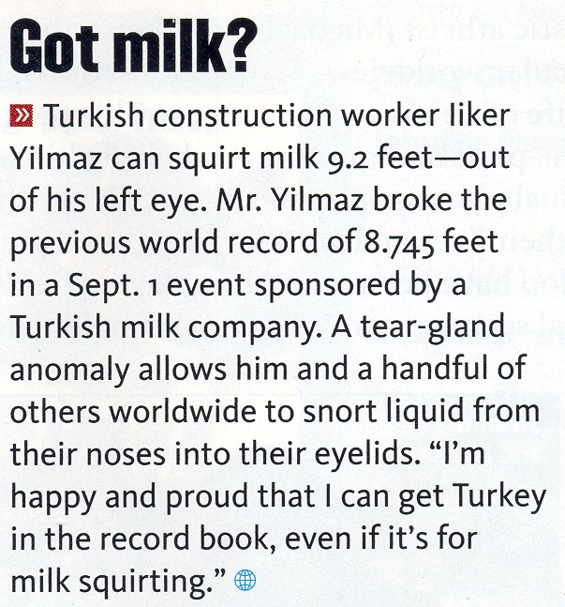
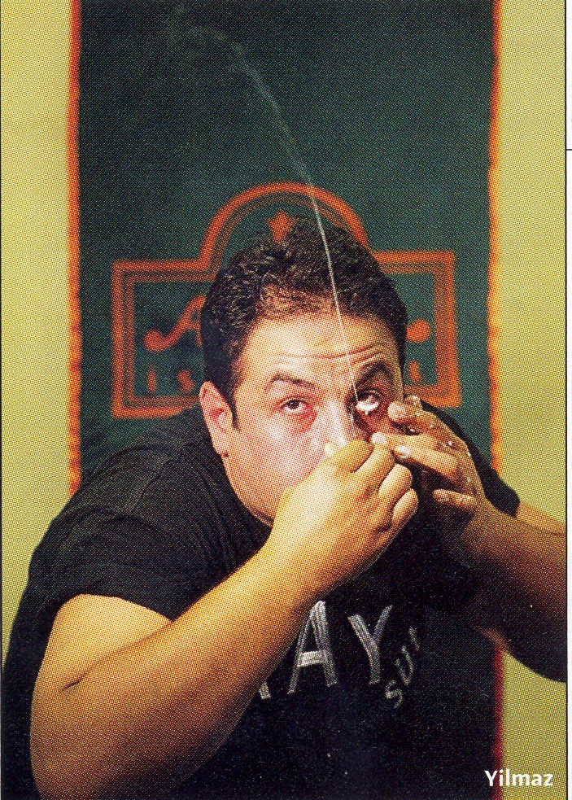
Interlude
Note: It's ilker, not liker

Slide 12
round robin example
(define round-robin
(let ([snoc (lambda (L x) (append L (list x)))])
(lambda (list-of-engines)
(if (null? list-of-engines)
'()
((car list-of-engines) ;run 1st engine in list.
1 ; it's only allowed to run for one tick.
(lambda (ticks value) ; complete procedure
(cons value (round-robin (cdr list-of-engines))))
(lambda (new-engine) ; expire procedure
(round-robin (snoc (cdr list-of-engines)
new-engine))))))))
> (round-robin (map engine-fib
'(3 7 11 4 12 9 1 6 10 8 2 5)))
Engine arguments:
Ticks complete
expire

Slide 13
round robin example
(define round-robin
(let ([snoc (lambda (L x) (append L (list x)))])
(lambda (list-of-engines)
(if (null? list-of-engines)
'()
((car list-of-engines) ;run 1st engine in list.
1 ; it's only allowed to run for one tick.
(lambda (ticks value) ; complete procedure
(cons value (round-robin (cdr list-of-engines))))
(lambda (new-engine) ; expire procedure
(round-robin (snoc (cdr list-of-engines)
new-engine))))))))
> (round-robin (map engine-fib
'(3 7 11 4 12 9 1 6 10 8 2 5)))
(1 1 2 3 5 8 13 21 34 55 89 144)
Engine arguments:
Ticks complete
expire
Notes:
This slide should not be part of the PDF.
ASK: What if we replaced the 1 by 10000?
What if we replaced the 1 by 100? (first couple in order given, others close to sorted order).

Slide 14
A more complex example
Simulating a multi-tasking operating system.

Slide 15
; Simulating a multi-tasking operating system
(load "queue.ss")
(define time-slice (lambda () (add1 (random 100))))
(define kernel
(lambda (proc)
(define ready-queue (make-queue))
(define start
(lambda (proc)
(enqueue (make-engine (lambda () (proc trap)))
ready-queue)))
(define restart
(lambda (k v)
(enqueue (make-engine (lambda () (k v)))
ready-queue)))
(define trap
(lambda (msg arg)
(call/cc
(lambda (k)
(engine-return
(lambda ()
(case msg
(uninterruptible
(restart k (arg)))
(start-process
(start arg)
(restart k #f))
(stop-process #f))))))))

Slide 16
(start proc)
(let dispatch ()
(if (empty-queue? ready-queue)
'finished
((dequeue ready-queue)
(time-slice)
(lambda (ticks trap-handler)
(trap-handler)
(dispatch))
(lambda (engine)
(enqueue engine ready-queue)
(dispatch)))))))

Slide 17
; An example that uses this multi-tasking simulator
(define amoeba
(lambda (generation final)
(lambda (trap)
(when (< generation final)
(trap 'uninterruptible
(lambda ()
(writeout generation)))
(trap 'start-process (amoeba (+ generation 1) final))
(trap 'start-process (amoeba (+ generation 1) final)))
(trap 'stop-process #f))))
(define writeln (lambda x (for-each display x) (newline)))
(define writeout
(let ([count 0])
(lambda (n)
(printf "~s " n)
(set! count (+ count (if (< n 10) 2 3)))
(when (>= count 77) (newline) (set! count 0)))))

Slide 18
> (kernel (amoeba 0 9))
0 1 2 1 3 2 2 2 4 3 4 3 3 3 3 5 4 3 4 3 5 4 4 6 5 5 5 4 4 4 4 5 6
4 4 5 4 5 4 7 6 6 6 5 5 5 5 4 6 5 4 6 5 6 5 5 5 5 8 7 7 7 6 7 7 5
5 6 6 6 5 6 6 5 5 6 5 5 5 8 7 7 7 6 6 5 7 6 6 6 5 6 6 5 7 7 6 6 5
5 8 8 7 7 7 8 8 7 6 6 7 7 7 6 6 6 7 6 6 6 6 6 6 6 6 6 6 8 8 8 7 8
8 8 8 7 6 7 7 7 7 6 7 7 7 6 7 7 6 6 6 6 8 7 7 7 6 6 8 8 8 8 7 7 6
7 6 7 6 8 8 8 8 7 7 7 7 6 6 7 5 7 6 8 8 7 7 7 7 7 6 7 6 8 8 8 8 7
7 6 8 8 8 8 8 7 7 7 8 7 7 8 7 8 7 7 7 7 6 8 7 8 7 7 7 7 7 8 7 8 7
8 7 6 6 6 6 7 7 8 8 8 8 8 8 7 8 7 7 7 8 8 8 8 8 8 7 7 7 8 8 8 8 8
7 8 7 8 7 8 7 7 7 7 8 8 8 8 7 8 7 8 7 7 7 8 8 8 8 8 7 8 8 7 8 8 7
7 8 8 8 8 8 8 7 8 8 7 8 7 8 8 7 7 6 6 8 8 8 7 8 8 8 8 8 8 8 8 8 8
8 7 7 7 8 8 7 8 7 8 8 8 8 8 7 8 8 8 7 8 8 8 8 8 8 8 8 7 8 8 8 7 7
7 8 8 8 8 7 8 8 8 7 8 8 8 8 8 8 7 7 7 7 7 8 8 8 7 8 8 8 8 8 8 8 8
8 7 8 8 8 8 8 8 8 8 8 8 7 8 8 7 8 8 8 8 8 8 8 8 8 8 8 8 8 8 8 8 8
8 8 8 8 8 8 8 8 8 8 8 8 8 8 8 8 8 7 7 8 8 8 8 8 8 8 8 7 8 8 8 8 8
8 8 8 8 8 8 8 8 8 8 8 8 8 8 8 8 8 8 7 8 8 8 8 8 8 8 8 8 8 8 8 8 8
8 8 8 8 8 8 8 8 8 8 8 8 8 8 8 8 finished

Slide 19
COroutines

Slide 20
A reference
Teach Yourself Scheme in Fixnum days by Dorai Sitaram
Coroutine presentation somewhat similar to this one.
http://www.ccs.neu.edu/home/dorai/t-y-scheme/t-y-scheme-Z-H-15.html#node_chap_13

Slide 21
Same-fringe problem
same-fringe takes two sn-lists and determines whether their leaf nodes (in a pre-order traversal) are the same (and in the same order).
See next slide for examples.
Note that a slight extension of sn-lists is allowed, where the “sn-list” can just be a single number or symbol.

Slide 22
same-fringe examples
> (same-fringe '((1 2 (3) () () 4)) '(1 (((2 ((3) 4))))))
#t
> (same-fringe '((1 2 (3) () () 4)) '(1 (((2 ((3) 5))))))
#f
> (same-fringe '((1 2 (3) () () 4)) '(1 (((2 ((3) ))))))
#f
> (same-fringe '((1 2 (3) () () 4)) '(1 (((2 ((3) 4 5))))))
#f
> (same-fringe '2 '3)
#f
> (same-fringe '2 '2)
#t

Slide 23
A short, simple way to write same-fringe
How would you write it if you only had 1 minute to do it?

Slide 24
A short, simple way to write same-fringe
How would you write it if you only had 1 minute to do it?
(define same-fringe
(lambda (s1 s2)
(equal? (flatten s1) (flatten s2))))
Why doesn’t the story end here?

Slide 25
A traditional approach to same-fringe
For each tree, create an iterator that gives each tree element “on-demand”
Iterator behavior is just like Java iterators, but in a functional language, we can make the interface simpler.

Slide 26
Example of iterator behavior
> (define iter (make-slist-leaf-iterator '(((1 (2) (()) (3 4))))))
> (iter)
1
> (iter)
2
> (iter)
3
> (iter)
4
> (iter)
#f
> (iter)
#f

Slide 27
Once we can make iterators, same-fringe is relatively easy.
Same-fringe first creates an iterator for each s-list. It then repeatedly asks each iterator for the next leaf from its s-list, comparing the results, until a list runs out or the leaves are different.
Code on next slide.

Slide 28
same-fringe code
(define same-fringe
(lambda (s1 s2)
(let ([iter1 (make-slist-leaf-iterator s1)]
[iter2 (make-slist-leaf-iterator s2)])
(let loop ()
(let ([v1 (iter1)]
[v2 (iter2)])
(if v1
(if (eq? v1 v2)
(loop)
#f)
(not v2)))))))

Slide 29
Writing the iterator
The next three slides review the ideas of the assignment in which you wrote make-slist-leaf-iterator.
They are for reference; we will not go over them in class

Slide 30
Writing a preorder iterator
It’s easy to write a complete preorder traversal recursively.
Not so easy to write an iterator recursively.
Why?
Soon, we’ll see that call/cc allows us write it simply and recursively.
How did we do the non-recursive iterator in CS 230?
We can use a stack to keep track of the parts of the tree not yet traversed
The algorithm that I use comes form the Weiss DS book Data Structures and Problem Solving With Java, 3rd Edition, pages 621-622.

Slide 31
(define make-slist-leaf-iterator
(lambda (slst)
(let ([stk (make-stack)]) ; Now define two local functions.
(define find-initial-leaf ; first go "left" as far as possible.
(lambda (slst)
(cond [(pair? slst) (stk 'push (cdr slst)) ; leave a trail.
(find-initial-leaf (car slst))]
[(null? slst) (find-next-leaf)] ; no non-empty leaf in
; "car branch";
; so we try the cdr.
[else slst])))
(define find-next-leaf ; Go up a level, to the right,
(lambda () ; and then as far left as possible.
(if (stk 'empty?)
#f ; all leaves have already been visited.
(find-initial-leaf (stk 'pop)))))
(let ([current-element (find-initial-leaf slst)]) ; This puts
; stuff on stk.
(lambda () ; The actual iterator function that we'll return.
(let ([return-val current-element])
(set! current-element (find-next-leaf))
return-val))))))

Slide 32
For completeness, I show the stack constructor
(define make-stack
(lambda ()
(let ([stk '()])
(lambda (msg . args )
(case msg
[(empty?) (null? stk)]
[(push) (set! stk (cons (car args)
stk))]
[(pop) (let ([top (car stk)])
(set! stk (cdr stk))
top)]
[else (error 'stack
"illegal message to stack object: ~a"
msg)])))))

Slide 33
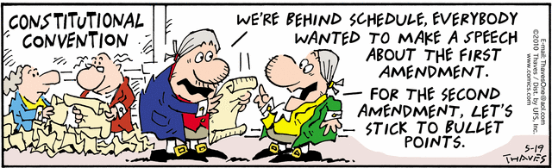
Interlude

Slide 34
A more natural approach
Coroutines.
In contrast to subroutines
Monopoly analogy.
No concurrency.

Slide 35
Examples to illustrate coroutines
(make-coroutine receiver) creates a coroutine that executes the code in receiver.
(resume cor value) resumes the cor coroutine.
Examples are in coroutines.ss
Running the first example:
>(example)
1-a 33 2-a 34 1-b 35 2-b 36 1-c 37

Slide 36
Coroutine example adapted from EoPL, first edition, Chapter 9
(define example
(lambda ()
(call/cc
(lambda (return-cont)
(let ([co1 'undefined]
[co2 'undefined])
(set! co1 (make-coroutine
(lambda (init-val1)
(display " 1-a ")
(display init-val1)
(set! init-val1
(resume co2 (+ 1 init-val1)))
(display " 1-b ")
(display init-val1)
(set! init-val1
(resume co2 (+ 1 init-val1)))
(display " 1-c ")
(return-cont init-val1))))
(set! co2 (make-coroutine
(lambda (init-val2)
(display " 2-a ")
(display init-val2)
(set! init-val2
(resume co1 (+ 1 init-val2)))
(display " 2-b ")
(display init-val2)
(set! init-val2
(resume co1 (+ 1 init-val2)))
(display " 2-c "))))
(co1 33))))))
;; >(example)
;; 1-a 33 2-a 34 1-b 35 2-b 36 1-c 37

Slide 37
Coroutine Implementation
You don’t need to understand all of the details
(define resume 'resume-undefined)
(define make-coroutine
(lambda (body)
(let ([local-continuation 'local-continuation-undefined])
(letrec
([newcoroutine
(lambda (value) (local-continuation value))]
[localresume
(lambda (continuation value)
(let ([value
(call/cc (lambda (k)
(set! local-continuation k)
(continuation value)))])
(set! resume localresume)
value))])
(call/cc
(lambda (exit)
(body (localresume exit newcoroutine))
(error 'coroutine
"fell off end of coroutine")))))))

Slide 38
same-fringe via coroutines

Slide 39
(define same-fringe
(lambda (tree1 tree2)
(call/cc
(lambda (return-cont)
(let ([co1 '()] [co2 '()] [driver '()])
(set! driver
(make-coroutine
(lambda (init-value)
(let loop ()
(let ([leaf1 (resume co1 'whocares)]
[leaf2 (resume co2
'whocare2)])
(if (equal? leaf1 leaf2)
(if (eq? leaf1 #f) (return-cont #t)
(loop))
(return-cont #f)))))))
(set! co1 (make-sf-coroutine driver tree1))
(set! co2 (make-sf-coroutine driver tree2))
(driver 'Whatsittoya?))))))
(define make-sf-coroutine
(lambda (driver tree)
(make-coroutine
(lambda (init-value)
(letrec ([traverse
(lambda (tree)
(if (pair? tree)
(begin
(traverse (car tree))
(if (pair? (cdr tree))
(traverse (cdr tree))))
(resume driver tree)))])
(traverse tree)
(resume driver #f))))))

