Slide 1
More environments and closures Environment datatype
Student questions
Have you and your team met yet?
Read-and-parse (live demo)
Back to E&C

Slide 2
Recap: Evaluate a let expression, apply a procedure
Evaluate (in the current environment) the expressions to get the values to be assigned to the let variables.
Create a new local environment with bindings for the let variables. Its "enclosing local environment" pointer is set to point to the current local environment.
Evaluate the body of the let in this new environment. If a variable is not found in local a environment, look in the global environment.
Evaluate a let expression
Apply a procedure (closure)
The expressions for the procedure and arguments are evaluated.
A new local environment is created:
Each variable from the procedure's formal parameter list is bound to the corresponding value from the actual argument list.
The new environment's "pointer to an enclosing local environment" is set to be a copy of the local environment pointer that is the third part of the closure.
The body of the procedure is evaluated, using this new local environment. If a variable is not found in local a environment, look in the global environment.

Slide 3
Summary/Review questions
What happens when a lambda-expression is executed?
When is a new local environment created?
What is the initial value of the current local environment?
When we evaluate a let expression, to what does the "env pointer" in the new local environment point?
When we evaluate a lambda expression, to what does the "env pointer" in the resulting closure point?
When we apply a closure, where does the new local environment get its "enclosing env" pointer?

Slide 4
Summary/Review questions
What happens when a lambda expression is executed?
A closure is created and returned
When is a new local environment created?
When Scheme (a) executes a let (or letrec) or (b) applies a closure to arguments
What is the initial value of the current local environment?
The empty environment
When we evaluate a let, to what does the "env pointer" in the new local environment point?
The local environment that is current when we start to evaluate the let.
When we evaluate a lambda expression, to what does the "env pointer" in the resulting closure point?
The local environment that is current when we start to evaluate the lambda.
When we apply a closure, where does the new local environment get its "enclosing env" pointer?
A copy of the closure's environment pointer

Slide 5
An example with recursion
The following three Scheme expressions are evaluated (in the order shown here):
>(define fact
(lambda (n)
(fact2 n 1))
>(define fact2
(lambda (n acc)
(if (zero? n)
acc
(fact2 (- n 1) (* n acc)))))
>(fact 2)
Draw a diagram showing all closures and local environments that are created during this execution
(with arrows indicating when one of these objects contains a reference to another one). Use words to describe the process.

Slide 6
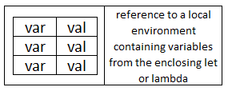
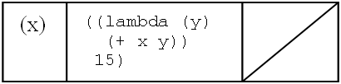
Diagram notation (use it!)
A local environment has two parts:
a table of bindings of variables to values (fixed number of entries)
A pointer to the enclosing local environment
A closure has three parts
List of parameter names
Code (the procedure's body)
A pointer to the local environment that was current when the closure was created.

Slide 7
Example: Similar in complexity to A12
The following two Scheme expressions are evaluated (in the order shown here):
>(define f
(lambda (x)
(let ([a (lambda (y z)
(+ x y z))])
(lambda (b)
(a (+ 5 b) x))))
>((f 3) 4)
I show the details of this example in a video called “Complex E&C example”.

Slide 8
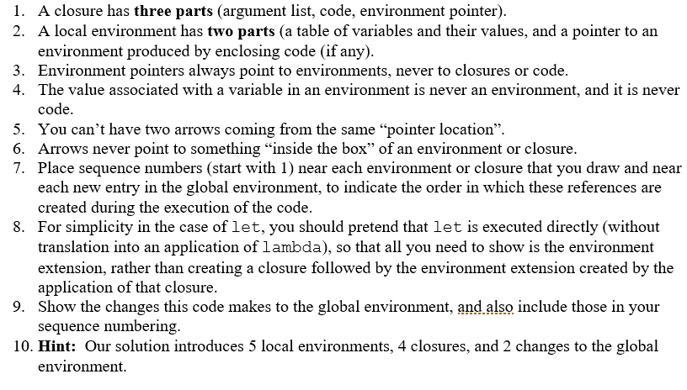
A12 details

Slide 9
Evaluate letrec expressions
Create a new local environment, similar to a let environment, except that:
The “enclosing local environment" pointers of all closures that are bound to the letrec variables point to the new environment, not the enclosing environment.
Evaluate the body of the letrec in this new local environment.

Slide 10
Example with letrec
>(define odd?
(letrec ([odd? (lambda (n)
(if (zero? n)
#f
(even? (- n 1))))]
[even? (lambda (m)
(if (zero? m)
#t
(odd? (- m 1))))])
(lambda (x)
(odd? x))))
>(odd? 2)
car
+
Notes:
Change the code on the quiz to include x and m

Slide 11
Interlude
Quote from Richard Feynman (1918-1988), Caltech physicist and Nobel Prize winner:
There are 10¹¹ stars in the galaxy. That used to be a huge number. But it's only a hundred billion. It's less than the national deficit! We used to call them astronomical numbers. Now we should call them economical numbers.
What does a trillion dollars look like?
https://www.youtube.com/watch?v=WBxWdD9YKdY

Slide 12
environment ADT
We now know how environments are supposed to behave.
Next question: How can we implement them?
We may have time to do some of this today

Slide 13
Summary of EoPL Section 2.2 (details on the following slides)
Principle from Section 2.1
Environment ADT
Environment Interface
Representation/Implementation Approaches

Slide 14
Principle from Section 2.1
Data abstraction leads to representation independence
Notes:
Recall what we did with non-negative integers. We first defined the interface and understood how it worked. Then we looked at various implementations. That is what we will do today with environments.

Slide 15
Environment ADT
An environment maps a finite set of symbols to a set of associated (Scheme) values
Thus, an environment is a finite function
Logically, an environment has the form { (s₁, v₁), (s₂, v₂), … (s_{n}, v_{n}) } , where the s_{i} are all distinct.
But we need some more details in order to get the “lexical scoping” effect.

Slide 16
Environment interface
If f is an environment, and s, s₁, …, s_{k} are all symbols, then
(empty-env) ➔ ⎡∅⎤ (representation of the empty set)
(apply-env ⎡f⎤ s) ➔ f(s) (get the value associated with s in the environment f)
(extend-env '(s₁ … s_{k}) (all symbols s_{i} must be distinct,
'(v₁ … v_{k}) the v_{i} may be any Scheme values)
⎡f⎤ ) ➔ ⎡g⎤ where g(s) is
v_{i} if s=s_{i} for some i, 1 ≤ i ≤ k
f(s) otherwise
Recall that ⎡x⎤ means "the representation of the abstract object x"
empty-env and extend-env are constructors; apply-env is an observer (getter)

Slide 17
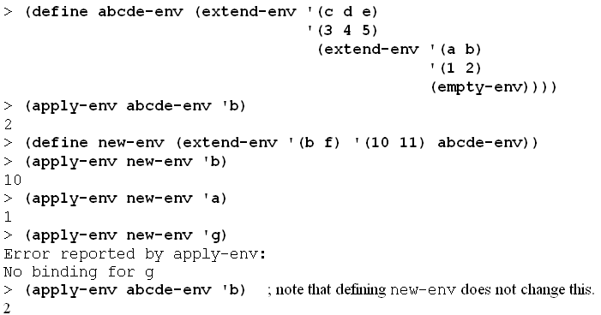
Examples
If f is an environment, and s, s₁, …, s_{k} are all symbols, then
(empty-env) ➔ ⎡∅⎤ (representation of the empty set)
(apply-env ⎡f⎤ s) ➔ f(s) (get the value associated with s in the environment f)
(extend-env '(s₁ … s_{k}) (all symbols s_{i} must be distinct,
'(v₁ … v_{k}) the v_{i} may be any Scheme values)
⎡f⎤ ) ➔ ⎡g⎤ where g(s) is
v_{i} if s=s_{i} for some i, 1 ≤ i ≤ k
f(s) otherwise
Draw the abstract “E&C” diagrams to show what the above code is doing.

Slide 18
Auxiliary procedure
; returns position of sym in los (or #f)
(define list-find-position
(lambda (sym los)
(let loop ([los los] [pos 0])
(cond [(null? los) #f]
[(eq? sym (car los)) pos]
[else (loop (cdr los)
(add1 pos))]))))

Slide 19
Representation 1
We first do an easy implementation, then aim for a more efficient one
Take advantage of Scheme's first-class procedures
Represent an environment by a procedure
Each environment procedure takes a symbol as an argument
This is straightforward
Just translate the formal definitions into code
We will do this same process later for other ADTs

Slide 20
Environment interface
If f is an environment, and s, s₁, …, s_{k} are all symbols, then
(empty-env) ➔ ⎡∅⎤ (representation of the empty set)
(apply-env ⎡f⎤ s) ➔ f(s) (get the value associated with s in
the environment f)
(extend-env '(s₁ … s_{k}) (all of the s_{i} must be distinct,
'(v₁ … v_{k}) the v_{i} may be any Scheme values)
⎡f⎤ ) ➔ ⎡g⎤ where g(s) is
v_{i} if s=s_{i} for some i, 1 ≤ i ≤ k
f(s) otherwise
Recall that ⎡x⎤ means "the representation of the abstract object x"
empty-env and extend-env are constructors; apply-env is an observer (getter)

Slide 21
Representation 1: empty environment
(define empty-env
(lambda () ; what should the rest be?
; recall that we are implementing ; environments as Scheme procedures.

Slide 22
Representation 1: empty environment
(define empty-env
(lambda ()
(lambda (sym)
(eopl:error 'apply-env
"No binding for ~s"
sym))))

Slide 23
Representation 1: apply-env
(define apply-env
(lambda (env sym) ; what should the rest be?

Slide 24
Representation 1: apply-env
(define apply-env
(lambda (env sym) (env sym)))

Slide 25
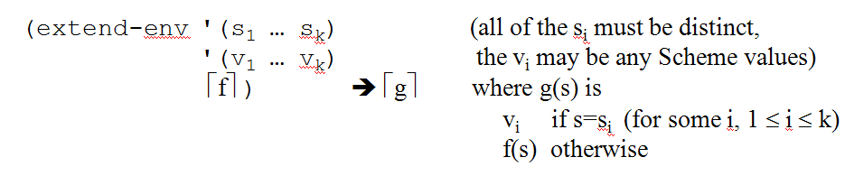
Representation 1: extend-env
(define extend-env
(lambda (syms vals env) ; what should the rest be?

Slide 26
Representation 1: extend-env
(define extend-env
(lambda (syms vals env)
(lambda (sym)
(let ([pos (list-find-position sym syms)])
(if (number? pos)
(list-ref vals pos)
(apply-env env sym))))))

Slide 27
Representation 2
Use data structures to represent environments.
in particular, variant records created using define-datatype
Note that the actual code for looking up symbols is the same as before, but now it is in apply-env.

Slide 28
Define the environment datatype
(define-datatype environment environment?
[empty-env-record]
[extended-env-record
(syms (list-of symbol?))
(vals (list-of scheme-value?))
(env environment?)])
How should scheme-value? be defined?
(define scheme-value?

Slide 29
Define the environment datatype
(define-datatype environment environment?
[empty-env-record]
[extended-env-record
(syms (list-of symbol?))
(vals (list-of scheme-value?))
(env environment?)])
How should scheme-value? be defined?
(define scheme-value?
(lambda (v) #t))

Slide 30
Implementation 2 - the two constructors
(define empty-env
(lambda ()
(define extend-env
(lambda (syms vals env)

Slide 31
Implementation 2 - the two constructors
(define empty-env
(lambda ()
(empty-env-record)))
(define extend-env
(lambda (syms vals env)
(extended-env-record syms
vals
env)))

Slide 32
Implementation 2: The observer (accessor) procedure
(define apply-env
(lambda (env sym)
(cases environment env
[empty-env-record ()
(errorf 'apply-env
"No binding for ~s" sym)]
[extended-env-record (syms vals env)
(let ([pos (list-find-position sym
syms)])
(if (number? pos)
(list-ref vals pos)
(apply-env env sym)))])))
Comparisons of the two representations?

Slide 33
Representation 3 Represent environment as a list of lists
<env-rep> ::= () ::= ((({<symbol>}*) ({<value>}*)) . <env-rep>)
Three examples:
(((a b) (3 4)) ((c) (2)))
(((a b) (3 4)) ((c a x) (2 3 #f)))
()
(define empty-env
(lambda ()
'()))
(define extend-env
(lambda (syms vals env)
(cons (list syms vals) env)))
(define apply-env
(lambda (env sym)
(if (null? env)
(eopl:error 'apply-env "No binding for ~s" sym)
(let ((syms (car (car env)))
(vals (cadr (car env)))
(env (cdr env)))
(let ((pos (rib-find-position sym syms)))
(if (number? pos)
(list-ref vals pos)
(apply-env env sym)))))))
(define rib-find-position list-find-position)
*Code that is green will change in Representation 4 (a slight variation of Representation 3)
Sometimes called a "ribcage" structure

Slide 34
Representation 4 adds two improvements
Make each rib a pair instead of a list
saves space and lookup time
Replace the list of values in each rib by a vector of values
So we can replace linear-time list-ref by constant-time vector-ref
(((a b). #(3 4)) ((c a x). #(2 3 #f)))

Slide 35
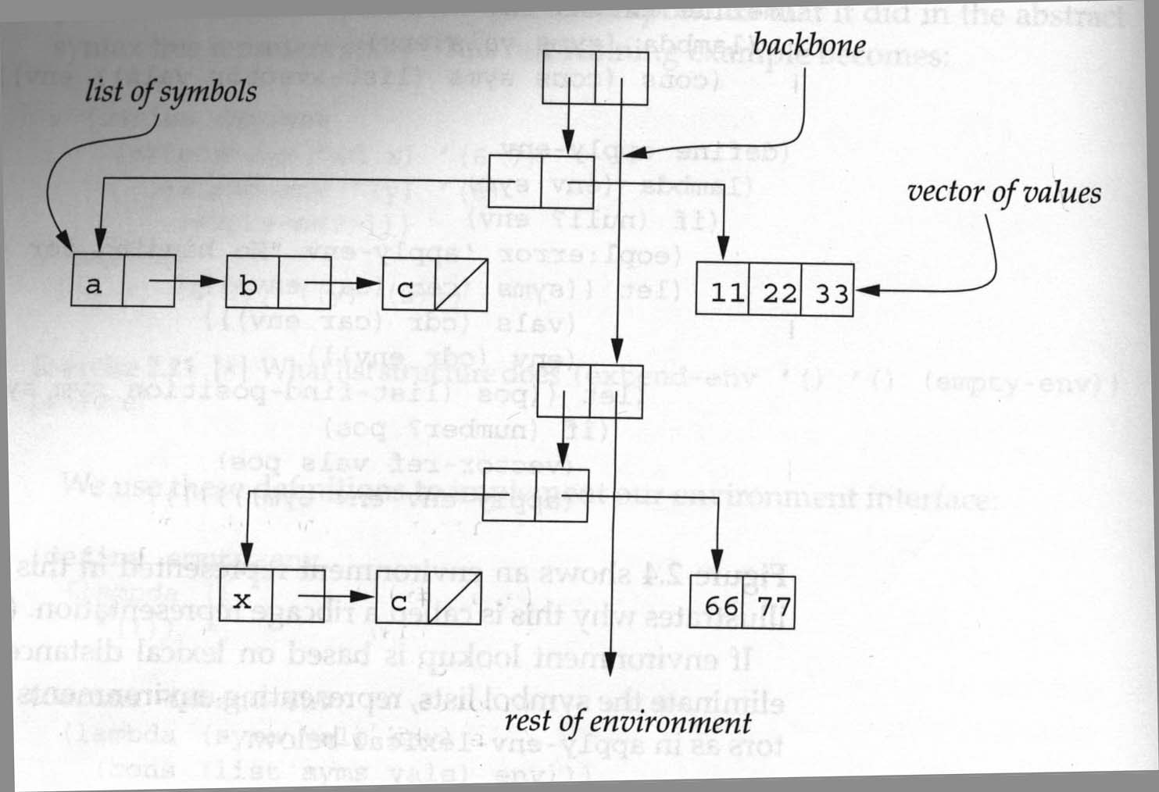
Representation 4 Ribcage structure with these improvements

Slide 36
Implementing the ribcage (slide 1)
(define empty-env
(lambda ()
'()))
(define extend-env
(lambda (syms vals env)
(cons (cons syms (list->vector vals)) env)))

Slide 37
Implementing the ribcage (slide 2)
(define apply-env
(lambda (env sym)
(if (null? env)
(error 'apply-env "No binding for ~s" sym)
(let ((syms (car (car env)))
(vals (cdr (car env)))
(env (cdr env)))
(let ([pos (rib-find-position sym syms)])
(if (number? pos)
(vector-ref vals pos)
(apply-env env sym)))))))

Slide 38
Compare with “List of lists” implementation
(define apply-env
(lambda (env sym)
(if (null? env)
(error 'apply-env "No binding for ~s" sym)
(let ((syms (car (car env)))
(vals (cadr (car env)))
(env (cdr env)))
(let ([pos (rib-find-position sym syms)])
(if (number? pos)
(list-ref vals pos)
(apply-env env sym)))))))

Slide 39
Implementation 5 callbacks (continuations)
This is what I use in the interpreter code.
Change the interface so apply-env expects:
An environment
A symbol, the variable to be looked up
A "succeed" callback function, applied to the value of the variable if the variable is found
A "fail" callback function, applied to no arguments if the variable is not found.

Slide 40
apply-env with callbacks
This is a modification of Representation 2; we could modify Representation 3 or 4 in a similar way.
(define apply-env
(lambda (env sym succeed fail)
(cases environment env
[empty-env-record
(fail)]
[extended-env-record (syms vals env)
(let ([pos (list-find-position sym syms)])
(if (number? pos)
(succeed (list-ref vals pos))
(apply-env env sym succeed fail)))])))

