Slide 1
CSSE 304 Day 38
Some Final Exam Details
About the Course Evals
More about Engines
Reference parameters
Notes:
Do not include second round-robin slide in PDF.
Find an interlude?

Slide 2
Final exam format
Moodle part (a lot of it will be about call/cc and continuations) 60-80 points
Will probably use the Respondus Lockdown browser and monitor.
If we do, you will need working webcam and microphone, and a space that is clear enough to make it obvious that you do not have any exam resources nearby.
Computer part – Write and debug code 70-90 points
Total – 150 points
Exam 1 was 90 points, Exam 2 was 120 points

Slide 3
Final exam material
Will cover the entire course
But more emphasis from things after Exam 2:
Interpreter
How did your team do this?
Add a new feature.
CPS, call/cc, imperative form
Engines and coroutines

Slide 4
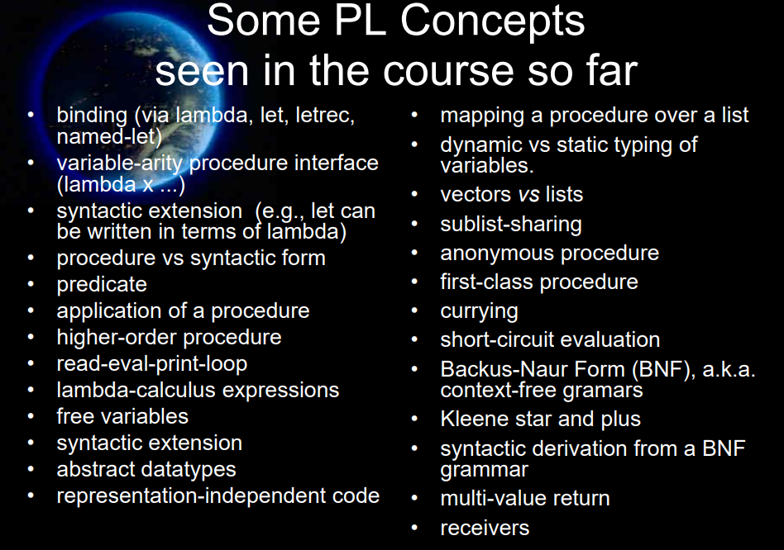

Slide 5
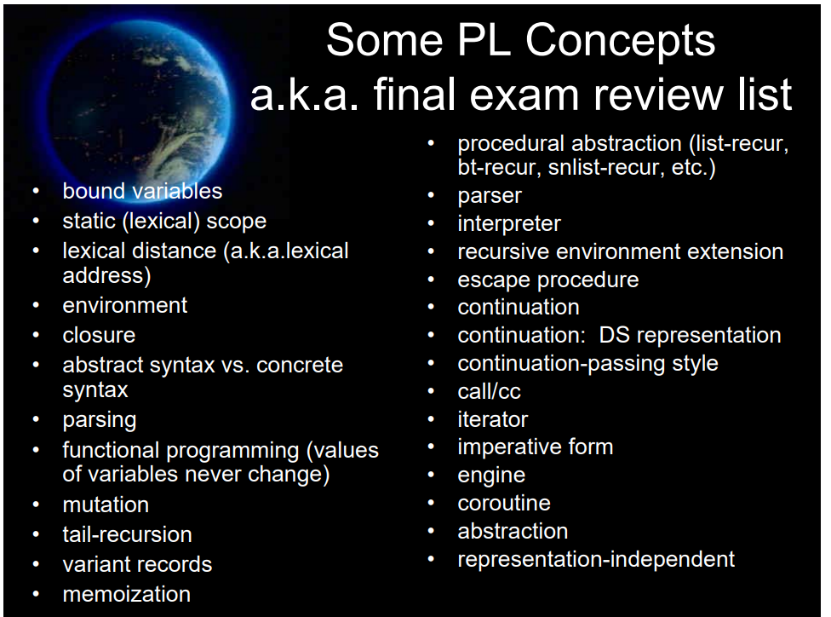

Slide 6
Course evals
I’d love to give extra credit to students who complete the evaluation.
But I can never know who completed it.
What I can see at any time is how many students from each section completed it.
I will give 5 extra-credit points on the final exam to everyone in a section if at least n-2 students answer all of the essay questions on the evaluation, where n is the number of students in the section.

Slide 7
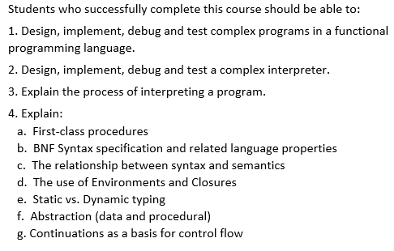
Course evaluations
How have the course and instructor done in helping you meet the official course learning objectives? How can I improve?

Slide 8
Course Evals – perhaps address some of these:
What would you change?
Is there something that you would hate if we changed it?
What could I do next term tomake the “online experience” better?
Is “teams of three" for the project a good idea?
Would teams of two be better for future terms?
Should anyone who wishes to do so be allowed to "go solo"?
What about requiring everyone to do the interpreter alone? Would you have learned more?

Slide 9
Recap - How Engines work 1
(make-engine thunk) creates an engine that will, when applied to three arguments
activate a timer-interrupt mechanism and then
evaluate the body of thunk.
A thunk is simply a procedure that takes no arguments

Slide 10
Recap - How Engines work 2
The three arguments passed to an engine are:
ticks: a positive integer specifying the amount of "fuel" given to the engine.
complete: a procedure that specifies what to do if the evaluation of thunk finishes before the fuel expires.
complete is a procedure of two arguments: amount of fuel "left over" and the result of the computation.
expire: a one-argument procedure to be executed if the computation runs out of fuel before it completes.
The argument that will be passed to expire is a new engine that can finish the computation from where it left off.
Notes:
return and expire are similar to succeed and fail continuations

Slide 11
Example
Engine arguments:
ticks (initial amount of fuel)
complete (receives # remaining ticks and answer if computation finishes)
expire (receives engine capable of completing the computation if fuel expires before computation finishes)
(define fib
(lambda (n)
(cond [(zero? n) 0]
[(= n 1) 1]
[else (+ (fib (- n 1))
(fib (- n 2)))])))
(define engine-fib
(lambda (n)
(make-engine
(lambda () (fib n)))))
> (define eng (engine-fib 7))
> (eng 50 cons (lambda (new-eng) (set! eng new-eng)))
> (eng 50 cons (lambda (new-eng) (set! eng new-eng)))
> (eng 50 cons (lambda (new-eng) (set! eng new-eng)))
> (eng 50 cons (lambda (new-eng) (set! eng new-eng)))
> (eng 50 cons (lambda (new-eng) (set! eng new-eng)))
> (eng 50 cons (lambda (new-eng) (set! eng new-eng)))
(9 . 13)
Notes:
How many ticks were needed to complete the computation?
Answer 300 – 9 = 293

Slide 12
Round Robin Example
Engine arguments:
ticks complete
expire
(define round-robin
(lambda (queue-of-engines)
(if (queue-of-engines 'empty?)
'()
(let ([first-engine (queue-of-engines 'dequeue!)])
(first-engine
1 ; it's only allowed to run for one tick each time.
(lambda (ticks value) ; complete procedure
(cons value (round-robin queue-of-engines)))
(lambda (new-engine) ; expire procedure
(queue-of-engines 'enqueue! new-engine)
(round-robin queue-of-engines)))))))
> (let* ([q (make-queue)]
[nums '(3 7 11 4 12 9 2 6 10 8 1 5)]
[engine-list (map engine-fib nums)])
(for-each (lambda (eng) (q 'enqueue! eng))
engine-list)
(round-robin q)) ; what will the output be?
(define engine-fib
(lambda (n)
(make-engine
(lambda () (fib n)))))
What if we change the number of ticks from 1 to 150?
What will the output be?

Slide 13
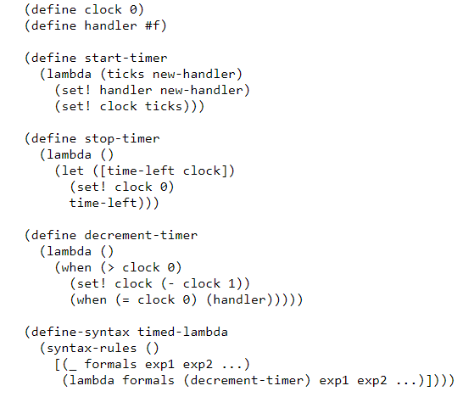
Implement make-engine using call/cc 1

Slide 14
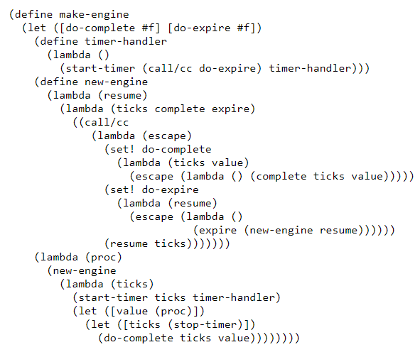
Implement make-engine using call/cc 2

Slide 15
A more complex example
Simulate a multi-tasking operating system.

Slide 16
(load “ooq")
(define time-slice (lambda () (add1 (random 100))))
(define kernel
(lambda (proc)
(define ready-queue (make-queue))
(define start
(lambda (proc)
(enqueue (make-engine (lambda () (proc trap)))
ready-queue)))
(define restart
(lambda (k v)
(enqueue (make-engine (lambda () (k v)))
ready-queue)))
(define trap
(lambda (msg arg)
(call/cc
(lambda (k)
(engine-return
(lambda ()
(case msg
(uninterruptible
(restart k (arg)))
(start-process
(start arg)
(restart k #f))
(stop-process #f))))))))
Simulate a multi-tasking operating system
(start proc)
(let dispatch ()
(if (empty-queue? ready-queue)
'finished
((dequeue ready-queue)
(time-slice)
(lambda (ticks trap-handler)
(trap-handler)
(dispatch))
(lambda (engine)
(enqueue engine ready-queue)
(dispatch)))))))

Slide 17
; An example that uses this multi-tasking simulator
(define amoeba
(lambda (generation final)
(lambda (trap)
(when (< generation final)
(trap 'uninterruptible
(lambda ()
(writeout generation)))
(trap 'start-process (amoeba (+ generation 1) final))
(trap 'start-process (amoeba (+ generation 1) final)))
(trap 'stop-process #f))))
(define writeln (lambda x (for-each display x) (newline)))
(define writeout
(let ([count 0])
(lambda (n)
(printf "~s " n)
(set! count (+ count (if (< n 10) 2 3)))
(when (>= count 77) (newline) (set! count 0)))))

Slide 18
> (kernel (amoeba 0 9))
0 1 2 1 3 2 2 2 4 3 4 3 3 3 3 5 4 3 4 3 5 4 4 6 5 5 5 4 4 4 4 5 6
4 4 5 4 5 4 7 6 6 6 5 5 5 5 4 6 5 4 6 5 6 5 5 5 5 8 7 7 7 6 7 7 5
5 6 6 6 5 6 6 5 5 6 5 5 5 8 7 7 7 6 6 5 7 6 6 6 5 6 6 5 7 7 6 6 5
5 8 8 7 7 7 8 8 7 6 6 7 7 7 6 6 6 7 6 6 6 6 6 6 6 6 6 6 8 8 8 7 8
8 8 8 7 6 7 7 7 7 6 7 7 7 6 7 7 6 6 6 6 8 7 7 7 6 6 8 8 8 8 7 7 6
7 6 7 6 8 8 8 8 7 7 7 7 6 6 7 5 7 6 8 8 7 7 7 7 7 6 7 6 8 8 8 8 7
7 6 8 8 8 8 8 7 7 7 8 7 7 8 7 8 7 7 7 7 6 8 7 8 7 7 7 7 7 8 7 8 7
8 7 6 6 6 6 7 7 8 8 8 8 8 8 7 8 7 7 7 8 8 8 8 8 8 7 7 7 8 8 8 8 8
7 8 7 8 7 8 7 7 7 7 8 8 8 8 7 8 7 8 7 7 7 8 8 8 8 8 7 8 8 7 8 8 7
7 8 8 8 8 8 8 7 8 8 7 8 7 8 8 7 7 6 6 8 8 8 7 8 8 8 8 8 8 8 8 8 8
8 7 7 7 8 8 7 8 7 8 8 8 8 8 7 8 8 8 7 8 8 8 8 8 8 8 8 7 8 8 8 7 7
7 8 8 8 8 7 8 8 8 7 8 8 8 8 8 8 7 7 7 7 7 8 8 8 7 8 8 8 8 8 8 8 8
8 7 8 8 8 8 8 8 8 8 8 8 7 8 8 7 8 8 8 8 8 8 8 8 8 8 8 8 8 8 8 8 8
8 8 8 8 8 8 8 8 8 8 8 8 8 8 8 8 8 7 7 8 8 8 8 8 8 8 8 7 8 8 8 8 8
8 8 8 8 8 8 8 8 8 8 8 8 8 8 8 8 8 8 7 8 8 8 8 8 8 8 8 8 8 8 8 8 8
8 8 8 8 8 8 8 8 8 8 8 8 8 8 8 8 finished

Slide 19
Implementing Reference parameters
For definiteness, I use an “each value in an environment is in a cell” approach.

Slide 20
(let ([a 3]
[b 4]
[rotate (lambda (x (ref y) (ref z))
(let ([temp x])
(set! x y)
(set! y z)
(set! z temp)
(list x y z)))])
(let ([result (rotate a b (+ a b))])
(list a b result)))
What interpreter changes are needed before we call apply-proc? Mainly a change to eval-rands: return a list of cells instead of a list of values.
What interpreter changes are needed in the apply-proc closure case? If it’s not a ref param, put the corresponding argument value in a new cell.
A small change to the expression datatype definition.
No changes to parse-exp or syntax-expand
Notes:
Draw the diagram on the board

Slide 21
A change to extend-env
This works for the “cell” representation of references. It’s slightly more complex for the ribcage representation without cells.
First, modify extend-env so that its second argument is a list of cells containing the values. Thus the values are put into the cells before calling extend-env.
Each level of extended environment will still contain a list or vector of cells, but these cells will not be created by extend-env.

Slide 22
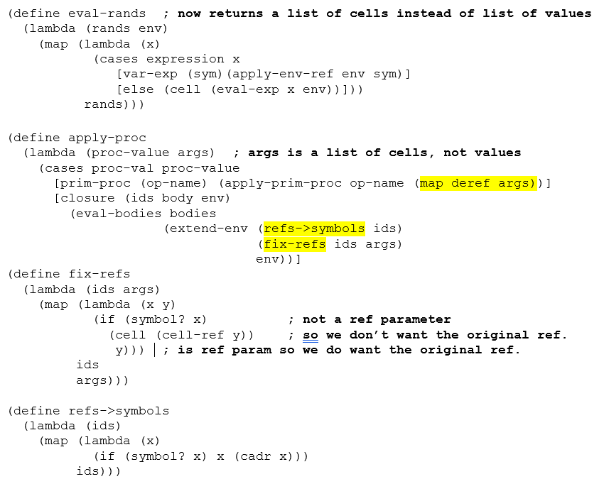
(define extend-env
(lambda (vars cells env)
(extended-env-record
vars cells env)))

