Slide 1
Introduction to me – part 2 Secrets known only to a few people at Rose-Hulman …
“Why are we called professors? Because we are supposed to profess!” - Frank Young CSSE dept. head 1987-2002

Slide 2
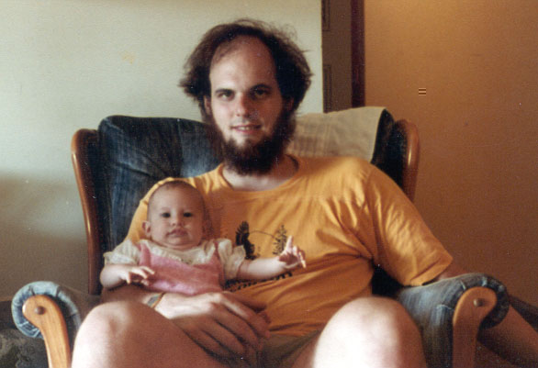
Secret #1: I used to be thinner and I had hair

Slide 3
Secret #2: I have not always succeeded
First term of my Junior year at Caltech
There was this one course (MA 120a)…
The most important course in my major that term (4th term of abstract Algebra)
Required of all Junior math majors in the Fall term

Slide 4
MA 120
I let myself get behind at the beginning
(always thought I’d eventually catch up)
Soon couldn't get the homework done
I didn't ask the professor for help.
Thought I'd bother other students if I asked them

Slide 5
Things got worse
So bad that I could only attempt one question out of eight on the final exam.
I hoped the professor would be merciful and give me a D.
But Professor Dilworth was even more merciful than that…

Slide 6
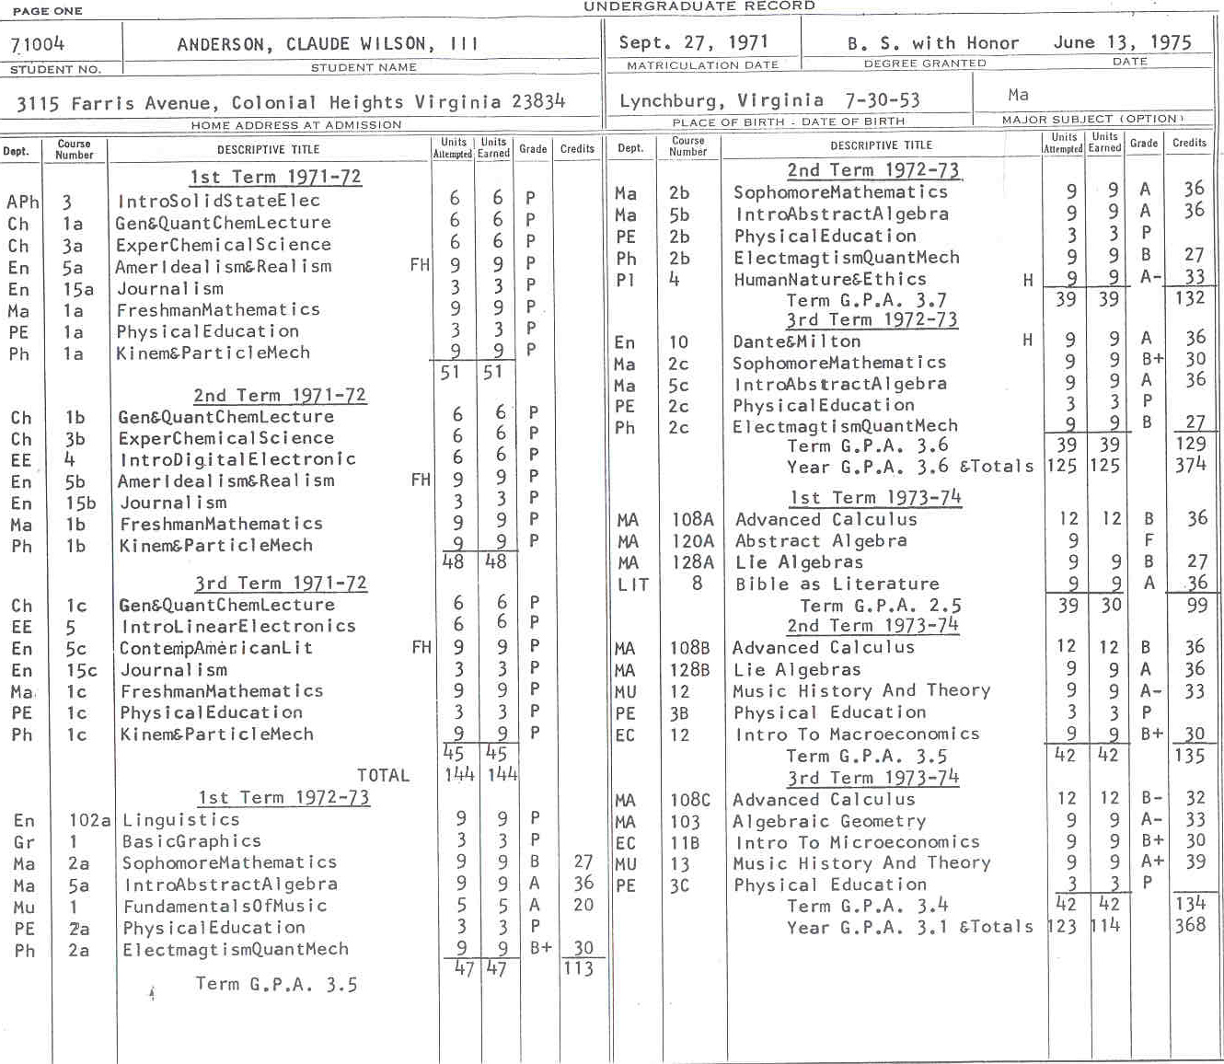
First term of my Junior year

Slide 7
I was devastated
I’d never had a grade below “B” before.
Except in handwriting.
I wondered if I could make it in Math.
Then came Dr. David Wales:

Slide 8
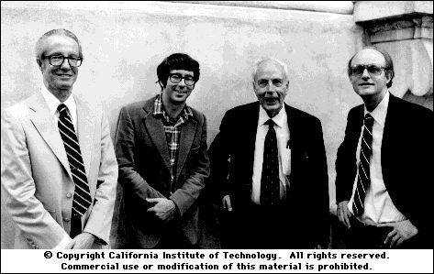
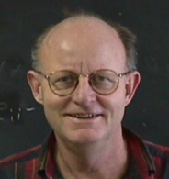
The person who most inspired me to become a professor
My Ph.D thesis was in the area of the course that I once failed.
He actually asked me to be a grader for the course the next time it was offered.
Where I eventually went with abstract algebra…

Slide 9
Why I tell you this story
A warning about getting behind
This course is a lot like that course
If you are behind on reading and/or homework, please get caught up very soon.
You now know that I know what it feels like to struggle and fail
"He'd never understand what I am going through!" Try me!
Maybe some of you should be thinking about becoming professors

