Slide 1
CSSE 304 Day 7
Simple Solution: Minimize-interval-list
Syntax and Semantics
Grammars and Derivations
s-lists
Follow the Grammar
Notes:
File needed: largest-in-list-2007.ss

Slide 2
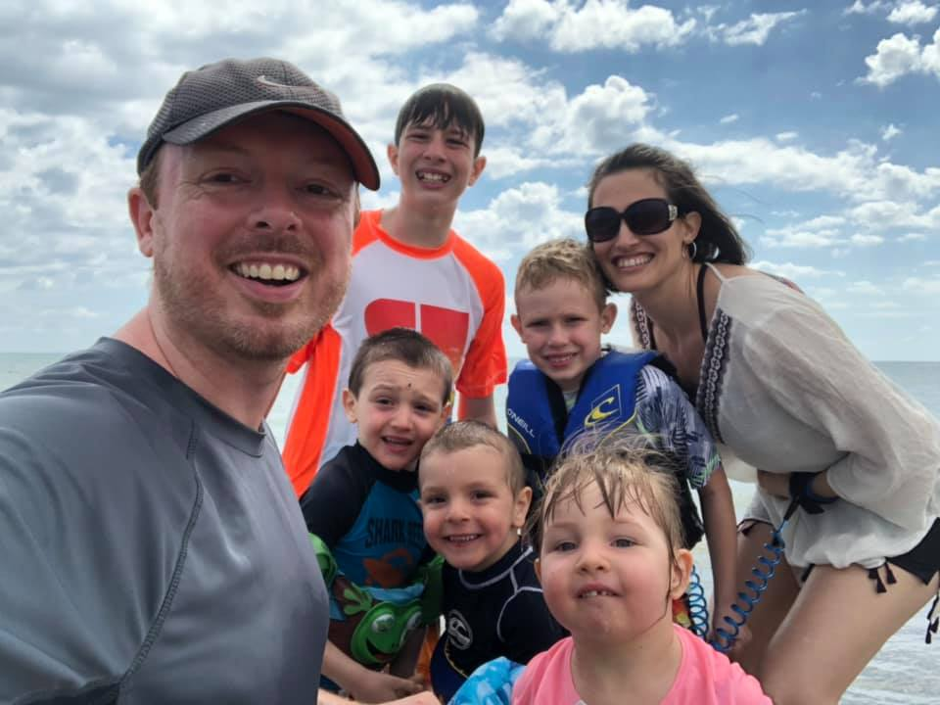

Slide 3
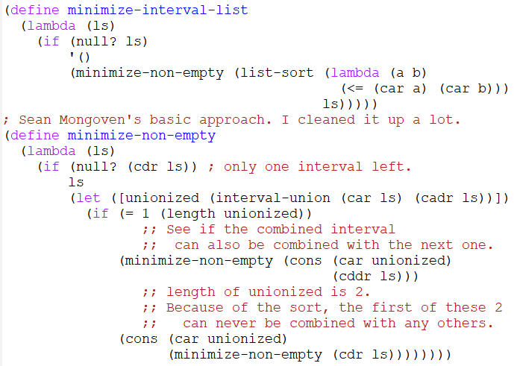
Minimize-interval-list solution
Big-O running time for this procedure?

Slide 4
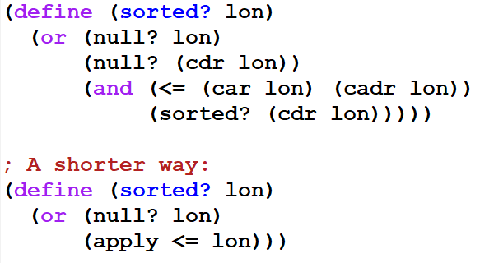

Slide 5
Interlude
Always code as if the guy who ends up maintaining your code will be a violent psychopath who knows where you live.
Martin Golding

Slide 6
Two major parts of a programming language’s definition
Syntax – what does a program in the given language look like?
Semantics- what does that program mean?
There should be an unambiguous translation from syntax to semantics
How to specify a language’s syntax? BNF
Semantics are harder to specify
denotational, operational

Slide 7
BNF: recursive syntax specification
Backus-Naur Form. Specify the syntax of a language. a.k.a. context-free grammar (CFG)
Example:
Nonterminals: <exp> <term> <factor> <number> <digit>
Terminals: + * ) ( 0 1 2 3 4 5 6 7 8 9
Productions:
<exp> ::= <exp> + <term> | <term>
<term> ::= <term> * <factor> | <factor>
<factor> ::= ( <exp> ) | <number>
<number> ::= <number> <digit> | <digit>
<digit> ::= 0 | 1 | 2 | 3 | 4 | 5 | 6 | 7 | 8 | 9
Derive 1 * (2 + 34)by showing a derivation tree.
Start Symbol
The language of this grammar is the set of all strings of terminals that can be derived from the start symbol. 3 + 2 is in the language; 2 * + 7 is not
Grammar

Slide 8
<exp> ::= <exp> + <term> | <term>
<term> ::= <term> * <factor> | <factor>
<factor> ::= ( <exp> ) | <number>
<number> ::= <number> <digit> | <digit>
<digit> ::= 0 | 1 | 2 | 3 | 4 | 5 | 6 | 7 | 8 | 9
Derive 1 * (2 + 34)by showing a derivation tree.

Slide 9
BNF: recursive syntax specification
Backus-Naur Form. Specify the syntax of a language. a.k.a. context-free grammar (CFG)
Example:
Nonterminals: <exp> <term> <factor> <number> <digit>
Terminals: + * ) ( 0 1 2 3 4 5 6 7 8 9
Productions:
<exp> ::= <exp> + <term> | <term>
<term> ::= <term> * <factor> | <factor>
<factor> ::= ( <exp> ) | <number>
<number> ::= <number> <digit> | <digit>
<digit> ::= 0 | 1 | 2 | 3 | 4 | 5 | 6 | 7 | 8 | 9
Derive 1 * (2 + 34)by showing a derivation tree.
Start Symbol
The language of this grammar is the set of all strings of terminals that can be derived from the start symbol. 3 + 2 is in the language; 2 * + 7 is not
Grammar

Slide 10
Abbreviations: Extended BNF:
Often it is helpful to add features to the BNF notation. Both of these features could be expressed in terms of “pure BNF”, so nothing new is added to what we can derive.
{ string }* (a.k.a. Kleene *) stands for 0 or more occurrences of things derivable from string
{ string }⁺ (a.k.a. Kleene +) stands for 1 or more occurrences of things derivable from string
Example:
{<digit>}⁺ . {<digit>}* E{<digit>}⁺ Language: certain numbers in scientific notation

Slide 11
Grammars for some languages used in EoPL and/or HW 7-9
<list-of-numbers> ::= ( {<number>}* )
<s-list> ::= ( {<symbol-exp>}* ) <symbol-exp> ::= <symbol> | <s-list>
<bintree> ::= <number> | ( <symbol> <bintree> <bintree> )
<BST> ::= ( ) | (<number> <BST> <BST> )
Notes:
Write down some examples

Slide 12
Grammars for some languages used in EoPL (continued)
<datum> ::= <number> | <symbol> | <string> | <boolean> | <dotted-datum> | <list> | <vector> <list> ::= ( {<datum>}* ) <dotted-datum> ::= ( {<datum>}⁺ . <datum> ) <vector> ::= # <list>
<LcExp> ::= Identifier | (lambda (Identifier) <LcExp>) | (<LcExp> <LcExp>)

Slide 13
One grammar from the list
Next Slide:
Derive ((a ()) b)
From the second grammar.
<s-list> ::= ( {<symbol-exp>}* ) <symbol-exp> ::= <symbol> | <s-list>
What are some examples of s-lists?
Rewrite without the * <s-list> ::= ( ) | (<s-exp> . <s-list>)
<s-exp> ::= <symbol> | <s-list>

Slide 14
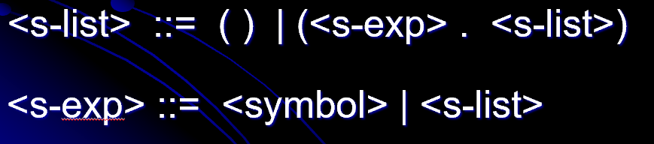




















Derive ((a ()) b)
From the this grammar.

Slide 15
s-list programming examples
contains?
count-occurrences
notate-depth
flatten
subst
I will do these on my computer (with your help) to make sure that they are correct.
You can do them on your computer or on paper; the latter may be preferable for some students.
We will probably do most of these (maybe all of them) in live coding. Most of it will happen on day 8.

